Slide 1
Abstract Mashups
for Enterprise Java
Ed Burns
Hazem Saleh
Notes:
HS>> Hello, My Name is Hazem Saleh, Iam a staff engineer in IBM Egypt.

Slide 2
AGENDA
1
What is Mashability.
2
How does mashability influence the success of a venture for both the public and enterprise.
3
Enterprise mashup case study.
4
Mashups development current challenges.
5
Mashup application Idea.
6
What is Mashups4JSF.
7
Building the mashup application using Mashups4JSF.
8
Conclusion
Notes:
Let's see our agenda today:
Today will know what is mashability ...

Slide 3
AGENDA
1
What is Mashability.
2
How does mashability influence the success of a venture for both the public and enterprise.
3
Enterprise mashup case study.
4
Mashups development current challenges.
5
Mashup application Idea.
6
What is Mashups4JSF.
7
Building the mashup application using Mashups4JSF.
8
Conclusion

Slide 4
Mashability
adjective – the property of a software system to be re-used in contexts not imagined at the time the system was first deployed.
Mashability is a matter of degree
  It's possible for software to only have superficial mashability
  Include graphic showing the spectrum of mashibility with twitter on one extreme and screen scrapers on the other

Slide 5
AGENDA
1
What is Mashability.
2
How does mashability influence the success of a venture for both the public and enterprise.
3
Enterprise mashup case study.
4
Mashups development current challenges.
5
Mashup application Idea.
6
What is Mashups4JSF.
7
Building the mashup application using Mashups4JSF.
8
Conclusion

Slide 6
How does mashability influence the success of a software venture?
General Public
Create alternate revenue streams
Co-optition
It fits reality: successful ventures derive success from different areas over time
Enterprise
Extend the ROI on IT
Spreads skills more broadly throughout the enterprise
Encourages re-usable software development

Slide 7
AGENDA
1
What is Mashability.
2
How does mashability influence the success of a venture for both the public and enterprise.
3
Enterprise mashup case study.
4
Mashups development current challenges.
5
Mashup application Idea.
6
What is Mashups4JSF.
7
Building the mashup application using Mashups4JSF.
8
Conclusion

Slide 8
Case study: twitter
  show some graphs of the usage of twitter by various services that re-expose it, compared to usage of twitter by the twitter website itself

Slide 9
Case study: corporate wikis
  Wikis have made their way into corporations and are being used in many different kinds of contexts.

Slide 10
AGENDA
1
What is Mashability.
2
How does mashability influence the success of a venture for both the public and enterprise.
3
Enterprise mashup case study.
4
Mashups development current challenges.
5
Mashup application Idea.
6
What is Mashups4JSF.
7
Building the mashup application using Mashups4JSF.
8
Conclusion

Slide 11
Mashups Development current challenges
There is no unified model agreed by all the mashup service providers for mashup service creation and consumption.
Different representation of mashup services
SOAP
REST
Different protocols of mashup services
ATOM
RSS
JSON
Others
Notes:
Now let's move to the mashup current development challenges.
As you may know there is no unified model agreed by all the mashups service provider

Slide 12

Mashups Development current challenges
Intensive JavaScript.
Atom Feed Parsing.
RSS Feed Parsing.
JSON Parsing.
Other formats Parsing.

Slide 13

Mashups Development current challenges
Study low level APIs of the Mashup service provider.
Write a great deal of integration code.

Slide 14
AGENDA
1
What is Mashability.
2
How does mashability influence the success of a venture for both the public and enterprise.
3
Enterprise mashup case study.
4
Mashups development current challenges.
5
Mashup application Idea.
6
What is Mashups4JSF.
7
Building the mashup application using Mashups4JSF.
8
Conclusion

Slide 15
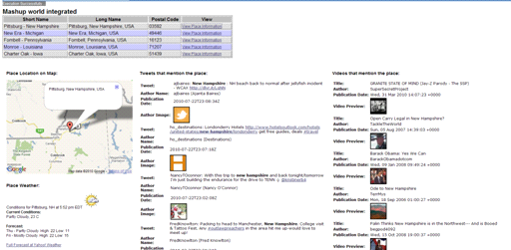
Mashup Application Idea

Slide 16
Mashup Application Idea
// YouTube API Example (RSS Format ==> Using JDOM Library for parsing).
String query = "JavaOne";
try {
URL feedUrl = new URL("http://gdata.youtube.com/feeds/api/videos?alt=rss&v=2&max-
results=5&q=" + query);
SAXBuilder builder = new SAXBuilder();
Document document = builder.build(feedUrl);
Element rootElement = document.getRootElement();
List children = rootElement.getChild("channel").getChildren("item");
for (int i = 0; i < children.size(); ++i) {
Element element = (Element) children.get(i);
System.out.println((i + 1) + "- ");
System.out.println(element.getChild("title").getText());
System.out.println(element.getChild("link").getText());
// Get other attributes here (Eliminated for simplification) ...
}
} catch (Exception e) {
// Exception Handling ...
e.printStackTrace();
}

Slide 17
Mashup Application Idea
// Twitter API Example (JSON ==> Using JSON Java Library for parsing).
String query = "JavaOne";
try {
query = URLEncoder.encode(query, "UTF-8");
URL url = new URL("http://search.twitter.com/search.json?q=" + query);
URLConnection connection = url.openConnection();
String line;
StringBuilder builder = new StringBuilder();
BufferedReader reader = new BufferedReader(new
InputStreamReader(connection.getInputStream()));
while ((line = reader.readLine()) != null) {
builder.append(line);
}
String response = builder.toString();
JSONObject json = new JSONObject(response);
JSONArray jsonArray = json.getJSONArray("results");
for (int i = 0; i < jsonArray.length(); ++i) {
System.out.print((i + 1) + "- ");
JSONObject j = jsonArray.getJSONObject(i);
System.out.println(j.getString("text"));
// Get other attributes here (Eliminated for simplification) ...
}
} catch (Exception e) {
// Exception Handling ...
e.printStackTrace();
}

Slide 18
Mashup Application Idea
<script type="text/javascript">
// Google Maps code ...
if (GBrowserIsCompatible()) {
var address = "NY, USA";
var map = new GMap2(document.getElementById("map"));
map.setCenter(new GLatLng(24, 15), 13);
var geocoder = new GClientGeocoder();
geocoder.getLatLng(address,
    function(location) {
    if (!location) {
    alert(location + " not found");
    } else {
    map.setCenter(location, 13);
    var marker = new GMarker(location);
    marker.openInfoWindow(address);
    map.addOverlay(marker);
    }
    }
);
//add the map control.
var mapControlPosition = new GControlPosition(G_ANCHOR_BOTTOM_RIGHT, new GSize(10,
10));
map.addControl(new GLargeMapControl(), mapControlPosition);
}
</script>

Slide 19
AGENDA
1
What is Mashability.
2
How does mashability influence the success of a venture for both the public and enterprise.
3
Enterprise mashup case study.
4
Mashups development current challenges.
5
Mashup application Idea.
6
What is Mashups4JSF.
7
Building the mashup application using Mashups4JSF.
8
Conclusion

Slide 20
What is Mashups4JSF
Simplify
JSF Components
Feed Import Export
API Wrapper
One of the possible ways for simplifying mashup development in the Java World
Provides a set of APIs that wraps the low level information of Mashup services.
Provides feed reader components for reading different types of feeds and the @Feed annotation for exporting application data as mashup feeds.
Provides a set of JSF components that allows the JSF developer to construct rich and customized mashups inside the web page.

Slide 21
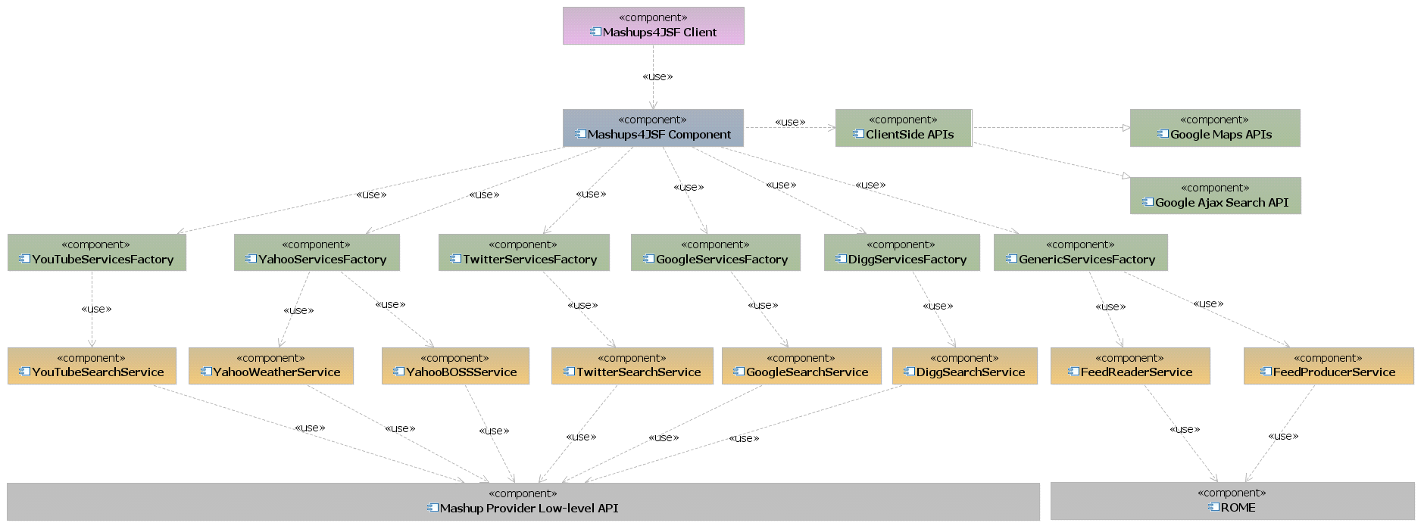
What is Mashups4JSF

Slide 22
AGENDA
1
What is Mashability.
2
How does mashability influence the success of a venture for both the public and enterprise.
3
Enterprise mashup case study.
4
Mashups development current challenges.
5
Mashup application Idea.
6
What is Mashups4JSF.
7
Building the mashup application using Mashups4JSF.
8
Conclusion

Slide 23
Building the mashup application using Mashups4JSF.
<m:map />
<mashup:
twitterSearchList />
<mashup:
youTubeVideoList />
<mashup:
yahooWeather />

Slide 24
AGENDA
1
What is Mashability.
2
How does mashability influence the success of a venture for both the public and enterprise.
3
Enterprise mashup case study.
4
Mashups development current challenges.
5
Mashup application Idea.
6
What is Mashups4JSF.
7
Building the mashup application using Mashups4JSF.
8
Conclusion

Slide 25
Conclusion
  Mashups are important.
  Having a mashup meta-model gives developers a lot of power.
  Key ingredients for a mashup meta-model:
  Mashup integration happens on the server.
  There is a declarative syntax for describing the mashup:
  This syntax includes a suitably powerful component abstraction model.
  There is a powerful programming language that works closely with the declarative syntax.
  Hide the lower level APIs offered by the mashup service providers.

