Slide 1
Abstract Mashups
for Enterprise Java
Ed Burns
Hazem Saleh
Notes:
HS>> Hello, My Name is Hazem Saleh, Iam a staff engineer in IBM Egypt.

Slide 2
AGENDA
1
What is Mashability.
2
How does mashability influence the success of a venture for both the public and enterprise.
3
Enterprise mashup case study.
4
Mashups development current challenges.
5
Mashup application Idea.
6
What is Mashups4JSF.
7
Building the mashup application using Mashups4JSF.
8
Conclusion
Notes:
Let's see our agenda today:
Today will know what is mashability ...

Slide 3
AGENDA
1
What is Mashability.
2
How does mashability influence the success of a venture for both the public and enterprise.
3
Enterprise mashup case study.
4
Mashups development current challenges.
5
Mashup application Idea.
6
What is Mashups4JSF.
7
Building the mashup application using Mashups4JSF.
8
Conclusion

Slide 4
Mashability
adjective
The property of a software system to be re-used in contexts not imagined at the time the system was first deployed
Mashability is a matter of degree
  It's possible for software to only have superficial mashability
  Include graphic showing the spectrum of mashibility with twitter on one extreme and screen scrapers on the other

Slide 5
AGENDA
1
What is Mashability.
2
How does mashability influence the success of a venture for both the public and enterprise.
3
Enterprise mashup case study.
4
Mashups development current challenges.
5
Mashup application Idea.
6
What is Mashups4JSF.
7
Building the mashup application using Mashups4JSF.
8
Conclusion

Slide 6
How does mashability influence the success of a software venture?
General Public
Enterprise
Create alternate revenue streams
Co-optition
It fits reality: successful ventures derive success from different areas over time
Extend the ROI on IT
Spreads skills more broadly throughout the enterprise
Encourages re-usable software development

Slide 7
AGENDA
1
What is Mashability.
2
How does mashability influence the success of a venture for both the public and enterprise.
3
Enterprise mashup case study.
4
Mashups development current challenges.
5
Mashup application Idea.
6
What is Mashups4JSF.
7
Building the mashup application using Mashups4JSF.
8
Conclusion

Slide 8
Case study: twitter
  show some graphs of the usage of twitter by various services that re-expose it, compared to usage of twitter by the twitter website itself

Slide 9
Case study: corporate wikis
  Wikis have made their way into corporations and are being used in many different kinds of contexts.

Slide 10
AGENDA
1
What is Mashability.
2
How does mashability influence the success of a venture for both the public and enterprise.
3
Enterprise mashup case study.
4
Mashups development current challenges.
5
Mashup application Idea.
6
What is Mashups4JSF.
7
Building the mashup application using Mashups4JSF.
8
Conclusion
Notes:
Now, Let's move to the current mashup development challenges.

Slide 11
Mashups Development current challenges
There is no unified model agreed by all the mashup service providers for mashup service creation and consumption.
Different representation of mashup services
SOAP
REST
Different protocols of mashup services
ATOM
RSS
JSON
Others
Notes:
As you may know there is no unified model agreed by all the mashups service provider for mashup service creation and consumption.
We have different representations for mashup services.
We have different protocols for mashup services.

Slide 12

Mashups Development current challenges
Intensive JavaScript.
Atom Feed Parsing.
RSS Feed Parsing.
JSON Parsing.
Other formats Parsing.
Notes:
As a result of that, The mashup developer has to know:
1. Much JavaScript.
2. Different feed formats parsing.

Slide 13

Mashups Development current challenges
Study low level APIs of the Mashup service provider.
Write a great deal of integration code.
Notes:
Adding to all of this, the mashup developer has to:
1. Study the low level APIs provided by the mashup service providers.
2. Write a great deal of code to integrate his application with the mashup services.

Slide 14
AGENDA
1
What is Mashability.
2
How does mashability influence the success of a venture for both the public and enterprise.
3
Enterprise mashup case study.
4
Mashups development current challenges.
5
Mashup application Idea.
6
What is Mashups4JSF.
7
Building the mashup application using Mashups4JSF.
8
Conclusion
Notes:
To realize the problem, Let's see a mashup application that using the mashup service APIs.

Slide 15
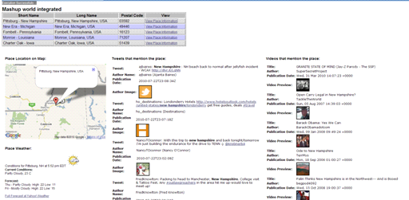
Mashup Application Idea
Notes:
Have you ever create a mashup application like this?
A mashup application that contains a master dataTable. Each row of the dataTable represents an address. When we click on any row link, we see:
1. The place location in the Google Map.
2. The place weather in the weather indicator.
3. The tweets that mentions the place in the twitter tweets list.
4. The videos that mentions the place in the youTube video list.

Slide 16
Mashup Application Idea
Building the application using The Mashup Service APIs
Notes:
Let's see how to build this application using the mashup service APIs

Slide 17


Slide 18
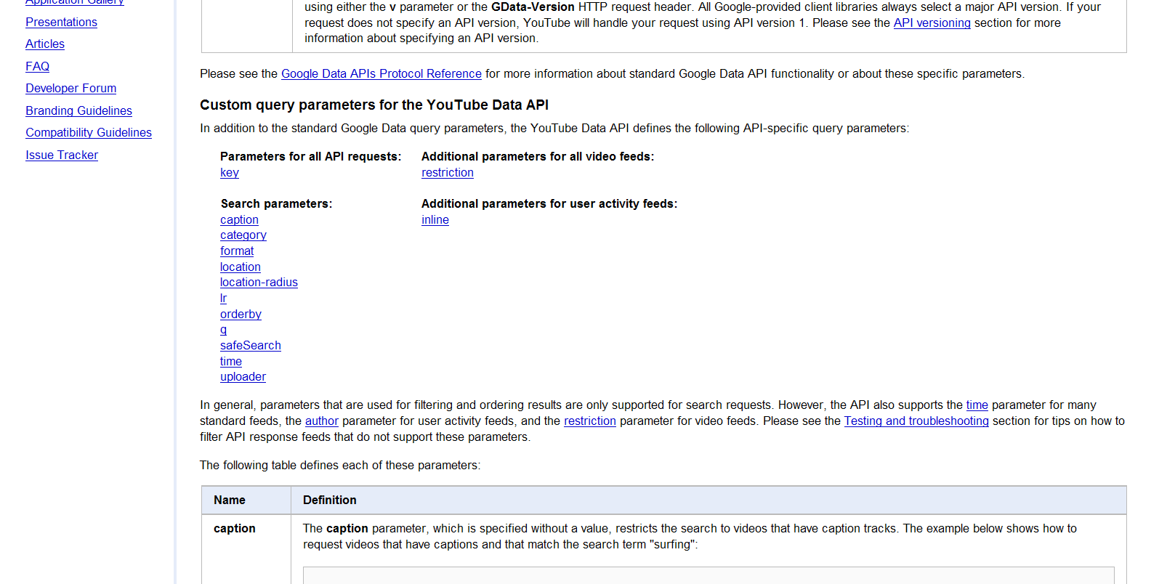
Go to the youTube API documentation site for getting the REST search URL and search parameters: http://code.google.com/apis/youtube/2.0/developers_guide_protocol_api_query_parameters.html
Step 1:
Notes:
Let's start with the youtube part.
In the first step to get the youTube video list, we should get the youTube REST service URL and its parameters information from the youTube documentation site.

Slide 19
Go to the youTube API documentation site for getting the REST search URL and search parameters: http://code.google.com/apis/youtube/2.0/developers_guide_protocol_api_query_parameters.html
Step 1:
Open a URL Connection to the youTube Search URL:
http://gdata.youtube.com/feeds/api/videos?alt=rss&v=2&max-results=5&q=#{param}
Step 2:
Where
1. alt indicates the feed format to be returned.
2. v indicates the API version to be used.
3. max-results indicates the maximum number of returned results.
4. q indicates the query to search by.
Notes:
In the second step, we will open a URL connection to the youTube search URL with the following parameters.

Slide 20
Go to the youTube API documentation site for getting the REST search URL and search parameters: http://code.google.com/apis/youtube/2.0/developers_guide_protocol_api_query_parameters.html
Step 1:
Open a URL Connection to the youTube Search URL:
http://gdata.youtube.com/feeds/api/videos?alt=rss&v=2&max-results=5&q=#{param}
Step 2:
The rss feed for a single video item
Step 3:
<?xml version='1.0' encoding='UTF-8'?>
<rss ...>
<channel>
...
<item>
<guid isPermaLink='false'>tag:youtube.com,2008:video:5EFb77oGRmo</guid>
<pubDate>Mon, 11 Jun 2007 20:39:55 +0000</pubDate>
<atom:updated>2010-08-22T06:05:23.000Z</atom:updated>
<category domain='http://schemas.google.com/g/2005#kind'>
http://gdata.youtube.com/schemas/2007#video
</category>
<title>JavaOne: Open Possibilities</title>
<link>http://www.youtube.com/watch?v=5EFb77oGRmo&amp;feature=youtube_gdata</link>
<author>SunMicrosystemsInc</author>
<yt:accessControl action='comment' permission='moderated'/>
<yt:accessControl action='videoRespond' permission='moderated'/>
<yt:accessControl action='rate' permission='allowed'/>
<yt:accessControl action='embed' permission='allowed'/>
<yt:accessControl action='syndicate' permission='allowed'/>
<yt:accessControl action='commentVote' permission='allowed'/>
<gd:comments>
<gd:feedLink href='http://gdata.youtube.com/feeds/api/videos/5EFb77oGRmo/comments?v=2'
countHint='2'/>
</gd:comments>
<media:group>
<media:title type='plain'>JavaOne: Open Possibilities</media:title>
<yt:duration seconds='114'/>
<yt:uploaded>2007-06-11T20:39:55.000Z</yt:uploaded>
<yt:videoid>5EFb77oGRmo</yt:videoid>
...
</media:group>
...
</item>
...
</channel>
</rss>
Notes:
Finally, the youTube search service will respond with the following RSS feed.
We should parse this feed and get the values to display in our web application.

Slide 21


Slide 22
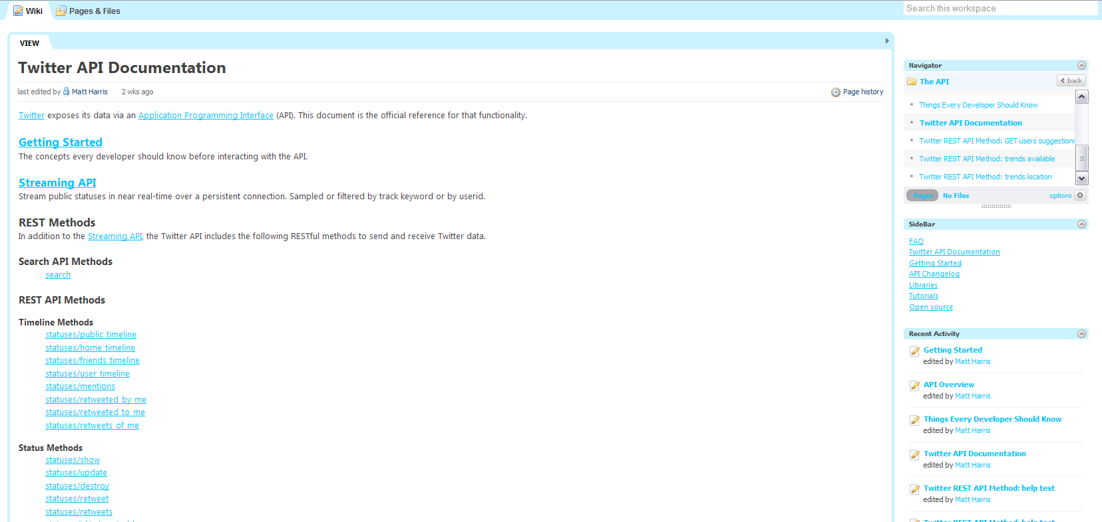
Go to the Twitter API documentation site for getting the REST search URL and search parameters:
http://apiwiki.twitter.com/Twitter-API-Documentation
Step 1:
Notes:
Now, Let's go to the twitter part.
As what we do with the youTube part, we should get the twitter REST service URL and its parameters information from the twitter documentation site.

Slide 23
Go to the Twitter API documentation site for getting the REST search URL and search parameters:
http://apiwiki.twitter.com/Twitter-API-Documentation
Step 1:
Open a URL Connection to the twitter Search URL:
http://search.twitter.com/search.json?q=#{param}&rpp=10
Step 2:
Where:
q indicates the query to search by.
2. rpp indicates the number of tweets per page.
Notes:
In the second step, we will open a URL connection to the twitter search URL with the following parameters.

Slide 24
Go to the Twitter API documentation site for getting the REST search URL and search parameters:
http://apiwiki.twitter.com/Twitter-API-Documentation
Step 1:
Open a URL Connection to the twitter Search URL:
http://search.twitter.com/search.json?q=#{param}&rpp=10
Step 2:
The JSON feed for a single tweet
Step 3:
{"results":
[
{
"profile_image_url":"http://a1.twimg.com/profile_images/598447517/
twitterProfilePhoto_normal.jpg",
"created_at":"Mon, 23 Aug 2010 22:33:30 +0000",
"from_user":"jamesfarrar",
"metadata":{"result_type":"recent"},
"to_user_id":null,
"text":"RT @oracleopenworld: Larry Ellison to Join EVP Thomas Kurian in
JavaOne Keynote to Discuss Future of Java http://bit.ly/ausg7I #javaone10",
"id":21948746363,
"from_user_id":23963,
"geo":null,
"iso_language_code":"en",
"source":"&lt;a href=&quot;http://www.tweetdeck.com&quot;
rel=&quot;nofollow&quot;&gt;TweetDeck&lt;/a&gt;"
}
],
"max_id":21948746363,
"since_id":0,
"refresh_url":"?since_id=21948746363&q=javaone",
"next_page":"?page=2&max_id=21948746363&rpp=1&q=javaone",
"results_per_page":1,"page":1,
"completed_in":0.016396,"query":"javaone"
}
Notes:
Finally, the twitter search service will respond with the following JSON feed.
We should parse this feed and get the values to display in our web application.

Slide 25


Slide 26
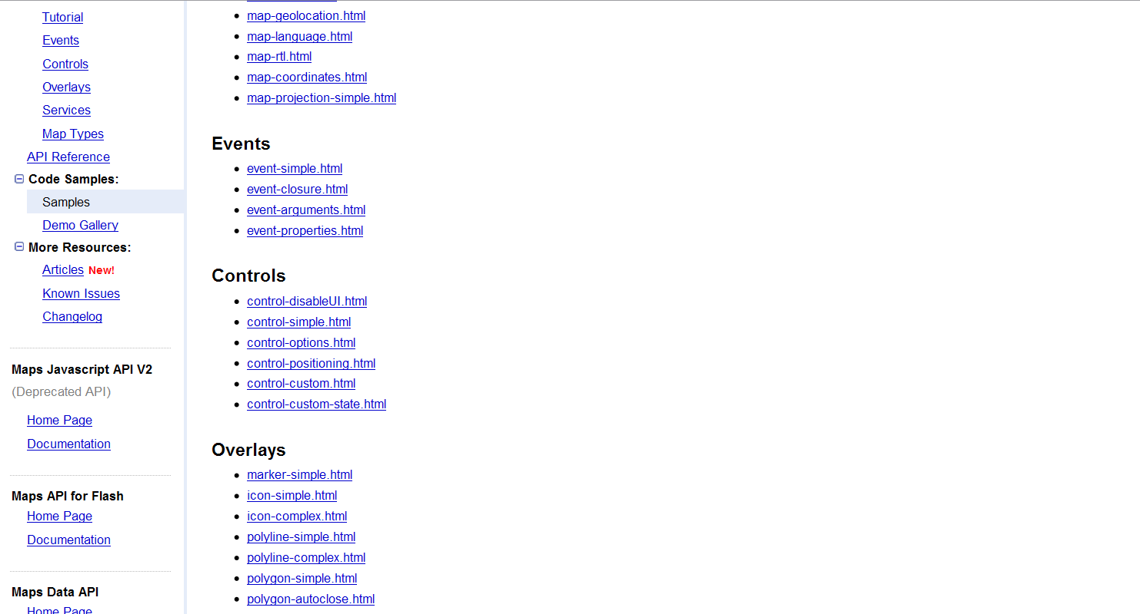
Go to the Google Maps API documentation site for creating the map:
http://code.google.com/apis/maps/documentation/javascript
Step 1:
Notes:
Finally, Let's go to the Google Maps part.
As usual, we will visit the Google Maps APIs site to study the Map creation API.

Slide 27
Go to the Google Maps API documentation site for creating the map:
http://code.google.com/apis/maps/documentation/javascript
Step 1:
Write a JS code
Step 2:
<script type="text/javascript">
// Google Maps code ...
if (GBrowserIsCompatible()) {
var address = "NY, USA";
var map = new GMap2(document.getElementById("map"));
map.setCenter(new GLatLng(24, 15), 13);
var geocoder = new GClientGeocoder();
geocoder.getLatLng(address,
    function(location) {
    if (!location) {
    alert(location + " not found");
    } else {
    map.setCenter(location, 13);
    marker.openInfoWindow(address);
    map.addOverlay(marker);
    }
    }
    );
//add the map control.
var mapControlPosition = new GControlPosition(G_ANCHOR_BOTTOM_RIGHT, new GSize(10,
10));
map.addControl(new GLargeMapControl(), mapControlPosition);
}
</script>
Notes:
And we will write a JS code like this in our web application.

Slide 28
SO

Slide 29
Many Web Sites To Visit
Much Documentation To Read
Many Configurations to Do
<script type="text/javascript">
// Google Maps code ...
if (GBrowserIsCompatible()) {
var address = "NY, USA";
var map = new GMap2(document.getElementById("map"));
map.setCenter(new GLatLng(24, 15), 13);
var geocoder = new GClientGeocoder();
geocoder.getLatLng(address,
function(location) {
if (!location) {
alert(location + " not found");
} else {
map.setCenter(location, 13);
marker.openInfoWindow(address);
map.addOverlay(marker);
}
}
);
//add the map control.
var mapControlPosition = new GControlPosition(G_ANCHOR_BOTTOM_RIGHT, new GSize(10, 10));
map.addControl(new GLargeMapControl(), mapControlPosition);
}
</script>
{"results":
[
{
"profile_image_url":"http://a1.twimg.com/profile_images/598447517/
twitterProfilePhoto_normal.jpg",
"created_at":"Mon, 23 Aug 2010 22:33:30 +0000",
"from_user":"jamesfarrar",
"metadata":{"result_type":"recent"},
"to_user_id":null,
"text":"RT @oracleopenworld: Larry Ellison to Join EVP Thomas Kurian in
JavaOne Keynote to Discuss Future of Java http://bit.ly/ausg7I #javaone10",
"id":21948746363,
"from_user_id":23963,
"geo":null,
"iso_language_code":"en",
"source":"&lt;a href=&quot;http://www.tweetdeck.com&quot;
rel=&quot;nofollow&quot;&gt;TweetDeck&lt;/a&gt;"
}
],
"max_id":21948746363,
"since_id":0,
"refresh_url":"?since_id=21948746363&q=javaone",
"next_page":"?page=2&max_id=21948746363&rpp=1&q=javaone",
"results_per_page":1,"page":1,
"completed_in":0.016396,"query":"javaone"
}
<rss ...>
<channel>
<item>
<guid isPermaLink='false'>tag:youtube.com,2008:video:5EFb77oGRmo</guid>
<pubDate>Mon, 11 Jun 2007 20:39:55 +0000</pubDate>
<atom:updated>2010-08-22T06:05:23.000Z</atom:updated>
<category domain='http://schemas.google.com/g/2005#kind'>
http://gdata.youtube.com/schemas/2007#video
</category>
<title>JavaOne: Open Possibilities</title>
<link>http://www.youtube.com/watch?v=5EFb77oGRmo&amp;feature=youtube_gdata</link>
<author>SunMicrosystemsInc</author>
<yt:accessControl action='comment' permission='moderated'/>
<yt:accessControl action='videoRespond' permission='moderated'/>
<yt:accessControl action='rate' permission='allowed'/>
<yt:accessControl action='embed' permission='allowed'/>
<yt:accessControl action='syndicate' permission='allowed'/>
<yt:accessControl action='commentVote' permission='allowed'/>
<gd:comments>
<gd:feedLink href='http://gdata.youtube.com/feeds/api/videos/5EFb77oGRmo/comments?v=2'
countHint='2'/>
</gd:comments>
<media:group>
<media:title type='plain'>JavaOne: Open Possibilities</media:title>
<yt:duration seconds='114'/>
<yt:uploaded>2007-06-11T20:39:55.000Z</yt:uploaded>
<yt:videoid>5EFb77oGRmo</yt:videoid>
...
</media:group>
</item>
...
</channel>
</rss>
Much Code to Write during project construction and maintenance
Notes:
Read as is.

Slide 30

Notes:
We really need a way for simplifying the mashup development and having a unified programming mashup model.
Mashups4JSF is the way for simplifying mashup development.

Slide 31
AGENDA
1
What is Mashability.
2
How does mashability influence the success of a venture for both the public and enterprise.
3
Enterprise mashup case study.
4
Mashups development current challenges.
5
Mashup application Idea.
6
What is Mashups4JSF.
7
Building the mashup application using Mashups4JSF.
8
Conclusion
Notes:
So what is Mashups4JSF?

Slide 32
What is Mashups4JSF
Simplify
JSF Components
Feed Import Export
API Wrapper
One of the possible ways for simplifying mashup development in the Java World
Provides a set of APIs that wraps the low level information of Mashup services.
Provides feed reader components for reading different types of feeds and the @Feed annotation for exporting application data as mashup feeds.
Provides a set of JSF components that allows the JSF developer to construct rich and customized mashups inside the web page.
Notes:
Read the slide.

Slide 33
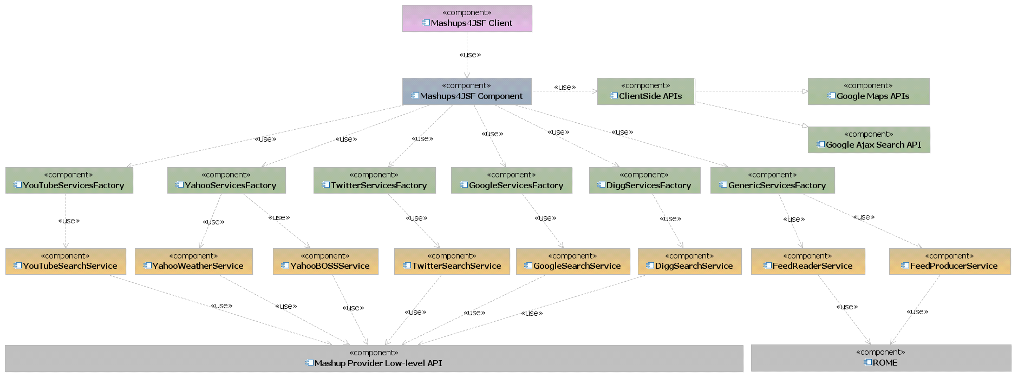
What is Mashups4JSF
Notes:
This is the high level architecture of Mashups4JSF.
As we see here, The Mashups4JSF components interact with the Mashup services through the Mashups4JSF factories and the client side APIs provided by the mashup service providers.
Every factory can contain one or more services. These services finally interacts with the low level APIs provided by the mashup service provider using The REST protocol.
Mashups4JSF offers a complete integration with the Google Maps API through GMaps4JSF.

Slide 34
AGENDA
1
What is Mashability.
2
How does mashability influence the success of a venture for both the public and enterprise.
3
Enterprise mashup case study.
4
Mashups development current challenges.
5
Mashup application Idea.
6
What is Mashups4JSF.
7
Building the mashup application using Mashups4JSF.
8
Conclusion
Notes:
Now, Let's see how to build this mashup application using Mashups4JSF.

Slide 35
Building the mashup application using Mashups4JSF.
<m:map />
<mashup:
twitterSearchList />
<mashup:
youTubeVideoList />
<mashup:
yahooWeather />
Notes:
Build the application on NetBeans using Mashups4JSF.

Slide 36
AGENDA
1
What is Mashability.
2
How does mashability influence the success of a venture for both the public and enterprise.
3
Enterprise mashup case study.
4
Mashups development current challenges.
5
Mashup application Idea.
6
What is Mashups4JSF.
7
Building the mashup application using Mashups4JSF.
8
Conclusion

Slide 37
Conclusion
  Mashups are important.
  Having a mashup meta-model gives developers a lot of power.
  Key ingredients for a mashup meta-model:
  Mashup integration happens on the server.
  There is a declarative syntax for describing the mashup:
  This syntax includes a suitably powerful component abstraction model.
  There is a powerful programming language that works closely with the declarative syntax.
  Hide the lower level APIs offered by the mashup service providers.

