Slide 1

Spark-Project
By Nagendra Yadav

Slide 2
Today agenda
Workflow of Spark in real time project
How to handle large set and config the spark
How optimize the spark and query
How spark.conf and spark feature work
Spark optimization technique

Slide 3
Requirement and setup
Spark install in machine
Java
Python (virtual-env should be there no dependencies issue will come)
Apache airflow
Data source (My case use post gre)
Vs code IDE
Github set up

Slide 4
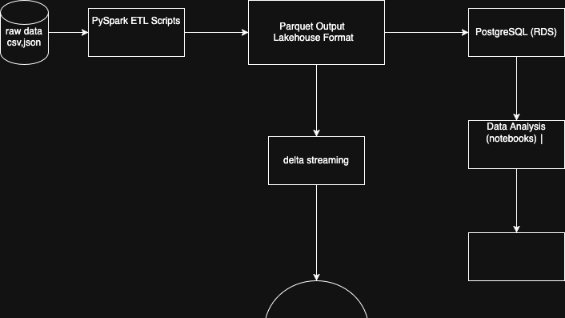
Architecture

Slide 5
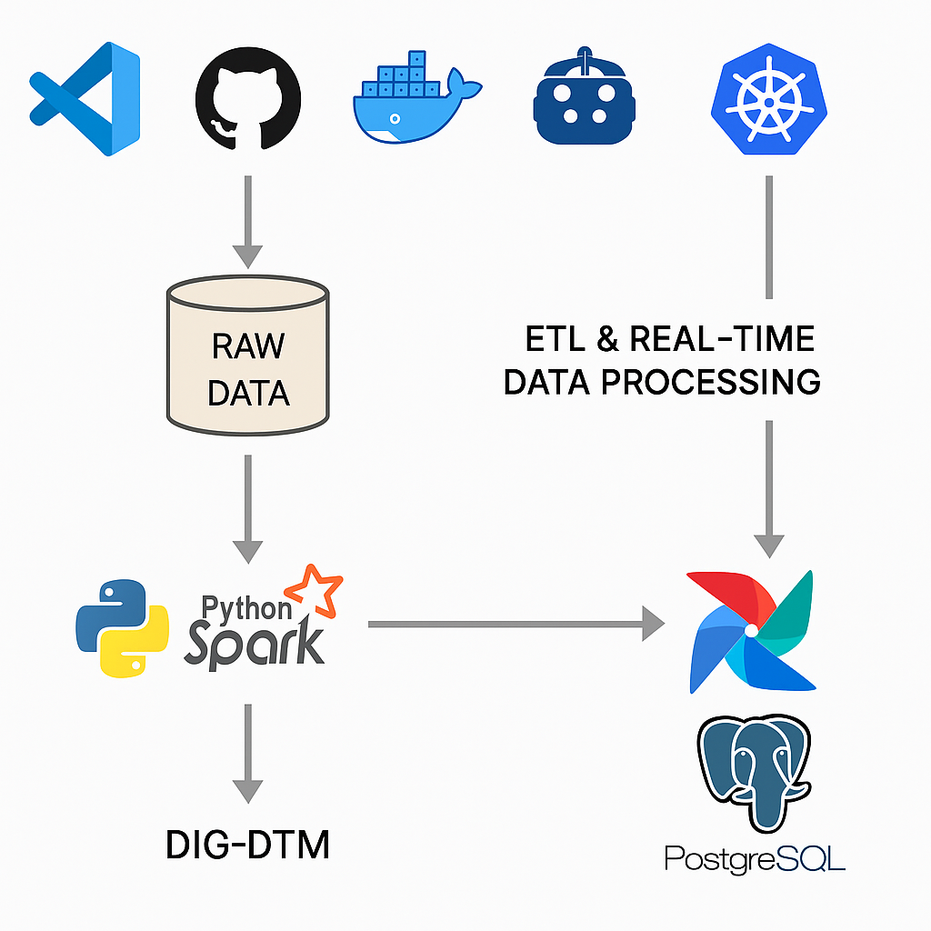
Raw data (use azure /s3 also)
Spark for doing ETL job
Airflow for deployment
Cluster in kubernative
Vs code IDE

Slide 6
Spark config
SparkConf is a configuration class in PySpark that is used to set up your Spark application. It lets you specify how Spark should behave in terms of memory, cores, parallelism, logging, etc.
onfig Key | Meaning | Example | Use Case
spark.app.name | Name of your Spark app | "IMDB_ETL" | Shows in Spark UI/logs
spark.master | Spark execution mode | "local[*]" | Run locally using all cores
spark.executor.memory | RAM per executor | "2g" | Controls memory each worker gets
spark.driver.memory | RAM for driver program | "1g" | Useful in large transformations
spark.executor.cores | CPU cores per executor | "2" | Controls parallelism level
spark.sql.shuffle.partitions | Number of partitions after shuffle (joins/groupBy) | "8" | More partitions = more parallelism, but too many = overhead
spark.sql.execution.arrow.enabled | Enables Apache Arrow for speed | "true" | Fast Pandas conversions
spark.sql.autoBroadcastJoinThreshold | Size (in bytes) of table for broadcast join | "10485760" (10MB) | Helps optimize join strategy
spark.default.parallelism | Default number of RDD partitions | "4" | Affects Spark’s default processing parallelism
spark.serializer | How data is serialized (transferred) | "org.apache.spark.serializer.KryoSerializer" | Faster and more compact than Java serializer

Slide 7
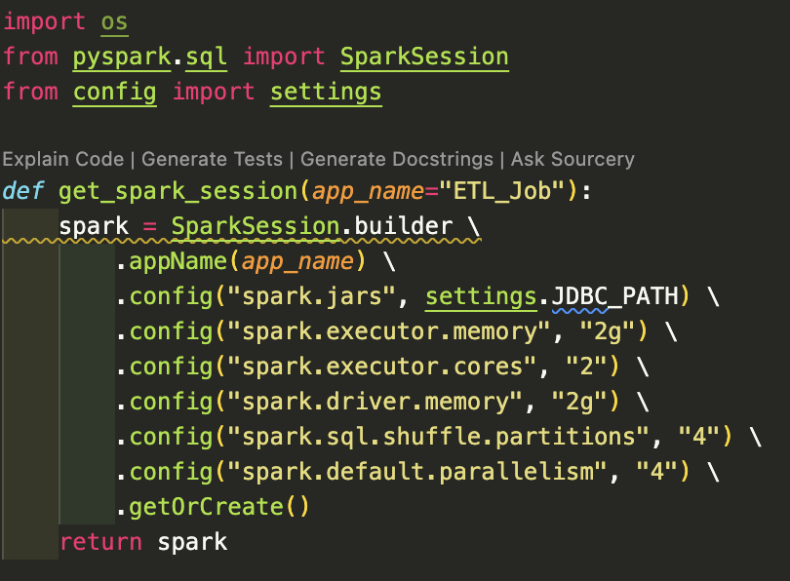
Sure! Here’s a single bullet point summary you can directly copy-paste into your slide: Initializes a SparkSession with optimized local configurations (memory, cores, shuffle partitions, JDBC driver) to efficiently run ETL jobs and connect to external databases.
Absolutely! Here’s a bullet-point breakdown of the code snippet for your slide:
appName(app_name): Sets a custom name for the Spark application (shown in Spark UI).
config("spark.jars", settings.JDBC_PATH): Adds external JDBC driver JAR needed for PostgreSQL connectivity.
config("spark.executor.memory", "2g"): Allocates 2 GB memory per executor for processing.
config("spark.executor.cores", "2"): Assigns 2 CPU cores per executor to parallelize tasks.
config("spark.driver.memory", "2g"): Allocates 2 GB memory to the Spark driver (main controller).
config("spark.sql.shuffle.partitions", "4"): Sets 4 partitions for shuffle operations (affects joins, aggregations).
config("spark.default.parallelism", "4"): Sets the default number of parallel tasks in RDD-based operations.
.getOrCreate(): Creates a new SparkSession or returns the existing one.

Slide 8
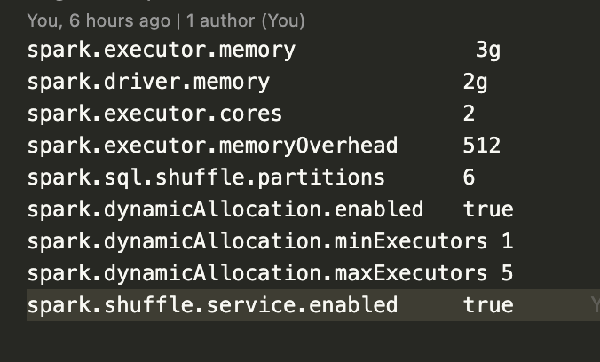
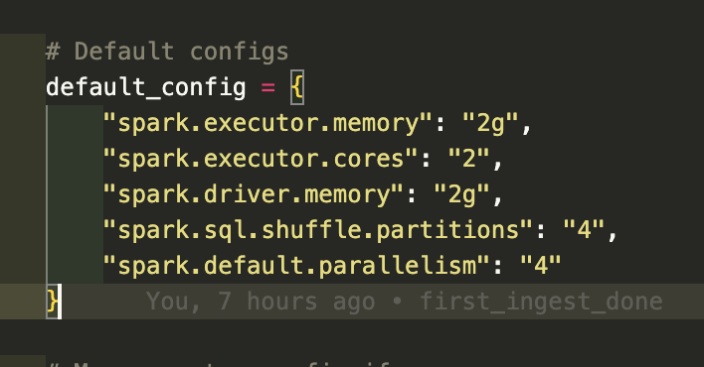
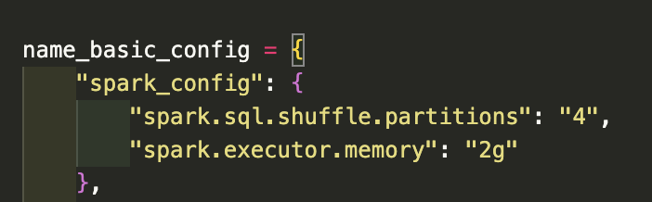
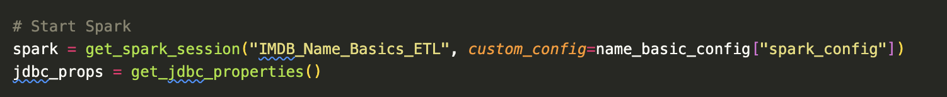
Dynamic config below example
Give or use
Give or use default config
Pull
Pull the config in ETL job
Use
Use custom config in you spark application

Slide 9
Today agenda
Now we have cleaned data
Learn performance tunning
Data scalability
introduction databricks

Slide 10
Now data is cleaned
Either use parquet file or direct form data source

Slide 11
Performance tunning
Setting | Description
spark.executor.memory | Memory per executor.
spark.driver.memory | Memory for the driver program.
spark.executor.cores | Number of cores per executor.
spark.sql.shuffle.partitions | Partitions for shuffle operations (joins, groupBy).
spark.default.parallelism | Default parallel tasks (usually 2x total cores).

Slide 12
With data base
Why it’s important:
Improper memory or parallelism leads to slow jobs, OOM errors, and disk spills.
Predicate Pushdown (Filter Pushdown)
Push filters to data source level (like Parquet/JDBC) to avoid loading all data.
Saves I/O and memory
Works with formats like Parquet, ORC, and JDBC
EXPLAIN & queryExecution
Use .explain(mode="formatted") or .queryExecution() to:
Analyze execution plan
Detect unwanted shuffles, scans, or broadcasts
Crucial for diagnosing why something is slow

Slide 13
Best approach
repartition(n) | To increase partitions for parallelism | Wide shuffle
coalesce(n) | To reduce partitions (e.g., for write) | Narrow shuffle

Slide 14
Avoid too many or too few partitions
Helps balance memory & CPU load
Cache vs. Persist
df.cache() — Keeps RDD in memory (default storage: MEMORY_AND_DISK)
df.persist(StorageLevel.MEMORY_AND_DISK_SER) — Custom storage levels
Columnar Storage Formats
Use Parquet or ORC instead of CSV/JSON
Columnar formats are:
Compressed
Enable predicate pushdown
More efficient in memory
Faster reads
Better with structured data
Avoid Collect()
Don’t use .collect() on big datasets.
It moves all data to driver memory
Causes OutOfMemoryError
Use .take(n), .limit(n), or .show(n) instead.
Broadcast Joins Use broadcast(df) when:
One table is very small
The other is very large

Slide 15
Skewed Joins & Salting
If one key is highly frequent (e.g., user_id = '123'), it causes skew. Use:
Salting
Skew hints
Aggregation before join
Avoids one task doing all the work
Avoid UDFs when Possible
Prefer Spark SQL functions or native expressions
UDFs are black boxes and disable catalyst optimizations
UDFs = last resort only

Slide 16
Area | Best Practices
Resources | Set memory, cores, partitions carefully
Data Read | Use pushdown filters, columnar formats
Processing | Use cache, avoid collect(), use explain
Joins | Broadcast small tables, avoid skew
Code | Use native functions, minimize UDFs

Slide 17

Go to python notebook
In this case we using same flow with IMBD data set

Slide 18
Filters
What is Predicate Pushdown?
Predicate Pushdown is a performance optimization technique where filter conditions (e.g., .filter(col("titleType") == "movie")) are pushed down to the data source layer, like Parquet or JDBC, so less data is loaded into memory.
When using columnar formats like Parquet, Spark can:
Skip reading full rows if a filter doesn’t match
Avoid reading unnecessary columns
Spark automatically performs predicate pushdown for Parquet if .filter() is immediately after .read.
Stage | What It Does | Good for Perf?
Scan parquet | Reads data & applies pushed filters | ✅ (Less I/O, faster read)
ColumnarToRow | Converts column format → row format | ⚠️ (Some overhead)
Filter | Final in-Spark filtering for accuracy | ✅ (Ensures correctness)
Filter Location | Efficiency
On DataFrame after .read() | ❌ less efficient
Directly in .filter() right after .read() | ✅ Best for predicate pushdown

Slide 19
Tool | Use case
df.explain() | Quick check of physical plan
queryExecution | Deep dive for debugging/optimizing
Predicate Pushdown | On title_ratings (averageRating >= 8.5) and title_basics (titleType)
✅ Column Pruning | Select only necessary columns from each file
✅ EXPLAIN & queryExecution | Used to inspect logical, optimized, and physical plans
✅ repartition() vs coalesce() | Coalesced final DF to reduce output files
✅ persist() / cache() | Cached DF after expensive joins
✅ Columnar Storage Optimization | Parquet format automatically uses columnar compression
✅ Partitioning & Caching | Could partition by genre_1, region, etc., if reused

Slide 20
Horizontal Scaling | Add machines | executor.instances, parallelism
Vertical Scaling | Bigger machine | executor.memory, executor.cores
Partitioning | Filter pruning, faster reads | .partitionBy("col")
Bucketing | Faster joins on large data | .bucketBy()
Broadcast Joins | Avoid shuffle | broadcast(df)
Skew Handling | Avoid long tasks | Salting keys or custom partitioners
Checkpointing | Save stable state | df.checkpoint()
Speculative Execution | Kill slow/stuck tasks | spark.speculation = true

Slide 21
Scalability
Feature | groupByKey() | reduceByKey()
Shuffles | More (heavy) | Less (combine locally)
Memory Usage | Higher | Lower
Performance | ❌ Slower on large data | ✅ Faster
df.rdd.map(lambda x: (x.genre_1, 1)).reduceByKey(lambda a, b: a + b)

Slide 22
spark.sql.shuffle.partitions
Scenario | Value | Use When
Default | 200 | Small jobs → overkill ⚠️
Optimized | 8 or 16 | Controlled shuffle partitions ✅
spark.conf.set("spark.sql.shuffle.partitions", "8")

Slide 23

Avoid Python UDFs
from pyspark.sql.functions import udf
@udf
def clean(x): return x.strip()
from pyspark.sql.functions import trim
df.select(trim(col("primaryTitle")))

Slide 24
Pandas UDFs (Vectorized UDFs)
Objective: Use vectorized operations for speed. ✅ Better than Python UDFs Requires: pandas >= 2.0, pyarrow >= 11.0
from pyspark.sql.functions import pandas_udf
@pandas_udf("string")
def upper_title(series):
return series.str.upper()
df.withColumn("title_upper", upper_title("primaryTitle"))

Slide 25
Arrow Optimization
Benefit: Speed up Pandas ↔ PySpark conversion
spark.sql.execution.arrow.pyspark.enabled >>>true
spark.conf.set("spark.sql.execution.arrow.pyspark.enabled", "true")
df.toPandas() # ⚡️ Fast conversion

Slide 26
Vertical vs Horizontal Scaling
Vertical Scaling: More memory/cores to executor
Horizontal Scaling: More partitions, more nodes
Type | Example Config
Vertical | spark.executor.memory = 6g
Horizontal | spark.default.parallelism = 8

Slide 27
Bucketing vs Partitioning
Feature | Partitioning | Bucketing
Based On | Column value (e.g., startYear) | Hashing column (e.g., genre_1)
Physical Files | Different folders | Same folder, multiple files
Use Case | Filter performance | Join optimization
df.write.partitionBy("startYear")
df.write.bucketBy(8, "genre_1").saveAsTable("bucketed")

Slide 28
Broadcast Join vs Distributed Join
Join Type | When to Use | Performance
Broadcast Join | When one table is small ✅ | No shuffle
Distributed (Shuffle) Join | Both tables large ❌ | Costly

Slide 29

Skew Handling with Salting
Problem: One key has 90% data → Skew
Solution: Add random salt column
df = df.withColumn("salt", (rand() * 10).cast("int"))
df = df.withColumn("skewed_key", concat(col("genre_1"), lit("_"), col("salt")))

Slide 30
Checkpointing
Use Case: Break long DAG lineages, stabilize transformations
01
Setup:spark.sparkContext.setCheckpointDir("/tmp/checkpoints")
02
df = df.checkpoint()
03

Slide 31
Speculative Execution
Problem: Some tasks run slow due to node issues
Solution: Re-run slow tasks on different node
spark.conf.set("spark.speculation", "true")

