Slide 1
By Anmol & Manav

Slide 2
Agenda
What is AOP?
Why use AOP?
Uses of AOP
AOP Terminologies
Types of Advice
Pros and Cons of AOP
Spring AOP Implementations
By Spring1.2 Old style (dtd based) (also supported in Spring3)
By AspectJ annotation-style
By Spring XML configuration-style(schema based)

Slide 3
What is AOP?
Aspect Oriented Programming (AOP) compliments OOPs in the sense that it also provides modularity. In OOPs, key unit is Objects, but in AOP key unit is aspects or concerns (simply assume stand-alone modules in your application)
AOP breaks the program logic into distinct parts (called concerns/aspects). It is used to increase modularity by cross-cutting concerns.
A cross-cutting concern is a concern that can affect the whole application and should be centralized in one location in code as possible, such as transaction management, authentication, logging, security etc.
AOP framework is plug-gable in spring.

Slide 4
Why use AOP?
It provides the plug-gable way to dynamically add the additional concern before, after or around the actual logic.
Suppose there are 10 methods in a class A as given below:
  class A
{
public void m1(){...}
      public void m2(){...}
public void m3(){...}
public void m4(){...}
public void m5(){...}
public void n1(){...}
public void n2(){...}
public void p1(){...}
public void p2(){...}
public void p3(){...}
  }

Slide 5
Why use AOP?
Understanding Scenario: I have to maintain log and send notification after calling methods that starts from m.
Problem without AOP: We can call methods (that maintains log and sends notification) from the methods starting with m. In such scenario, we need to write the code in all the 5 methods.
But, if client says in future, I don't have to send notification, you need to change all the methods. It leads to the maintenance problem.
Solution with AOP: We don't have to call methods from the method. Now we can define the additional concern like maintaining log, sending notification etc. in the method of another class. Its entry is given in the xml file.In future, if client says to remove the notifier functionality, we need to change only in the xml file. So, maintenance is easy in AOP.

Slide 6
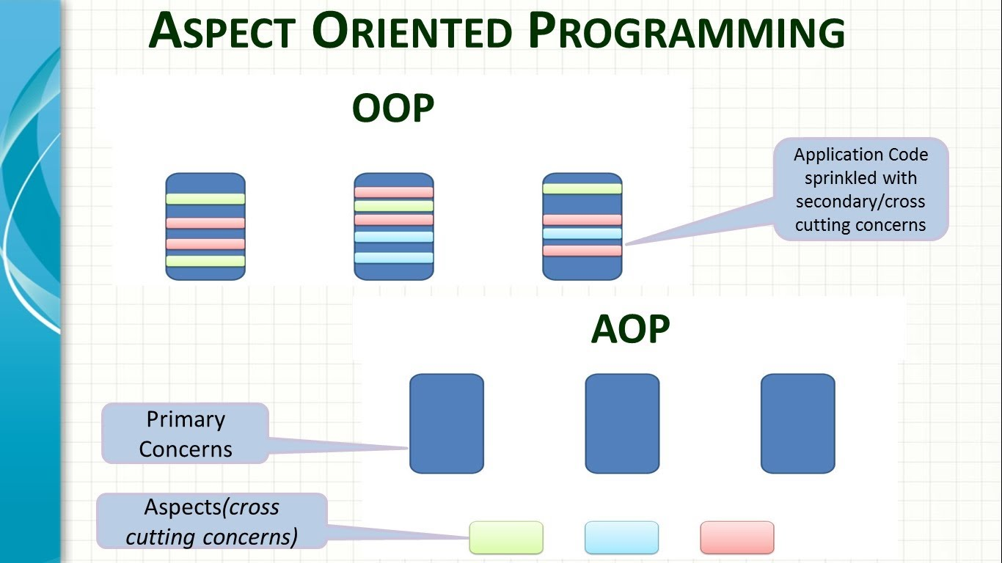
Uses of Spring AOP
To provide declarative enterprise services such as declarative transaction management.
It allows users to
implement custom
aspects

Slide 7
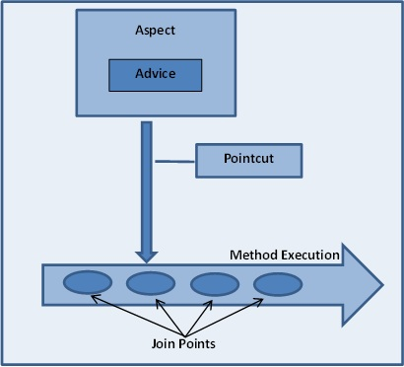
AOP Terminologies
1. Aspect: It means service [It means
if we want to use service layer into
business layer then we can use AOP
by using proxy]
2. Advice: It means Service Provider
[It means it provides and implement
the service]. At a join point, the action
taken by aspect is Advice.
3. PointCut: It means Point or condition will be executed for aspect(service) into the business layer. Those predicates which matches join point is called Pointcut.
4. Join Point: Join Point is a point during the execution of the method.

Slide 8
AOP Terminologies
5. Weaving: Other application type can be linked with aspect and that is known as weaving.
6. Target object: Those objects which are advised by aspects are Target Object.
7. Proxy: It is a well-used design pattern. To put it simply, a proxy is an object that looks like another object, but adds special functionality behind the scene.
8. AOP proxy: AOP proxy is an object created by the AOP framework in order to implement the aspect contracts in runtime.

Slide 9
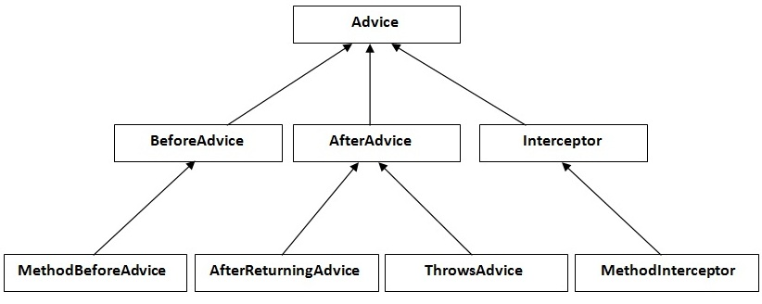
Hierarchy of advice interfaces

Slide 10
Types of Advice
Before: This advice runs before the execution of Join point methods. This functionality occurs before the advised method is invoked.
After: This advice gets executed after the Join point method finishes executing. This functionality occurs after the advice method completes, regardless of outcome.
After-returning: This advice method executes only if the Join point method executes normally. This functionality occurs after the advice method successfully completes.
After-throwing: This advice gets executed only when the join point method throws an exception. We can use this to roll back the transaction declarative.
Around: Wraps the advised method, providing functionality before and after the advised method is invoked.

Slide 11
Advantages of Spring AOP
1. AOP is non-invasive. Eg. Service or Domain classes get advice by the aspects (cross-cutting concerns) without adding Spring AOP related classes or interfaces into the service or domain classes. Allows the developers to concentrate on the business logic, instead of the cross-cutting concerns.
2. AOP is implemented in Java
3. Centralizes or modularizes the cross-cutting concerns
4. Like any other AOP framework, it weaves cross-cutting concerns into the classes, without making a call to the cross-cutting concerns from those classes.
5. Provision to create aspects using schema-based (XML configuration) or @AspectJ annotation based style.

Slide 12
Disadvantages of Spring AOP
1. Since it uses proxy-based AOP, only method-level advising is supported; it does not support field-level interception. So join-points can be at method level not at field level in a class.
2. Local or internal method calls within an advised class doesn’t get intercepted by proxy, so advise method of the aspect does not get fired/invoked. For example, say you have a service class with two public methods saveUser() and savRole(), both are advised by a logging aspect. If a client (Controller) invokes these methods individually, then the advice method of the logging Aspect gets invoked. But if you call saveRole() method from saveUser() method (a method call within the same class) then the advice method will not get invoked, though saveRole() method is captured by the AOP point-cut.

Slide 13
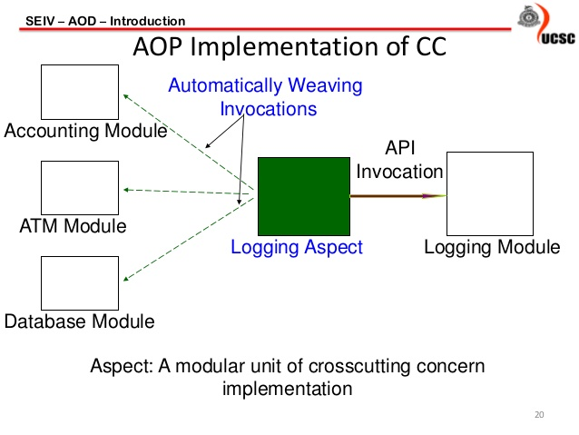
Spring AOP Implementations
Spring AOP implementations are provided by:
Spring AOP
AspectJ
JBoss AOP

Slide 14
Spring 1.2 Old style
There are given examples of Spring 1.2 old style AOP (dtd based) implementation. There are 4 types of advices supported in spring1.2 old style aop.
Before Advice: It is executed before the actual method call.
After Advice: It is executed after the actual method call.
Around Advice: It is executed before and after the actual method call.
Throws Advice: It is executed if actual method throws exception.

Slide 15
Interfaces required for Advices
Let's understand the advice hierarchy by the diagram given below:
MethodBeforeAdvice interface extends the BeforeAdvice interface.
AfterReturningAdvice interface extends the AfterAdvice interface.
ThrowsAdvice interface extends the AfterAdvice interface.
MethodInterceptor interface extends the Interceptor interface. It is used in around advice.

Slide 16
MethodBeforeAdvice Example
Create a class that contains actual business logic.
public class A {
  public void m(){
    System.out.println("actual business logic");
  }
}

Slide 17
MethodBeforeAdvice Example
Now, create the advisor class that implements MethodBeforeAdvice interface.
import java.lang.reflect.Method;
import org.springframework.aop.MethodBeforeAdvice;
public class BeforeAdvisor implements MethodBeforeAdvice{
  public void before(Method method, Object[] args, Object target) throws Throwable {
System.out.println("additional concern before actual logic");
}
}

Slide 18
MethodBeforeAdvice Example
<?xml version="1.0" encoding="UTF-8"?>
<beans
xmlns="http://www.springframework.org/schema/beans"
xmlns:xsi="http://www.w3.org/2001/XMLSchema-instance"
xmlns:p="http://www.springframework.org/schema/p"
xsi:schemaLocation="http://www.springframework.org/schema/beans http://www.springframework.org/schema/beans/spring-beans-3.0.xsd">
<bean id="obj" class="com.javatpoint.A"></bean>
<bean id="ba" class="com.javatpoint.BeforeAdvisor"></bean>
<bean id="proxy" class="org.springframework.aop.framework.ProxyFactoryBean">

Slide 19
MethodBeforeAdvice Example
<property name="target" ref="obj"></property>
<property name="interceptorNames">
<list>
<value>ba</value>
</list>
</property>
</bean>
</beans>

Slide 20
MethodBeforeAdvice Example
In xml file, create 3 beans, one for A class, second for Advisor class and third for ProxyFactoryBean class.
  Understanding ProxyFactoryBean class
The ProxyFactoryBean class is provided by Spring Framework. It contains 2 properties target and interceptorNames. The instance of A class will be considered as target object and the instance of advisor class as interceptor. You need to pass the advisor object as the list object as in the xml file given below.

Slide 21
MethodBeforeAdvice Example
public class Test {
  public static void main(String[] args) {
Resource r=new ClassPathResource("applicationContext.xml");
BeanFactory factory=new XmlBeanFactory(r);
A a=factory.getBean("proxy",A.class);
a.m();
  }
}

Slide 22
Spring1.2 old style other examples
AfterReturningAdvice Example
MethodInterceptor (AroundAdvice) Example
ThrowsAdvice Example

Slide 23
AOP AspectJ Annotation Example
The Spring Framework recommends you to use Spring AspectJ AOP implementation over the Spring 1.2 old style dtd based AOP implementation because it provides you more control and it is easy to use.
There are two ways to use Spring AOP AspectJ implementation:
1. By annotation: We are going to learn it here.
2. By xml configuration (schema based): We will learn it in next pages.

Slide 24
AOP AspectJ Annotation Example
The annotations used to create advices are given below:
@Before declares the before advice. It is applied before calling the actual method.
@After declares the after advice. It is applied after calling the actual method and before returning result.
@AfterReturning declares the after returning advice. It is applied after calling the actual method and before returning result. But you can get the result value in the advice.
@Around declares the around advice. It is applied before and after calling the actual method.
@AfterThrowing declares the throws advice. It is applied if actual method throws exception.

Slide 25
AOP AspectJ Annotation Example
Understanding Pointcut Expression.Let's try the understand the pointcut expressions by the examples given below:
@Pointcut("execution(public * *(..))")
It will be applied on all the public methods.
@Pointcut("execution(public Operation.*(..))")
It will be applied on all the public methods of Operation class.

Slide 26
AOP AspectJ Annotation Example
@Pointcut("execution(* Operation.*(..))")
It will be applied on all the methods of Operation class.
@Pointcut("execution(public Employee.set*(..))")
It will be applied on all the public setter methods of Employee class.
@Pointcut("execution(int Operation.*(..))")
It will be applied on all the methods of Operation class that returns int value.

Slide 27
AOP AspectJ Annotation Example
@Before Example
@After Example
@AfterReturning Example
@Around Example
@AfterThrowing Example

Slide 28
AOP AspectJ Xml Example
aop:before:
It is applied before calling the actual business logic method.
aop:after:
It is applied after calling the actual business logic method.
aop:after-returning:
It is applied after calling the actual business logic method. It can be used to intercept the return value in advice.
aop:around:
It is applied before and after calling the actual business logic method.
aop:after-throwing:
It is applied if actual business logic method throws exception.

Slide 29
AOP AspectJ Xml Example
aop:before Example
aop:after example
aop:after-returning example
aop:around example
aop:after-throwing example

Slide 30


