Slide 1

Project Title -Seasonal Agriculture Performance Analysis
Student Name – Mohit De
College Name - Institute Of Engineering & Management
AICTE STU ID : STU6970f889cdd8b1769011337

Slide 2

PROBLEM STATEMENT
Agricultural activities are influenced by seasonal variations in environmental conditions, farming practices, resource availability and market conditions. As a result, agricultural performance may differ from one season to another. However, raw agricultural data does not clearly explain how agricultural performance changes across seasons or what patterns can be observed in different seasonal conditions. The problem is to analyze the given agricultural dataset and investigate seasonal differences in agricultural performance by identifying meaningful patterns, trends, relationships and variations within the available data.

Slide 3
Project Description
This project focuses on analyzing agricultural data across different seasons, geographical areas, and farming conditions. The analysis aims to identify seasonal patterns, trends, relationships, and variations in agricultural performance. The project involves data exploration, cleaning, statistical analysis, and visualization to understand how factors such as environmental conditions, farming practices, resource usage, crop production, and economic performance vary across seasons. The findings will help generate data-driven insights and recommendations for better understanding and planning of seasonal agricultural activities.

Slide 4

WHO ARE THE END USERS?
Farmers – To understand seasonal crop performance and improve farming decisions.
Agricultural Planners – To support seasonal planning and resource allocation.
Government & Agricultural Departments – To understand agricultural trends and support planning.
Agricultural Analysts/Researchers – To analyze seasonal patterns and agricultural performance.
Agribusiness Stakeholders – To understand production and economic performance across seasons.

Slide 5

Technology Used
Python – Data cleaning, analysis, and processing
Pandas – Data manipulation and exploration
NumPy – Numerical computations
Matplotlib / Seaborn – Data visualization
Jupyter Notebook – Performing and documenting the analysis

Slide 6
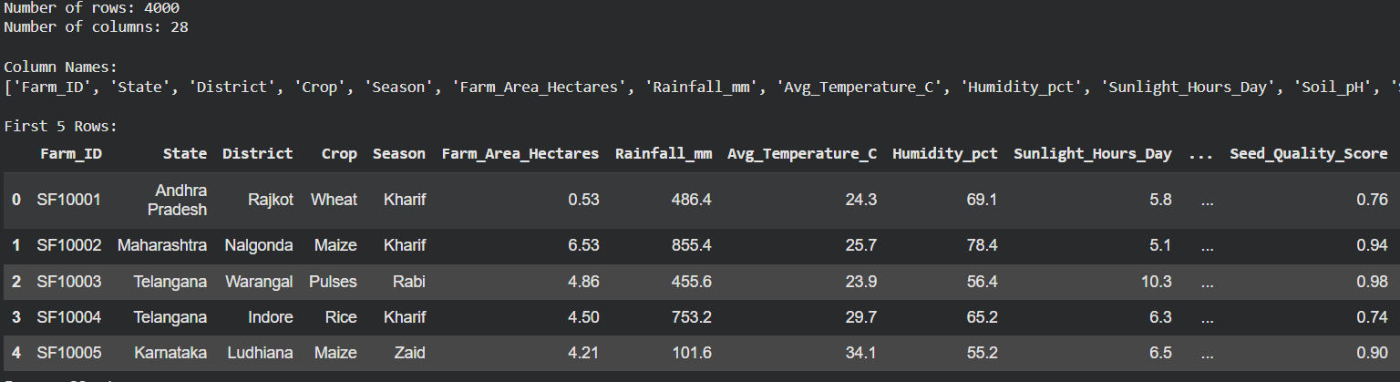
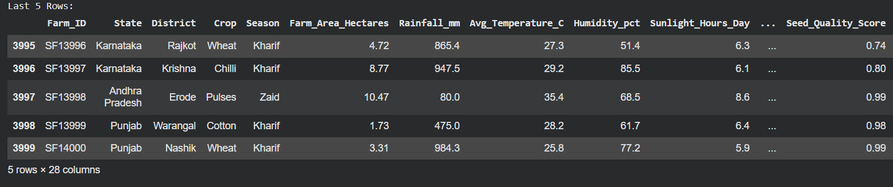
RESULTS
print("Number of rows:", df.shape[0])
print("Number of columns:", df.shape[1])
print("\nColumn Names:")
print(df.columns.tolist())
print("\nFirst 5 Rows:")
display(df.head())
print("\nLast 5 Rows:")
display(df.tail())

Slide 7
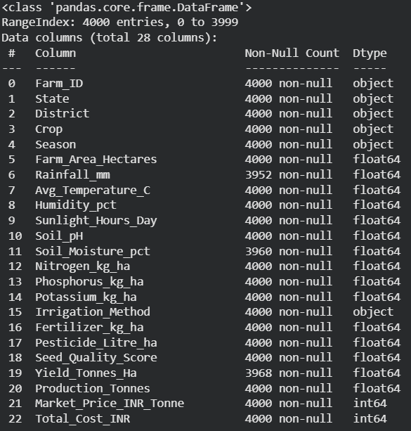
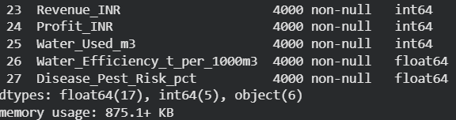
RESULTS
df.info()

Slide 8
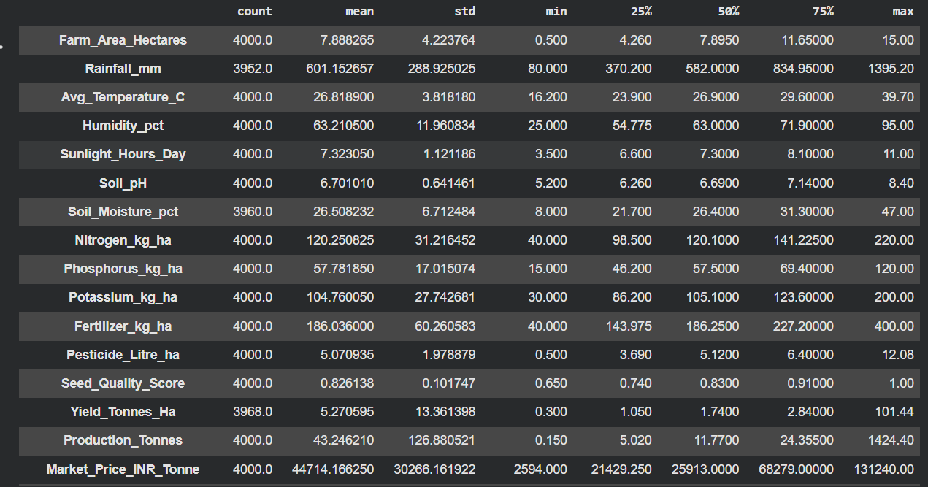
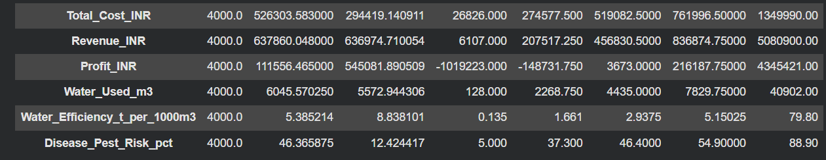
RESULTS
display(df.describe().T)

Slide 9
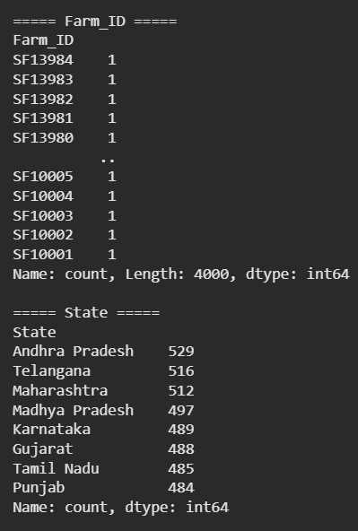
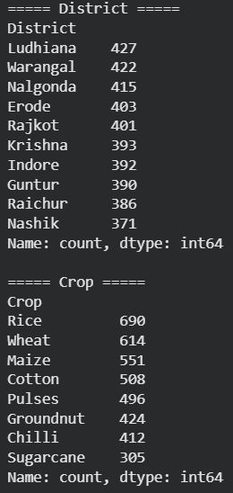
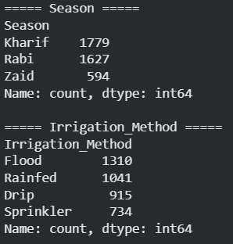
RESULTS
categorical_columns = df.select_dtypes(include='object').columns
for col in categorical_columns:
print(f"\n===== {col} =====")
print(df[col].value_counts())

Slide 10
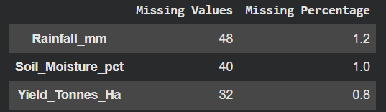

RESULTS
missing = df.isnull().sum()
missing_percentage = (missing / len(df)) * 100
missing_table = pd.DataFrame({
'Missing Values': missing,
'Missing Percentage': missing_percentage
})
display(missing_table[missing_table['Missing Values'] > 0])
duplicates = df.duplicated().sum()
print("Number of duplicate rows:", duplicates)

Slide 11
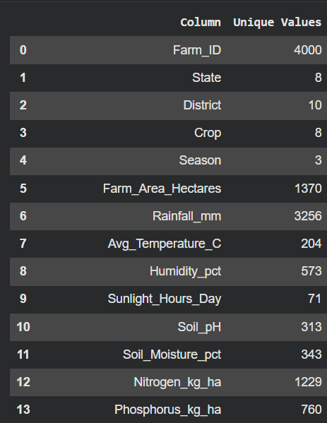
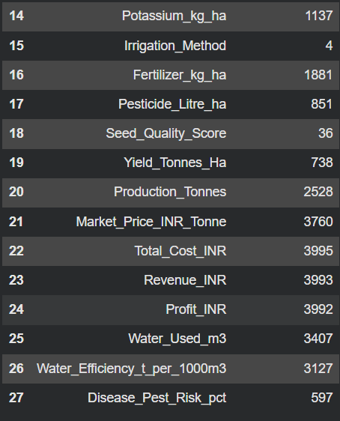
RESULTS
unique_table = pd.DataFrame({
'Column': df.columns,
'Unique Values': [df[col].nunique() for col in df.columns]
})
display(unique_table)

Slide 12
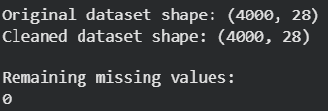
RESULTS
df_clean = df.copy()
numeric_columns = df_clean.select_dtypes(include=np.number).columns
for col in numeric_columns:
if df_clean[col].isnull().sum() > 0:
df_clean[col] = df_clean[col].fillna(df_clean[col].median())
df_clean = df_clean.drop_duplicates()
print("Original dataset shape:", df.shape)
print("Cleaned dataset shape:", df_clean.shape)
print("\nRemaining missing values:")
print(df_clean.isnull().sum().sum())

Slide 13
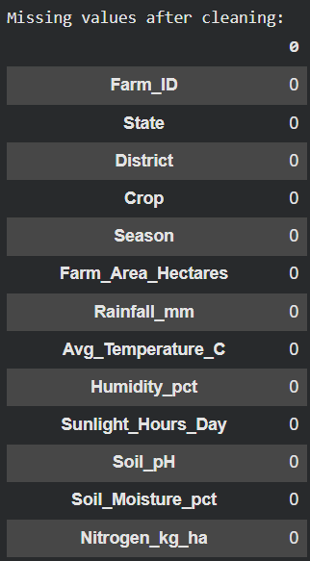
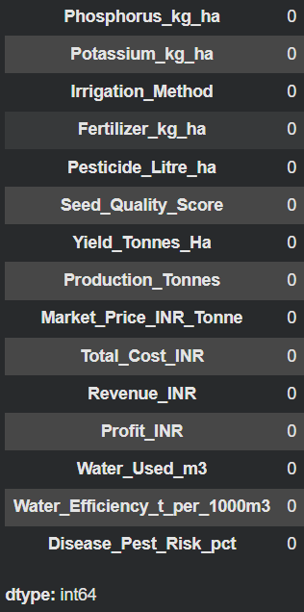

RESULTS
print("Missing values after cleaning:")
display(df_clean.isnull().sum())
print("\nDuplicate rows after cleaning:")
print(df_clean.duplicated().sum())

Slide 14
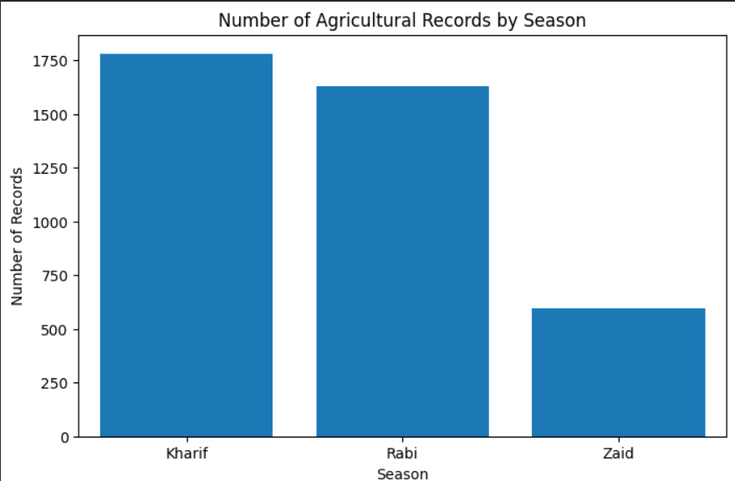
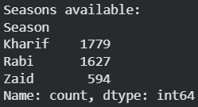
plt.figure(figsize=(8,5))
sns.countplot(data=df_clean, x='Season’)
plt.title('Number of Agricultural Records by Season')
plt.xlabel('Season')
plt.ylabel('Number of Records')
plt.show()
RESULTS
print("Seasons available:")
print(df_clean['Season'].value_counts())

Slide 15
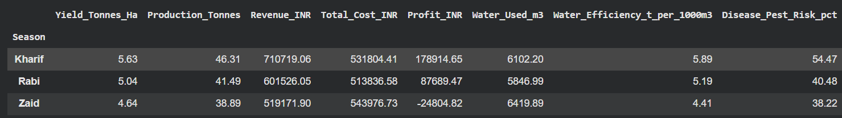
RESULTS
season_summary = df_clean.groupby('Season').agg({
'Yield_Tonnes_Ha': 'mean',
'Production_Tonnes': 'mean',
'Revenue_INR': 'mean',
'Total_Cost_INR': 'mean',
'Profit_INR': 'mean',
'Water_Used_m3': 'mean',
'Water_Efficiency_t_per_1000m3': 'mean',
'Disease_Pest_Risk_pct': 'mean’
}).round(2)
display(season_summary)

Slide 16
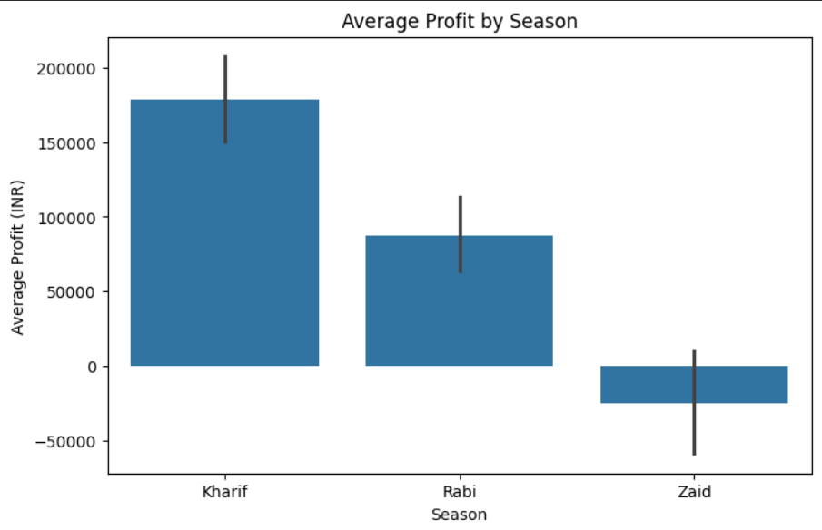
plt.figure(figsize=(8,5))
sns.barplot(
data=df_clean,
x='Season',
y='Profit_INR',
estimator='mean'
)
plt.title('Average Profit by Season')
plt.xlabel('Season')
plt.ylabel('Average Profit (INR)')
plt.show()

Slide 17
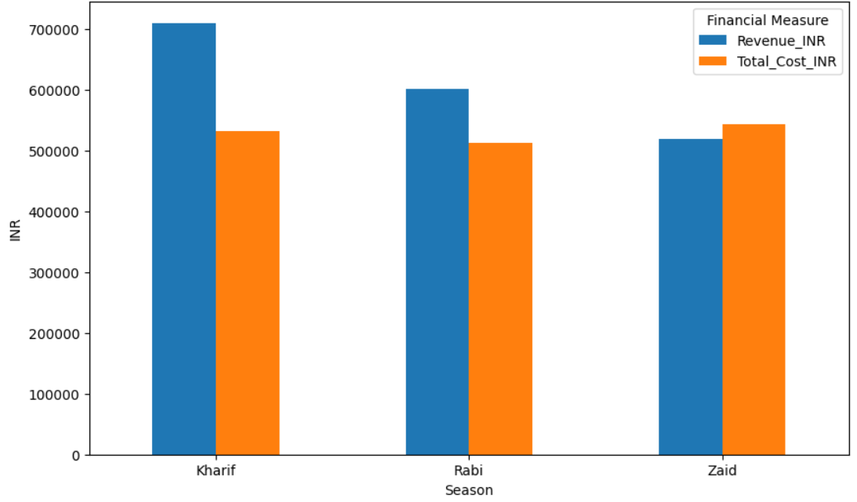
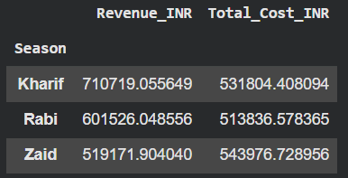
revenue_cost.plot(
kind='bar',
figsize=(10,6)
)
plt.title('Average Revenue and Cost by Season')
plt.xlabel('Season')
plt.ylabel('INR')
plt.xticks(rotation=0)
plt.legend(title='Financial Measure')
plt.show()
revenue_cost = df_clean.groupby('Season').agg({
'Revenue_INR': 'mean',
'Total_Cost_INR': 'mean'
})
display(revenue_cost)

Slide 18
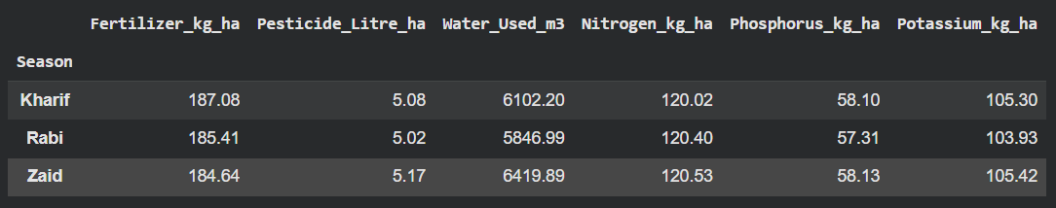
resource_summary = df_clean.groupby('Season').agg({
'Fertilizer_kg_ha': 'mean',
'Pesticide_Litre_ha': 'mean',
'Water_Used_m3': 'mean',
'Nitrogen_kg_ha': 'mean',
'Phosphorus_kg_ha': 'mean',
'Potassium_kg_ha': 'mean'
}).round(2)
display(resource_summary)

Slide 19
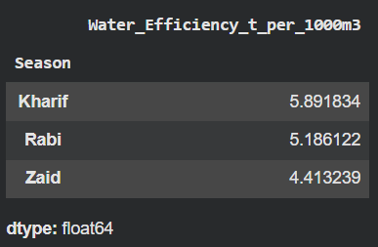
water_efficiency = df_clean.groupby(
'Season'
)['Water_Efficiency_t_per_1000m3'].mean().sort_values(
ascending=False
)
display(water_efficiency)

Slide 20
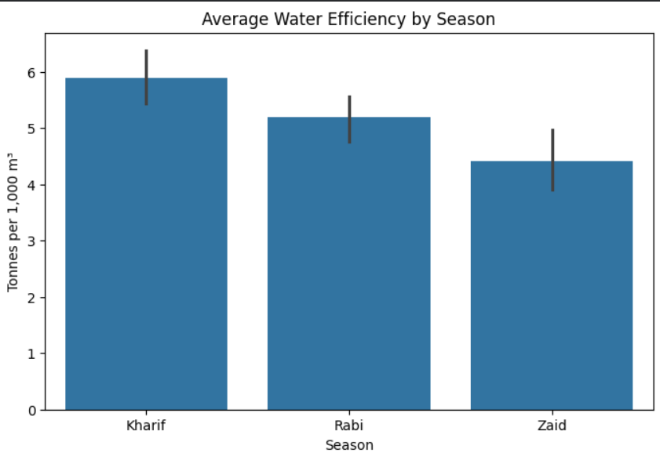
plt.figure(figsize=(8,5))
sns.barplot(
data=df_clean,
x='Season',
y='Water_Efficiency_t_per_1000m3',
estimator='mean'
)
plt.title('Average Water Efficiency by Season')
plt.xlabel('Season')
plt.ylabel('Tonnes per 1,000 m³')
plt.show()

Slide 21
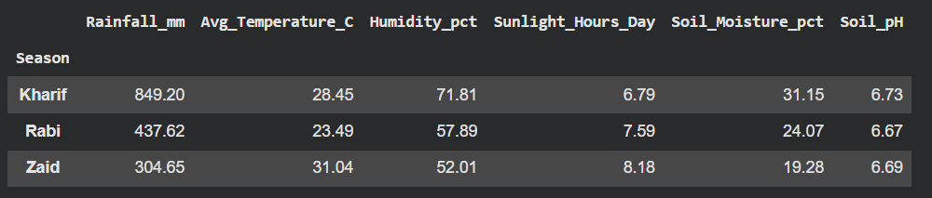
environment_summary = df_clean.groupby('Season').agg({
'Rainfall_mm': 'mean',
'Avg_Temperature_C': 'mean',
'Humidity_pct': 'mean',
'Sunlight_Hours_Day': 'mean',
'Soil_Moisture_pct': 'mean',
'Soil_pH': 'mean'
}).round(2)
display(environment_summary)

Slide 22
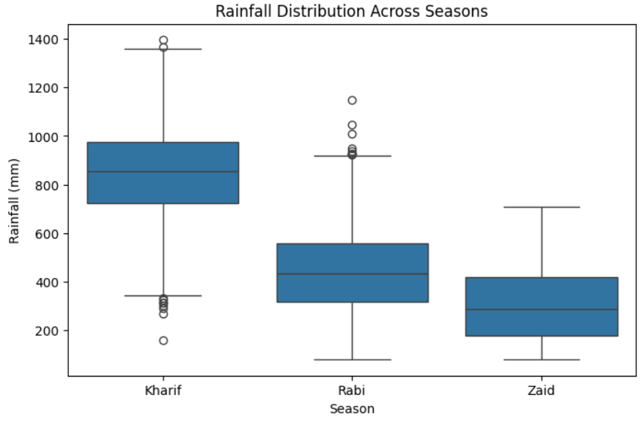
plt.figure(figsize=(8,5))
sns.boxplot(
data=df_clean,
x='Season',
y='Rainfall_mm'
)
plt.title('Rainfall Distribution Across Seasons')
plt.xlabel('Season')
plt.ylabel('Rainfall (mm)')
plt.show()

Slide 23
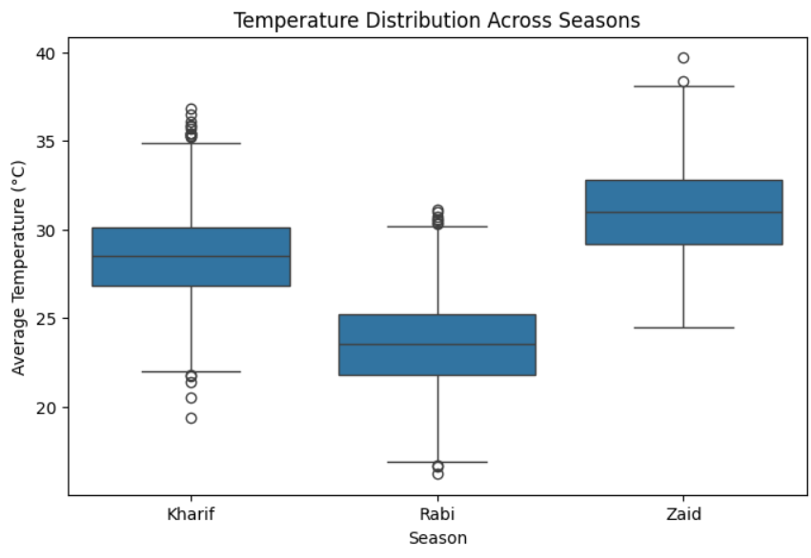
plt.figure(figsize=(8,5))
sns.boxplot(
data=df_clean,
x='Season',
y='Avg_Temperature_C'
)
plt.title('Temperature Distribution Across Seasons')
plt.xlabel('Season')
plt.ylabel('Average Temperature (°C)')
plt.show()

Slide 24
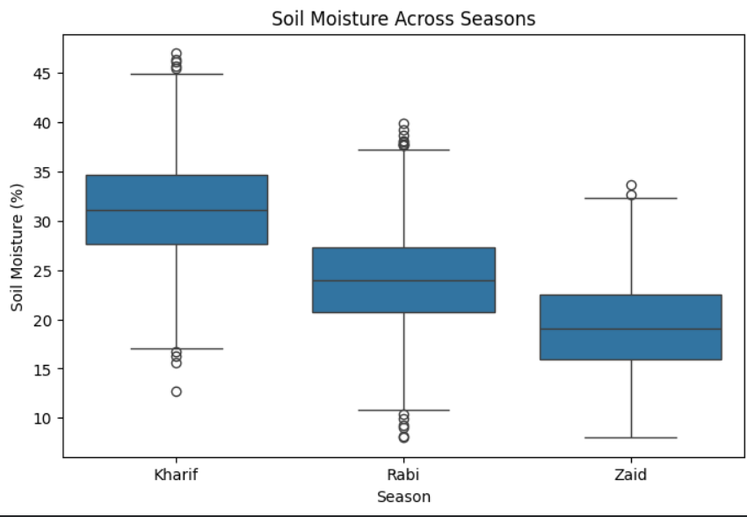
plt.figure(figsize=(8,5))
sns.boxplot(
data=df_clean,
x='Season',
y='Soil_Moisture_pct'
)
plt.title('Soil Moisture Across Seasons')
plt.xlabel('Season')
plt.ylabel('Soil Moisture (%)')
plt.show()

Slide 25
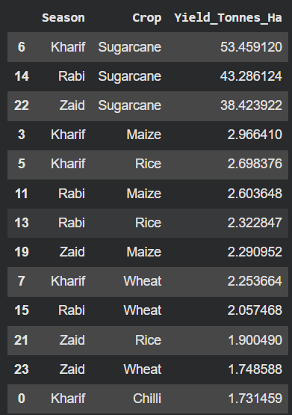
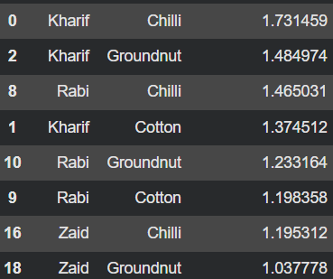
crop_season_summary = df_clean.groupby(
['Season', 'Crop']
)['Yield_Tonnes_Ha'].mean().reset_index()
display(
crop_season_summary.sort_values(
'Yield_Tonnes_Ha',
ascending=False
).head(20)
)

Slide 26
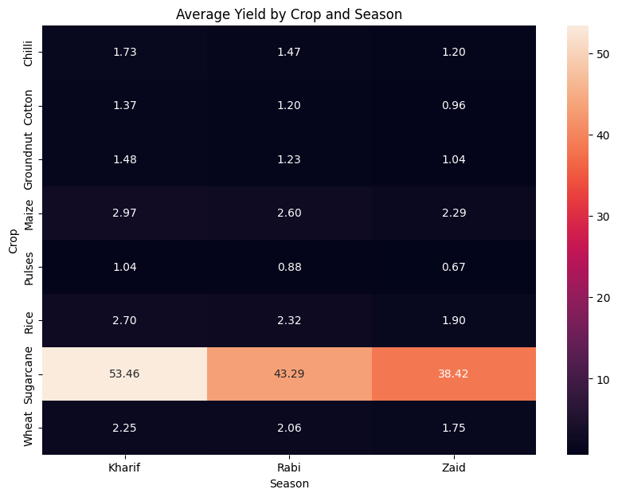
crop_season_pivot = df_clean.pivot_table(
index='Crop',
columns='Season',
values='Yield_Tonnes_Ha',
aggfunc='mean’
)
plt.figure(figsize=(10,7))
sns.heatmap(
crop_season_pivot,
annot=True,
fmt='.2f'
)
plt.title('Average Yield by Crop and Season')
plt.xlabel('Season')
plt.ylabel('Crop')
plt.show()

Slide 27
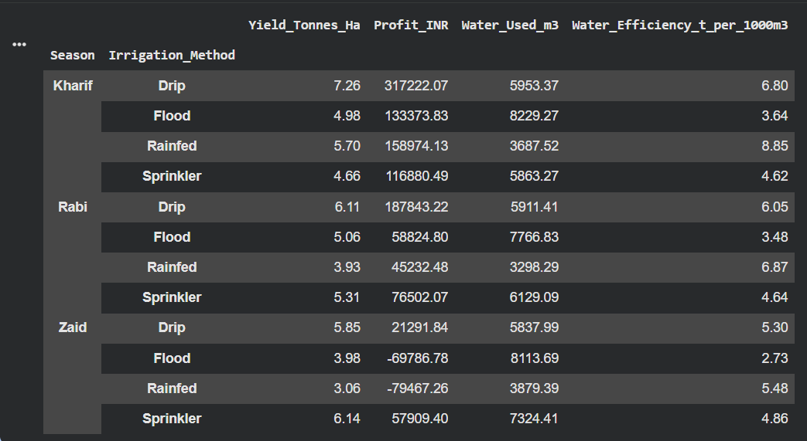
irrigation_summary = df_clean.groupby(
['Season', 'Irrigation_Method']
).agg({
'Yield_Tonnes_Ha': 'mean',
'Profit_INR': 'mean',
'Water_Used_m3': 'mean',
'Water_Efficiency_t_per_1000m3': 'mean'
}).round(2)
display(irrigation_summary)

Slide 28
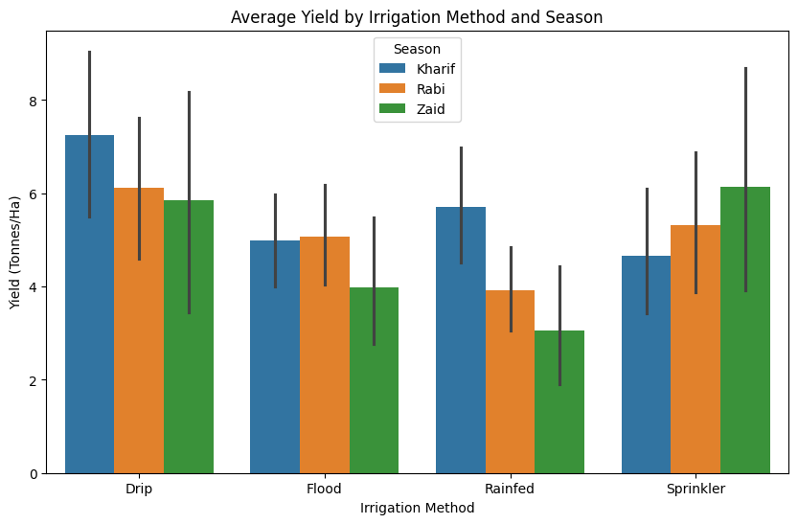
plt.figure(figsize=(10,6))
sns.barplot(
data=df_clean,
x='Irrigation_Method',
y='Yield_Tonnes_Ha',
hue='Season',
estimator='mean'
)
plt.title('Average Yield by Irrigation Method and Season')
plt.xlabel('Irrigation Method')
plt.ylabel('Yield (Tonnes/Ha)')
plt.show()

Slide 29
state_summary = df_clean.groupby('State').agg({
'Yield_Tonnes_Ha': 'mean',
'Production_Tonnes': 'mean',
'Revenue_INR': 'mean',
'Profit_INR': 'mean',
'Water_Efficiency_t_per_1000m3': 'mean'
}).round(2)
display(state_summary.sort_values(
'Yield_Tonnes_Ha',
ascending=False
))
 | Yield_Tonnes_Ha | Production_Tonnes | Revenue_INR | Profit_INR | Water_Efficiency_t_per_1000m3
State
Punjab | 6.12 | 52.23 | 686225.70 | 136025.64 | 5.62
Karnataka | 5.69 | 47.73 | 653426.18 | 119422.34 | 5.56
Gujarat | 5.66 | 48.33 | 654692.86 | 117568.24 | 5.58
Telangana | 5.04 | 39.25 | 628784.53 | 108829.62 | 5.46
Maharashtra | 5.02 | 43.98 | 650032.67 | 135428.86 | 5.28
Madhya Pradesh | 4.99 | 37.56 | 597558.36 | 86840.76 | 5.27
Tamil Nadu | 4.88 | 40.84 | 629093.42 | 117744.75 | 5.31
Andhra Pradesh | 4.63 | 36.91 | 606663.66 | 73453.53 | 5.03

Slide 30
state_season = df_clean.pivot_table(
index='State',
columns='Season',
values='Yield_Tonnes_Ha',
aggfunc='mean'
)
display(state_season)
Season | Kharif | Rabi | Zaid
State
Andhra Pradesh | 5.676958 | 3.470931 | 4.448000
Gujarat | 6.338416 | 5.441700 | 4.066716
Karnataka | 6.455024 | 4.567864 | 6.623243
Madhya Pradesh | 5.985265 | 3.760385 | 5.478889
Maharashtra | 5.430315 | 5.501927 | 2.277778
Punjab | 4.100633 | 8.609355 | 5.909610
Tamil Nadu | 5.520534 | 4.501394 | 4.097746
Telangana | 5.552436 | 4.784569 | 4.248471

Slide 31
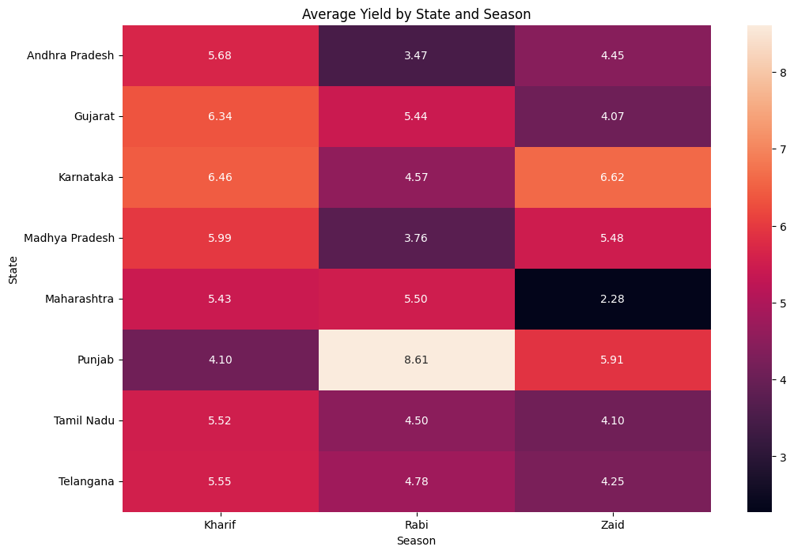
plt.figure(figsize=(12,8))
sns.heatmap(
state_season,
annot=True,
fmt='.2f'
)
plt.title('Average Yield by State and Season')
plt.xlabel('Season')
plt.ylabel('State')
plt.show()

Slide 32
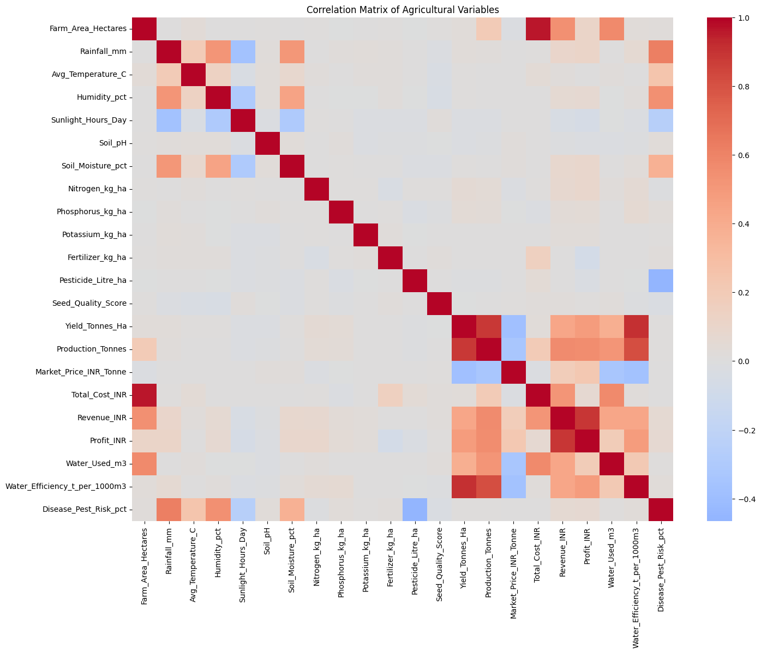
numeric_df = df_clean.select_dtypes(include=np.number)
correlation = numeric_df.corr()
plt.figure(figsize=(16,12))
sns.heatmap(
correlation,
cmap='coolwarm',
center=0
)
plt.title('Correlation Matrix of Agricultural Variables')
plt.show()

Slide 33
 | Yield_Tonnes_Ha
Yield_Tonnes_Ha | 1.000000
Water_Efficiency_t_per_1000m3 | 0.912568
Production_Tonnes | 0.882813
Profit_INR | 0.488466
Revenue_INR | 0.432152
Water_Used_m3 | 0.386294
Nitrogen_kg_ha | 0.053149
Phosphorus_kg_ha | 0.047941
Rainfall_mm | 0.030951
Total_Cost_INR | 0.030622
Farm_Area_Hectares | 0.030203
Disease_Pest_Risk_pct | 0.014292
Humidity_pct | 0.012297
Soil_Moisture_pct | 0.010999
Avg_Temperature_C | 0.009996
Potassium_kg_ha | 0.003382
Fertilizer_kg_ha | 0.000018
Seed_Quality_Score | -0.007209
Pesticide_Litre_ha | -0.007779
Sunlight_Hours_Day | -0.015341
Soil_pH | -0.020672
Market_Price_INR_Tonne | -0.382607
yield_corr = correlation['Yield_Tonnes_Ha'].sort_values(
ascending=False
)
display(yield_corr)
dtype: float64

Slide 34
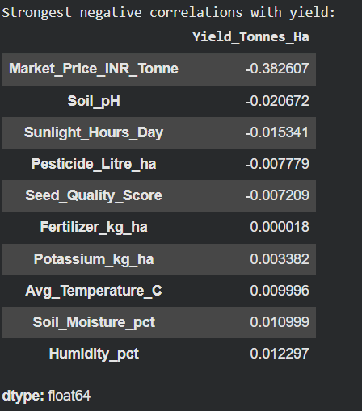
print("Strongest negative correlations with yield:")
display(
yield_corr.sort_values().head(10)
)

Slide 35
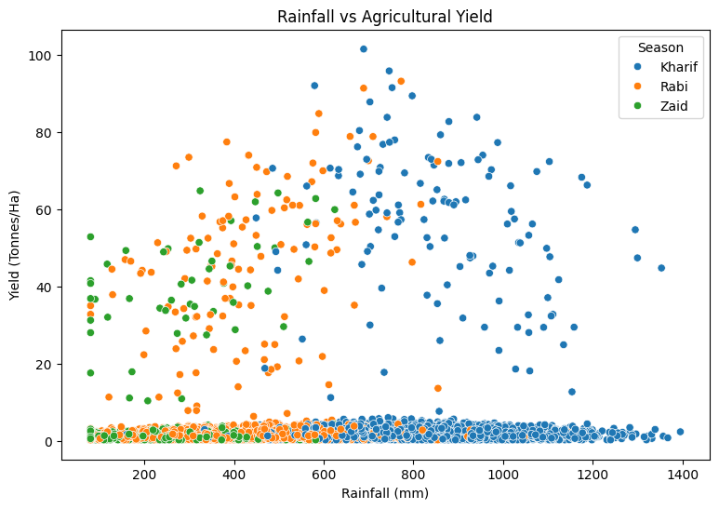
plt.figure(figsize=(9,6))
sns.scatterplot(
data=df_clean,
x='Rainfall_mm',
y='Yield_Tonnes_Ha',
hue='Season'
)
plt.title('Rainfall vs Agricultural Yield')
plt.xlabel('Rainfall (mm)')
plt.ylabel('Yield (Tonnes/Ha)')
plt.show()

Slide 36
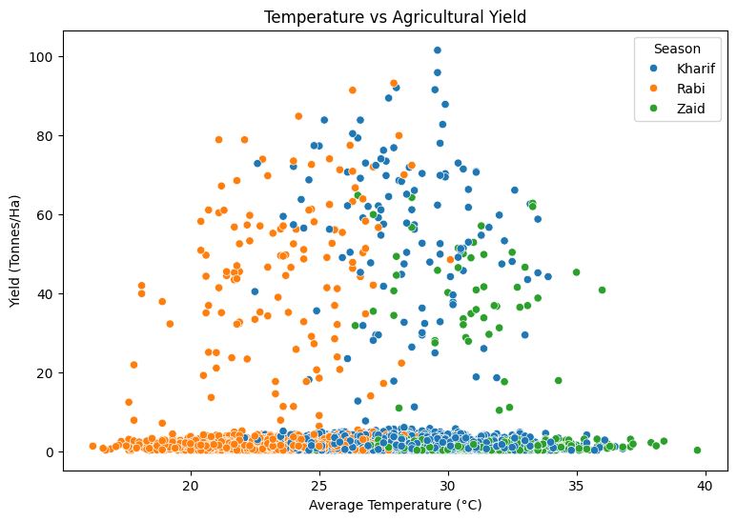
sns.scatterplot(
data=df_clean,
x='Avg_Temperature_C',
y='Yield_Tonnes_Ha',
hue='Season'
)
plt.title('Temperature vs Agricultural Yield')
plt.xlabel('Average Temperature (°C)')
plt.ylabel('Yield (Tonnes/Ha)')
plt.show()

Slide 37
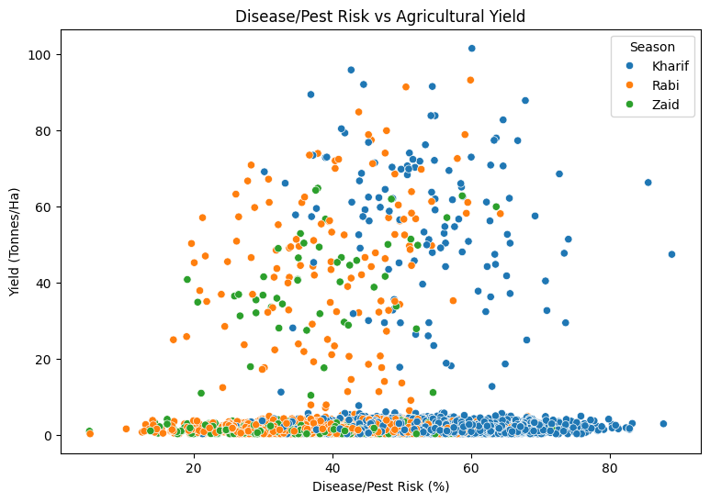
plt.figure(figsize=(9,6))
sns.scatterplot(
data=df_clean,
x='Disease_Pest_Risk_pct',
y='Yield_Tonnes_Ha',
hue='Season'
)
plt.title('Disease/Pest Risk vs Agricultural Yield')
plt.xlabel('Disease/Pest Risk (%)')
plt.ylabel('Yield (Tonnes/Ha)')
plt.show()

Slide 38
seasons = df_clean['Season'].unique()
season_groups = [
df_clean[df_clean['Season'] == season]['Yield_Tonnes_Ha']
for season in seasons
]
anova_stat, p_value = f_oneway(*season_groups)
print("ANOVA F-statistic:", anova_stat)
print("ANOVA p-value:", p_value)
alpha = 0.05
if p_value < alpha:
print("\nResult: Yield differs significantly across seasons.")
else:
print("\nResult: No statistically significant difference in yield across seasons.")
ANOVA F-statistic: 1.5438804542488311
ANOVA p-value: 0.21367813841792296
Result: No statistically significant difference in yield across seasons.

Slide 39
r, p = pearsonr(
df_clean['Rainfall_mm'],
df_clean['Yield_Tonnes_Ha']
)
print("Pearson correlation coefficient:", r)
print("p-value:", p)
if p < 0.05:
print("The relationship is statistically significant.")
else:
print("The relationship is not statistically significant.")
Pearson correlation coefficient: 0.030950993551650867
p-value: 0.05030400505380311
The relationship is not statistically significant.

Slide 40
r, p = pearsonr(
df_clean['Avg_Temperature_C'],
df_clean['Yield_Tonnes_Ha']
)
print("Correlation coefficient:", r)
print("p-value:", p)
Correlation coefficient: 0.009996320546703604
p-value: 0.5273600766164954

Slide 41
r, p = pearsonr(
df_clean['Water_Used_m3'],
df_clean['Yield_Tonnes_Ha']
)
print("Correlation coefficient:", r)
print("p-value:", p)
Correlation coefficient: 0.3862938118886715
p-value: 1.64140286973321e-142

Slide 42
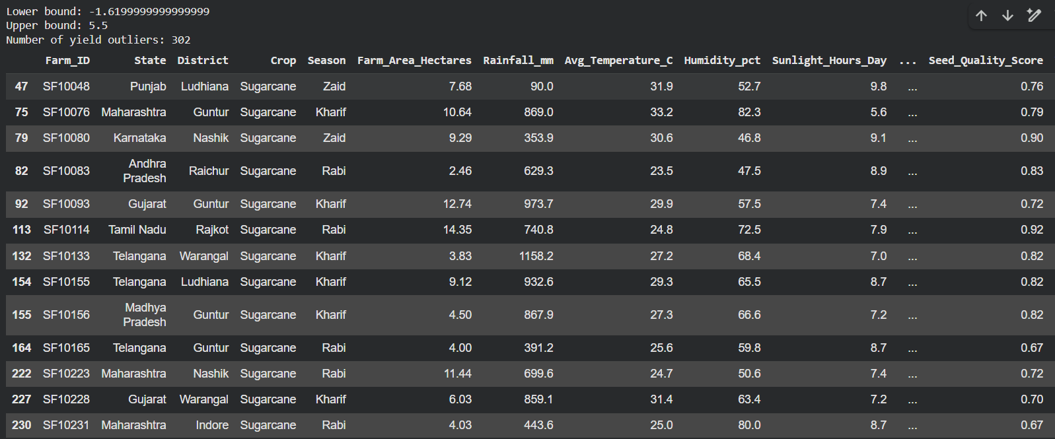
Q1 = df_clean['Yield_Tonnes_Ha'].quantile(0.25)
Q3 = df_clean['Yield_Tonnes_Ha'].quantile(0.75)
IQR = Q3 - Q1
lower_bound = Q1 - 1.5 * IQR
upper_bound = Q3 + 1.5 * IQR
outliers = df_clean[
(df_clean['Yield_Tonnes_Ha'] < lower_bound) |
(df_clean['Yield_Tonnes_Ha'] > upper_bound)
]
print("Lower bound:", lower_bound)
print("Upper bound:", upper_bound)
print("Number of yield outliers:", len(outliers))
display(outliers.head(20))

Slide 43
season_variability = df_clean.groupby('Season').agg({
'Yield_Tonnes_Ha': ['mean', 'std', 'min', 'max'],
'Profit_INR': ['mean', 'std'],
'Water_Used_m3': ['mean', 'std']
}).round(2)
display(season_variability)
 | Yield_Tonnes_Ha |  |  |  | Profit_INR |  | Water_Used_m3
 | mean | std | min | max | mean | std | mean | std
Season
Kharif | 5.63 | 14.39 | 0.3 | 101.44 | 178914.65 | 611549.78 | 6102.20 | 5670.58
Rabi | 5.04 | 12.75 | 0.3 | 93.13 | 87689.47 | 489901.25 | 5846.99 | 5397.65
Zaid | 4.64 | 11.27 | 0.3 | 64.76 | -24804.82 | 436356.75 | 6419.89 | 5734.62

Slide 44
score_data = df_clean[
['Yield_Tonnes_Ha',
'Profit_INR',
'Water_Efficiency_t_per_1000m3']
].copy()
scaler = StandardScaler()
score_data_scaled = scaler.fit_transform(score_data)
df_clean['Performance_Score'] = score_data_scaled.mean(axis=1)
season_score = df_clean.groupby(
'Season'
)['Performance_Score'].mean().sort_values(
ascending=False
)
display(season_score)
 | Performance_Score
Season
Kharif | 0.069980
Rabi | -0.027189
Zaid | -0.135115
dtype: float64

Slide 45
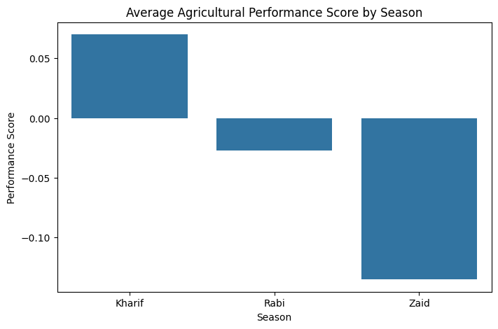
plt.figure(figsize=(8,5))
sns.barplot(
x=season_score.index,
y=season_score.values
)
plt.title('Average Agricultural Performance Score by Season')
plt.xlabel('Season')
plt.ylabel('Performance Score')
plt.show()

Slide 46
ml_df = df_clean.copy()
ml_df = ml_df.drop(columns=['Farm_ID'])
ml_df = pd.get_dummies(
ml_df,
columns=['State', 'District', 'Crop', 'Season', 'Irrigation_Method'],
drop_first=True
)
print("ML dataset shape:", ml_df.shape)
ML dataset shape: (4000, 51)

Slide 47
X = ml_df.drop(columns=['Yield_Tonnes_Ha'])
y = ml_df['Yield_Tonnes_Ha']
X_train, X_test, y_train, y_test = train_test_split(
X,
y,
test_size=0.20,
random_state=42
)
model = RandomForestRegressor(
n_estimators=200,
random_state=42
)
model.fit(X_train, y_train)
predictions = model.predict(X_test)
print("Model trained successfully!")
Model trained successfully!

Slide 48
mae = mean_absolute_error(y_test, predictions)
rmse = np.sqrt(
mean_squared_error(y_test, predictions)
)
r2 = r2_score(y_test, predictions)
print("Mean Absolute Error:", mae)
print("Root Mean Squared Error:", rmse)
print("R² Score:", r2)
Mean Absolute Error: 0.449497187500001 Root Mean Squared Error: 1.577680117927312 R² Score: 0.9870897554013689

Slide 49
 | Feature | Importance
19 | Water_Efficiency_t_per_1000m3 | 0.850272
21 | Performance_Score | 0.102538
13 | Production_Tonnes | 0.019703
14 | Market_Price_INR_Tonne | 0.006142
0 | Farm_Area_Hectares | 0.003713
48 | Irrigation_Method_Rainfed | 0.003057
15 | Total_Cost_INR | 0.001646
17 | Profit_INR | 0.001446
43 | Crop_Sugarcane | 0.001303
10 | Fertilizer_kg_ha | 0.000851
12 | Seed_Quality_Score | 0.000820
5 | Soil_pH | 0.000706
9 | Potassium_kg_ha | 0.000665
8 | Phosphorus_kg_ha | 0.000623
4 | Sunlight_Hours_Day | 0.000610
2 | Avg_Temperature_C | 0.000574
11 | Pesticide_Litre_ha | 0.000556
3 | Humidity_pct | 0.000530
16 | Revenue_INR | 0.000526
1 | Rainfall_mm | 0.000503
feature_importance = pd.DataFrame({
'Feature': X.columns,
'Importance': model.feature_importances_
})
feature_importance = feature_importance.sort_values(
'Importance',
ascending=False
)
display(feature_importance.head(20))

Slide 50
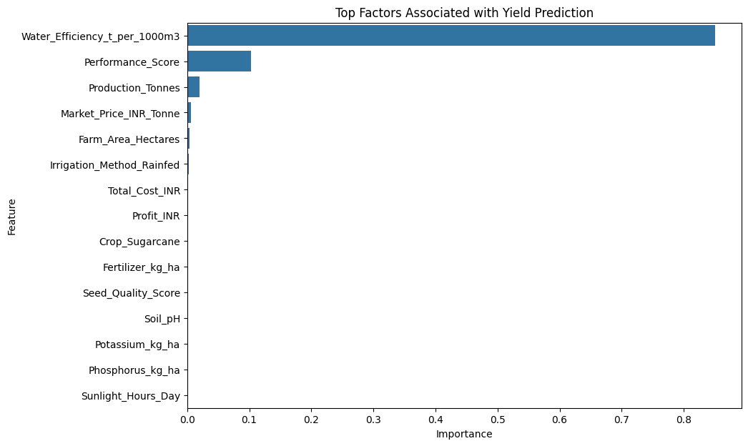
top_features = feature_importance.head(15)
plt.figure(figsize=(10,7))
sns.barplot(
data=top_features,
x='Importance',
y='Feature'
)
plt.title('Top Factors Associated with Yield Prediction')
plt.xlabel('Importance')
plt.ylabel('Feature')
plt.show()

Slide 51
final_summary = df_clean.groupby('Season').agg({
'Yield_Tonnes_Ha': 'mean',
'Production_Tonnes': 'mean',
'Profit_INR': 'mean',
'Water_Efficiency_t_per_1000m3': 'mean',
'Disease_Pest_Risk_pct': 'mean'
}).round(2)
display(final_summary)
 | Yield_Tonnes_Ha | Production_Tonnes | Profit_INR | Water_Efficiency_t_per_1000m3 | Disease_Pest_Risk_pct
Season
Kharif | 5.63 | 46.31 | 178914.65 | 5.89 | 54.47
Rabi | 5.04 | 41.49 | 87689.47 | 5.19 | 40.48
Zaid | 4.64 | 38.89 | -24804.82 | 4.41 | 38.22

Slide 52
best_yield_season = (
df_clean.groupby('Season')['Yield_Tonnes_Ha']
.mean()
.idxmax()
)
worst_yield_season = (
df_clean.groupby('Season')['Yield_Tonnes_Ha']
.mean()
.idxmin()
)
best_profit_season = (
df_clean.groupby('Season')['Profit_INR']
.mean()
.idxmax()
)
best_water_season = (
df_clean.groupby('Season')['Water_Efficiency_t_per_1000m3']
.mean()
.idxmax()
)
print("Best season based on average yield:", best_yield_season)
print("Lowest season based on average yield:", worst_yield_season)
print("Best season based on average profit:", best_profit_season)
print("Best season based on water efficiency:", best_water_season)
Best season based on average yield: Kharif
Lowest season based on average yield: Zaid
Best season based on average profit: Kharif
Best season based on water efficiency: Kharif

Slide 53
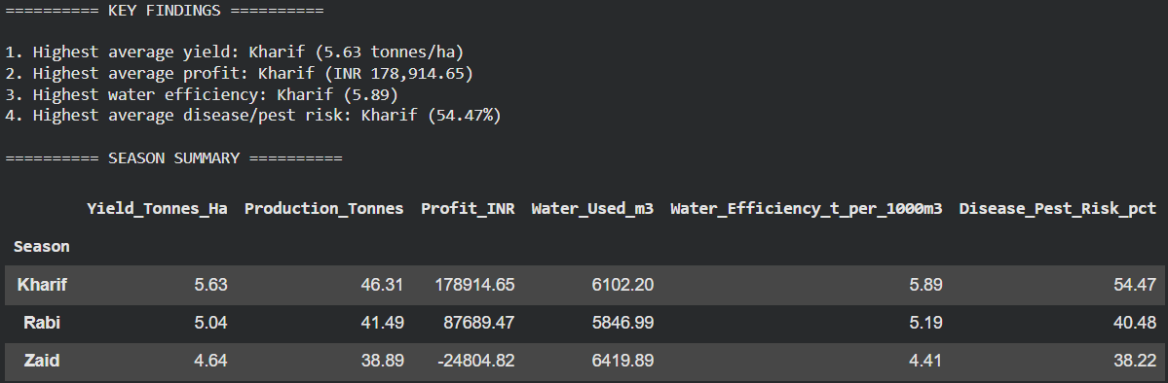
season_stats = df_clean.groupby('Season').agg({
'Yield_Tonnes_Ha': 'mean',
'Production_Tonnes': 'mean',
'Profit_INR': 'mean',
'Water_Used_m3': 'mean',
'Water_Efficiency_t_per_1000m3': 'mean',
'Disease_Pest_Risk_pct': 'mean'
})
best_yield = season_stats['Yield_Tonnes_Ha'].idxmax()
best_profit = season_stats['Profit_INR'].idxmax()
best_water = season_stats['Water_Efficiency_t_per_1000m3'].idxmax()
highest_risk = season_stats['Disease_Pest_Risk_pct'].idxmax()
print("========== KEY FINDINGS ==========\n")
print(
f"1. Highest average yield: {best_yield} "
f"({season_stats.loc[best_yield, 'Yield_Tonnes_Ha']:.2f} tonnes/ha)"
)
print(
f"2. Highest average profit: {best_profit} "
f"(INR {season_stats.loc[best_profit, 'Profit_INR']:,.2f})"
)
print(
f"3. Highest water efficiency: {best_water} "
f"({season_stats.loc[best_water, 'Water_Efficiency_t_per_1000m3']:.2f})"
)
print(
f"4. Highest average disease/pest risk: {highest_risk} "
f"({season_stats.loc[highest_risk, 'Disease_Pest_Risk_pct']:.2f}%)"
)
print("\n========== SEASON SUMMARY ==========\n")
display(season_stats.round(2))

Slide 54
Future scope
Develop predictive models for seasonal crop performance.
Include real-time weather and market data.
Build an interactive dashboard for farmers and planners.
Provide personalized crop and resource recommendations.
Expand the analysis to more regions and crops.

Slide 55
GitHub Link
https://github.com/demohit37-jpg/Seasonal-Agriculture-Performance-Analysis

Slide 56

VOIS Course completion certificate - Course name- Data Visualization

Slide 57
Thank you
.
.

