Slide 1
Model Deployment
MixAR

Slide 2
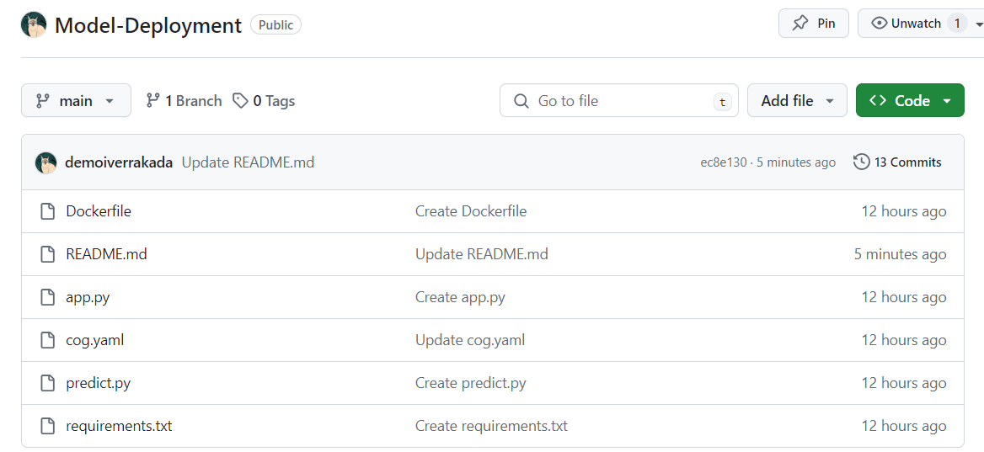

Slide 3
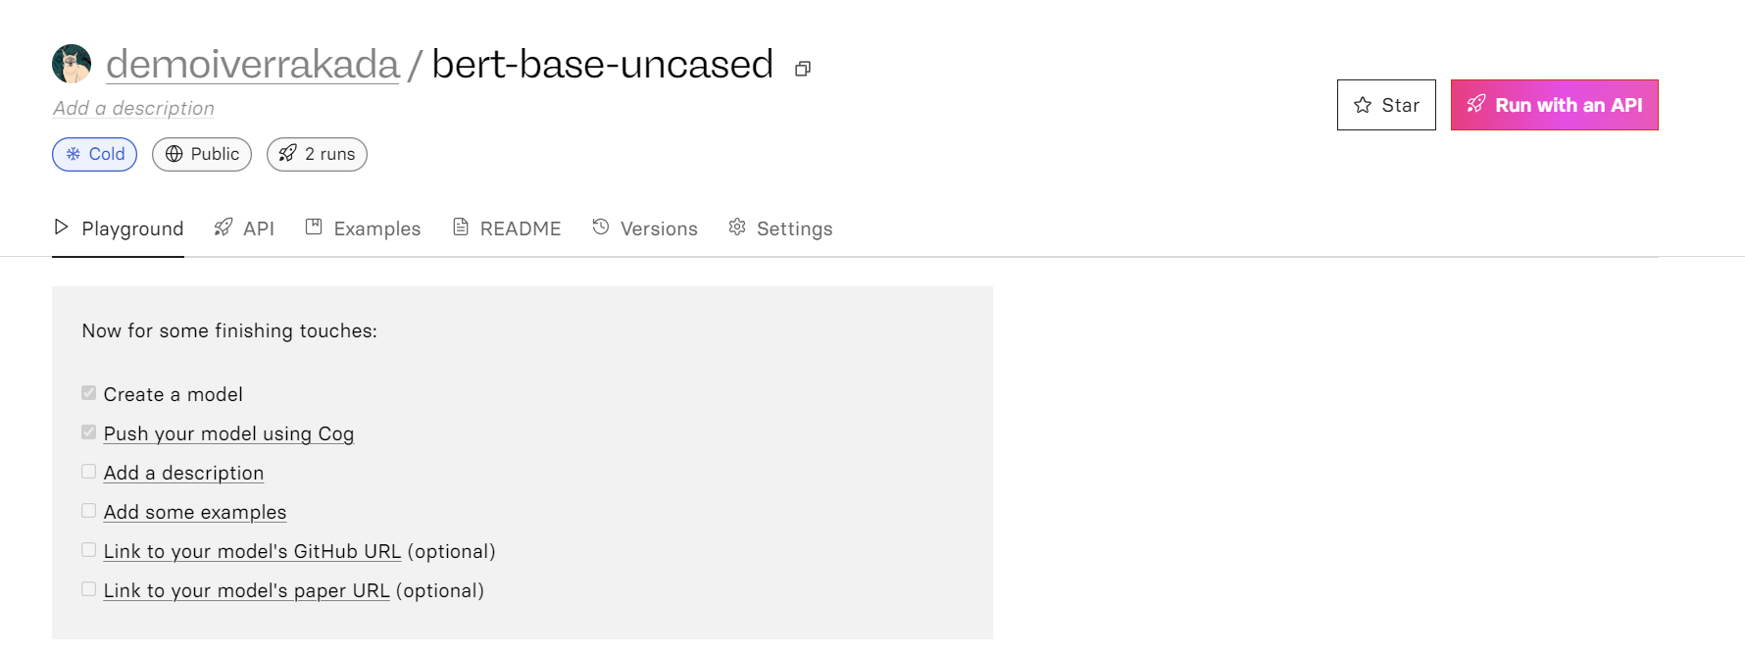

Slide 4
To deploy the model on your id
Clone the repo : https://github.com/demoiverrakada/Model-Deployment.git
The go inside the repo directory
Then deploy this model onto your replicate account
cog push r8.im/<your-usernmae>/bert-base-uncased

