Slide 1
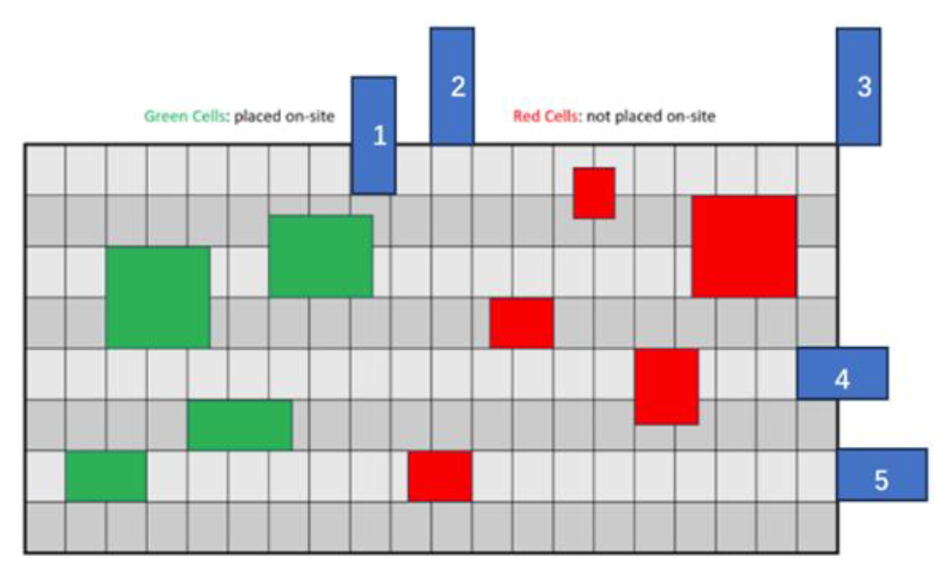

Slide 2
Flow Chart
Parser
Debanking
Legalization
Method: An Effective Legalization Algorithm for Mixed-Cell-Height Standard Cells
Banking
Method: meanshift 2024
GlobalPlacement
NTUplace3
Legalization
DetailPlacement

Slide 3
An Effective Legalization Algorithm for Mixed-Cell-Height Standard Cells
ASP-DAC 2017

Slide 4
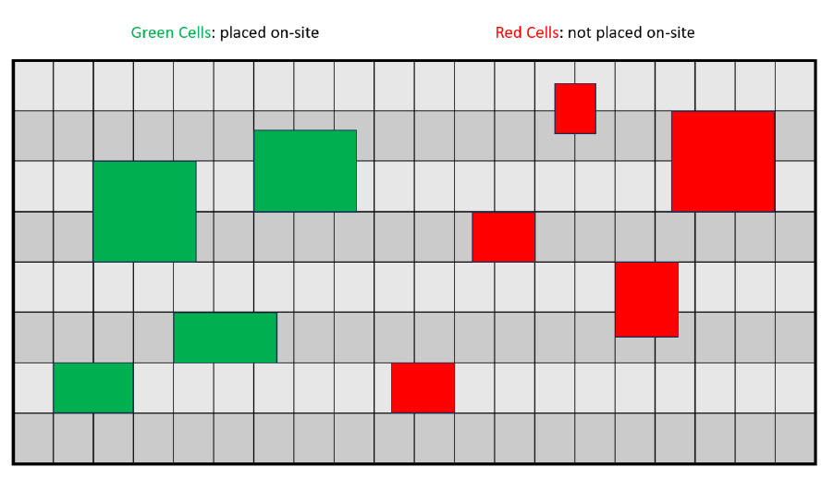
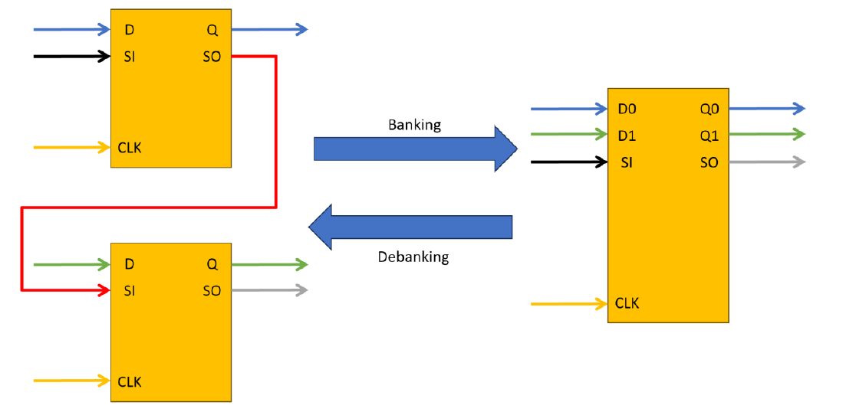
Constraints
All instances must be placed on-site and within the die region.
No overlap
Must satisfy utilization rate of each bin
Banking / Debanking Criteria :
All D pin and Q pin connections need to remain functionally equivalent after banking / debanking, and all CLK pins need to remain connected to the same clock net.
If there is any design for testability (DFT) scan chain connection on scan-input (SI) or scan-output (SO) pins of the lower / higher-bit flip-flops, the banking / debanking process should honor the scan chain connection.

