Slide 1
Slack Redistributed Register Clustering with Mixed-Driving Strength Multi-bit Flip-Flops
ISPD 2024

Slide 2
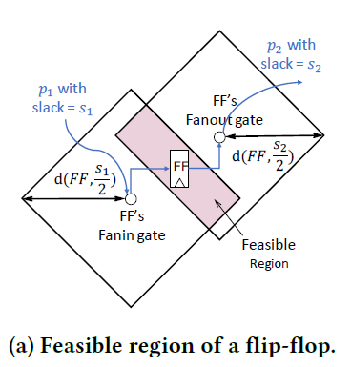
Preliminaries

Slide 3
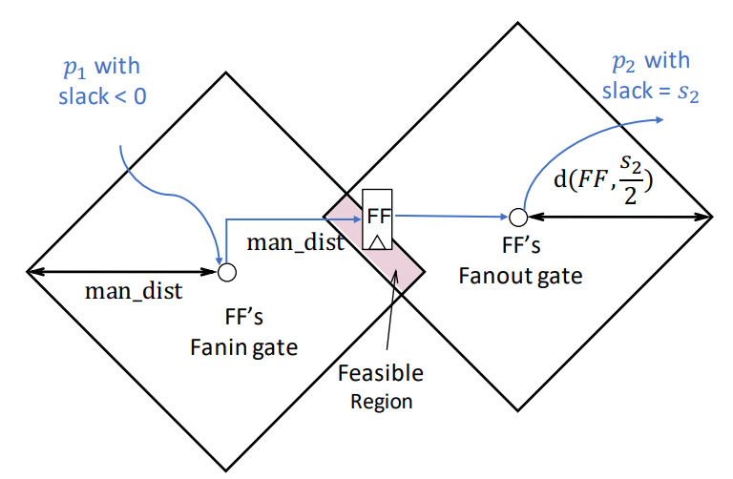
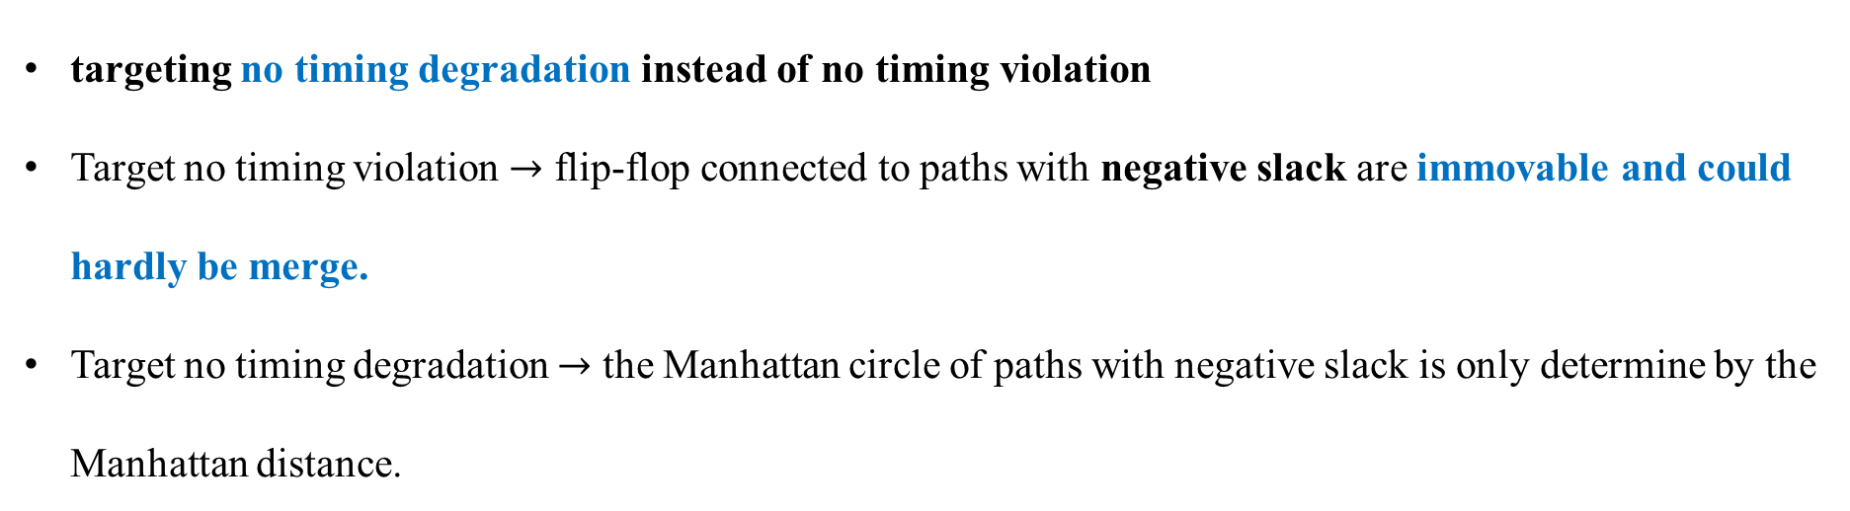
targeting no timing degradation instead of no timing violation
Target no timing violation $→$ flip-flop connected to paths with negative slack are immovable and could hardly be merge.
Target no timing degradation $→$ the Manhattan circle of paths with negative slack is only determine by the Manhattan distance.

Slide 4
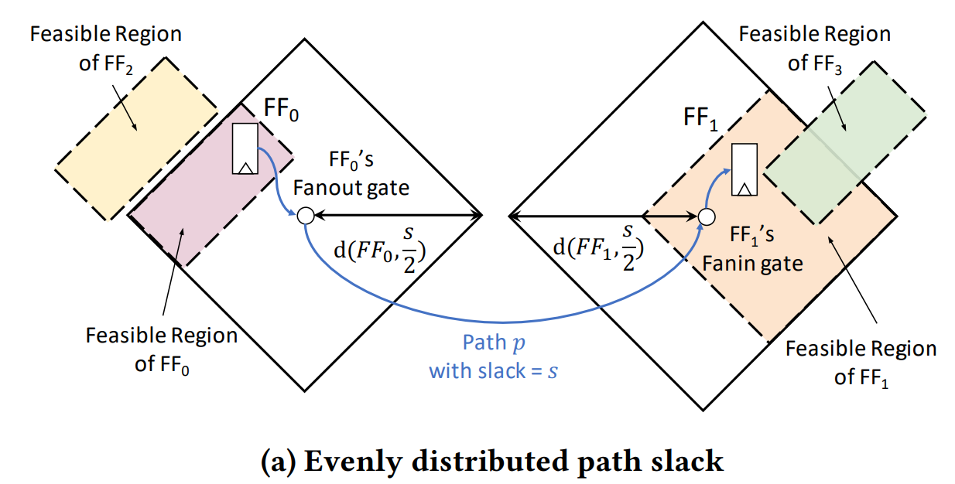
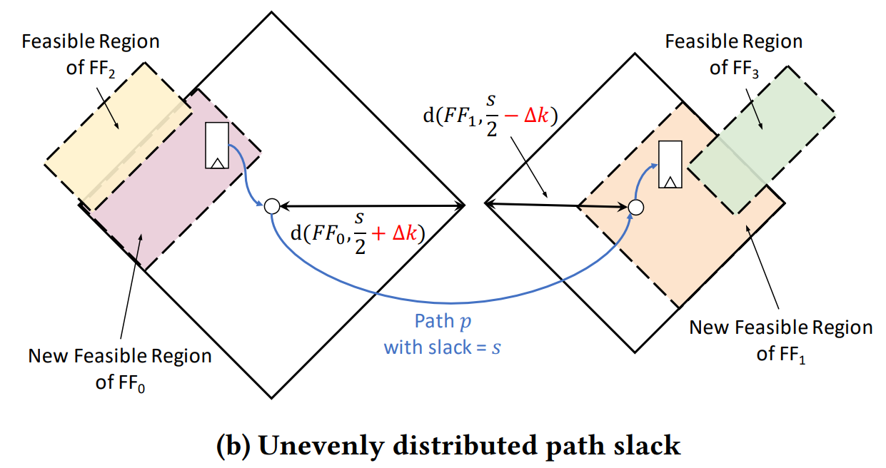

Slide 5
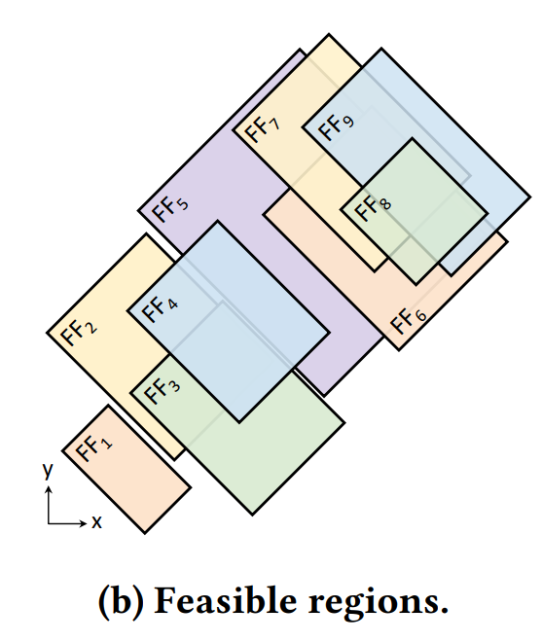
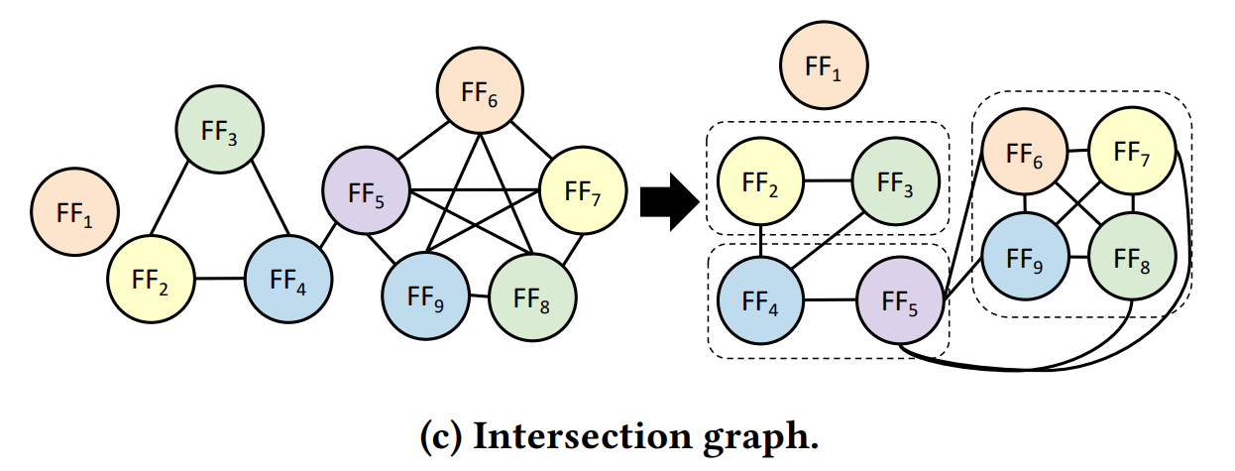
Flip-flop whose feasible regions overlap can be merged.
The mergeable relationship can be captured by an intersection graph shown in Fig c.

Slide 6
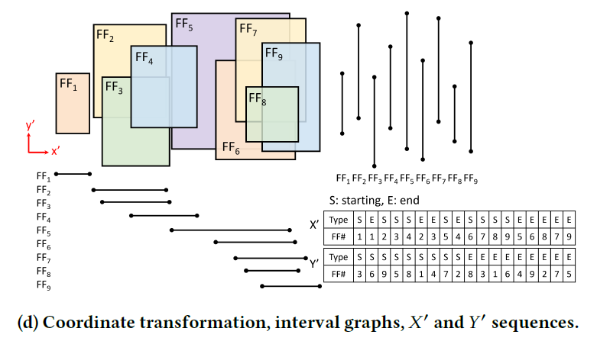

Slide 7
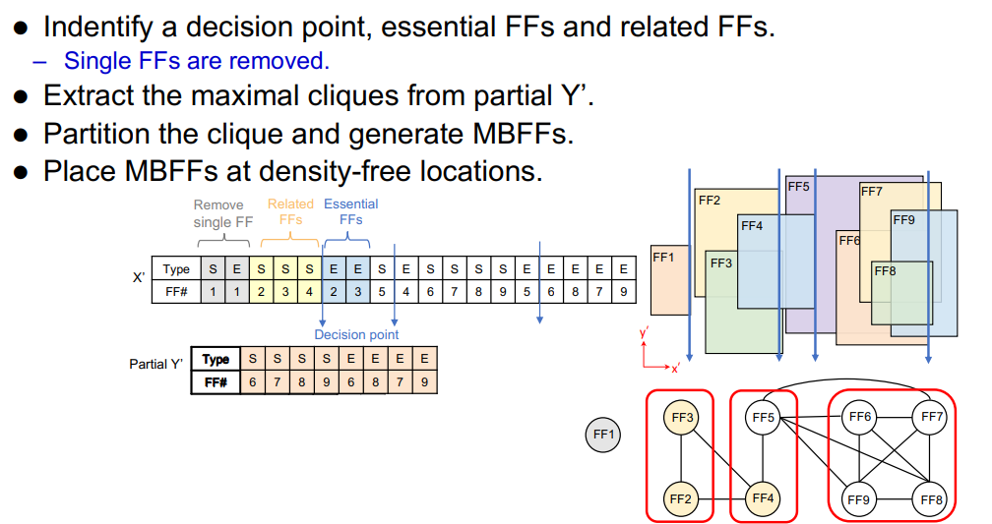
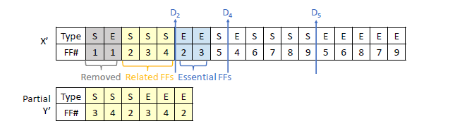
MBFF Generation

Slide 8
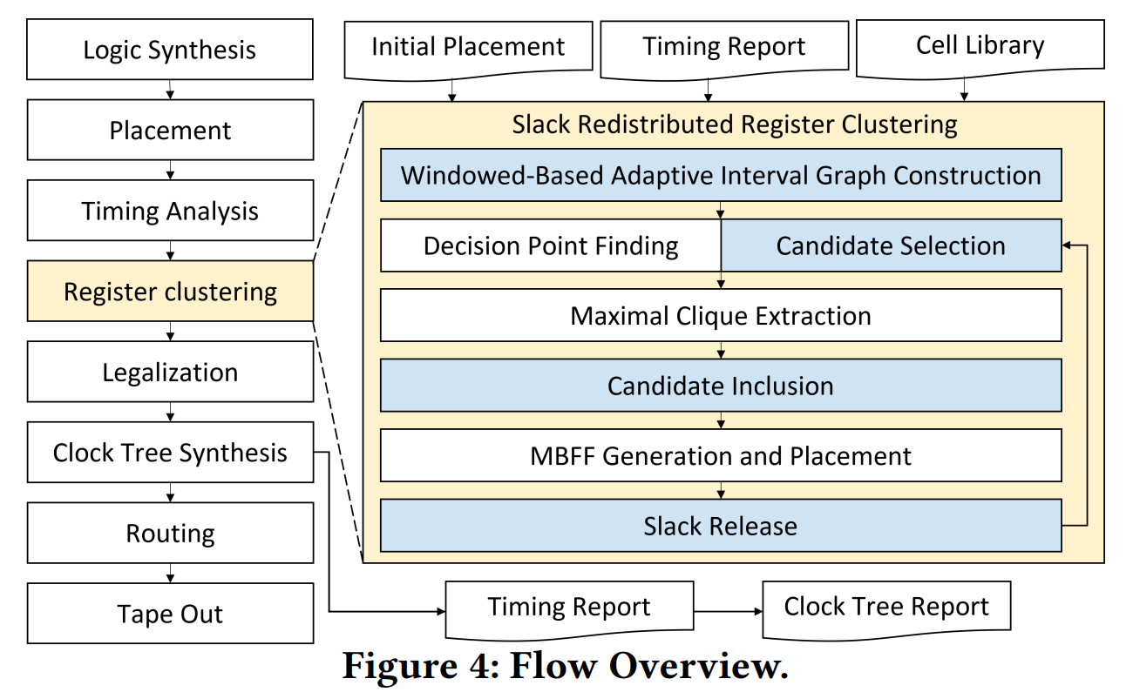
Avoid unexpected timing degradation
due to large displacement
Include those with high potential but originally unclusterable flip-flop
Release extra stack to other flip-flops on its connected paths

Slide 9
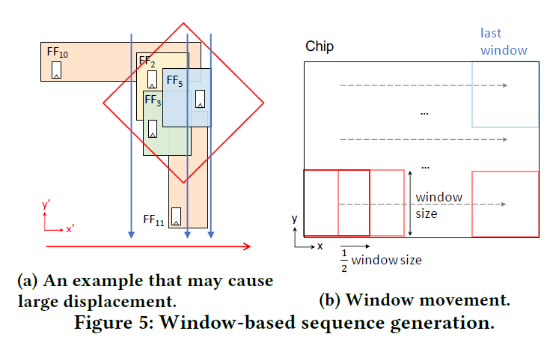
Window-Based Adaptive Interval Graph

Slide 10
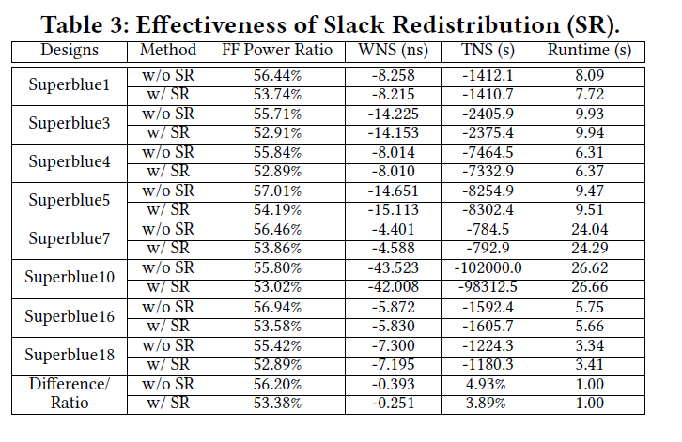
Experimental Result

Slide 11
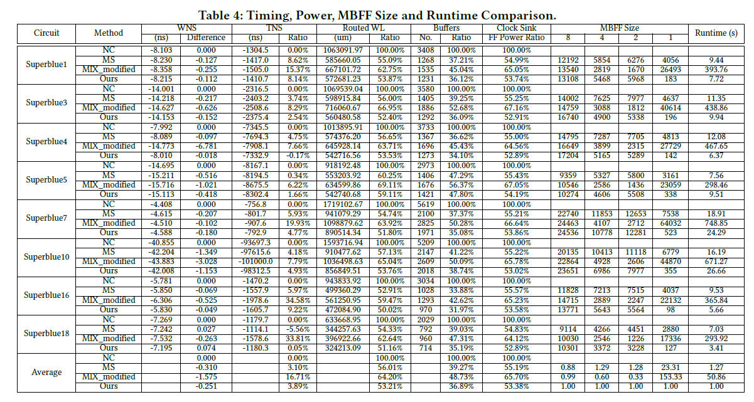
Experimental Result

