Slide 1
Timing Optimization

Slide 2
Optimization of Timing
Three phases
  globally restructure to reduce the maximum level or longest path
  Ex: a ripple carry adder ==>
  a carry look-ahead adder
  physical design phase
    transistor sizing
    timing driven placement
    buffering
  actual design
    fine tune the circuit parameter

Slide 3
Delay Model at Logic Level
Unit delay model
  assign a delay of 1 (or gate delay) to a gate
Unit fanout delay model
  incorporate an additional delay for each fanout
Library delay model
  use delay data in the library to provide more accurate delay value

Slide 4
Arrival Time & Required Time
1
1
3
g h
3
2
c d e f
Arrival time : from input to output
Required time : from output to input
Slack = required time - arrival time

Slide 5
Arrival Time
at= 5
at= 4
1
at= 3
1
3
at= 3
at= 2
g h
3
2
c d e f
Arrival time (at) : from input to output
Required time (rt) : from output to input
Slack = required time - arrival time

Slide 6
Required Time
rt= 5
rt = 4
1
rt= 4
1
3
rt= 3
rt= 3
g h
3
2
c d e f
Arrival time (at) : from input to output
Required time (rt) : from output to input
Slack = required time - arrival time

Slide 7
Slack Time
s = 0
1
s = 0
s = 1
1
3
s = 0
s = 1
g h
3
2
c d e f
Arrival time of output : 5
Required time of output : 5
Slack (s) = required time - arrival time

Slide 8
Timing Optimization in SIS

Slide 9
Restructure for Timing [SIS]
Two Steps:
minimize area
speed up
required time
output
input
arrival time
critical node = with negative slack time

Slide 10
Basic Idea
collapse critical nodes and re-decompose
y
y
x
a
c
a b
b c
critical path a-x-y

Slide 11
Speed Up Algorithm
speed up (d)
compute the slack time of each node
find all critical nodes and compute cost for each critical node
select re-synthesis points (find minimum cut set of all critical node)
collapse and re-decompose the re-synthesis points
if timing requirement is satisfied, done. otherwise go to step 1

Slide 12
Speed Up (Conti.)
Step 2 :
  compute cost function
    selecting re-synthesis points has to consider
      (1) ease for speed-up (re-synthesis)
      (2) area overhead

Slide 13
Ease for Speed-Up
y
x
let d = 1 (collapsing depth, given)
y => 1 critical input
2 non-critical inputs
x => 4 critical inputs
If y is chosen, it will be easier to
perform re-decomposition.

Slide 14
Area Penalty
f
g
x
d
b c
b-x-g critical
collapse x into g
f
g
x
d
duplicate
b c

Slide 15
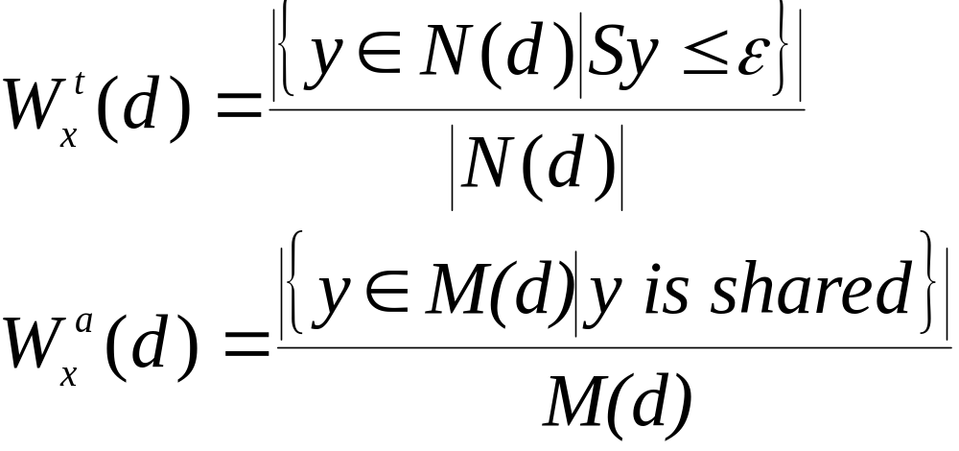
Area Penalty (Conti.)
define weight for critical node X
W_{x}(d) = W_{x}^{t}(d) + α∗W_{x}ª(d)
  W_{x}^{t}(d) reflect the ease for speed up
  W_{x}ª(d) reflect area increase
  N(d) = signals that are input to
  re-synthesis region
  M(d) = nodes in the re-synthesis region

Slide 16
Area Penalty (Conti.)
Ex:
x
y
z
y
a
u
f
v
w
b c d e
d=3
W_{x}^{t}(d) = 2/6
W_{x}ª(d) = 3/5

Slide 17
Speed Up Algorithm
speed up(d)
compute the slack time of each node
find all critical nodes and compute cost for each critical node
select re-synthesis points
collapse and re-decompose the re-synthesis points
if timing requirement is satisfied, done. otherwise go to step 1

Slide 18
Selection of Re-synthesis Point
Now, cost function is defined,
  How to select re-synthesis point ?
  Greedy algorithm?
    Very local
  Any other more global algorithm ….

Slide 19



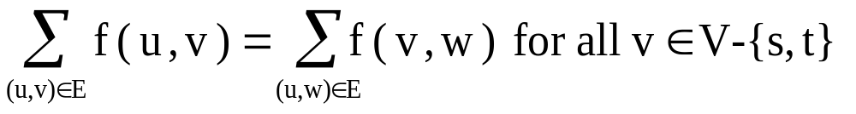
Speed Up (Conti.)
Step 3 :
Background:
A network N=(s,t,V,E,b) is a diagram (V, E) together with a source s V and a sink t V with bound (capacity),
b(u,v) Z⁺ for all edges.
A flow f in N is a vector in such that
1. 0 f(u,v) b(u,v) for all (u,v) E
2.
Ex:
17
5
4
s
1
t
3
2
3
The value of the max flow f =6

Slide 20
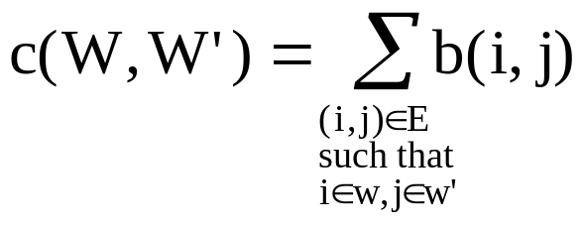
Speed Up (Conti.)
An s-t cut is a partition (W,W’) of the nodes of V into sets W and W’ such that s W and t W’. The capacity of an s-t cut
W
W’
forward
s
t
backward
Max-flow = min-cut

Slide 21
Speed Up (Conti.)
Ex:
y
x
z
w
u
v
=> Network flow
But we want to have node cut
not edge cut ?

Slide 22

Speed Up (Conti.)
Step 3:
Duplicate each node
y
x
w(y)
w(x)
y’
x’
z
w
w(z)
w(w)
z’
w’
u
v
w(u)
w(v)
u’
v’
use maxflow(min-cost) algorithm to
find resysthesis points

Slide 23
Speed Up (Conti.)
Step 4 :
Re-decompose
1. kernel based decomposition
    extract divisor
    the weight of a divisor is a linear sum of area component (literal saved) and time component (prefer the smallest arrival time)
2. and-or decomposition
2.0
1.0
0 0 1.0 2.0
0 0

Slide 24
Further Improvement of Cut Set (ICCAD 1999)
Notes:
ICCAD1999

Slide 25
An Improved Cut Set (Separator Set)
Let required time = 4.9
Un-balanced path delay
Minimum cost cut set = 4 ({C})
Delay reduction = 0.5
(-0.6/1/0.25)
(-0.6/2/0.25)
(-0.6/2/0.5)
(-0.6/4/0.5)
B
d=1.5
E
d=1
F
d=1.5
A
d=1
C
d=0.5
D
d=1
G
d=2
(-0.6/4/0.5)
(-0.1/2/0.25)
(-0.1/4/0.25)
(x,y, z) means (slack, cost, delay reduction)
Notes:
ICCAD1999 paper

Slide 26
Construct a Path-balanced Graph
ds(e) = slack (HeadNode (e))– slack (TailNode(e))
If ds(e) > 0, insert a “padding node”
P1 and P2 are two padding nodes
Minimum cost cut-set = 2 ({E, P2})
Delay reduction = 0.5
(-0.6/1/0.25)
(-0.6/2/0.25)
(-0.6/2/0.5)
(-0.6/4/0.5)
B
d=1.5
E
d=1
F
d=1.5
A
d=1
C
d=0.5
P1
d=0.5
D
d=1
P2
d=0.5
G
d=2
(-0.6/4/0.5)
(-0.6/0/0.5)
(-0.1/2/0.25)
(-0.6/0/0.5)
(-0.1/4/0.5)
(-0.6/2/0.25)
(-0.6/4/0.5)
(x,y, z) means (slack, cost, delay reduction)

Slide 27
Techniques Used in Other Optimization Steps
  Gate sizing
  Low power design (threshold voltage assignment)
    high threshold voltage:
      leakage power↓
      delay↑
    low threshold voltage:
      leakage power ↑
      delay↓

