Slide 1
Mediatek Interview : Academic Background & Self-Introduction Date : 2025 / 4 / 2 (Wed.) Presenter：徐義鈞 Andy Hsu

Slide 2

Introduction
Education
National Tsing Hua University Sep 2024 – Jul 2026 (expected)
M.S. in Computer Science - PDA LAB
National Taipei University Sep 2019 – Jun 2023
B.S. in Computer Science
Course
TSRI’s Cell-Based IC Physical Design and Verification
VLSI Physical Design Automation
VLSI Design for Manufacturability
Name: 徐義鈞 Andy Hsu
Department: Computer Science

Slide 3
Lessons Learned from Cell-Based IC Physical Design and Verification
IC Compiler Flow
Synthesis
Design Setup
Design Planning
Placement
CTS
Routing
Chip Finishing

Slide 4
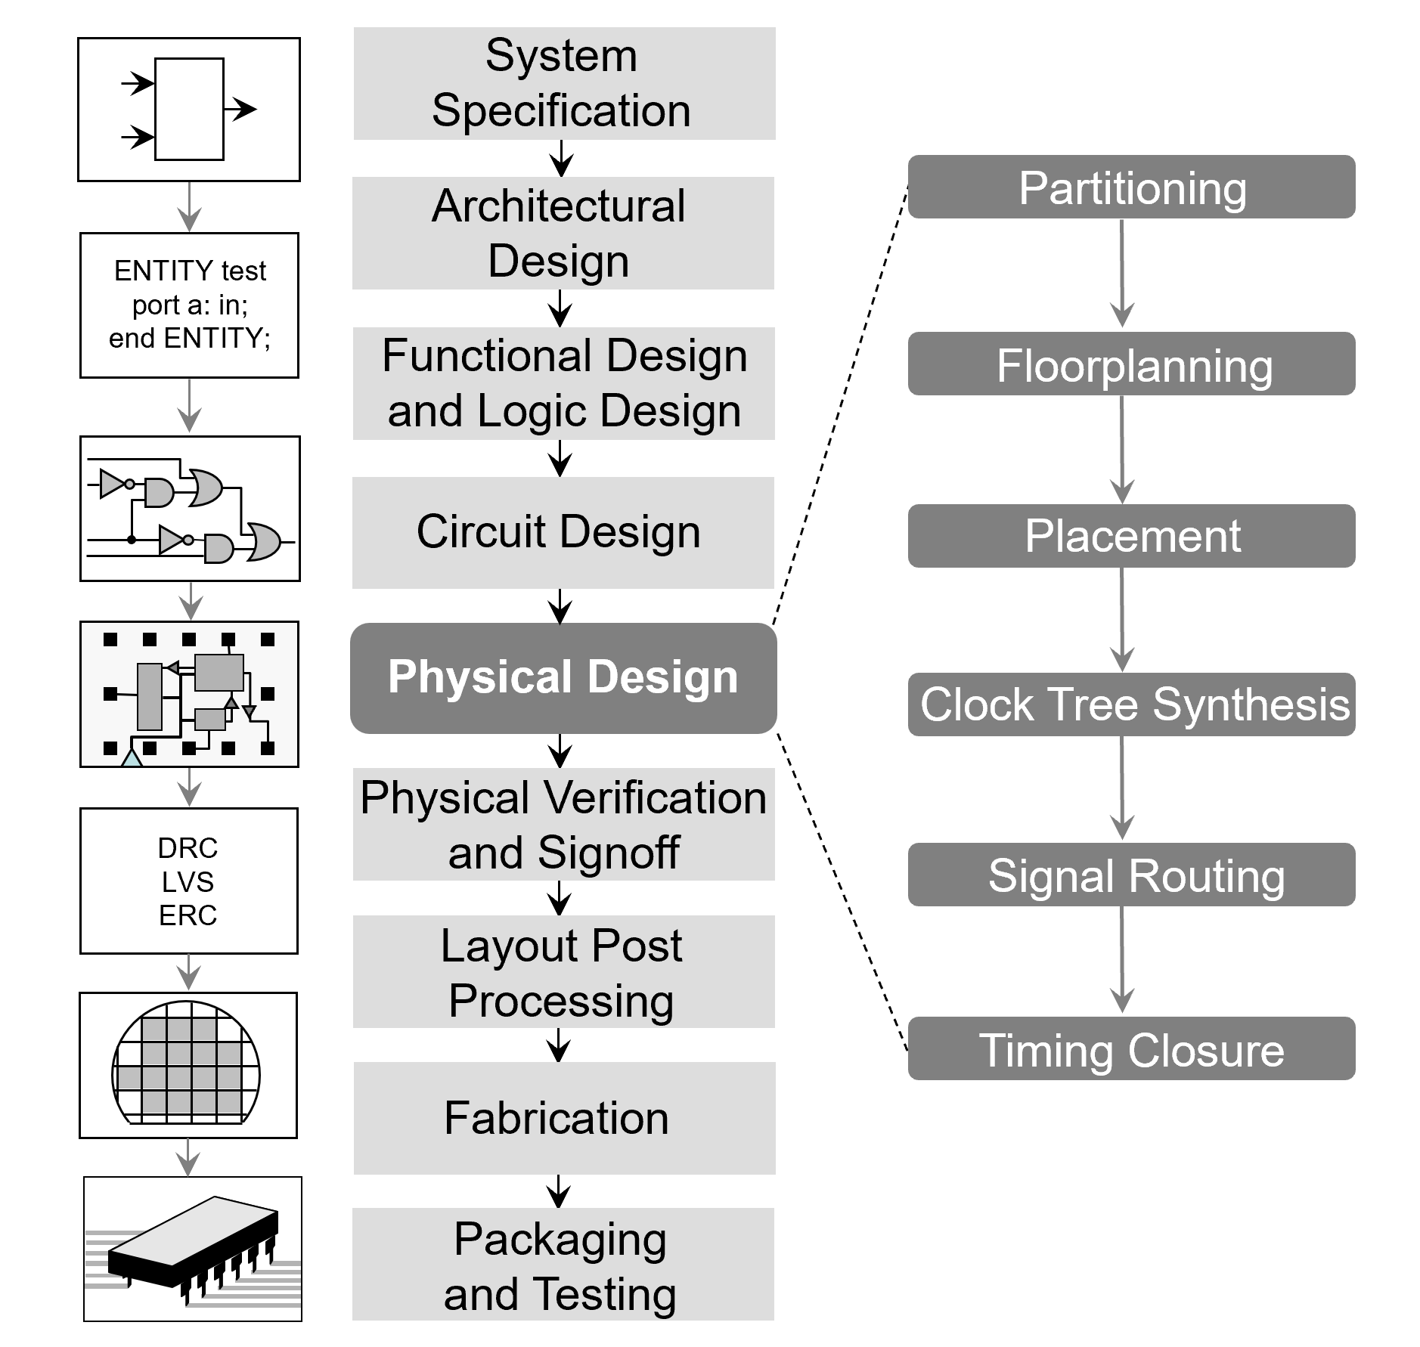
Lessons Learned from VLSI Physical Design Automationon

Slide 5
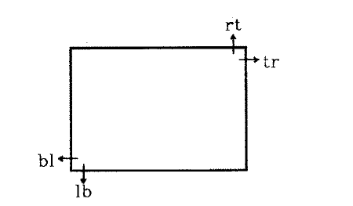
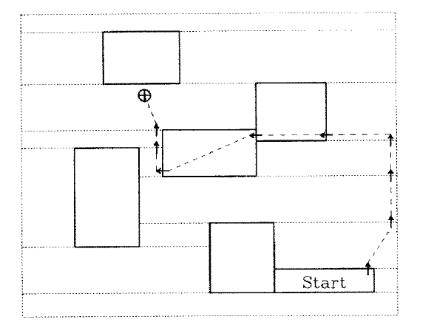
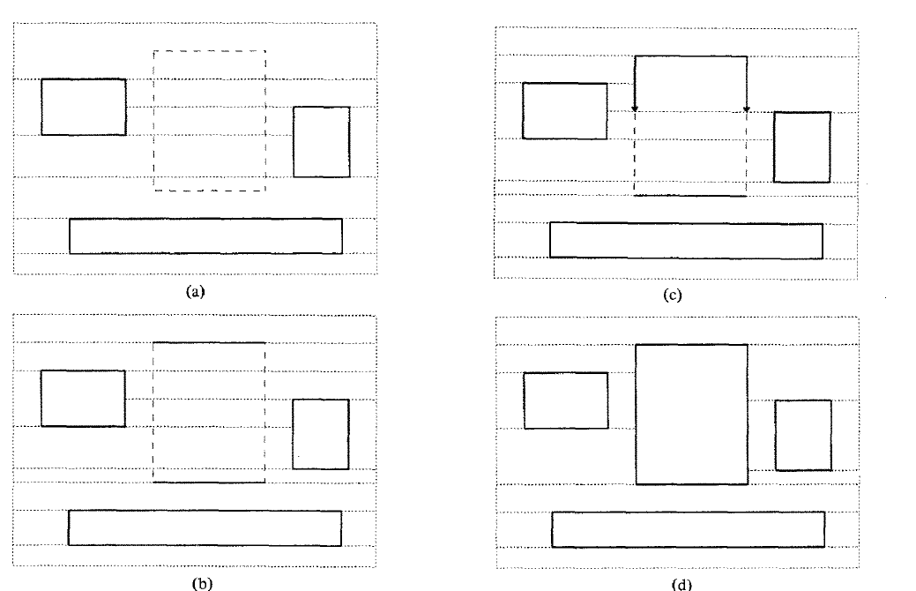
Course Project on VLSI Physical Design Automationon
Corner Stitching
Use corner stitching as data structure to implement point-finding and tile creation.

Slide 6
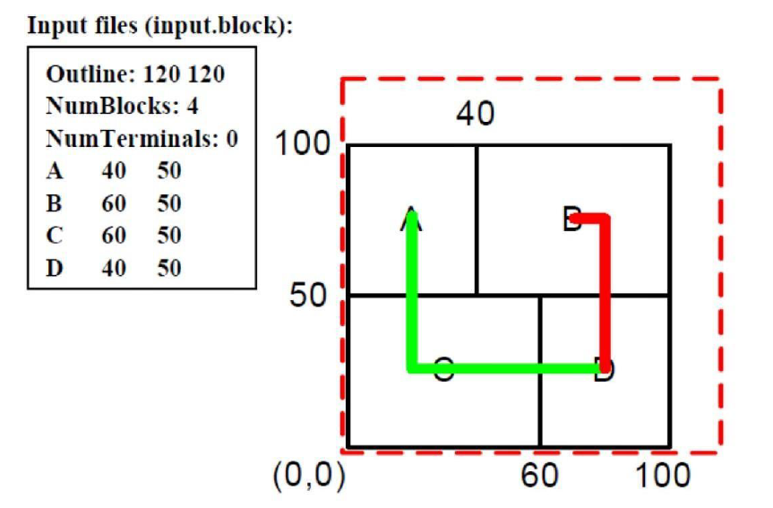
Course Project on VLSI Physical Design Automation
Fixed Outline Floorplanning
To design a fixed-outline floorplanner to handle hard macros.
Use B* Tree as data structure and SA(simulated annealing) algorithm to solve.

Slide 7
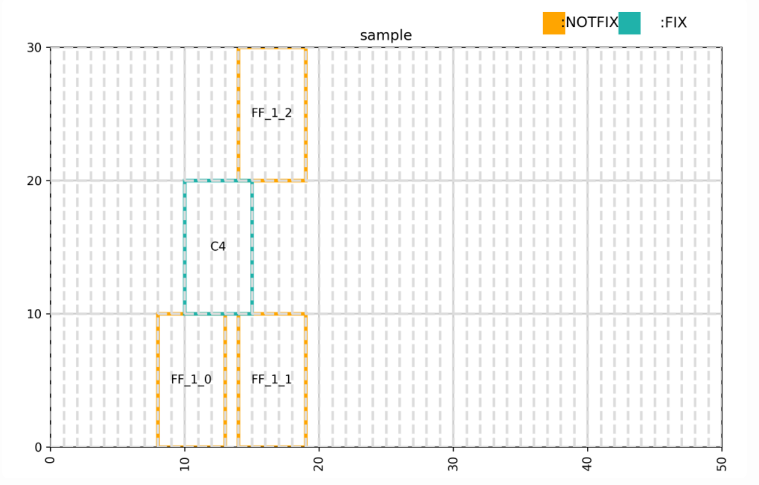
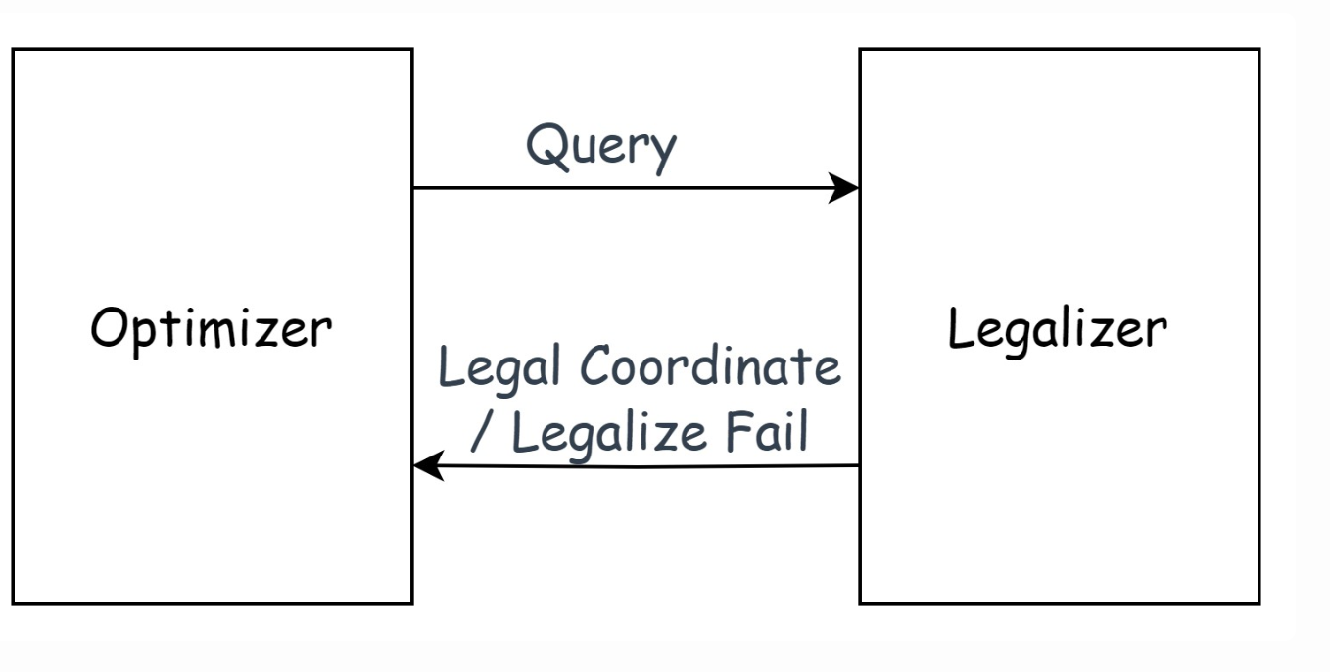
Course Project on VLSI Physical Design Automation
Optimizer and Legalizer Co-optimization
Implement a local legalizer that legalizes the cells into placement one by one.
Use a Legalization Algorithm for Multiple-Row Height Standard Cell Design.

Slide 8
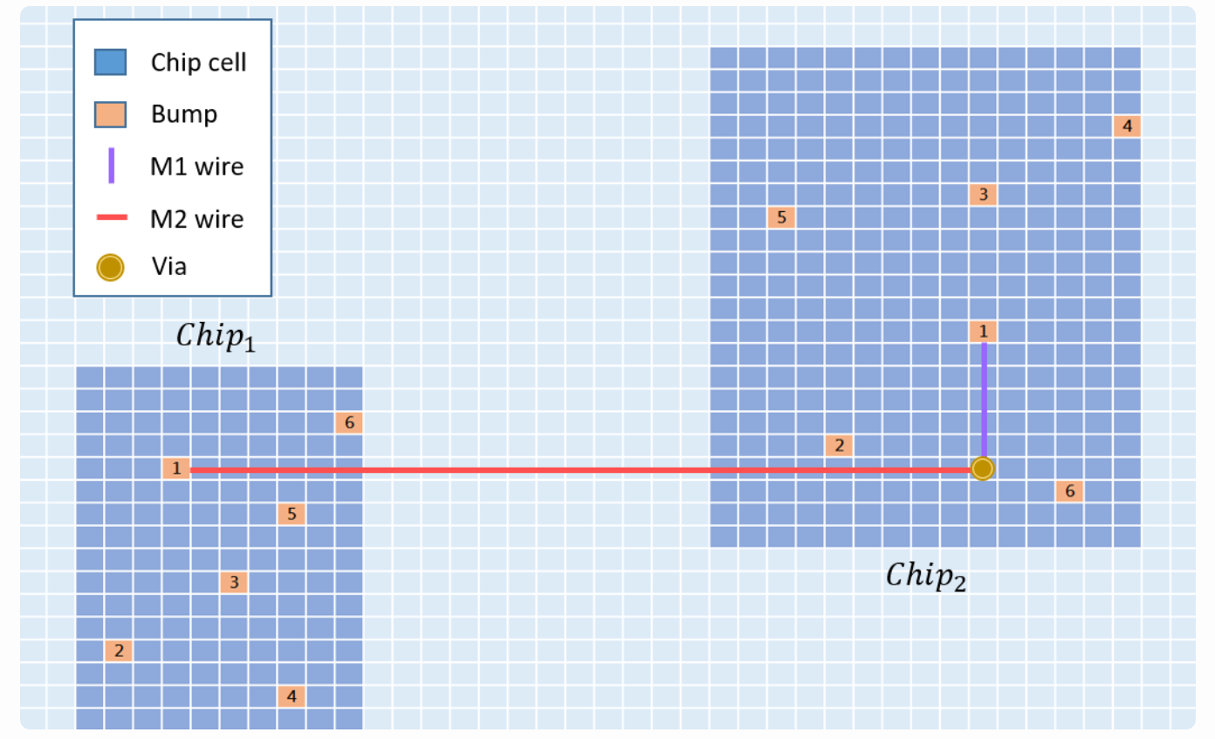
Course Project on VLSI Physical Design Automation
Die-to-Die Global Routing
To complete a die-to-die global routing using the A*-search algorithm
(i.e. to find a minimum-cost path between each pair of bumps).

Slide 9
Lessons Learned from VLSI Design for Manufacturability
Topics
Routing under Nanometer Design Rules
Redundant Via Insertion
Dummy Fill Insertion
Detailed Placement Refinement for Complex Manufacturing Constraints
Lithography Hotspot Detection
…

