Slide 1
Standard Cells Do Matter: Uncovering Hidden Connections for High-Quality Macro Placement
DATE 2024

Slide 2
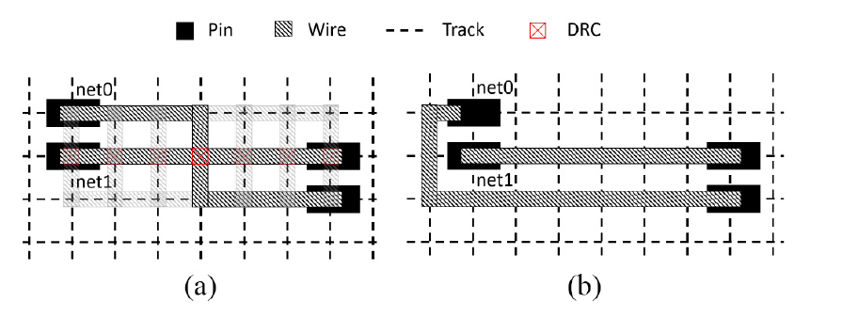
Introduction
The sequential routing approach uses iterative rip-up and reroute (R&R) to reduce the number of design rule violations (DRVs) [1]–[7].
Issue
The net ordering during routing is critical for the runtime and the solution quality.
Net routes ripped-up may be discarded too early.

Slide 3
