Slide 1
Generation of Mixed-Driving Multi-Bit Flip-Flops
for Power Optimization
Meng-Yun Liu, Yu-Cheng Lai, Wai-Kei Mak, and Ting-Chi Wang
Proceedings of ICCAD 22’

Slide 2
OUTLINE
03
Introduction
10
Problem Formulation
12
Proposed Approach
31
Experimental Results
02

Slide 3
Introduction
Increasing demand for long battery life, reducing power consumption has become one of the most important goals.
Clock network accounts for a major portion of power consumption in a chip.
Multi-bit flip-flops(MBFFs) is often used in low-power circuit design:
Power per bit is smaller than a single-bit flip-flop(FF)
Reduces the number of clock sinks->reduces wirelength(WL) of clock tree and clock buffer count
03

Slide 4
Previous Works
Introduction
MBFFs can be generated by merging or clustering multiple single FFs in three stages:
Logic synthesis stage
Placement stage:
[19] proposed a method that was inspired by ionic.
[14] proposed an anchor method while considering clock trees.
04
Notes:
[19] FF 當成電子來結合
[14]只consider pair of FF，(圖上找pair，越小cost的edge越好)

Slide 5
Previous Works
Introduction
Post-placement stage :
[20] finds timing feasible regions utilizing timing slacks of FF’s pins.
[16] uses Integer Linear Programming(ILP) to generate non-conflicting MBFF set, they also decompose MBFF and leaves empty bit in MBFFs.
[2] proposed a mean shift method.
05
Notes:
[20]跟這篇paper的方法差不多

Slide 6
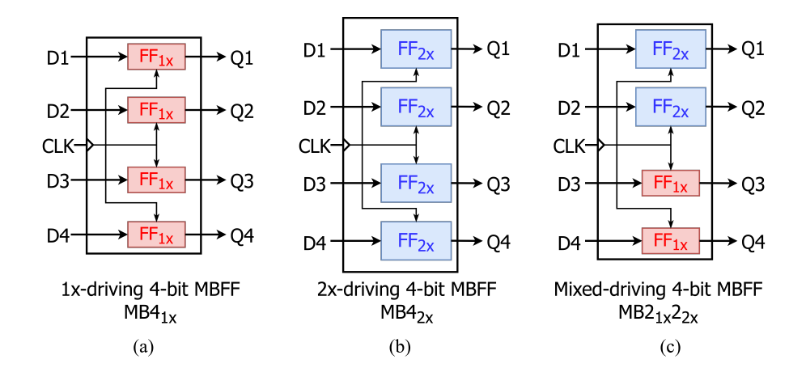
Motivation
Introduction
Previous works focus on uniform-driving MBFFs (Fig.(a)).
If only one of the bit violates time constraint, the MBFF has to be sized up or decomposed.
[5] motivates this paper to use mixed-driving strength MBFFs.
06
Notes:
Reference 5 是一篇mixed-driving MBFF的專利

Slide 7
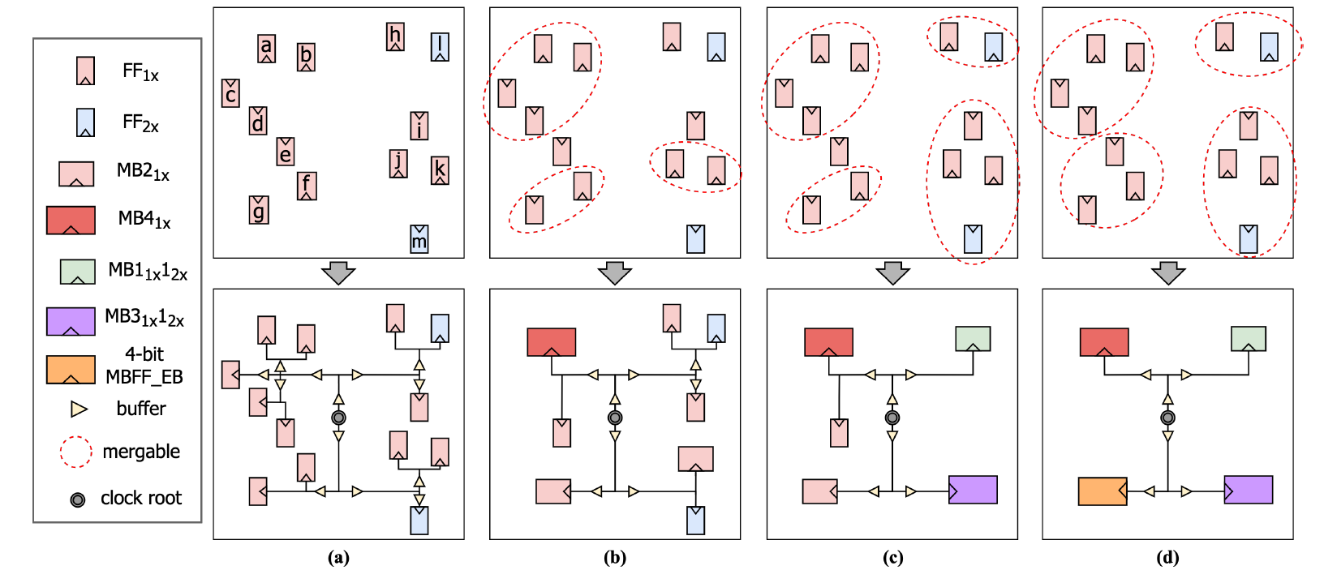
Motivation
Introduction
Can’t be merged here
approach
traditional
Mixed-driving
Mixed-driving
+empty bit
# of buffer
13 CLK buffers
8 CLK buffers
6 CLK buffers
6 CLK buffers
07

Slide 8
Our Contributions
Introduction
First work that considers mixed-driving MBFFs and also with empty bits.
The approach is aware of timing and power by using cost function to select candidates.
The approach is tightly integrated with commercial tool to do legalization, timing analysis, clock tree synthesis(CTS), and routing.
08

Slide 9
OUTLINE
03
Introduction
10
Problem Formulation
12
Proposed Approach
31
Experimental Results
09

Slide 10
Problem Formulation
FF Library : containing uniform & mixed-driving MBFFs. Strength from 1x to nx, # bits from 2 to k.
Input : A netlist and an associated legal placement. Uniform-driving MBFFs will be pre-decomposed to single-bit FFs.
Output : A refined netlist containing mixed-driving MBFFs, a refined placement without timing violations.
Objective : minimize the total power consumption and the amount of oversized MBFFs for power optimization.
10
Notes:
Did Not mentioned if the decomposed FF is legal or not

Slide 11
OUTLINE
03
Introduction
10
Problem Formulation
12
Proposed Approach
31
Experimental Results
11

Slide 12
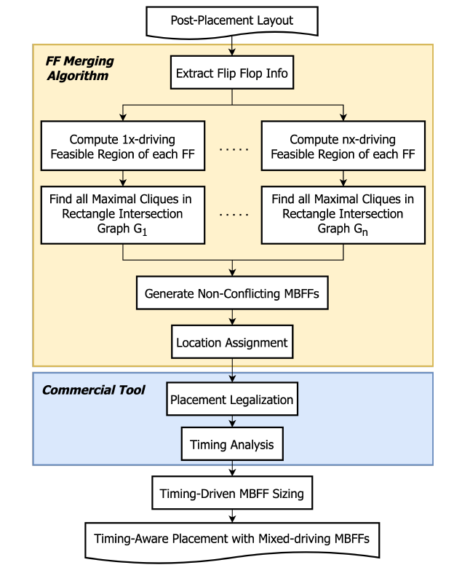
Proposed Approach
FF sets
12

Slide 13
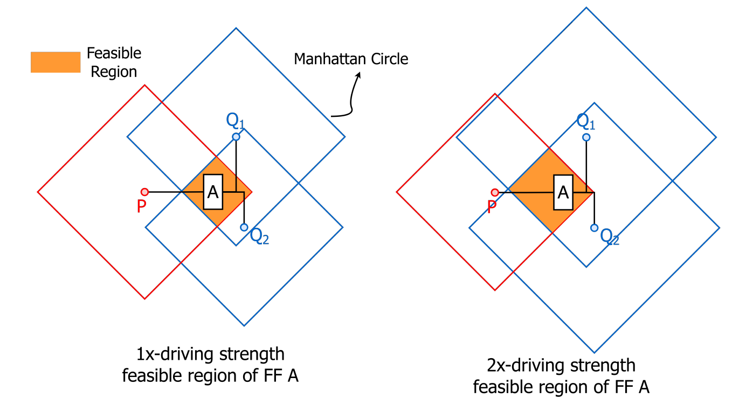
Compute Feasible Regions of Flip-Flop
Proposed Approach
Timing feasible Region is the intersection area of Manhattan circles of each fan-in/fan-out pin of a FF.
Radius is determined by the timing slack between the fan-in/fan-out pin and the FF.
13
Notes:
Radius 是由Fan-in/fan-out pin跟FF的time slack下去計算的
因為feasible region 是依照timing 去算的，所以FF被擺在region裡面不會violate timing

Slide 14
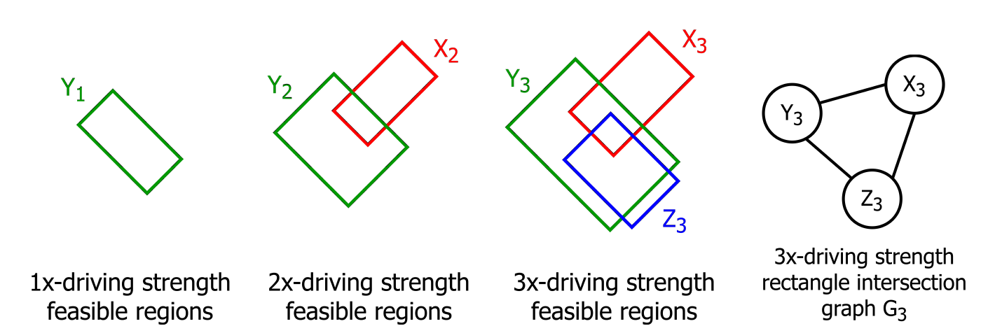
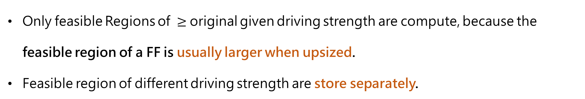
Compute Feasible Regions of Flip-Flop
Proposed Approach
Only feasible Regions of $≥$ original given driving strength are compute, because the feasible region of a FF is usually larger when upsized.
Feasible region of different driving strength are store separately.
X : 2x
Y : 1x
Z : 3x
14

Slide 15
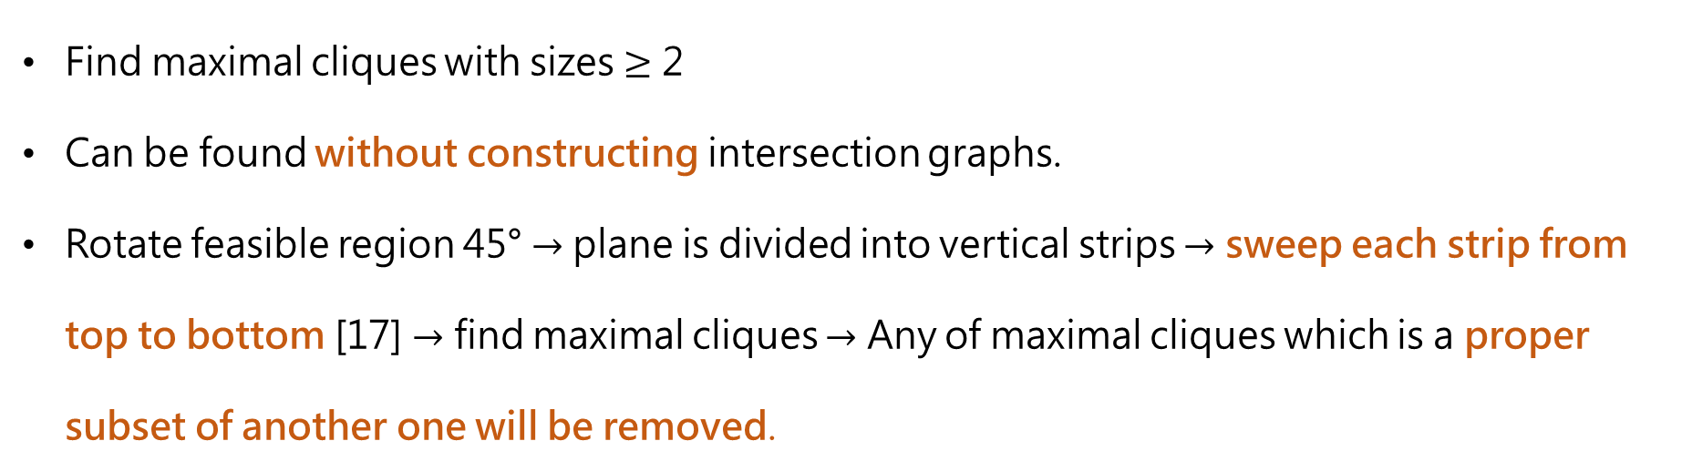
Find all Maximal Cliques in Multiple Rectangle Intersection Graphs
Proposed Approach
Find maximal cliques with sizes $≥$ 2
Can be found without constructing intersection graphs.
Rotate feasible region 45° $→$ plane is divided into vertical strips $→$ sweep each strip from top to bottom [17] $→$ find maximal cliques $→$ Any of maximal cliques which is a proper subset of another one will be removed.
15

Slide 16
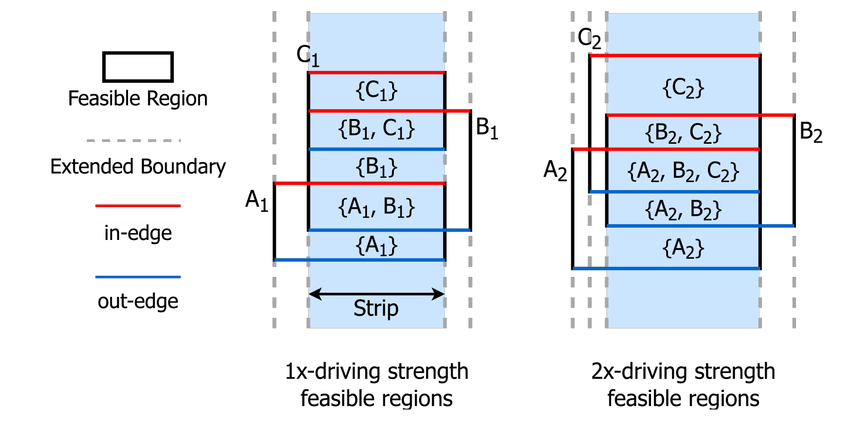

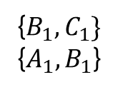
Find all Maximal Cliques in Multiple Rectangle Intersection Graphs
Proposed Approach
A clique is maximal if its size is greater than the clique directly above it and the clique directly below it
Maximal Cliques
{$B_{1},C_{1}\}$
{$A_{1},B_{1}$}
{$A_{2},B_{2},C_{2}\}$
16
Notes:
箭頭是Strip，同個strip下可能有多個max clique

Slide 17
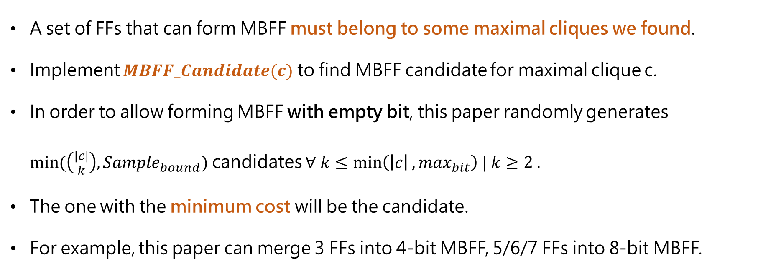
Non-Conflicting MBFFs Generation
Proposed Approach
A set of FFs that can form MBFF must belong to some maximal cliques we found.
Implement $MBFF_Candidate(c)$ to find MBFF candidate for maximal clique c.
In order to allow forming MBFF with empty bit, this paper randomly generates $min⁡(\left({\left|c\right| \atop k}\right),{Sample}_{bound})$ candidates $∀ k≤\min\left(\left|c\right|,{\max_{bit}}\right) | k≥2 .$
The one with the minimum cost will be the candidate.
For example, this paper can merge 3 FFs into 4-bit MBFF, 5/6/7 FFs into 8-bit MBFF.
17
Notes:
Sample bound 在這篇paper是50，可以user defined
Max bit 是library 中bit size 最大的ff的bit size
Cost 接下來會說
假設C size 是7，則可以產生2~7 size 的MBFFcandidate，且5/6/7size的都是會被merge成8 bit的

Slide 18
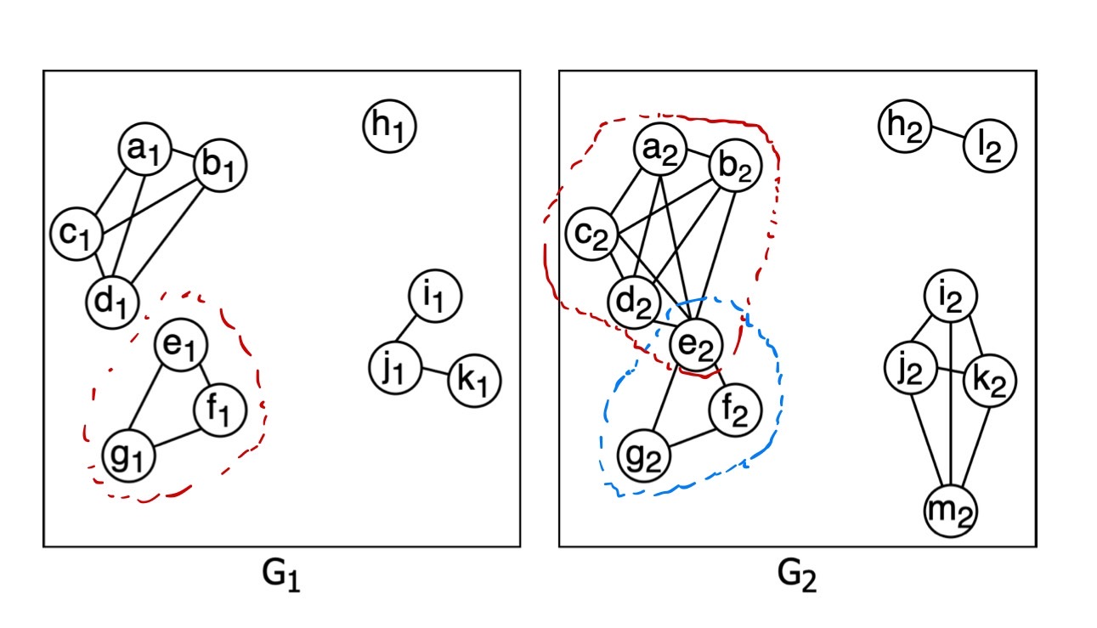
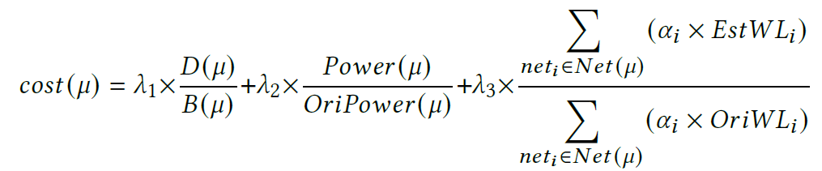
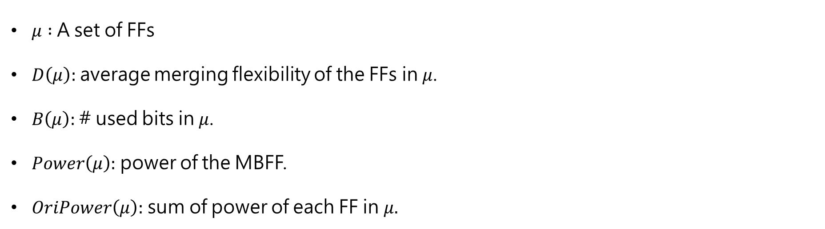
Non-Conflicting MBFFs Generation
Proposed Approach
$μ :$ A set of FFs
$D\left(μ\right):$average merging flexibility of the FFs in$μ$.
$B\left(μ\right):$# used bits in $μ$.
$Power\left(μ\right):$ power of the MBFF.
$OriPower\left(μ\right):$ sum of power of each FF in $μ.$
18
Notes:
D()中若有empty bit 則empty 不會算入平均(ex. 只有三個的話會除以3) B()的意思是假設有一個 3 bit 的要合成4bit 的，則B是3
考慮爛打one這項的原因是bit使用率越高的MBFF有更高的priority ，merging flexibility越低的MBFF也會有更高的priority
Power 此處的MBFF指的是可能會被此set合成的MBFF(注意這邊還沒merge)

Slide 19
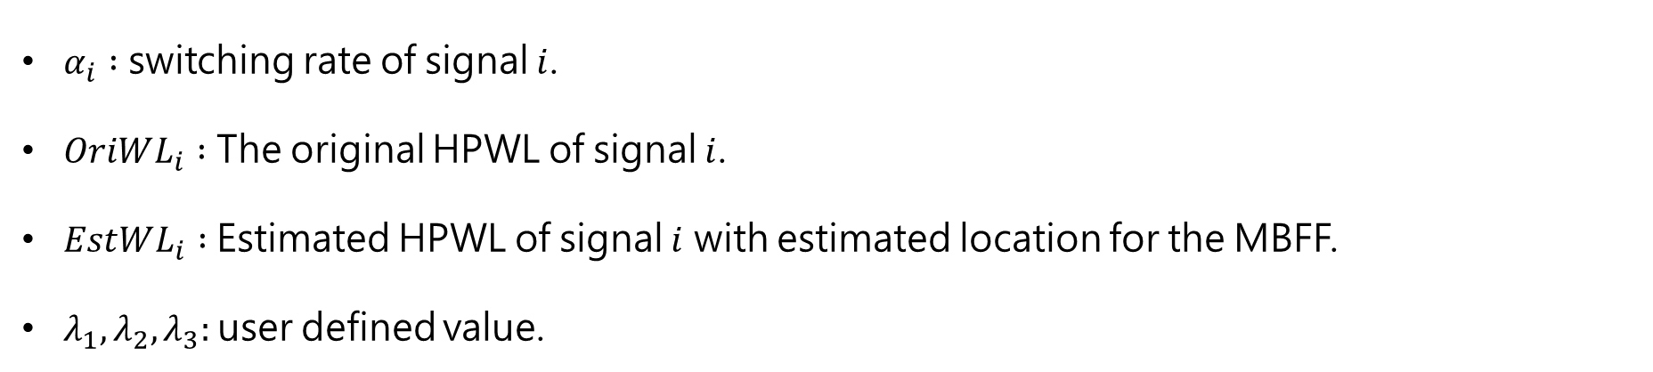
Non-Conflicting MBFFs Generation
Proposed Approach
$α_{i} :$ switching rate of signal $i$.
$OriWL_{i} :$ The original HPWL of signal $i$.
$EstWL_{i} :$Estimated HPWL of signal $i$ with estimated location for the MBFF.
$λ_{1},λ_{2},λ_{3}:$user defined value.
19
Notes:
EstWL這邊的estimated location 是以所有與此MBFF有connect的cell的x,y位置的加權中位數
最後爛打三這項是希望WL減少得越多越好

Slide 20
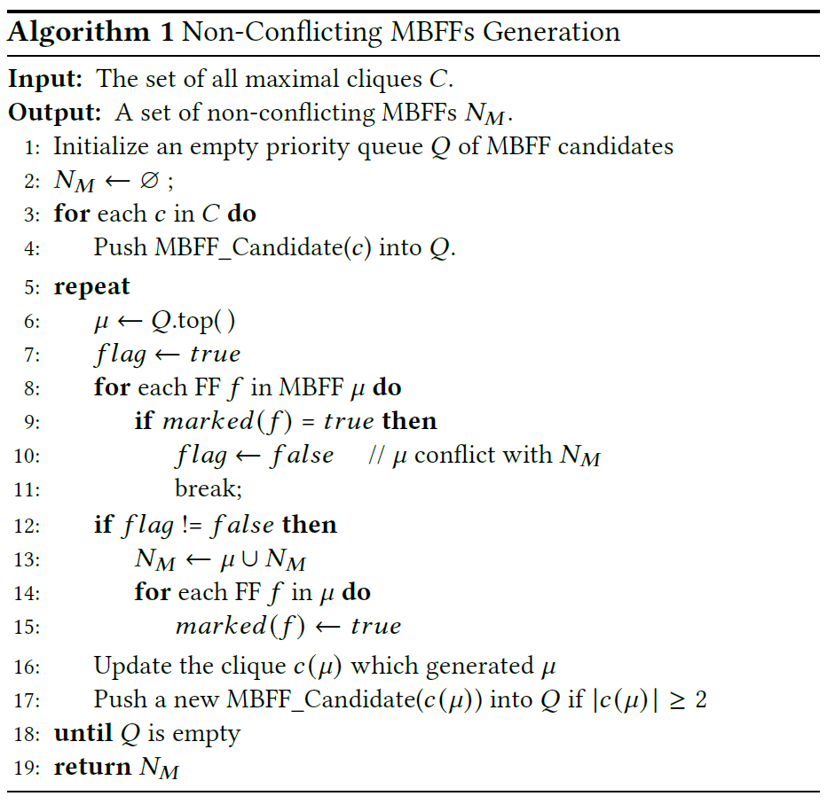
Non-Conflicting MBFFs Generation
Proposed Approach
Find candidate
Check conflict
Update clique
20
Notes:
Input是一個element是maximal cliques的set
Output一個element是互相不衝突的MBFF，也就是[舉例]
先用前面提到的MBFF_candidate()將每個clique的candidate選出來，並且從cost最小的開始一個一個取出，與前面沒有衝突就合成，有衝突的話就把衝突的那幾個去掉，剩下來的如果還有超過兩個FF就再push回去priority queue.

Slide 21
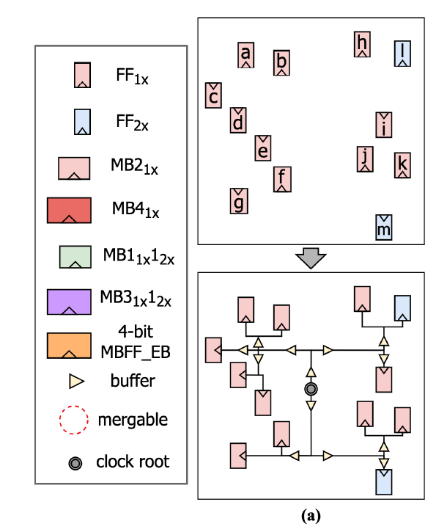
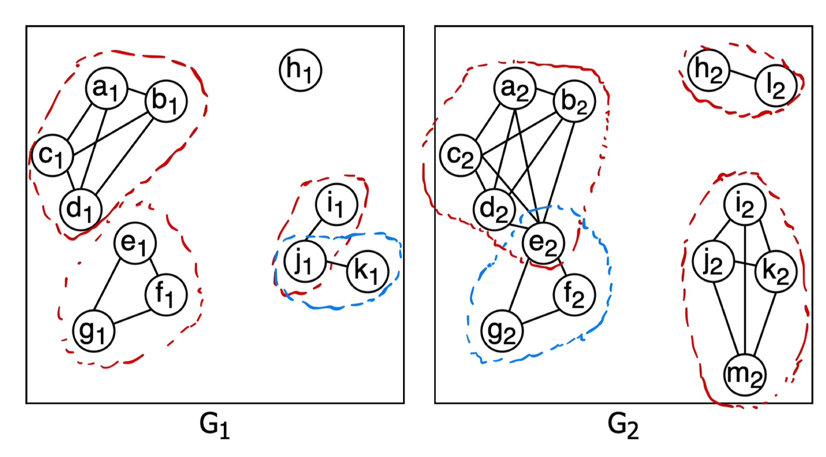
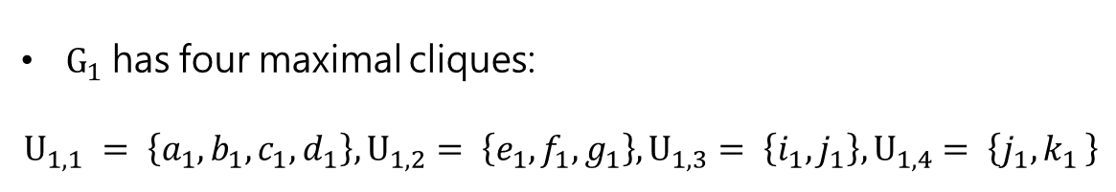
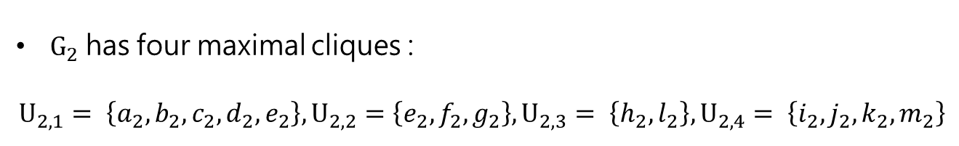
Non-Conflicting MBFFs Generation
Proposed Approach
Consider MBFF Library with 1/2/4-bits MBFF for 1x and 2x driving
$G_{1}$has four maximal cliques:
$$U_{1,1} = \left\{a_{1}, b_{1}, c_{1}, d_{1}\right\}, U_{1,2}= \left\{e_{1}, f_{1}, g_{1}\right\}, U_{1,3}= \left\{i_{1}, j_{1}\right\}, U_{1,4}= \left\{j_{1}{,k}_{1}\right\}$$
$G_{2}$ has four maximal cliques :
$$U_{2,1}= \left\{a_{2}, b_{2}, c_{2}, d_{2}, e_{2}\right\}, U_{2,2}=\left\{e_{2}, f_{2}, g_{2}\right\}, U_{2,3}= \left\{h_{2}, l_{2}\right\}, U_{2,4}= \left\{i_{2}, j_{2}, k_{2}, m_{2}\right\}$$
21
Notes:
這個部分所產生的MBFF都還是uniform driving的，後面會再形成mixed driving的MBFF

Slide 22
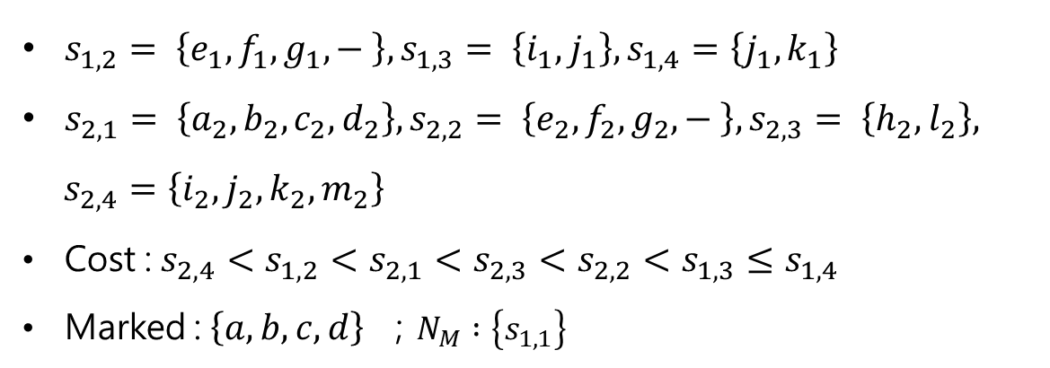
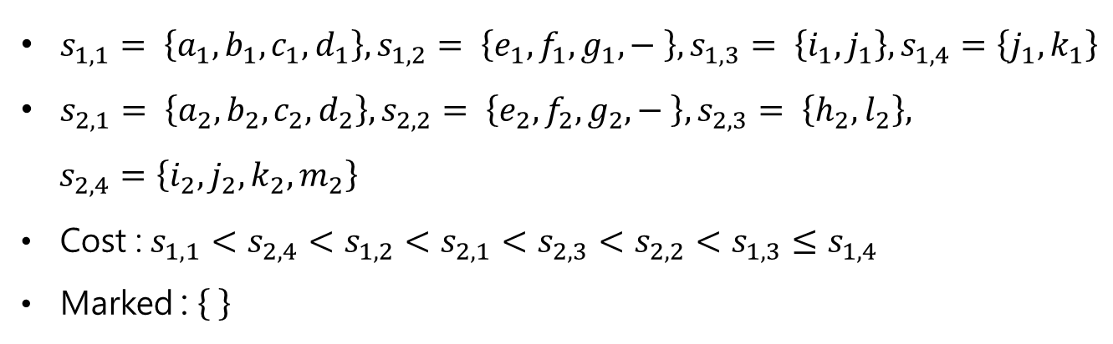
Non-Conflicting MBFFs Generation
Proposed Approach
$s_{1,1}= \left\{a_{1}, b_{1}, c_{1}, d_{1}\right\}, s_{1,2}= \left\{e_{1}, f_{1}, g_{1}, − \right\}, s_{1,3}= \left\{i_{1}, j_{1}\right\}, s_{1,4}=\left\{j_{1}, k_{1}\right\}$
$s_{2,1}= \left\{a_{2}, b_{2}, c_{2}, d_{2}\right\}, s_{2,2}= \left\{e_{2}, f_{2}, g_{2}, − \right\}, s_{2,3}= \left\{h_{2},l_{2}\right\},$
$s_{2,4}=\left\{i_{2}, j_{2}, k_{2}, m_{2}\right\}$
Cost :$s_{1,1}<s_{2,4}<s_{1,2}<s_{2,1}<s_{2,3}<s_{2,2}<s_{1,3}≤s_{1,4}$
Marked :
$s_{1,2}= \left\{e_{1}, f_{1}, g_{1}, − \right\}, s_{1,3}= \left\{i_{1}, j_{1}\right\}, s_{1,4}=\left\{j_{1}, k_{1}\right\}$
$s_{2,1}= \left\{a_{2}, b_{2}, c_{2}, d_{2}\right\}, s_{2,2}= \left\{e_{2}, f_{2}, g_{2}, − \right\}, s_{2,3}= \left\{h_{2},l_{2}\right\},$
$s_{2,4}=\left\{i_{2}, j_{2}, k_{2}, m_{2}\right\}$
Cost :$s_{2,4}<s_{1,2}<s_{2,1}<s_{2,3}<s_{2,2}<s_{1,3}≤s_{1,4}$
Marked : $\left\{a,b,c,d\right\}$ ；$N_{M} :\left\{s_{1,1}\right\}$
22

Slide 23
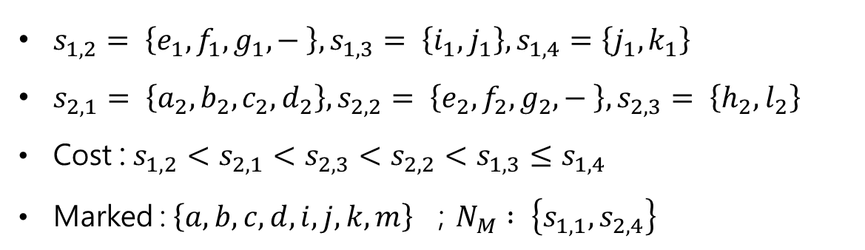
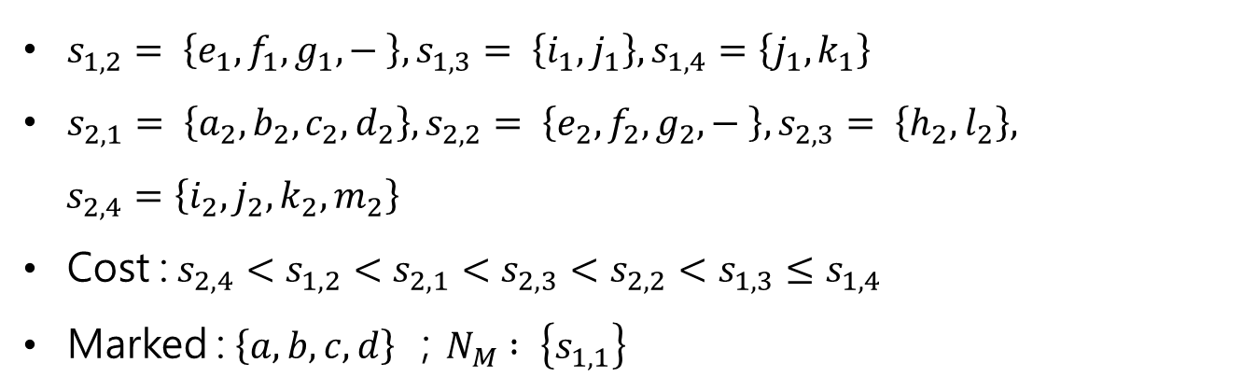
Non-Conflicting MBFFs Generation
Proposed Approach
$s_{1,2}= \left\{e_{1}, f_{1}, g_{1}, − \right\}, s_{1,3}= \left\{i_{1}, j_{1}\right\}, s_{1,4}=\left\{j_{1}, k_{1}\right\}$
$s_{2,1}= \left\{a_{2}, b_{2}, c_{2}, d_{2}\right\}, s_{2,2}= \left\{e_{2}, f_{2}, g_{2}, − \right\}, s_{2,3}= \left\{h_{2},l_{2}\right\},$
$s_{2,4}=\left\{i_{2}, j_{2}, k_{2}, m_{2}\right\}$
Cost :$s_{2,4}<s_{1,2}<s_{2,1}<s_{2,3}<s_{2,2}<s_{1,3}≤s_{1,4}$
Marked : $\left\{a,b,c,d\right\}$ ；$N_{M} : \left\{s_{1,1}\right\}$
$s_{1,2}= \left\{e_{1}, f_{1}, g_{1}, − \right\}, s_{1,3}= \left\{i_{1}, j_{1}\right\}, s_{1,4}=\left\{j_{1}, k_{1}\right\}$
$s_{2,1}= \left\{a_{2}, b_{2}, c_{2}, d_{2}\right\}, s_{2,2}= \left\{e_{2}, f_{2}, g_{2}, − \right\}, s_{2,3}= \left\{h_{2},l_{2}\right\}$
Cost :$s_{1,2}<s_{2,1}<s_{2,3}<s_{2,2}<s_{1,3}≤s_{1,4}$
Marked : $\left\{a,b,c,d,i,j,k,m\right\}$ ；$N_{M} : \left\{s_{1,1},s_{2,4}\right\}$
23

Slide 24
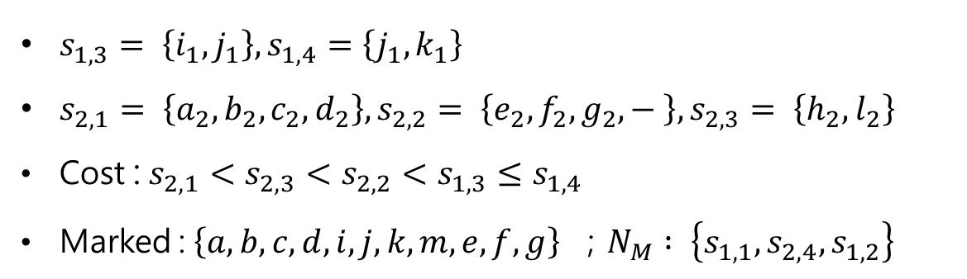
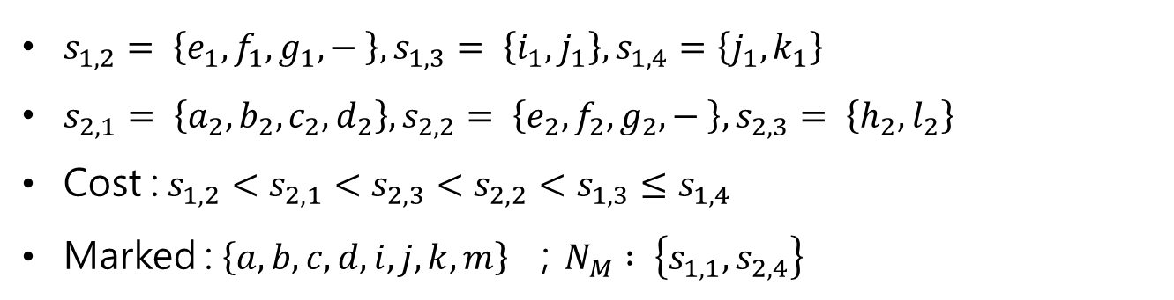
Non-Conflicting MBFFs Generation
Proposed Approach
$s_{1,2}= \left\{e_{1}, f_{1}, g_{1}, − \right\}, s_{1,3}= \left\{i_{1}, j_{1}\right\}, s_{1,4}=\left\{j_{1}, k_{1}\right\}$
$s_{2,1}= \left\{a_{2}, b_{2}, c_{2}, d_{2}\right\}, s_{2,2}= \left\{e_{2}, f_{2}, g_{2}, − \right\}, s_{2,3}= \left\{h_{2},l_{2}\right\}$
Cost :$s_{1,2}<s_{2,1}<s_{2,3}<s_{2,2}<s_{1,3}≤s_{1,4}$
Marked : $\left\{a,b,c,d,i,j,k,m\right\}$ ；$N_{M} : \left\{s_{1,1},s_{2,4}\right\}$
$s_{1,3}= \left\{i_{1}, j_{1}\right\}, s_{1,4}=\left\{j_{1}, k_{1}\right\}$
$s_{2,1}= \left\{a_{2}, b_{2}, c_{2}, d_{2}\right\}, s_{2,2}= \left\{e_{2}, f_{2}, g_{2}, − \right\}, s_{2,3}= \left\{h_{2},l_{2}\right\}$
Cost :$s_{2,1}<s_{2,3}<s_{2,2}<s_{1,3}≤s_{1,4}$
Marked : $\left\{a,b,c,d,i,j,k,m,e,f,g\right\}$ ；$N_{M} : \left\{s_{1,1},s_{2,4},s_{1,2}\right\}$
24

Slide 25

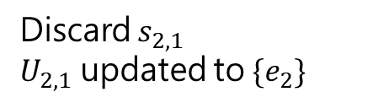
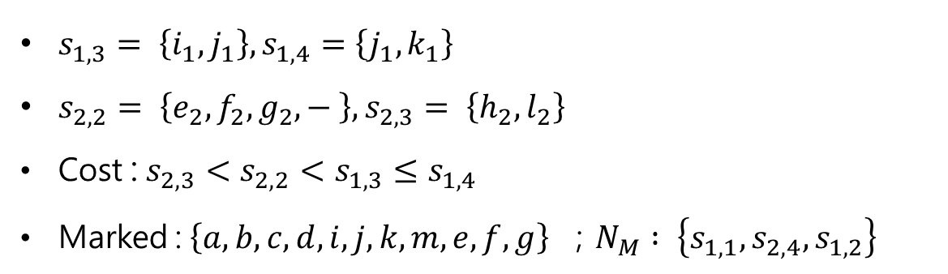
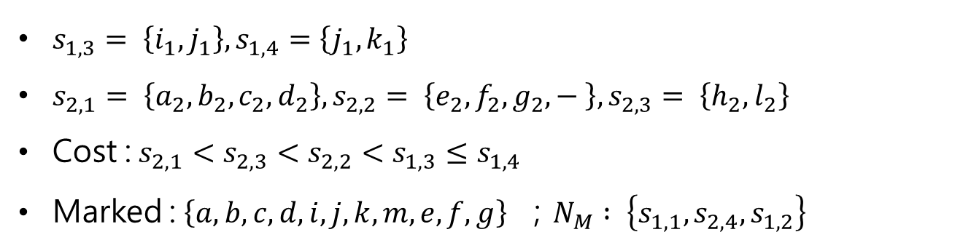
Non-Conflicting MBFFs Generation
Proposed Approach
$s_{1,3}= \left\{i_{1}, j_{1}\right\}, s_{1,4}=\left\{j_{1}, k_{1}\right\}$
$s_{2,1}= \left\{a_{2}, b_{2}, c_{2}, d_{2}\right\}, s_{2,2}= \left\{e_{2}, f_{2}, g_{2}, − \right\}, s_{2,3}= \left\{h_{2},l_{2}\right\}$
Cost :$s_{2,1}<s_{2,3}<s_{2,2}<s_{1,3}≤s_{1,4}$
Marked : $\left\{a,b,c,d,i,j,k,m,e,f,g\right\}$ ；$N_{M} : \left\{s_{1,1},s_{2,4},s_{1,2}\right\}$
Discard $s_{2,1}$
$U_{2,1}$ updated to $\{e_{2}\}$
$s_{1,3}= \left\{i_{1}, j_{1}\right\}, s_{1,4}=\left\{j_{1}, k_{1}\right\}$
$s_{2,2}= \left\{e_{2}, f_{2}, g_{2}, − \right\}, s_{2,3}= \left\{h_{2},l_{2}\right\}$
Cost :$s_{2,3}<s_{2,2}<s_{1,3}≤s_{1,4}$
Marked : $\left\{a,b,c,d,i,j,k,m,e,f,g\right\}$ ；$N_{M} : \left\{s_{1,1},s_{2,4},s_{1,2}\right\}$
25
Notes:
由於U21的size沒有大於等於2，所以不用push新的candidate進入priority queue

Slide 26

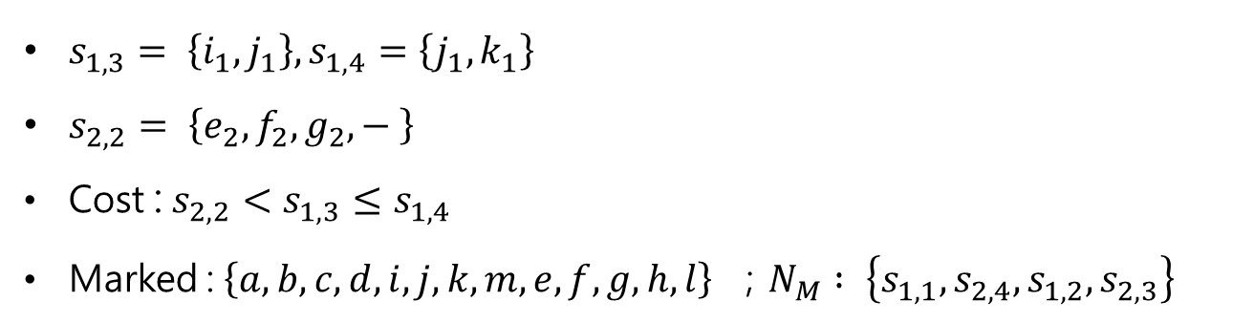
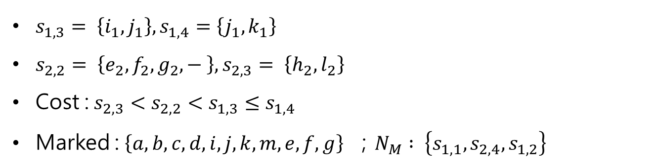
Non-Conflicting MBFFs Generation
Proposed Approach
$s_{1,3}= \left\{i_{1}, j_{1}\right\}, s_{1,4}=\left\{j_{1}, k_{1}\right\}$
$s_{2,2}= \left\{e_{2}, f_{2}, g_{2}, − \right\}, s_{2,3}= \left\{h_{2},l_{2}\right\}$
Cost :$s_{2,3}<s_{2,2}<s_{1,3}≤s_{1,4}$
Marked : $\left\{a,b,c,d,i,j,k,m,e,f,g\right\}$ ；$N_{M} : \left\{s_{1,1},s_{2,4},s_{1,2}\right\}$
$s_{1,3}= \left\{i_{1}, j_{1}\right\}, s_{1,4}=\left\{j_{1}, k_{1}\right\}$
$s_{2,2}= \left\{e_{2}, f_{2}, g_{2}, − \right\}$
Cost :$s_{2,2}<s_{1,3}≤s_{1,4}$
Marked : $\left\{a,b,c,d,i,j,k,m,e,f,g,h,l\right\}$ ；$N_{M} : \left\{s_{1,1},s_{2,4},s_{1,2},s_{2,3}\right\}$
return$N_{M} : \left\{s_{1,1},s_{2,4},s_{1,2},s_{2,3}\right\}$
26
Notes:
剩下的皆marked過，因此會依序被Discard掉 並retrun Nm

Slide 27
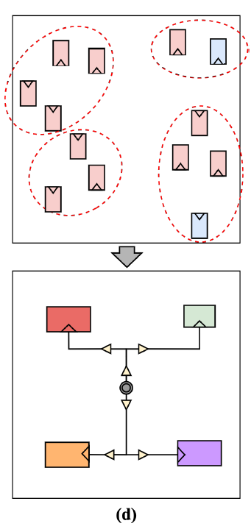
Non-Conflicting MBFFs Generation
Proposed Approach
27
Notes:
可以注意到的是如果不能使用empty bit的話，U1,2會不能被merge，就會因此多一個clk sink

Slide 28
Location Assignment
Proposed Approach
The weight of a pin is the switching rate of the signal net.
We calculates the weighted median interval of the MBFF’s fan-in and fan-out pins.
Preferred region is the intersection of the two weighted median interval(fan-in/fan-out).
The MBFF will be assigned to the closest bin, and a vacant slot inside the bin.
28
Notes:
為了有minimal overlap，且讓commercial tool 可以解決overlap，Vacant slot 在這邊被設為一個2x driving 2-bit MBFF的大小

Slide 29
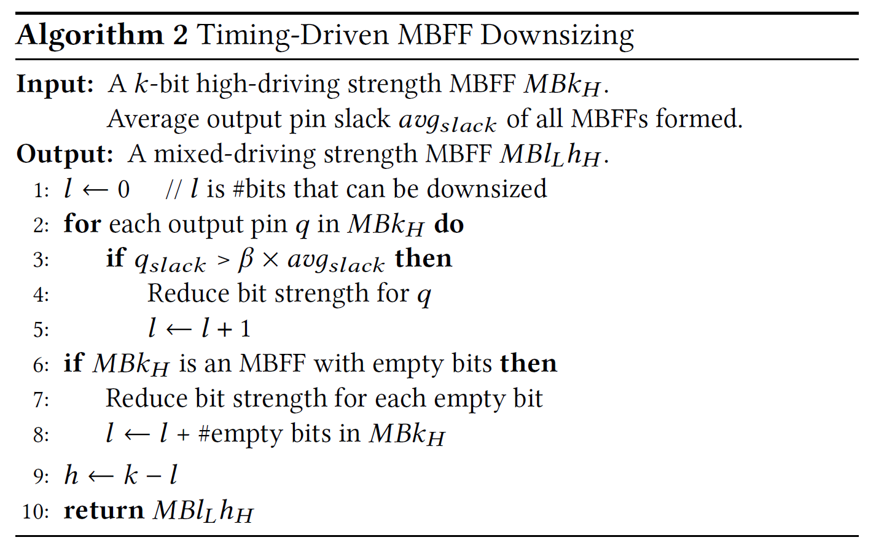
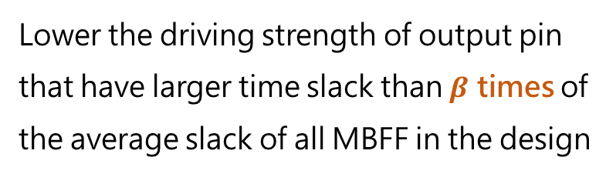
Timing-Driven MBFF Sizing
Proposed Approach
After timing analysis, we try to down size some bits if possible.
Assume there’re only low and high driving strength
Lower the driving strength of output pin that have larger time slack than $β$ times of the average slack of all MBFF in the design
Lower the driving strength of all the empty bits
29
Notes:
對所有的high driving strength MBFF都做algorithm 2

Slide 30
OUTLINE
03
Introduction
10
Problem Formulation
12
Proposed Approach
31
Experimental Results
30

Slide 31
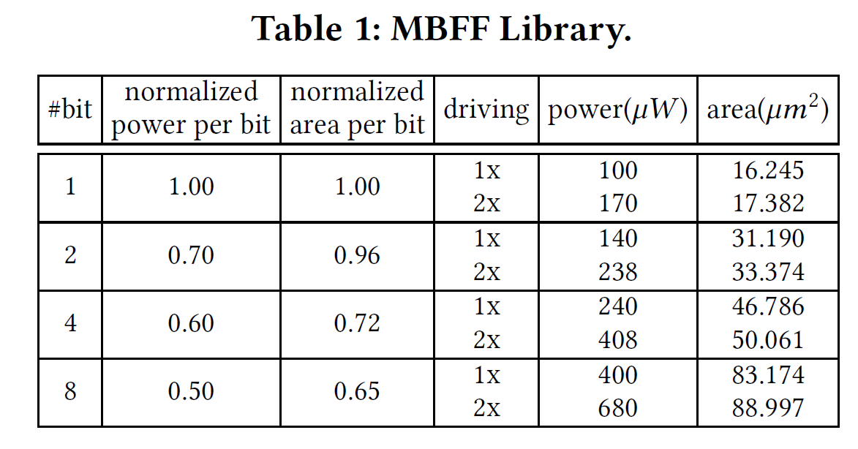
Experimental Result
C++, 64-bit Ubuntu server with ThreadRipper 3970X and 256GM memory.
ICCAD contest 2015 benchmarks
Includes all types of mixed-driving MBFFS
Uses Cadence Innovus[8] to do Legalization, timing analysis, CTS, and routing.
31

Slide 32
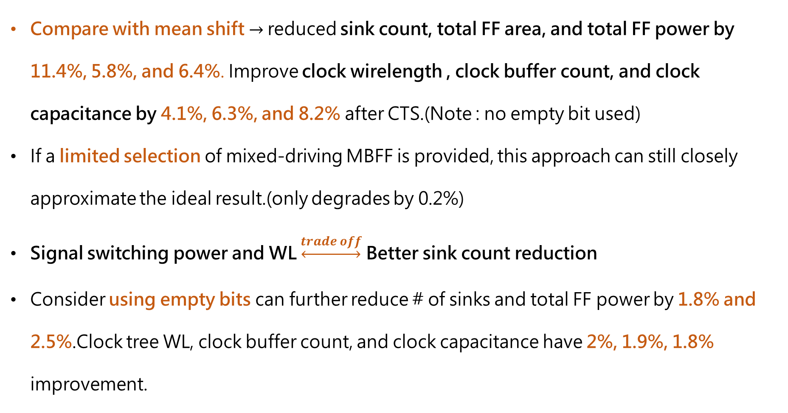
Experimental Result
Compare with mean shift $→$reduced sink count, total FF area, and total FF power by 11.4%, 5.8%, and 6.4%. Improve clock wirelength , clock buffer count, and clock capacitance by 4.1%, 6.3%, and 8.2% after CTS.(Note : no empty bit used)
If a limited selection of mixed-driving MBFF is provided, this approach can still closely approximate the ideal result.(only degrades by 0.2%)
Signal switching power and WL $\underset{↔}{trade off}$ Better sink count reduction
Consider using empty bits can further reduce # of sinks and total FF power by 1.8% and 2.5%.Clock tree WL, clock buffer count, and clock capacitance have 2%, 1.9%, 1.8% improvement.
32
Notes:
調整 爛打 來達到不同的objective

Slide 33
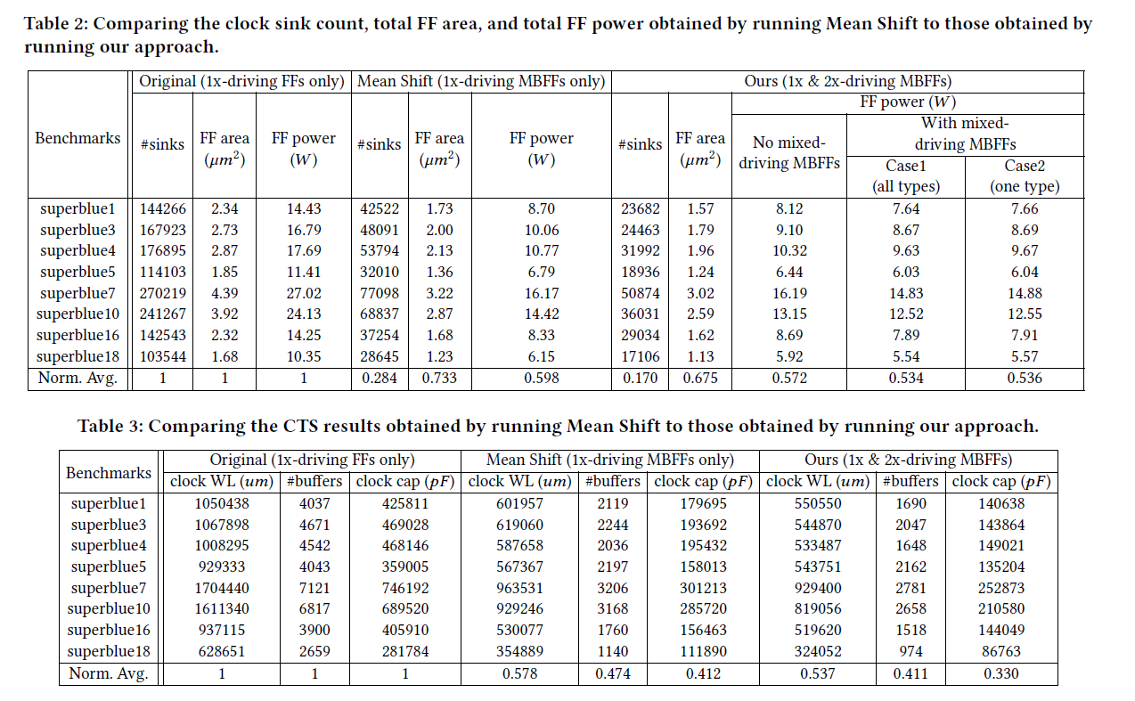
Experimental Result
33

Slide 34
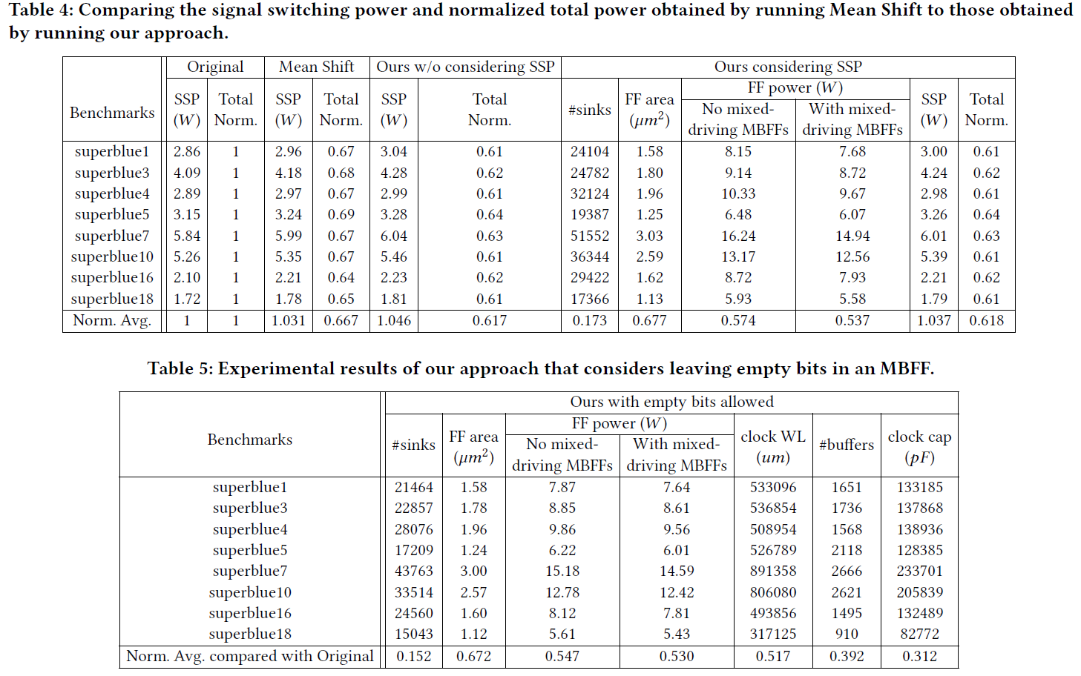
Experimental Result
34

Slide 35
Heng-Yo Zhang
Thank You
For watching
Generation of Mixed-Driving Multi-Bit Flip-Flops
for Power Optimization

