Slide 1
Power and Timing Optimization Using Multibit Flip-Flop
ICCAD 2025 Problem B

Slide 2
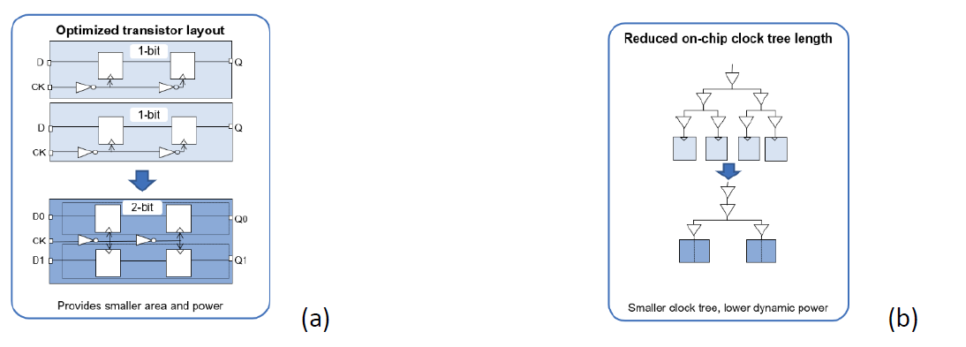
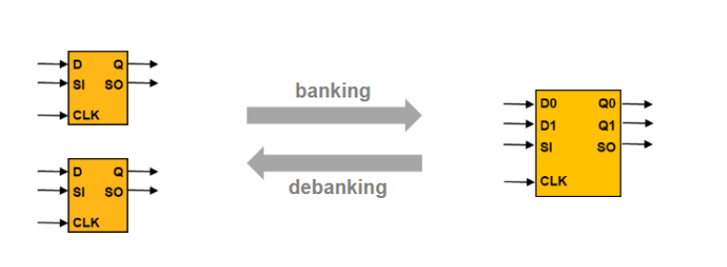
Introduction
To develop a banking and debanking algorithm that produces a placement result optimized for timing, power, and area.

Slide 3
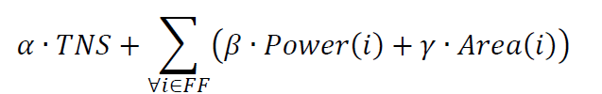

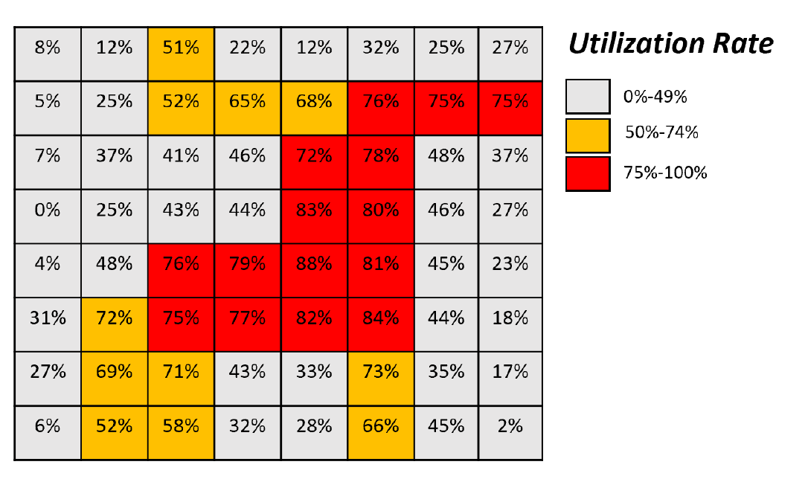
Contest Objective
2025:
2024:

Slide 4
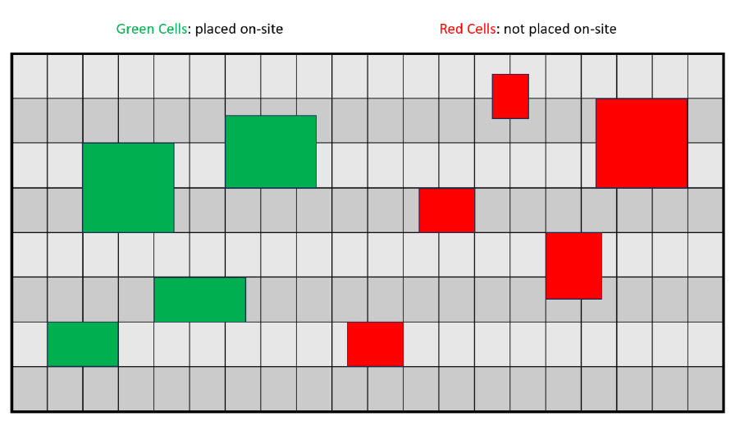
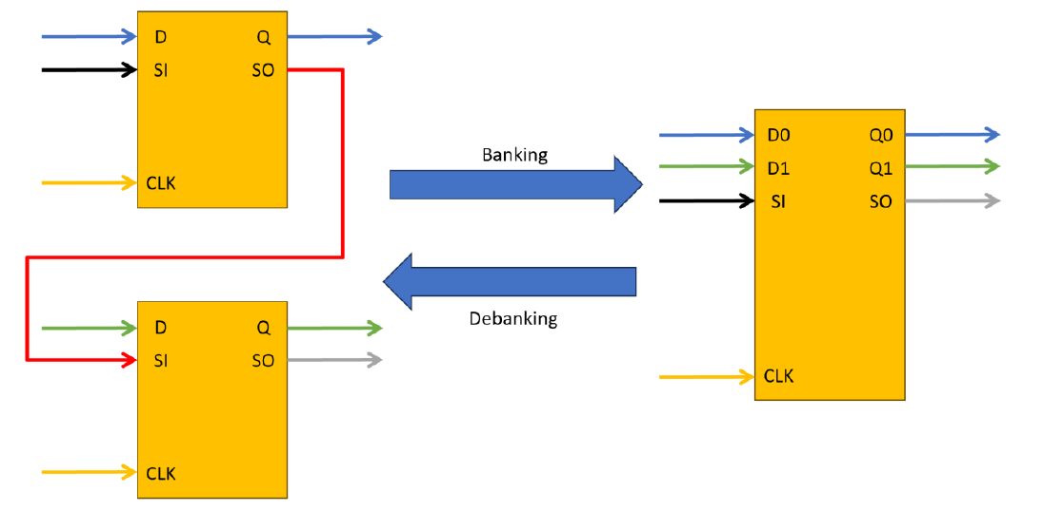
Constraints
All instances must be placed on-site and within the die region.
No overlap
Must satisfy utilization rate of each bin
Banking / Debanking Criteria :
All D pin and Q pin connections need to remain functionally equivalent after banking / debanking, and all CLK pins need to remain connected to the same clock net.
If there is any design for testability (DFT) scan chain connection on scan-input (SI) or scan-output (SO) pins of the lower / higher-bit flip-flops, the banking / debanking process should honor the scan chain connection.

Slide 5
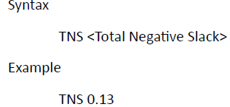
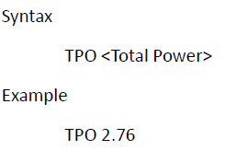
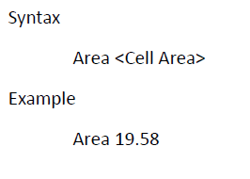
Problem Formulation and Input/Output Format
Given:
1.Weight factors for cost metrics (i.e. 𝛼, 𝛽, and 𝛾 )
2.Timing slack and delay information
3.Power information
4.Area information
5. Flip-Flop Library Cells
6.Cell placement result with flip-flop cells ( LEF/DEF format )

Slide 6
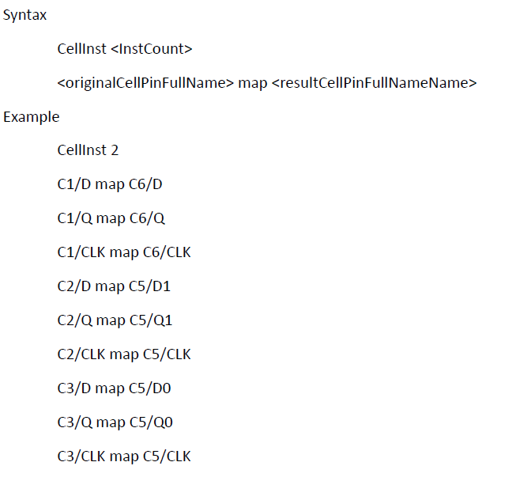
Problem Formulation and Input/Output Format
Output:
A list of pin mapping between each input flip-flop pins and the output flip-flop pins
A flip-flop placement solution (LEF/DEF format )

Slide 7
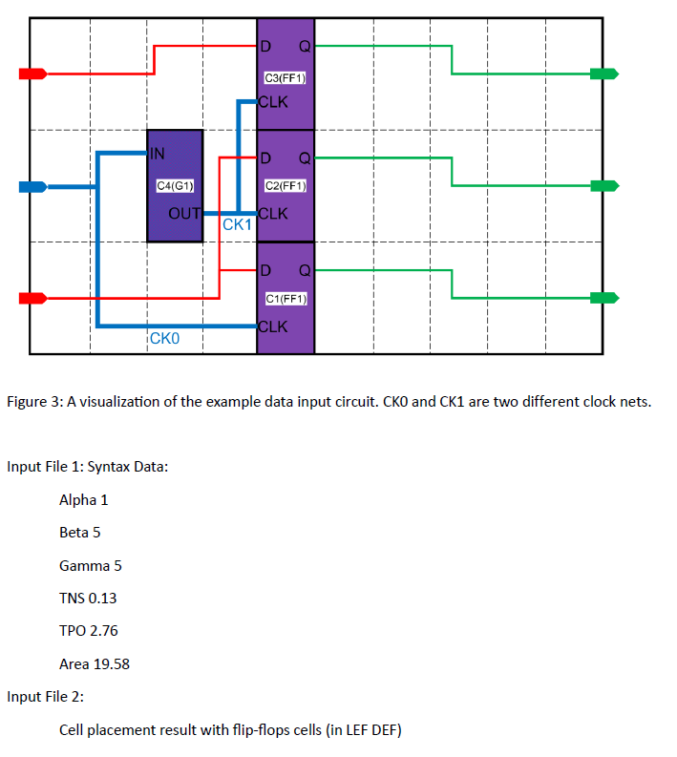
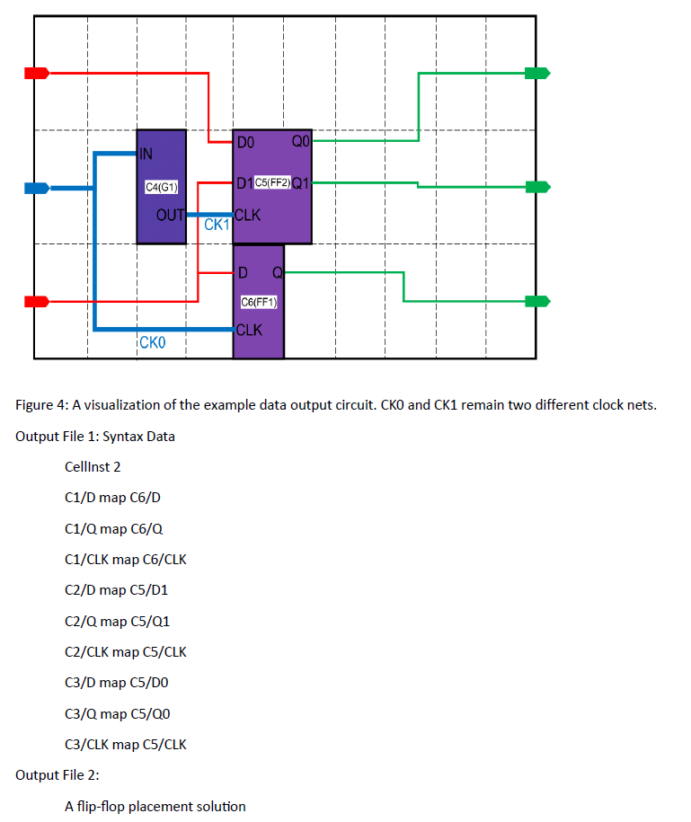
Sample input: Sample output:

Slide 8
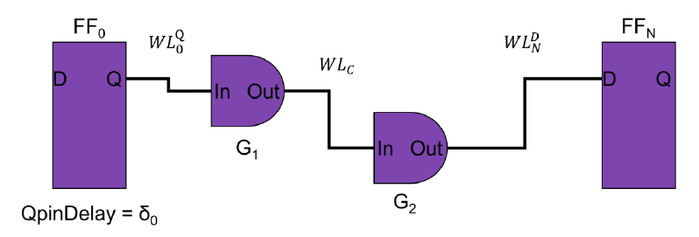
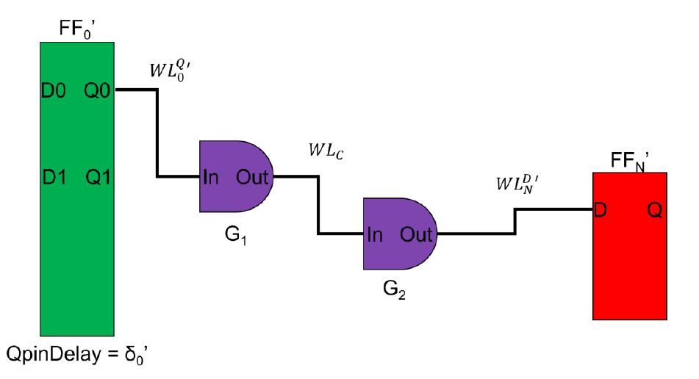
Slack

Slide 9


Score Function
TNS, Power, Area are reported using the command report_qor , report_power , report_qor from Fusion Compiler.
CPU Cores: You have 8 CPU cores available for your program.
Time Limit: The evaluation machine is limited to 60 minutes for each test case. The hidden cases will be in the same scale as public cases.

Slide 10
Flow Chart
Parser
Debanking
Pre-GlobalPlacement
Legalization
Banking
Post-GlobalPlacement
Legalization
DetailPlacement

