Slide 1
Logic Representations

Slide 2
Basic Definitions
- Let B = {0,1} Y = {0,1,2}
A logic function f in n inputs x_{1,} x_{2, ...}x_{n} and
m outputs y₁,y₂, ...y_{m} is a mapping.
f : B^{n}
Y^{m}
- For each component f_{i}, i = 1,2, ...,m, define
ON_SET:the set of input values x such that f_{i}(x) =1
OFF_SET:the set of input values x such that f_{i}(x) = 0
DC_SET:the set of input values x such that f_{i}(x) = 2
- Completely specified function : DC_SET = φ
φ
Incompletely specified function : DC_SET
- m=1 => a single output function
m>1 => a multiple output function

Slide 3
Representations
1. Truth Table
Full adder
X Y Cin Sum Cout
0 0 0 0 0
0 0 1 1 0
0 1 0 1 0
0 1 1 0 1
1 0 0 1 0
1 0 1 0 1
1 1 0 0 1
1 1 1 1 1
Multiple output function
Sum : on-set = {(0 0 1), (0 1 0), (1 0 0),
(1 1 1)}
off-set= {(0 0 0), (0 1 1), (1 0 1),
(1 1 0)}
Completely specified function

Slide 4
Representations
2. Geometrical representation
1 variable
0
1
2 variables
00
01
10
11
3 variables
011
111
001
101
010
010
110
000
100
sum : on-set ={(0 0 1),(0 1 0),(1 0 0),(1 1 1)}
off-set ={(0 1 1),(1 0 1),(1 1 0),(0 0 0)}

Slide 5
Representations
3. Algebraic representations
Canonical sum of product (list of minterms)
C_{out} = x’yC_{in} + xy’C_{in} + xyC_{in}’ + xyC_{in}
Reduced sum of product (two-level)
C_{out} = yC_{in} + xC_{in} + xy
= yC_{in} + xC_{in} + xyC_{in}’
- List of cubes (Sum of Products (SOP), Disjunctive Normal Form (DNF))
- List of conjuncts (Product of Sums (POS), Conjunctive Normal Form (CNF))
Multi-level representation
C_{out} = C_{in} (x + y) + xy

Slide 6
4. Reduced Ordered Binary Decision Diagrams

Slide 7
Binary Decision Diagram
Truth Table
Decision Tree
X1
X2
X2
X3
X3
X3
X3
0
0
0
1
0
1
0
1
Vertex represents decision
Follow dashed line for value 0
Follow solid line for value 1
Function value determined by leaf value

Slide 8
Reduced Ordered Binary Decision Diagram (ROBDD)
Binary decision graph:
f = x₂x₃ + x₁x₃
- Terminal node:
attribute
value (v) = 0
value (v) = 1
- Nonterminal node:
index (v) = i, i= 1~3
two children
low (v)
high (v)
- Evaluate an input vector
X1
X2
X2
X3
X3
X3
X3
0
0
0
1
0
1
0
1

Slide 9
ROBDD
A BDD graph which has a vertex v as root
corresponds to the function F_{v} :
(1) If v is a terminal node:
a) if value (v) is 1, then F_{v} = 1
b) if value (v) is 0, then F_{v} = 0
(2) If F is a nonterminal node (with index(v) = i)
F_{v}(x_{i} , ...x_{n}) = x_{i}’ F_{low(v)} (x_{i+1} , ...x_{n}) +
x_{i} F_{high(v)} (x_{i+1} , ...x_{n})
Shannon expansion

Slide 10
Variable Ordering
Assign arbitrary total ordering to variable
e.g. X1 < X2 < X3
Variable must appear in ascending order along all paths
Properties
No conflicting variable assignments along path
Simplifies manipulation
X1
X1
X3
X1
X2
X2
X3
X3
X1
X3
Not
OK
OK

Slide 11
Reduced OBDD
Reduced OBDD :
No distinct vertices v and w such that
subgraphs rooted by v and w are
isomorphism.
2. No vertex v with low (v) = high (v)

Slide 12
Reduction Rule #1
Merge equivalent leaves
a
a
a
X1
X1
X2
X2
X2
X2
X3
X3
X3
X3
X3
X3
X3
X3
0
0
0
1
0
1
0
1
0
1

Slide 13
Reduction Rule #2
Merge isomorphic nodes
X
X
X
Y
Z
Y
Z
X1
X1
X2
X2
X2
X2
X3
X3
X3
X3
X3
X3
0
1
0
1

Slide 14
Reduction Rule #3
Eliminate redundant node
X
Y
Y
X1
X1
X2
X2
X2
X2
X3
X3
X3
0
1
0
1

Slide 15
Reduction Rule #3
Eliminate redundant node
X
Y
Y
X1
X1
X2
X2
X2
X3
X3
X3
0
1
0
1

Slide 16
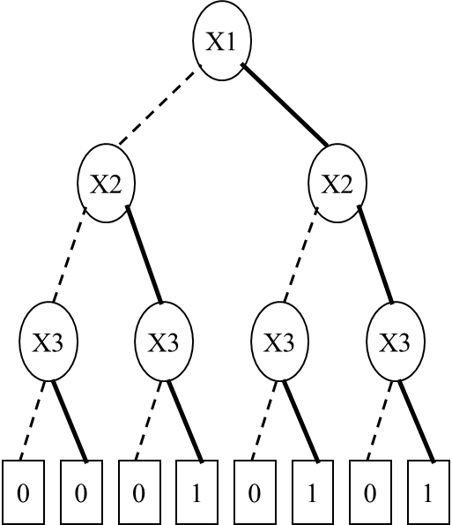
ROBDD
After reduce
X1
X2
X3
0
1

Slide 17
Implementation of Reduce
Visit OBDD bottom up and label each vertex with an identifier
Redundancy
if id( low(v) ) = id( high(v) ), then vertex v is redundant
⇒ set id(v) = id( low(v) )
if index (v) = index(u) and id( low(v) ) = id( low(u) ) and id( high(v) ) = id( high(u) ), then set id(v) = id(u)
A different identifier is given to each vertex at level i
An ROBDD is identified by a subset of vertices with different identifiers

Slide 18
Reduce
a
index=1
b
b
index=2
c
c
index=3
0
0
1
0
1
(a)
1
id=5
1
id=5
id=4
id=3
id=4
2
3
2
id=3
id=3
id=3
4
5
4
0
0
1
0
1
0
1
id=1
id=1
id=2
id=1
id=2
id=1
id=2
(b)
(c)
: 0
: 1

Slide 19
Construct ROBDD Using Hash Table
Using a hash table called unique table
Contain a key for each vertex of an OBDD
Key : (variable, right child, left child)
Each key uniquely identify the specific function
Look up the table can determine if another vertex in the table implements the same function

Slide 20
The Unique Table – Hash Table
U₁
U₂
X1
T₁
X1
T₂
Hash Table Mapping
(X1, T1, 1 ) --> U1
(X1, T2, T1) --> U2
(X2, T3, 1 ) --> T1
(X2, 0 , T3) --> T2
(X3, 0 , 1 ) --> T3
X2
T₃
X2
1
1
X3
0
true
false
1
0
Unique table : hash table mapping (Xi, G, H) into a node in the DAG
before adding a node to the DAG, check if it already exists
avoids creating two nodes with the same function
constructed bottom up
terminated when root is reached
canonical form : pointer equality determines function equality

Slide 21
ROBDD Using Unique Table
a
id=5
id=4
b
id=3
c
0
1
id=1
id=2
f = (a+b) c
variable order (a, b, c)
Unique table
Key

Slide 22
Multi-Rooted ROBDD
d
id=6
id=5
a
b
id=4
id=3
c
0
1
id=1
id=2
f = (a+b) c
g = b c d
variable order (d, a, b, c)
f is constructed first and is associated with id=5
g : id=6
Unique table
Key

Slide 23
Ordering Effects
Ordered BDD: if x < y, then all nodes representing x precede all nodes representing y
Given an ordering of variables, reduced OBDD is canonical

Slide 24
Example of a Good Ordering
The size of OBDD depends on the ordering of
variables
ex : x₁x₂ + x₃x₄
x₁ < x₂ < x₃ < x₄
x₁
1
0
x₂
0
1
x₃
1
0
x₄
0
1
0
1

Slide 25
Example of a Less Good Ordering
For a good ordering, the size of an OBDD
remains reasonably small
Multiplier is an exception
x₁
0
1
x₃
x₃
1
0
1
0
x₂
x₂
0
1
0
1
x₄
0
1
0
1
x₁ < x₃ < x₂ < x₄

Slide 26
Which Ordering is Better?
Let x3 x2 x1 x0 and y3 y2 y1 y0 be two binary numbers and carry-out3 the carry out of the most significant bit.
Two ordering :
x3 < x2 < x1 < x0 < y3 < y2 < y1 < y0
x3 < y3 < x2 < y2 < x1 < y1 < x0 < y0
Which ordering will result in smaller size and why?

Slide 27
Sample Function Classes
General Experience
Many tasks have reasonable ROBDD representations
Algorithms remain practical for up to 100,000 vertex ROBDD
Heuristic ordering methods generally satisfactory

Slide 28
Operations on ROBDD
Apply f₁ <op> f₂
(f₁, f₂ must have the same ordering of variables,
then operations can be operated on f₁, f₂ )
f₁ f₂ = (x₁’g₁ + x₁g₂)(x₁’g₃ + x₁g₄)
= x₁’g₁g₃ + x₁g₂g₄
= x₁’(g₁g₃) + x₁(g₂g₄)
f₁
f₂
f₁ f₂
x₁
x₁
x₁
0
1
0
1
0
1
g₁
g₂
g₃
g₄
g₁g₃
g₂g₄
f₁ + f₂
f₁ f₂
etc.

Slide 29
ROBDD
complement : f
1
f1
f2 : f1’ + f1f2 (implication)
time complexity
Reduced O(
G
log
G
)
Apply O(
G₁
G₂
)

Slide 30
Generating ROBDD from Network
Represent output functions of gate network as ROBDDs
Network
Evaluation
A new_var(“a”)
B new_var(“b”)
C new_var(“c”)
T₁ AND(A, B)
T₂ AND(B, C)
Out OR(T₁, T₂)
Out
T₁
T₂
a
A
B
C
a
b
b
b
a
b
c
b
c
c
0
1
0
1
0
1
0
1
0
1
0
1

Slide 31
Property of ROBDD
(1) Commonly encountered functions have
reasonable representations.(except
multiplier)
(2) Complementation will not blow up the
representation.
(3) Canonical form so that equivalence,
satisfiability checking can be done easily.
(4) Multi-level representation
Achille’s heel function:
F = x₁x₂x₃ + x₄x₅x₆ + ……+ x_{3n-2}x_{3n-1}x_{3n}
F’ has 3^{n} terms

Slide 32
5. And-Inverter Graphs (AIGs)

Slide 33
And-Inverter Graph
5. And-Inverter Graph (AIG)
Simple structure
And-Gates as nodes (shown as circles) with two inputs as edges (shown as arrows)
Inverter edges marked with a dot
Used in ABC

Slide 34
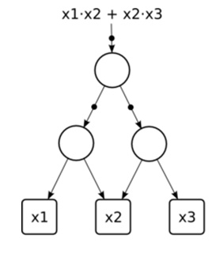
Example
Ex: y = f( x₁,x₂,x₃) =( (x₁ ‧ x₂ )’ ‧ (x₂ ‧ x₃)’)’
= ( x₁ ‧ x₂ ) ＋ (x₂ ‧ x₃)

Slide 35

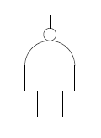
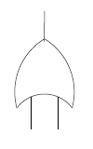
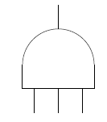
AIG Construction
Start from SOP representation
Convert to AIG using DeMorgan’s law
x₁ ＋ x₂ = ( x₁ ＋ x₂) ’’= ( x₁ ’ ‧ x₂ ’) ’
2-input and
2-input nand
3-input and
2-input or

Slide 36
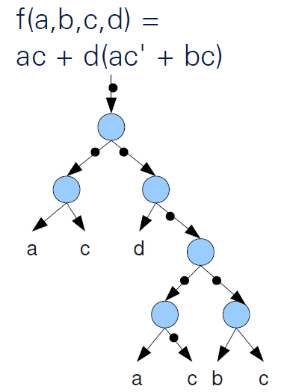
AIG Attributes
Size is the number of AND nodes in it
Logic level is the number of AND-gates on the longest path from the primary inputs (PIs) to the primary outputs (POs)
The inverters are ignored
6 nodes, 4 levels

Slide 37
AIG Canonicity
AIGs are not canonical
ROBDDs are canonical
Same function represented by two functionally equivalent AIGs with different structures
Different structures can still be optimal with different objectives

Slide 38
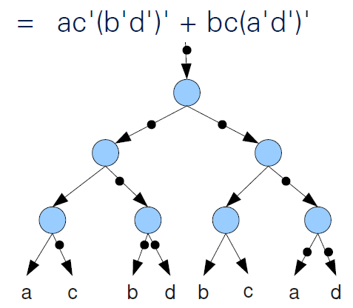
AIG Canonicity
6 nodes, 4 levels => area optimal
7 nodes, 3 levels => speed (delay) optimal

Slide 39
6. Reed-Muller Form

Slide 40

Representation
Reed-Muller Expression (with AND, XOR and 1)
Algebraic Normal Form (ANF)
$f\left(x_{1},x_{2},x_{3},…,x_{n}\right)=a_{0}⊕a_{1}x_{1}⊕a_{2}x_{2}⊕…⊕a_{n}x_{n}⊕a_{1,2}x_{1}x_{2}⊕a_{1,3}x_{1}x_{3}⊕…⊕a_{n−1,n}x_{n−1,n}⊕…⊕a_{1,2,…,n}x_{1}x_{2}…x_{n}$
$where a_{i}=0 or 1$
Use un-complemented literals only
The above is called the Positive Polarity RM (PPRM), which is canonical (unique) for the given function
$ab=ba, a1=a’, (ab)c=a(bc), c(ab)=acbc$
$a+b=ab$when $a, b$are exclusive

Slide 41
Example
f(x₁, x₂) = f(0, 0)x₁’x₂’ + f(0, 1)x₁’x₂ + f(1, 0)x₁x₂’
+ f(1, 1)x₁x₂
=f(0, 0)x₁’x₂’ ⊕ f(0, 1)x₁’x₂ ⊕ f(1, 0)x₁x₂’
⊕ f(1, 1)x₁x₂
=f(0, 0)(x₁⊕1)(x₂⊕1) ⊕
f(0, 1)(x₁⊕1)x₂ ⊕
f(1, 0)x₁(x₂⊕1) ⊕
f(1, 1)x₁x₂
=f(0, 0)(x₁x₂⊕x₁⊕x₂⊕1) ⊕
f(0, 1)(x₁x₂⊕x₂) ⊕
f(1, 0)(x₁x₂⊕x₁) ⊕
f(1, 1)x₁x₂
=f(0, 0) ⊕
( )x₁ ⊕
( )x₂ ⊕
( )x₁x₂
f(0,0)⊕f(1,0)
f(0,0)⊕f(0,1)
f(0,0)⊕f(0,1)⊕f(1,0) ⊕f(1,1)

Slide 42
Characteristic Functions

Slide 43
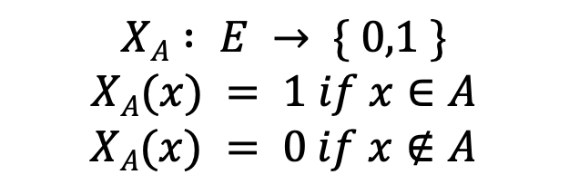
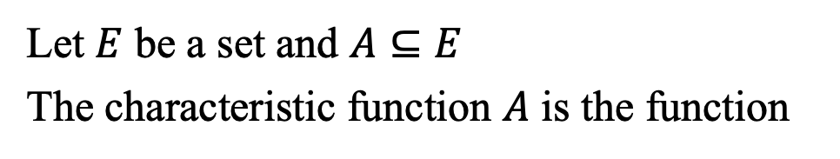
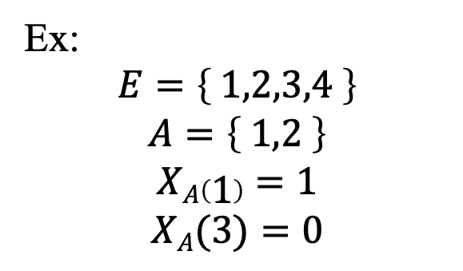
Characteristic Function
Let $E$ be a set and $A⊆E$
The characteristic function $A$ is the function
$$XA : E → \{ 0,1 \}$$
$$XA(x) = 1 if x∈A$$
$$XA(x) = 0 if x∉A$$
A
E
Ex:
$$E=\left\{ 1,2,3,4 \right\}$$
$$A=\left\{ 1,2 \right\}$$
$$XA\left(1\right)=1$$
$$XA(3)=0$$

Slide 44

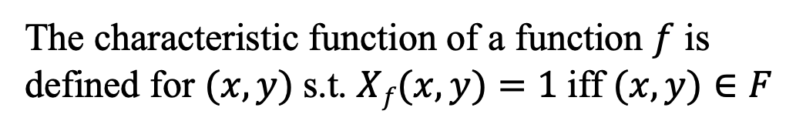
Characteristic Function
Given a Boolean function
$f : Bn → Bm$
the mapping relation denoted as $F⊆B^{n}×B^{m}$
is defined as
The characteristic function of a function $f$ is defined for $(x,y)$s.t. $Xf(x,y)=1$iff $(x,y)∈F$

Slide 45

Characteristic Function
Ex: $y=f( x1,x2 )=x1+x2$
x₁ x₂ y
0 0 0
0 1 1
1 0 1
1 1 1
$F_{y}(x1,x2,y) =$
x₁ x₂ y F
0 0 0 1 v
0 0 1 0
0 1 0 0
0 1 1 1 v
1 0 0 0
1 0 1 1 v
1 1 0 0
1 1 1 1 v

Slide 46
Operations on Logic Functions

Slide 47
Operation on Logic Function
Complement
Intersection
Union
Difference
XOR
F is a tautology
Cofactor
Boolean difference
Consensus operator
Smoothing operator

Slide 48
Cofactor
Cofactor operation ( restriction )
cofactor of f with respect to x_{i}=0
cofactor of f with respect to x_{i}=1
Cofactor is a new function independent of x_{i}

Slide 49
Cofator
Cofactor with respect to any cube
Ex:

Slide 50
Shannon Expansion

Slide 51

Boolean Difference
$\frac{∂f}{∂x}$is called Boolean difference of $f$ with respect to $x$
$$Def: \frac{∂f}{∂x}=f_{x}⊕f_{\overline{x}}$$
$f$ is sensitive to the value of $x$ when $\frac{∂f}{∂x}$
Ex:
Application: Test pattern generation

Slide 52
Consensus Operator
evaluate f to be true for x=1 and x=0
Ex:
Universal quantification of function w.r.t. variable x

Slide 53
Smoothing Operator
evaluate f to be true for x=1 or x=0
Ex:
Existential quantification of function w.r.t. variable x
Application: Image computation of sequential circuits

