Slide 1
Multi-Level Logic Optimization

Slide 2
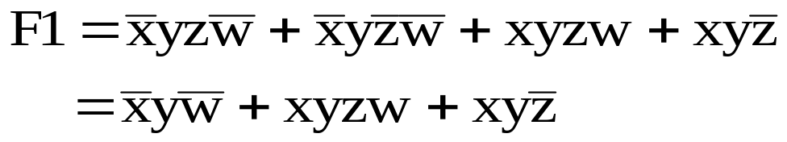

Multi-Level Logic Synthesis
Two Level Logic :
  Espresso
  Programmable Logic Array (PLA)
Multilevel Logic :
  Standard Cell

Slide 3
Multi-level Logic
Standard cell implementation:
o₁
o₁
o₁
i₁
i₁
i₂
i₁
i₂
i₃
inverter
NAND
AOI 21
Y
AOI21 (x)
NAND
(y)
NAND
(z)
INV
(w)
A
B
C

Slide 4
Different Placement
y
z
w
x
A
Y
B
C
y
z
x
w
A
Y
B
C

Slide 5
Local Optimization
1
1
2
2
3
3
4
4
1
2
3
4
a
f
a
f
b
l
b
l
c
c
k
d
k
d

Slide 6
Circuit Restructuring
a
c
b
c
f
a
d
c
b
f
a
d

Slide 7
Representation Choices
How to represent the function?
How to represent the implementation?
Two-level logic :
two issues are merged
Multi-level logic :
. merged view (representation and
implementation are one)
. separated view

Slide 8
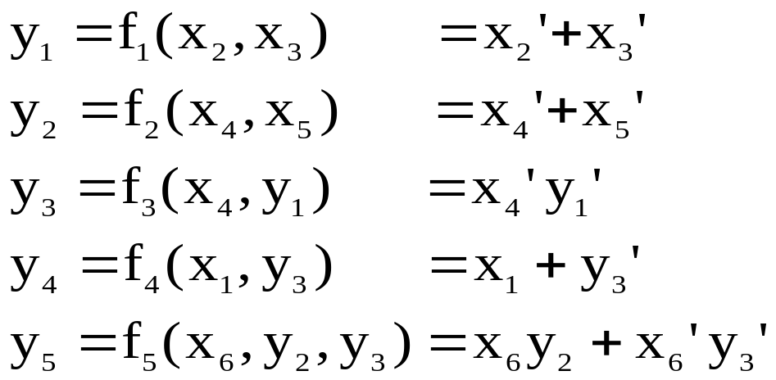
Boolean Network
x1
y4
x2
y1
y3
z1
x3
y5
x4
y2
z2
x5
x6
Directed Acyclic Graph (DAG)
Primary Input (PI)
Primary Output (PO)
Intermediate node : logic function f_{i}, variable y_{i}
Edge
Fan-in, transitive fan-in
Fan-out, transitive fan-out

Slide 9
Node Representation
(1) Sum-of-Product
abc’+a’bd+b’d’+b’e’f
adv :
  easy to manipulate and minimize
  many algorithms available
  disadv:
  not representative of logic complexity
  f = ad+ae+bd+be+cd+ce
  f’ = a’b’c’+d’e’
  not easy to estimate if logic becoming simpler

Slide 10
Node Representation
(2) factored form : Any depth of sum of product
Ex: a
a’
ab’c
ab+c’d
(a+b)(c+a’+de)+f

Slide 11
Node Representation
a
c
A CMOS complex gate
implementing
f = ((a+bc)(c+d))’
2 * literal count = transistors#
b
c
d
b
a
c
d
c
adv:
  natural multi-level representation
  good estimate of the complexity of function
  represent both the function and its
  complement
disadv:
  more difficult to manipulate than two-level
  form
  lack of the notion of optimality

Slide 12
Node Representation
(3) NAND or NOR form
a
b
c
c
d
A simple gate implementation of
f = ((a+bc)(c+d))’
adv :
  simple data structure
  storage -save
  fast simulation
  efficient optimization strategies for rule-
  based logic optimization
  complete with inverter count
disadv:
  The network is finely decomposed in a
  particular way and this may obscure some
  natural structures.
Notes:
Nand form is complete with inverter while factored form ignores inveter

Slide 13
Multi-level Logic Optimization
Technology independent
  Decomposition/Restructuring
  Algebraic (Boolean) (SIS)
  Functional
  Node optimization
Technology dependent
  Technology mapping

Slide 14
Technology Independent Phase
Restructuring
Basic Operations:
1. decomposition (single function)
f = abc+abd+a’c’d’+b’c’d’
f = xy + x’y’
x = ab
y = c+d
2. extraction (multiple funciton)
f = (az+bz’)cd+e
g = (az+bz’)e’
h = cde
f = xy + e
g = xe’ h = ye
x = az+bz’ y = cd

Slide 15

Technology Independent Phase
3. factoring (series-parallel decomposition)
f = ac+ad+bc+bd+e
f = (a+b)(c+d)+e
4. substitution boolean
g = a+b x + x’ = 1
f = a+bc x x’ = 0
(a+b)(a+c)
f = g(a+c) =a+ac+ba+cb
5. collapsing
f = ga+g’b
g = c+d
f = ac+ad+bc’d’
g = c + d
“Division” plays a key role in all these operations.

Slide 16
Division
Division plays a key role in all restructuring operations
Boolean divide
Algebraic divide

Slide 17
Algebraic and Boolean Operations
Algebraic operations:
  Algebra of expression involving real numbers
  Those rules that are common to the algebra of real numbers and Boolean Algebra
Boolean operations:
  All laws of Boolean Algebra

Slide 18

Boolean Algebra
Rules hold for Boolean Algebra only
  Idempotency
  a a = a² (real number)
  a a = a (Boolean Algebra)
  Complementation
  No direct correspondence in real field
  Distributivity of “+” over “ “
  a + bc = (a+b)(a+c) in Boolean Algebra
  Not in real number
  Absorption
  a + ab = a in Boolean Algebra
  Not in real number

Slide 19


Boolean Divide
Def 1: p is a Boolean divisor of f if q φ and r exists such that
f = pq + r
(p is said to be a factor of f if r = φ )
(1) q is called the quotient , f/p
(2) r is called the remainder
(3) q and r are not unique
Let = (f, d, r)
Def 2 : g is a Boolean divisor of f if there exists h such that
f gh + e f + d (d : don’t care)

Slide 20
Boolean Divide
Theorem 1
A logic function g is a Boolean factor of a logic function of f <=> f g
g
f
f = gh
Theorem 2
If f g φ , then g is a Boolean divisor of f.
g
f
f = gq + r
too many Divisor (factors)!

Slide 21
Algebraic Divide
Def 3:
f is an algebraic expression if f is a set of cubes such that no one cube contains another.
Ex: a + ab is not an algebraic expression
because a contains ab.
ab + bd is an algebraic expression
Def 4:
f g is an algebraic product if f and g are algebraic expression and have disjoint support (no input variable in common). Otherwise,
f g is a Boolean product.
Ex:
(a+b)(c+d) = ac+ad+bc+bd => Algebraic
product
(a+b)(a+c) = aa+ac+ba+bc => Boolean
product

Slide 22
Weak Division
Given f and p , return q and r such that pq
is an algebraic product and
f = pq + r

Slide 23




Algebraic Divide
Weak-Div (f, p)
U = set {U_{j}} of cubes in f with literals
not in p deleted
V = set {V_{j}} of cubes in f with literals in
P deleted
^{i} = {V_{j} V : U_{j} = p_{i}}
q =
^{i}
r = f - pq
Ex:
f = ac + ad + ae + bc +bd +be +a’b
p = a + b
U = a + a + a + b + b + b + b
V = c + d + e + c + d + e + a’
ª = c + d + e
^{b} = c + d + e + a’
q = ª ^{b} = c + d + e r = f - pq = a’b

Slide 24
Division
Substitution : knows divisor ? Yes
Extraction : knows divisor ? No
Factor : knows divisor ? No
Decomposition : knows divisor ? No

Slide 25
Boolean Division
Theorem
f1 = hx + e be a cover of an incompletely specified function (f, d, r). Suppose
x’g +xg’ d
where g is any function. Then, f2 = hg + e
is also a cover.
Algorithm
1. f = h g + e (where h = f/g)
2. use a new variable x to represent g,
f = h x + e
3. form the don’t care set, xg’ + x’g
4. minimize f with the don’t care
5. quotient f/x (quotient = the terms of f with x)
remainder = the terms of f
without x)

Slide 26
Substitution
An existing node in a network may be a useful divisor in another node.
f_{i}
f_{j}

Slide 27
Algebraic Substitution
Dividing the function f_{i} at node i by f_{j} or f_{j}’ at
node j pair-wise.
If f_{j} is a divisor of f_{i}
f_{i} = g y_{j} + r
No need to try all pairs
( Cases where f_{j} is not an algebraic divisor of f_{i})
1. f_{j} contains a literal not in f_{i}
2. f_{j} contains more terms than f_{i}
3. for any literal, the count in f_{j} exceed that in f_{i}
4. f_{i} is f_{j}’s transitive fan-in ( cycle )

Slide 28
Boolean Substitution
Ex:
f = a + bc
g = a + b
substituting g into f (Let X = a + b)
DC = X(a + b)’ + X’(a + b)
minimize (a + bc) DC’ (force X to appear in f)
=> (a + bc)(X(a + b)’ + X’(a + b))’
using Don’t Care = X(a + b)’ + X’(a + b)
A minimum cover is a + bc. But it does not contain X or X’
force X (or X’) to remain in f
=> f = a + Xc
f = a + gc
g = a + b

Slide 29
Division
Substitution : knows divisor ? Yes
Extraction : knows divisor ? No
Factor : knows divisor ? No
Decomposition : knows divisor ? No

Slide 30
Kernel
Kernel : for finding divisor (algebraic)
  What is kernel?
  Kernel algorithm
  kernel intersection
Too many divisor, but much smaller number of kernel.

Slide 31

Kernel
Definition:
An expression is cube-free if no cube divides the expressions evenly.
Ex:
a + bc is cube-free
ab + ac is not cube-free
abc is not cube-free
Definition:
The kernel of an expression f are the set of expression
(f) = { f/c | f/c is cube free and c is a cube}
Ex:
f = acb + acd + e a kernel
f /a = cb + cd not a kernel
f/ac = b + d a kernel

Slide 32
Kernel
Definition :
A cube c used to obtain the kernel k=f/c is a
co-kernel c(f) denotes the set of co-kernel.
Ex:
f = adf + aef + bdf + bef + cdf + cef + g
= (a + b + c)(d + e)f + g
kernel co-kernel
a+b+c df,ef
d+e af,bf,cf
(a+b+c)(d+e) f
(a+b+c)(d+e)f+g 1

Slide 33

Kernel
Theorem:
f and g have a common multiple-cube divisor d
<=> h_{f} (f) h_{g} (g)
such that d = h_{f} h_{g}
Ex:
f₁ = ab (cl + f + g) + m
f₂ = ai (cl + f + j) + k
(f₁) = { cl + f + g }
(f₂) = { cl + f + j }
(f₁) (f₂) = cl + f
common multiple cube divisor cl + f

Slide 34
Kernel
The level of a kernel
A kernel is level-0 if it has no kernels except itself.
A kernel is level-n if it has at least one level n-1 kernel but no kernel (except itself) of level n or higher.
Ex:
f = (a+b+c)(d+e)f + g
kernel level
a+b+c 0
d+e 0
(a+b+c)(d+e) 1
(a+b+c)(d+e)f + g 2

Slide 35
Kernel
Why need to define level of kernel?
  sometimes it is nearly as effective to compute a certain subset of kernel
  computation time and quality trade off

Slide 36




Kernel Algorithm
literal index expression
Kernel( j , g)
R =
for (i=j ; i n ; i++){
if (l_{i} appears in more than one cube)
c = largest cube dividing g/{l_{i}} evenly
if (l_{k} c for all k < i)
R = R Kernel (i+1, g/({l_{i}} c))
}
R = R {g}
Return R
The literals in the support of f are numbered
from 1 to n.

Slide 37
Kernel Algorithm
f = abcd+abce+adfg+aefg+abde+acdef+beg
a
b
c
b
c
d
e
f
c d e
(a)
c
e
e
d
d
f
(a)(a) ac+ad+g
d+e
c+d
b+cf ce+g
g
c+e
b+ef b+df
cd+g d+e
co-kernel kernel
1 a((bc+fg)(d+e)+de(b+cf)))+beg
a (bc+fg)(d+e)+de(b+cf)
ab c(d+e)+de
abc d+e
abd c+e
abe c+d
ac b(d+e)+def
acd b+ef
Note : f/bc = ad+ae = a(d+e).

Slide 38
Kernel Intersection
Kernel Intersection
K = { ₁, ₂, ..... _{n} }
Form a new expression IF(k) which corresponds to the set K of kernel
  associate each distinct cube with a new
  literal
  each kernel corresponds to a cube of the new function
  Then, every element in the set of co-kernel of IF(K) corresponds to a unique kernel intersection.

Slide 39
Example
Ex:
Let t₁ = abc
t₂ = de
t₃ = fg
t₄ = fh
t₅ = gh
K₁ = abc + de + fg = t₁t₂t₃
K₂ = abc + de + fh = t₁t₂t₄
K₃ = abc + fh + gh = t₁t₄t₅
IF(K) = t₁t₂t₃ + t₁t₂t₄ + t₁t₄t₅
Co-kernel of (IF(k)) = {t₁,t₁t₂,t₁t₄}

Slide 40
Kernel Extraction
Kernel extraction (k, n)
1. Find all kernels of all functions and
generate all kernel intersections.
2. Choose one with best “value” .
3. Create a new node with this as function.
4. Algebraically substitute new node every- where.
5. Repeat 1,2,3,4 until value threshold.
Step1: Selection of level of kernel determines
speed and quality trade off.
Step2:
y(new node)
area-value(y) = freq(y) * literal(y) - literal(y)
- freq(y)

Slide 41
Factor
Factor(F)
1. If F = 1 return False
2. D = Choose_Divisor(F)
3. (Q,R) = Divide(F,D)
4. Return. Factor(Q)*Factor(D) + Factor(R)
Efficiency and quality
Step2 :
Divisor : 1. choose literal factor
2. choose one level-0 kernel
3. choose the best kernel
Step3 :
Algebraic divide
Boolean divide

Slide 42
Decomposition
Decomposition
  similar to factoring, except that each divisor is formed as a new node
  For each method of factoring, we have the associated method for decomposition.

Slide 43

Example
Ex: f₁ = ab(c(d+e)+f+g)+h
f₂ = ai(c(d+e)+f+j)+k
  extraction(level-0 kernel)
⁰(f₁) = {d+e}
⁰(f₂) = {d+e}
⁰(f₁) ⁰(f₂) = {d+e}
l = d + e
f₁ = ab(cl+f+g)+h
f₂ = ai(cl+f+j)+k
  extraction (level-0 kernel)
⁰(f₁) = {cl+f+g}
⁰(f₂) = {cl+f+j}
⁰(f₁)
⁰(f₂) = {cl+f}
m = cl+f l = d+e
f₁ = ab(m+g)+h
f₂ = ai(m+j)+k No kernel intersection at
this point

Slide 44
Example (cont.)
  cube extraction
n = am
m = cl+f
l = d+e
f1 = b(n+ag)+h
f2 = i(n+aj)+k
l = d+e
2*1-2-1 = -1
m = cl+f
3*1-3-1 = -1
n = am
2*2-2-2 = 0
f1 = b(n+ah)+h
f2 = i(n+aj)+k

Slide 45
Example (cont.)
  eliminate -1 (collapsing)
n = a(c(d+e)+f)
f1 = b(n+ah)+h
f2 = i(n+aj)+k

