Slide 1
Multi-Level Logic Optimization - Node Optimization

Slide 2
Simplification
Represent each node in two level form
Use espresso to minimize each node
Several simplification procedures which vary only in the size of don’t care constructed
  don’t care set empty
  subset of don’t care

Slide 3
Simplification
Don’t care
  External DC
  Internal DC (derived from the structure)
  (1) Satisfiability DC (SDC)
  (2) Observability DC (ODC)

Slide 4




Satisfiability Don’t Care
Satisfiability DC (to all nodes)
Ex: x = ab
y = a’b’
f = x’y’+a
x ab = x(ab)’+x’(ab)
Why?
Expand the Boolean space of PI to include intermediate variables B^{n} B^{n+ m}
n=2 m=1
111
010
b
x
000
100
a
In general, SDC = (y_{i} f_{i}’ + y_{i}’ f_{i})

Slide 5


Observability Don’t Care
Observability DC ( to certain intermediate node)
f is sensitive to the value of x
( )’ f is not sensitive to the value of x
x is observable at f if 0
(Note is a function of the inputs)

Slide 6
Example
u=ab+xc’+x’b’
Ex:
u = ab+xc’+x’b’
x = a’b+ac’
= u_{x} u_{x’} + u_{x}’ u_{x’}’
u_{x} = ab + c’
u_{x’} = ab + b’
= u_{x} u_{x’} + u_{x}’ u_{x’}’
= (ab+b’c’) + a’bc (the ODC of x)
u = ab + xc’ + x’b’
a =1 b =1 => u = 1· 1 + xc’ + x’b’ = 1
b =0 c = 0 => u = a· 0 + x · 1+ x’ · 1 = 1
a =0 b =1 c=1 => u = 0· 1 + x · 0+ x’ · 0 = 0
δ
u
x=a’b+ac’
(
δ
x
)’
abc
δ
u
(
δ
x
)’

Slide 7

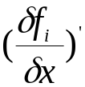

Observability Don’t Care
ODC relative to x is
ODC_{x} =
f_{i} output
Including the external DC
( + D_{xi})
f_{i} output
In general, the complete DC is too large
solutions:
filter the DC
=> subset “support” filter

Slide 8
Controlling and Non-controlling Values of Simple Gates
Given a simple gate (i.e. AND, OR, NAND, NOR), a controlling value on an input determines the output of the gate independent of the other inputs
Given a simple gate (i.e. AND, OR, NAND, NOR), a non-controlling value on an input cannot determine the output of the gate independent of the other inputs
Example:
  0 is a controlling value for AND gate
  1 is non-controlling value for AND gate
  0 is a controlling value for NAND gate
  1 is non-controlling value for NAND gate
  1 is a controlling value for OR gate
  0 is non-controlling value for OR gate
  1 is a controlling value for NOR gate
  0 is non-controlling value for NOR gate

Slide 9
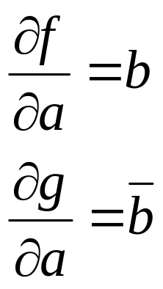
Boolean Difference of Simple Gates
Non-controlling value of a side input is merely a specialization of the Boolean difference of an on-input to the simple gate
a is an on-input and b is a side input
a
b
f
a
b
g

Slide 10
ODC of Simple Gates
Controlling value of a side input is merely a specialization of ODC of an on-input to the simple gate
a is an on-input and b is a side input
ODC = complement of Boolean difference
a
b
f
ODC (a) = b’
a
b
g
ODC (a) = b

Slide 11
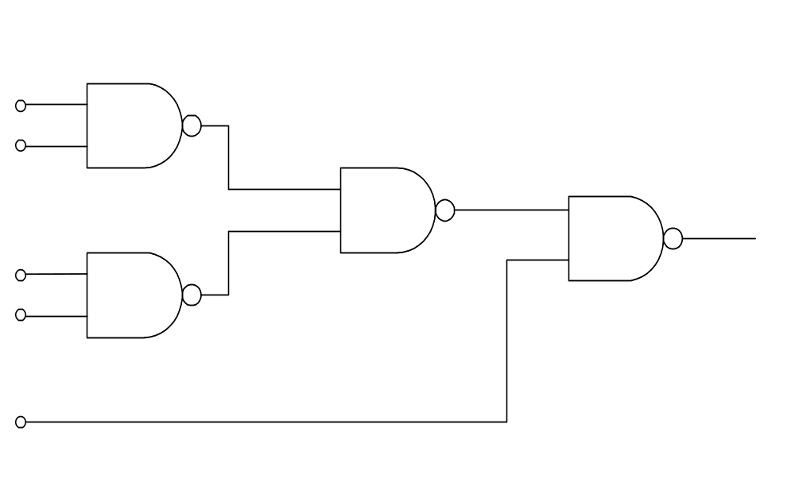
Example of Computing Boolean Difference of ff
A
ff
B
F
H
J
C
0
D
X
G
1
E
1
(C = 0 and D=x ) or (C = x and D=0)
=> C’ + D’
E = 1
=> E
Boolean Difference (ff) = (C’ + D’) E (conditions of side inputs are anding)

Slide 12
Example of Computing ODC of ff
A
ff
B
F
H
J
C
1
D
1
G
0
E
0
(C = 1 and D=1 )
=> C D
E = 0
=> E’
ODC (ff) = CD + E’ (conditions of side inputs are oring)
(ODC (ff))’ = Boolean Difference (ff)
= (C’ + D’) E

Slide 13
Standard Script of MisII
sweep constant propagation, remove buffer
eliminate –l collapse; node has < 1000 cubes
simplify espresso for each node
eliminate –l
sweep
eliminate 5 value > 5
simplify
resub –a algebraic div
gkx –abt 30 -a generate all kernel –b the best kernel inter
-t value saved
resub –a; sweep
gcx –bt 30 -b the best cube -t the value saved
resub –a; sweep
gkx –abt 10
resub –a; sweep
gcx –bt 10
resub –a; sweep
……..

Slide 14
Incompleteness of Don’t Cares
Example
  z₁ z₀
B
COMPARATOR
N₂
 x₂ x₁ x₀ 
N₁
A
ADDER
  a₁ a₀ b₁ b₀ 
Z = 0 1 ⇒ a + b < 3
Z = 0 0 ⇒ a + b = 3
Z = 1 0 ⇒ a + b > 3

Slide 15
Equivalence
x₂ x₁ x₀ z₁ z₀
0 0 0 0 1
0 0 1 0 1
0 1 0 0 1
0 1 1 0 0
1 0 0 1 0
1 0 1 1 0
1 1 0 1 0
1 1 1 1 0
Input values 000, 001, and 010 are equivalent
with respect to B.
{000,001,010} forms an equivalence class.  
The other equivalent classes are:
{011} and {100,101,110,111}

Slide 16
Boolean Relation Formulation
If x', x'' are input values indistinguishable from the outputs of B, they are interchangeable output values for A.
a₁ a₀ b₁ b₀ x₂ x₁ x₀
0 0 0 0 {000,001,010}
0 0 0 1 {000,001,010}
0 0 1 0 {000,001,010}
0 1 0 0 {000,001,010}
1 0 0 0 {000,001,010}
0 0 1 1 {011}
0 1 0 1 {000,001,010}
0 1 1 0 {011}
1 0 0 1 {011}
1 0 1 0 {100,101,110,111}
1 1 0 0 {011}
0 1 1 1 {100,101,110,111}
1 0 1 1 {100,101,110,111}
1 1 0 1 {100,101,110,111}
1 1 1 0 {100,101,110,111}
1 1 1 1 {100,101,110,111}

Slide 17
Example
The optimal implementation of the following
relation R ⊆ B² × B²
a b x y
0 0 0 0, 0 1
0 1 0 1, 1 0
1 1 1 1
1 0 1 0
a
0 1
a
0 1
b
b
0
00
10
0
00
10
1
01
11
1
10
11
a
0 1
a
0 1
b
b
0
01
10
0
01
10
1
01
11
1
10
11

Slide 18
Problems
1. How to find a multiple-output sub-network ?
2. How to utilize Boolean Relations for minimization ?
  full set of Boolean Relation
  subset of Boolean Relation

