Slide 1
DAC-Aware AIG Re-writing (ABC Tool)

Slide 2
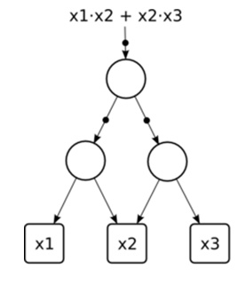
AIG Example
Ex: y = f( x₁,x₂,x₃) =( (x₁ ‧ x₂ )’ ‧ (x₂ ‧ x₃)’)’
= ( x₁ ‧ x₂ ) ＋ (x₂ ‧ x₃)

Slide 3
And-Inverter Graph
And-Inverter Graph (AIG)
Simple structure
And-Gates as nodes (shown as circles) with two inputs as edges (shown as arrows)
Inverter edges marked with a dot
Used in ABC

Slide 4
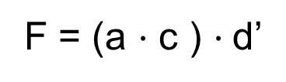
AIG Structure
A directed graph where
node = and gate
edge = wire
circle on edge = inverter
F = (a $·$ c ) $·$d’
d
a
c

Slide 5
To Derive a Baseline AIG
Find SOPs and then factored forms of nodes in a logic network
Convert AND and OR gates of factored form into 2-input ANDs and inverter using DeMorgan’s rule
Apply structural hashing during AIG construction to ensure that no two AND gates have identical pairs of incoming edges

Slide 6
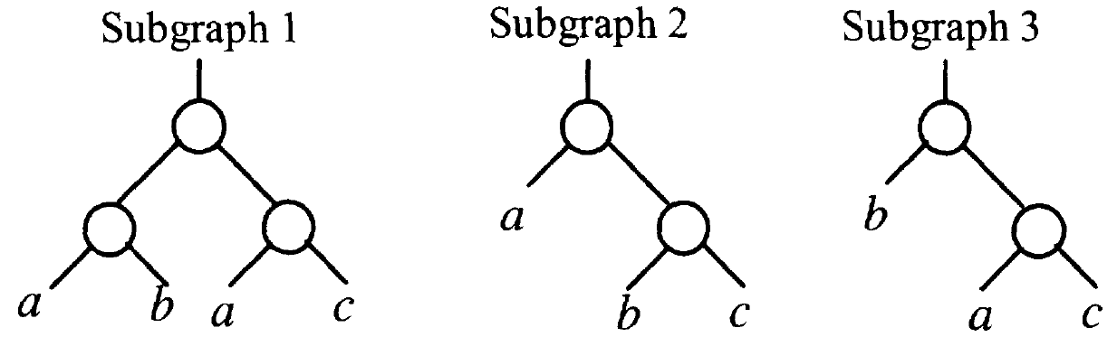

Different AIG Structures for the Same Function
F = a $·$ b $·$ c

Slide 7
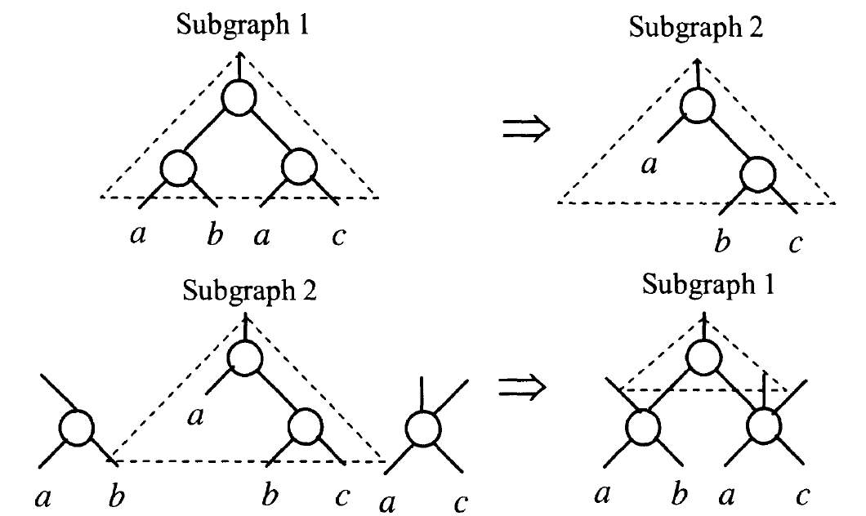
A Simple Example of AIG Rewriting
A rule based transformation

Slide 8
How to Re-Write?

Slide 9
A Cut
A cut of C of node N is a set of nodes of the network, called leaves, such that each path from PIs to N passes at least one leaf
A trivial cut of the nodes is the node itself
A cut is K-feasible if the number of leaves does not exceed K

Slide 10
An Example of 4-feasible Cut
Find subfunctions rooted at F
F
a 4-feasible cut
a
c
not a cut
a
d
b
c

Slide 11
Re-Writing Algorithm
Step 1: Pre-compute all AIG implementations of 4-input functions and store them in a table
2¹⁶ 4-input functions
222 equivalence classes (NPN)
40 found experimentally to lead to improvement
4-input function stored using 16-bit string (signature)
AIG subgraphs stored in shared DAC with about 2000 nodes

Slide 12
Step 2:
- For a node, find its 4-feasible cuts
- For each cut, find its NPN equivalence
- compute the cost of a subgraph
- choose the subgraph that leads to
the largest improvement
Nodes are processed in topological order
Logic sharing is checked between the new subgraph and nodes already in the network using reference counters
The old subgraph is dereferenced and the new subgraph is added

Slide 13
Delay-aware Re-writing
A subgraph representation will not be accepted if the final logic level is increased
Using slack of the node
No negative slack after replacement

Slide 14
AIG Refactoring
Produce deeper permutations of the logic structures
Work for larger cuts, K, for 10 <= K <= 20
The function is converted to SOP, factored, AIGs built using baseline AIG rewriting

Slide 15
AIG Balancing
For delay optimization
A(BC) = (AB)C = (AC)B is applied to maximally reduce the number of levels of AIG
One linear time sweep over the network in a topological order

Slide 16
Zero-cost Replacement Enabled
Create new re-writing opportunity
If the option is enabled, the node is replaced by a new subgraph if the cost = 0
Enabled later in the script

Slide 17
An Example of Script in ABC
A re-writing script, resyn2, in abc.rc
b (balance) ;
rw (rewrite);
rf (refactor);
b;
rw;
rwz (re-write with 0 cost);
b ;
rfz (refactor with 0 cost);
rwz;
b
Perform 10 times over the network

