Slide 1
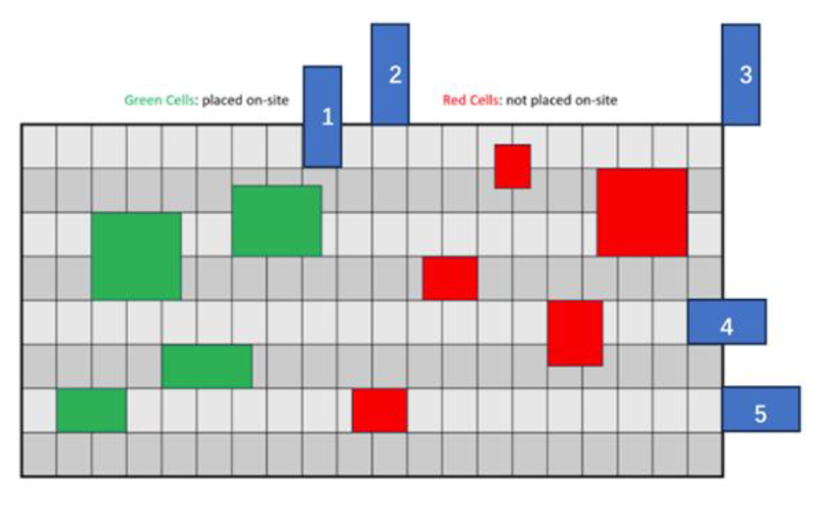
We assume all combinational gate delays are equal or 0. contestants don’t need to consider the combinational gate delay when calculating arrival time.
We do not need to consider the clock delay and clock skew.
Input may has illegal cells. (cells not on site, out of placement area)

Slide 2
Flow Chart
Parser
Debanking
Banking
Method: meanshift 2024
Legalization
Method: 1. Abacus-based
DetailPlacement

Slide 3
An Effective Legalization Algorithm for Mixed-Cell-Height Standard Cells
ASP-DAC 2017

Slide 4
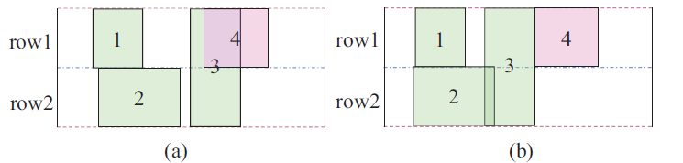
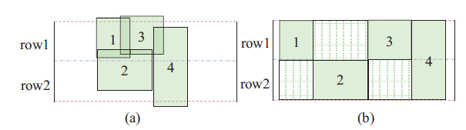

Slide 5
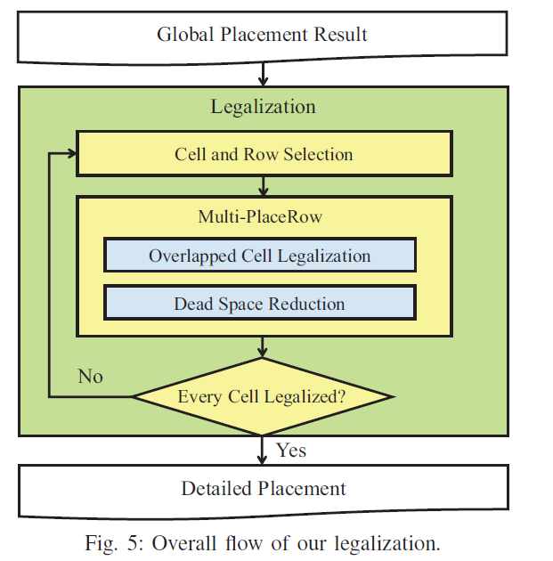

Slide 6

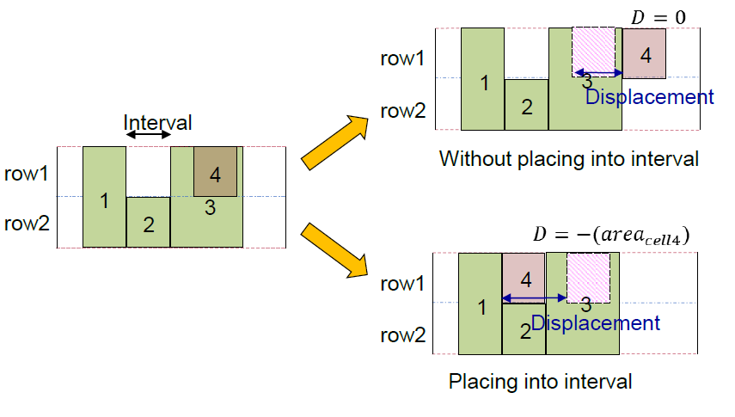
Cell and Row Selection
Sort the cells by their x-coordinates in non-decreasing order
Cost of each row:

Slide 7
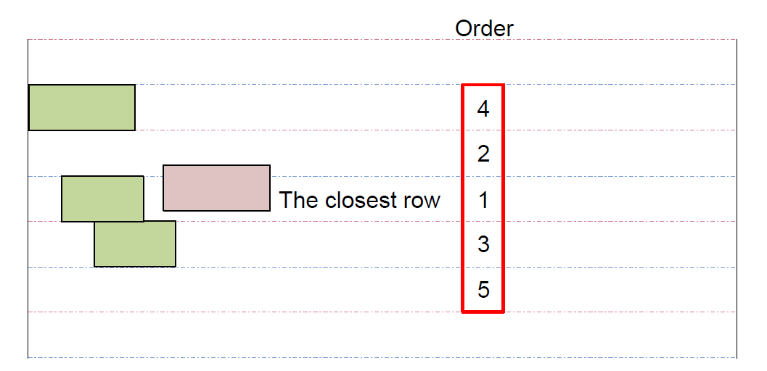
Cell and Row Selection
Speed up this process by only placing cells into their neighboring rows

Slide 8
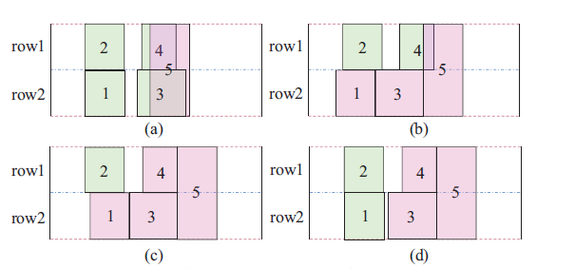
Multi-PlaceRow Method

