Slide 1
Power and Timing Optimization Using Multibit Flip-Flop
ICCAD 2025 B

Slide 2
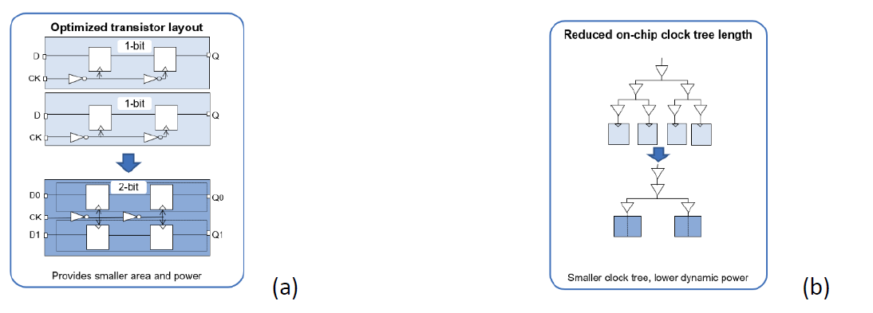
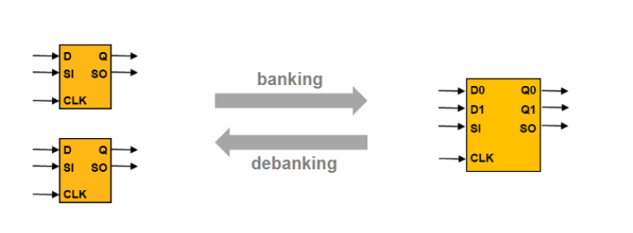
Introduction
To develop a banking and debanking algorithm that produces a placement result optimized for timing, power, and area.

Slide 3
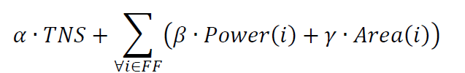

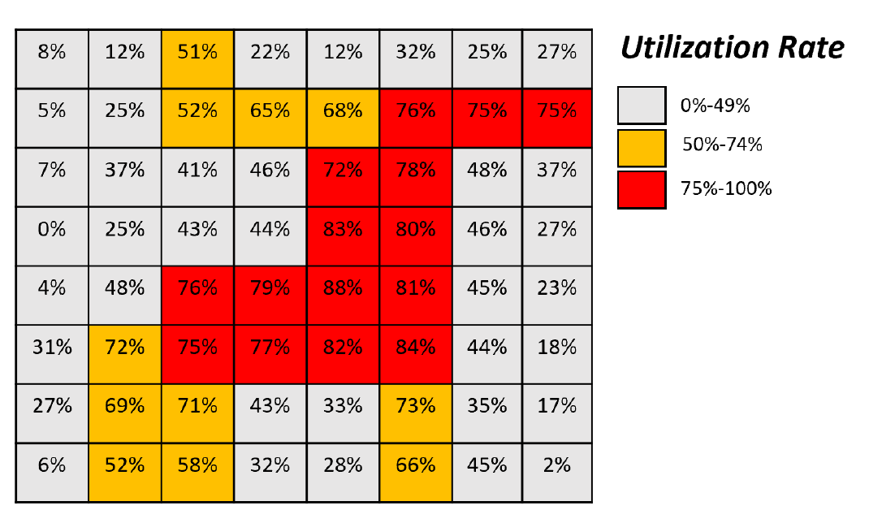
Contest Objective
2025:
2024:

Slide 4
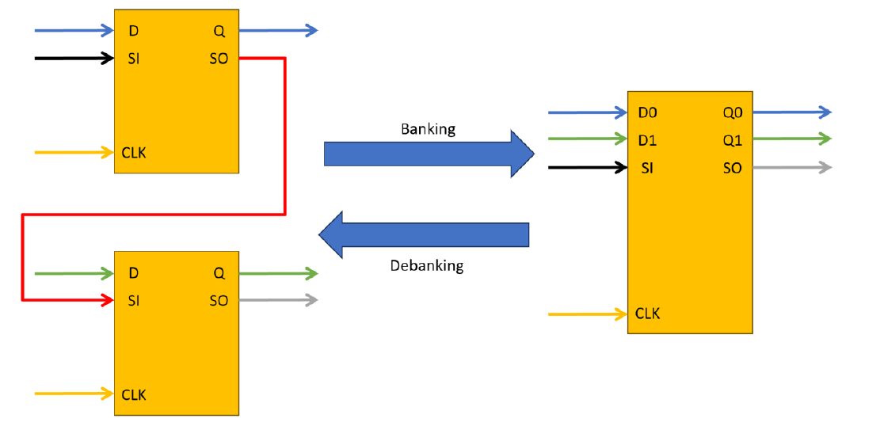
Contest Objective
Banking / Debanking Criteria :
All D pin and Q pin connections need to remain functionally equivalent after banking / debanking, and all CLK pins need to remain connected to the same clock net.
If there is any design for testability (DFT) scan chain connection on scan-input (SI) or scan-output (SO) pins of the higher-bit flip-flops, the banking / debanking process should honor the scan chain connection.

