Slide 1
SIS: A System for Sequential Circuit Synthesis
A Tutorial of Usage and Programming of SIS

Slide 2
Introduction
Berkeley: MIS II -> SIS
SIS: A System for Sequential Circuit Synthesis
  Combinational logic synthesis
    Two level & multi-level logic synthesis
    Technology mapping
  Sequential Circuit Synthesis
  Verification

Slide 3
Interactive Interface: Example
$ /u/class/CS258G/sis-1.3/bin/sis
sis> read_blif C1908.blif2
sis> print_stats
C1908.iscas pi=33 po=25 nodes=400 latches= 0
lits(sop)= 800
sis> source script.rugged
sis> print_stats
C1908.iscas pi=33 po=25 nodes=152 latches= 0
lits(sop)= 553
sis> write_blif C1908_r.blif
sis> quit

Slide 4
SIS Commands used in the example
read_blif circuit1.blif
  Read blif-format circuit
source script.rugged
  Do optimization using a set of commands
  many scripts in
    /u/class/CS258G/sis-1.3/sis/sis_lib
write_blif circuit2.blif
  Write blif-format circuit

Slide 5
Some Other SIS Commands
tech_decomp
  Decompose all the nodes in the current network into AND gates or OR gates or both
read_eqn eqn_circuit
  Read eqn-format circuit
verify blif_circuit
  Verify whether the blif_circuit is identical with the one read in before, which is eqn_circuit.
print_stats
  Print stats of the current circuit

Slide 6
SIS Programming
Two styles:
  Integrated programming style (being able to add commands into existing SIS interface)
    Take advantage of the SIS commands online
    Running and debugging need to be carried out under SIS’s interface.
    /u/class/CS258G/project_template/sis_guide.txt
    /u/class/CS258G/project_template/readme.txt
  Stand-alone programming style
    Only link with SIS library
    Easier to run and debug

Slide 7
Directory Structure
/u/class/CS258G/sis-1.3/
  SIS package location
/u/class/CS258G/sis-1.3/bin/
  Executable SIS program
  Add it to your path settings
/u/class/CS258G/proj_2004/circuits/
  Benchmark circuits
/u/class/CS258G/project_template/
  programming template for integrated style
/u/class/CS258G/proj_2004/rasp/
  UCLA RASP package executable
/u/class/CS258G/tutorial/
  Contains this tutorial

Slide 8
SIS Network
PI
Node
PO
PI
Node
PO
PI
PI: Primary Input
PO: Primary Output, a special node with one input and no output. Its function is the same as a buffer.
Node: Internal node

Slide 9
Input and Output: BLIF format
BLIF format:
  Berkeley Logic Interchange Format
  Used widely in academic research work
Function: Cubic form (sum of product)
Each node has multi-inputs and single output
Benchmark circuit for this project
  /u/class/CS258G/proj_2004/circuits/
  optimized by script.algebraic
  Decomposed into 2-input AND gates and OR gates

Slide 10
Blif Example: C17.blif
.model C17.iscas
.inputs 1GAT[0] 2GAT[1] 3GAT[2] 6GAT[3] 7GAT[4]
.outputs 22GAT[10] 23GAT[9]
.names 1GAT[0] 2GAT[1] 3GAT[2] [2] 22GAT[10]
1-1- 1
-1-1 1
.names 2GAT[1] 7GAT[4] [2] 23GAT[9]
1-1 1
-11 1
.names 3GAT[2] 6GAT[3] [2]
0- 1
-0 1
.end

Slide 11
Programming Example (Makefile of Stand-alone Style)
  CC = gcc
  SIS = /u/class/CS258G/sis-1.3/sis
  PSRC = my_main.c my_util.c
  POBJ = $(PSRC:.c=.o)
  PHDR = my_main.h
  TARGET = my.x
  LIBS = $(SIS)/lib/libsis.a
  INCLUDE = -I$(SIS)/include
  CFLAGS = -g $(INCLUDE) -DSIS
  LDFLAGS = -g
  $(TARGET): $(POBJ) $(LIBS)
  $(CC) $(LDFLAGS) -o $(TARGET) $(POBJ) $(LIBS) -lm

Slide 12
Programming Example
(C codes)
#include “my_main.h”
int blif_to_network ( char *filename, network_t **net )
{
  FILE *fp;
  fp=fopen( filename, "r");
  read_blif( fp, net ) ;
  fclose( fp );
}
int write_result( char *filename, network_t *net )
{
  FILE *fp;
  fp=fopen( filename, "w");
  write_blif(fp, net, 0, 0 );
  fclose( fp );
}

Slide 13
Programming Example (Con’t)
main(int argc, char **argv) {
  init_sis(0);
  option(argc, argv);
  blif_to_network(mid_filename,&net1);
  dfs = network_dfs(net1);
  for(i1=0;i1<array_n(dfs);i1++){
  node1 = array_fetch(node_t*, dfs, i1);
  if(node_type(node1)==PRIMARY_INPUT)
  continue;
  if(node_type(node1)==PRIMARY_OUTPUT)
  continue;
  if(node_num_fanin(node1)==1)
  continue;
  simplify_node(node1, SIM_METHOD_NOCOMP, SIM_DCTYPE_ALL, SIM_ACCEPT_SOP_LITS, SIM_FILTER_NONE);
  }
  network_sweep(net1);
  write_result(final_filename, net1);
  network_free(net1);
}

Slide 14
SIS Documents
SIS paper
  /u/class/CS258G/sis-1.3/SIS_paper.ps
  The detailed introduction of SIS system, including BLIF format description
Description of functions
  /u/class/CS258G/sis-1.3/sis/doc/

Slide 15
Commonly Used Documents
network.doc
  describe network operations.
node.doc
  describe node operations.
array.doc
  describe the operations for array data structure.
st.doc
  describe the operations for st_table (hash table)
io.doc
  describe the operations for I/O of SIS.
util.doc
  describe some supporting operations for programming.

Slide 16
Questions To
Deming Chen
  demingc@cs.ucla.edu
Check FAQ once in a while
  /u/class/CS258G/FAQ

Slide 17
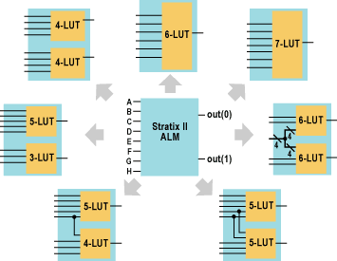
Stratix II ALM Overview
High flexibility
Implement complex logic functions with large input number
  Reduce logic level
  Reduce routing utilization
extended

Slide 18
Stratix II ALM Overview
High flexibility
Implement complex logic functions with large input number
  Reduce logic level
  Reduce routing utilization
extended
required

Slide 19



ALM Normal Mode
One ALM can implement the following functions without any restrictions
  Any two 4-input functions
  One 5-input function and one 3-input function
  One 6-input function

Slide 20



ALM Normal Mode
One ALM can implement the following functions with sharing inputs
  One 5-input function and one 4-input function that sharing one inputs
  Two 5-input functions that sharing two inputs
  Two 6-input functions that sharing 4 inputs

Slide 21
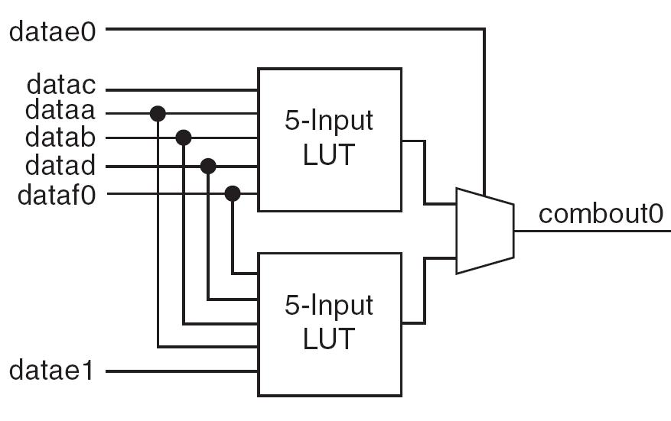
Extended LUT mode
One ALM can implement one 7-input function if it can fit into the following diagram

Slide 22
QUIP flow
Verify the quality of the designs through state-of-art tools
Quartus can take the QUIP interface to read in mapped circuits
read in
SIS
network
mapping
VQM
dumper
Quartus
Quip interface

Slide 23
Additional Notes
Extra data fields in SIS data structure
  One ALM may contains two LUTs
  Pairing is needed to record the two LUTs in one ALM
  The “undef1” field in SIS can be used for such purpose
  typedef struct {
  int label;
  ... ...
  } proj_aux_t;
  API: PROJ_PAIR_ID(n)
  Remember to allocate the memory for the structure
  Example code in /u/class/CS258G/project_template/myproj/com_myproj.c

