Slide 1
A High Performance Detailed Router Based on Integer Programming with Adaptive Route Guides
ASP-DAC 2024

Slide 2
Introduction
Facing the high complexity of the detailed routing problem, there are two main approaches to solve it, including sequential routing approach and concurrent routing approach.

Slide 3
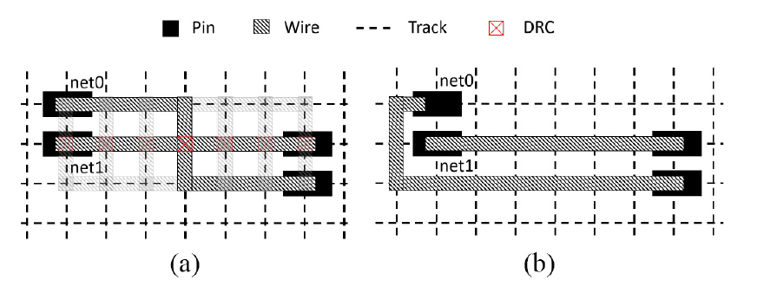
Introduction
The sequential routing approach uses iterative rip-up and reroute (R&R) to reduce the number of design rule violations (DRVs) [1]–[7].
Issue
The net ordering during routing is critical for the runtime and the solution quality.
Net routes ripped-up may be discarded too early.

Slide 4
Introduction
The net ordering issue is considerably mitigated by queue-based R&R approach TritonRoute-WXL[7].

Slide 5
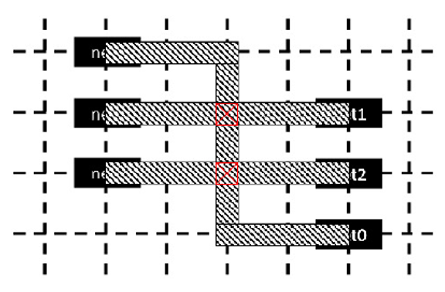
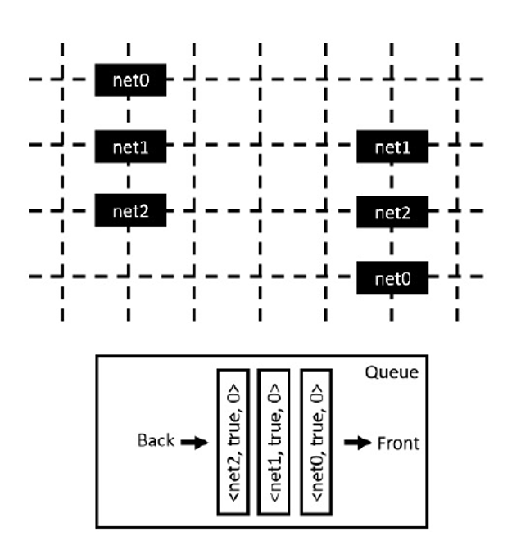
Queue-based R&R
aggressor and victim
Element : (net name, isRoute, route times)
isRoute = true : (re)route and incremental DRC
false : incremental DRC only

Slide 6
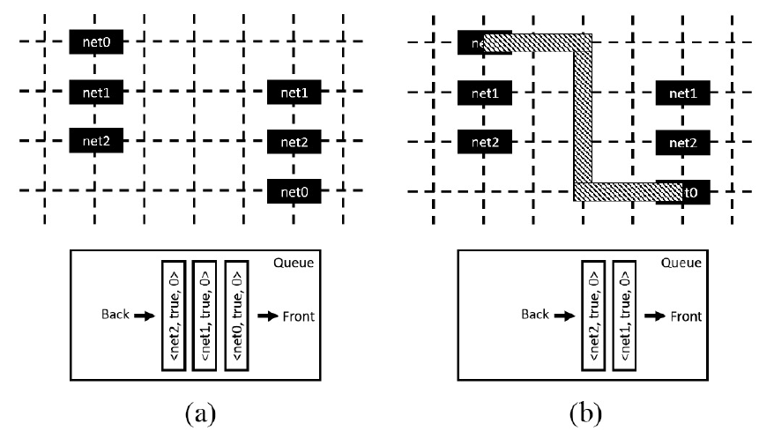
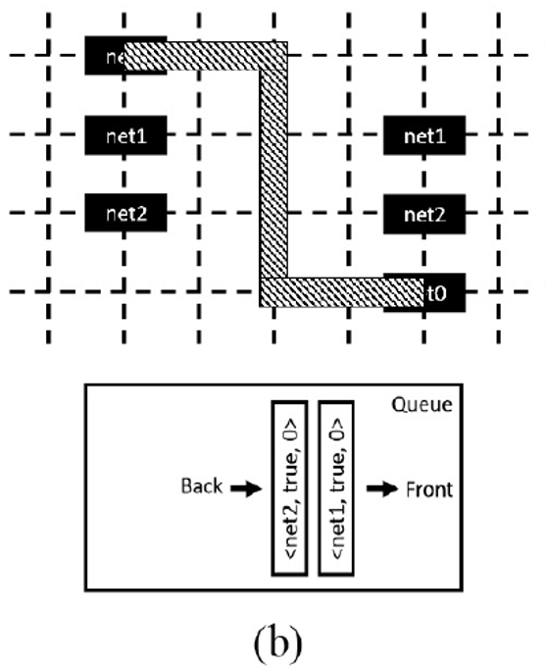
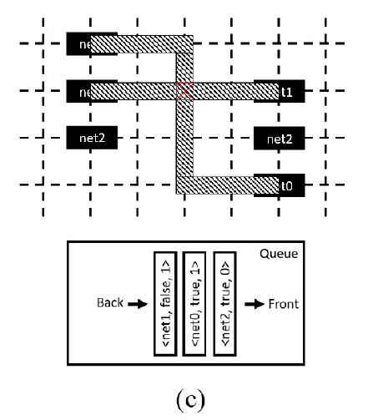
Queue-based R&R

Slide 7
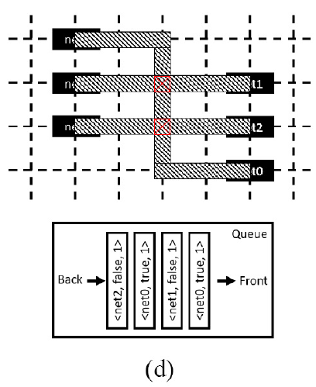
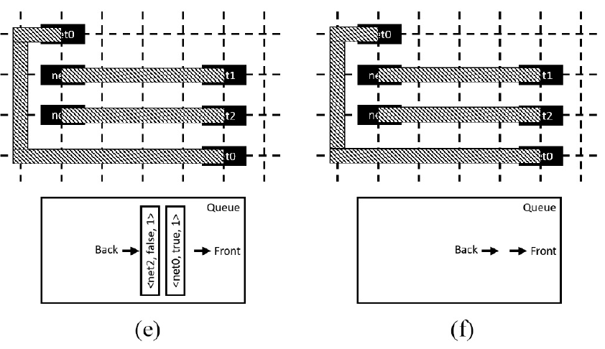
Queue-based R&R

Slide 8
Introduction
The concurrent routing approach formulates detailed routing as integer linear programming (ILP), Boolean satisfiability(SAT), or satisfiability modulo theories (SMT) problems [9]–[11].
In this approach, route construction of multiple nets are performed concurrently to optimize the solution quality.

Slide 9
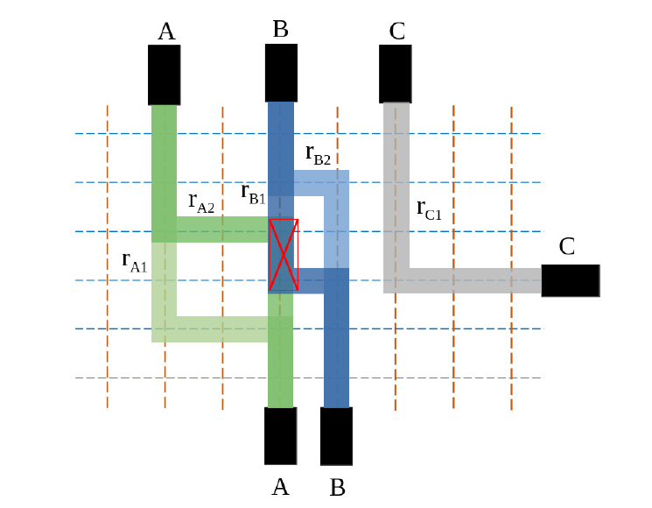

Introduction
A well-studied formulation is to treat the assignment of each routing grid point to a net (routing-grid-based) as a decision variable, and model connectivity and design rules as constraints.
It generates high quality solutions, but often requires long runtime. As a result, it is generally applied in small routing regions.
routing-grid-based
Horizontal : 6 X 9 = 54
Vertical : 8 X 7 = 56
54 + 56 = 110 decision variables

Slide 10
Introduction
Another formulation is to use selection of possible net routes (route-based) as decision variables.
Benefits
It is more scalable than the routing-grid-based formulation [12].
Overcome the issue of discarding routes in early R&R procedure.
route-based
net_{A} : r_{A1} , r_{A2} => 2
net_{B} : r_{B1} , r_{B2} => 2
net_{C} : r_{C1} => 1 2 +2 + 1 = 5 decision variables

Slide 11
Introduction
routing-grid-based
Horizontal : 6 X 9 = 54
Vertical : 8 X 7 = 56
54 + 56 = 110 decision variables
route-based
net_{A} : r_{A1} , r_{A2} => 2
net_{B} : r_{B1} , r_{B2} => 2
net_{C} : r_{C1} => 1 2 +2 + 1 = 5 decision variables

Slide 12
Contribution
An effective detailed routing algorithm with a scalable IP formulation is proposed.
High quality candidate routes are generated using queue-based R&R with adaptive global route guides following.
An efficient design rule checking engine which supports examining nets with multiple routes simultaneously is designed.
Achieves better solution quality and shorter runtime than the state of-the-art TritonRoute-WXL [7] results.

Slide 13
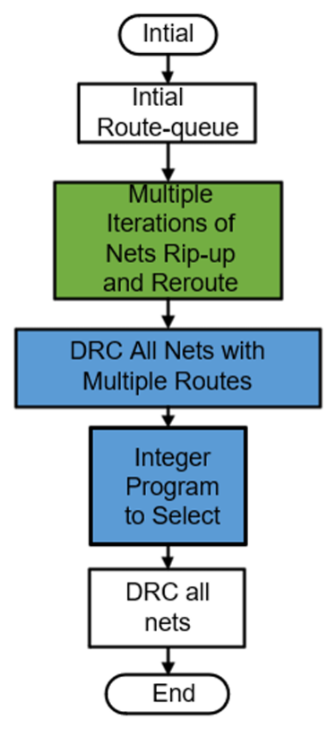
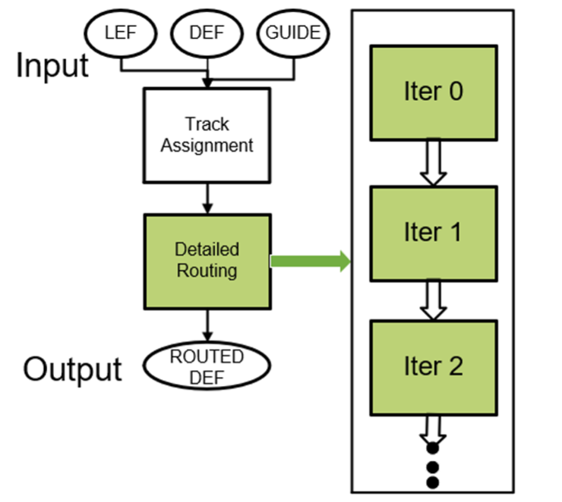
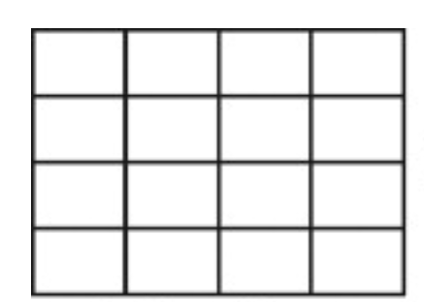
IPAG - Overall Flow
Process in Local Routing Region

Slide 14
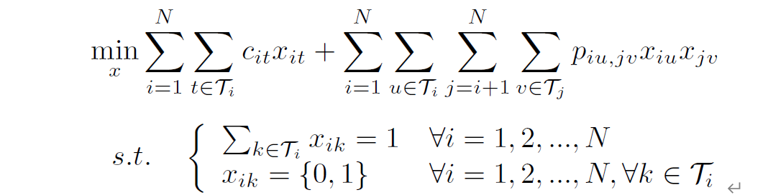

IP Formulation
The detailed routing procedure in each local region include two phases, namely IP instance construction and IP solving to select best routes.

Slide 15
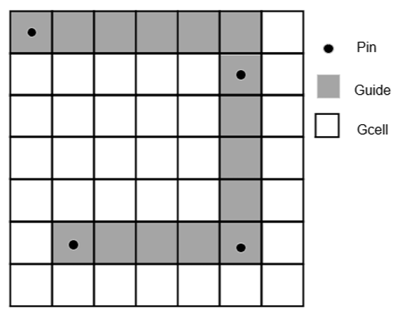
IP Formulation
preferred direction and non-preferred direction

Slide 16
IP Formulation
The formulation has some unique properties compared to the routing-grid-based formulation.
Explicit representation of various design rules in the formulation is not required.
The size of IP instances depends on the number of nets to be routed and the number of candidate routes.
The candidate routes are not restricted to be on grid, so it is applicable for both gridded routing and gridless routing.

Slide 17
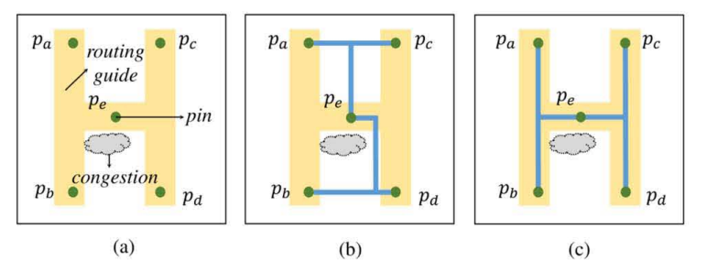
Candidate Generation with Adaptive Guide Following
Adaptive Global Routing Guides

Slide 18
Candidate Generation with Adaptive Guide Following
Queue-based R&R

Slide 19
Candidate Generation with Adaptive Guide Following
Queue-based R&R

Slide 20
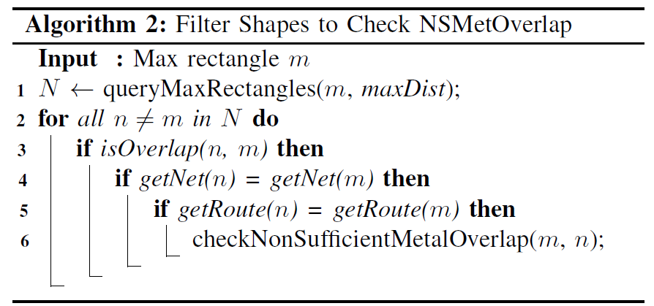
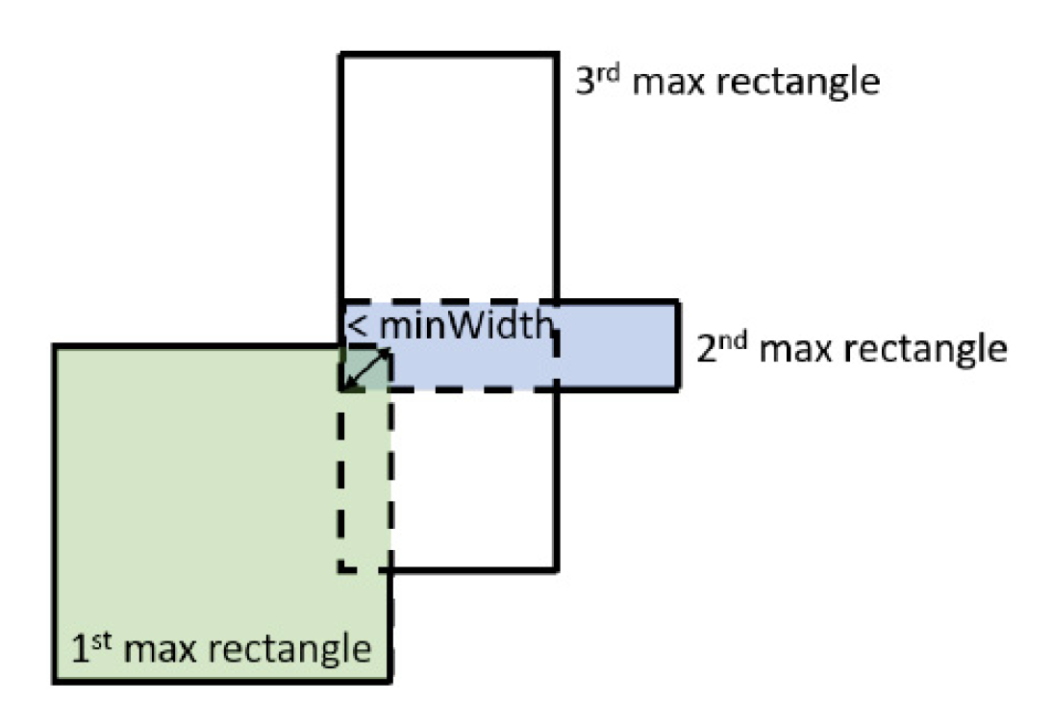


Multi-Route Design Rule Checking
Treating each candidate route as a net in design rule checking, multiple candidate routes of a net can be processed at the same time.

Slide 21
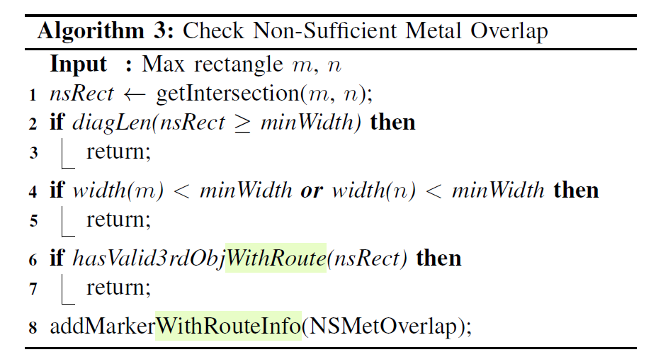
Multi-Route Design Rule Checking

Slide 22
EXPERIMENTS
Use CPLEX[18] as the IP solver.
Use ISPD 2018 detailed routing benchmark suite [19].
The detailed router runs on a computer with an Intel CPU @ 2.30GHz and 64 GB RAM.
The detailed routing results are verified by design rule checking in Cadence Innovus Implementation Systems 15.2 [20].

Slide 23
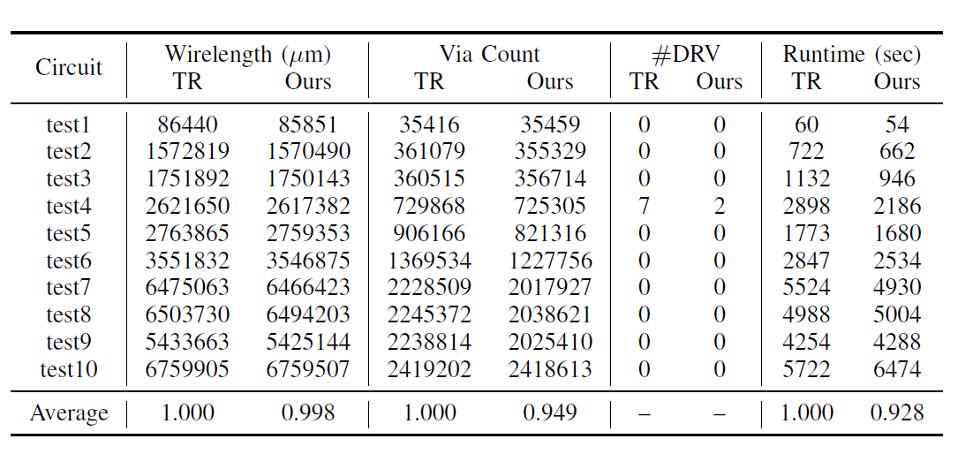
EXPERIMENTS

Slide 24
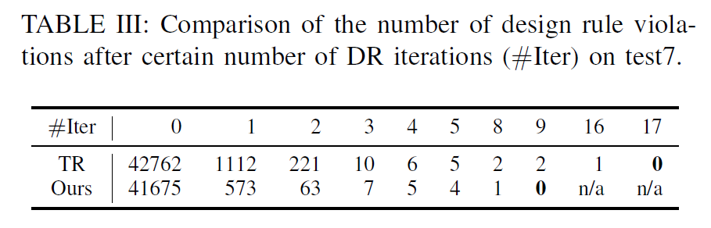
EXPERIMENTS

Slide 25
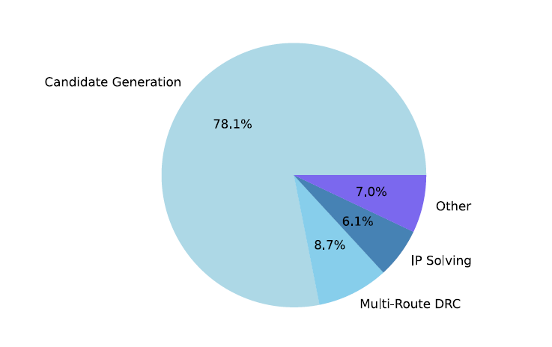
EXPERIMENTS

