Slide 1
Power and Timing Optimization Using Multibit Flip-Flop
ICCAD 2025 Problem B

Slide 2
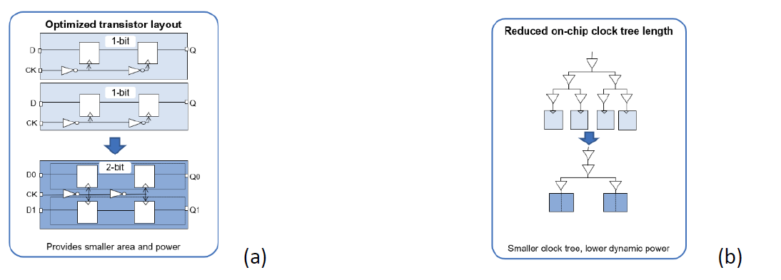
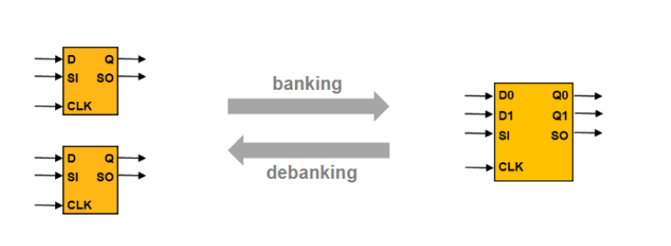
Introduction
To develop a banking and debanking algorithm that produces a placement result optimized for timing, power, and area.

Slide 3
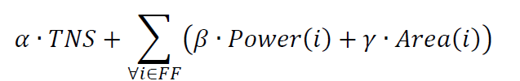

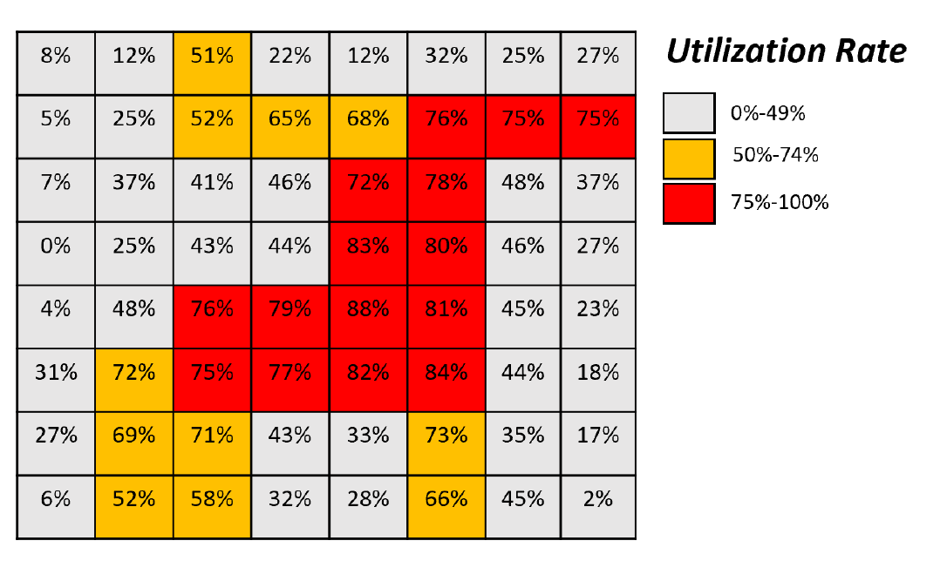
Contest Objective
2025:
2024:

Slide 4
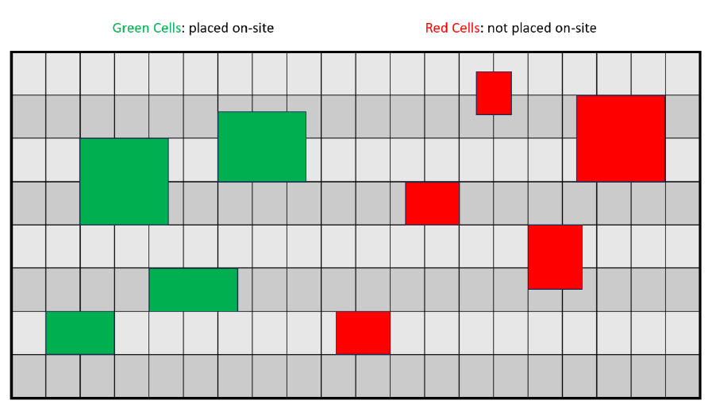
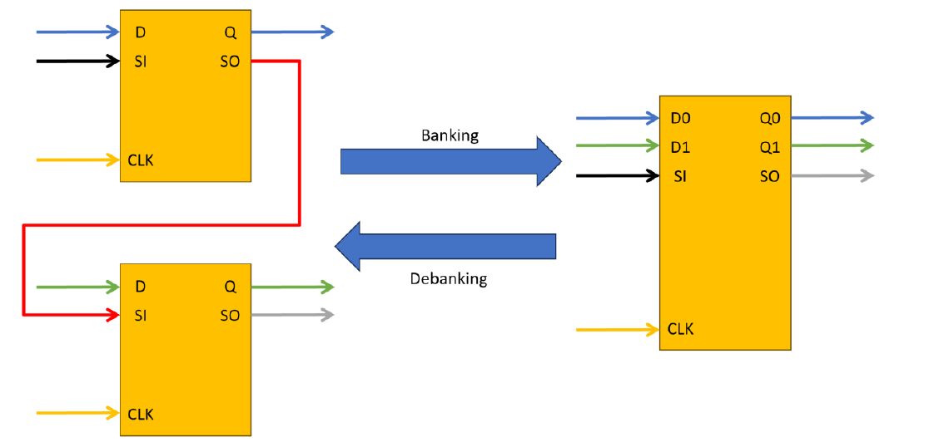
Constraints
All instances must be placed on-site and within the die region.
No overlap
Must satisfy utilization rate of each bin
Banking / Debanking Criteria :
All D pin and Q pin connections need to remain functionally equivalent after banking / debanking, and all CLK pins need to remain connected to the same clock net.
If there is any design for testability (DFT) scan chain connection on scan-input (SI) or scan-output (SO) pins of the lower / higher-bit flip-flops, the banking / debanking process should honor the scan chain connection.

Slide 5
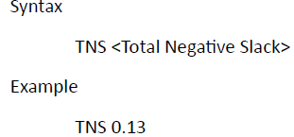
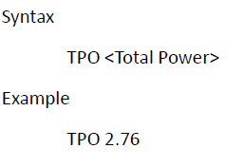
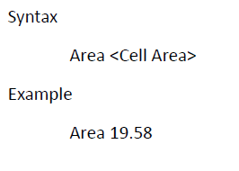
Problem Formulation and Input/Output Format
Given:
1.Weight factors for cost metrics (i.e. 𝛼, 𝛽, and 𝛾 )
2.Timing slack and delay information
3.Power information
4.Area information
5. Flip-Flop Library Cells
6.Cell placement result with flip-flop cells ( LEF/DEF format )

Slide 6
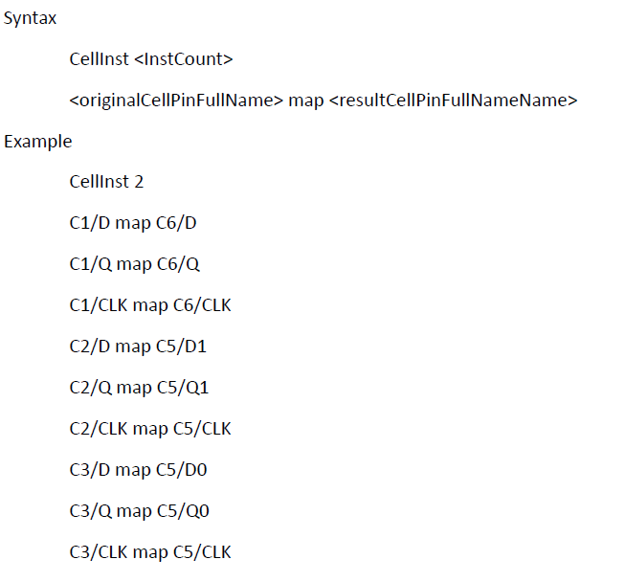
Problem Formulation and Input/Output Format
Output:
A list of pin mapping between each input flip-flop pins and the output flip-flop pins
A flip-flop placement solution (LEF/DEF format )

Slide 7
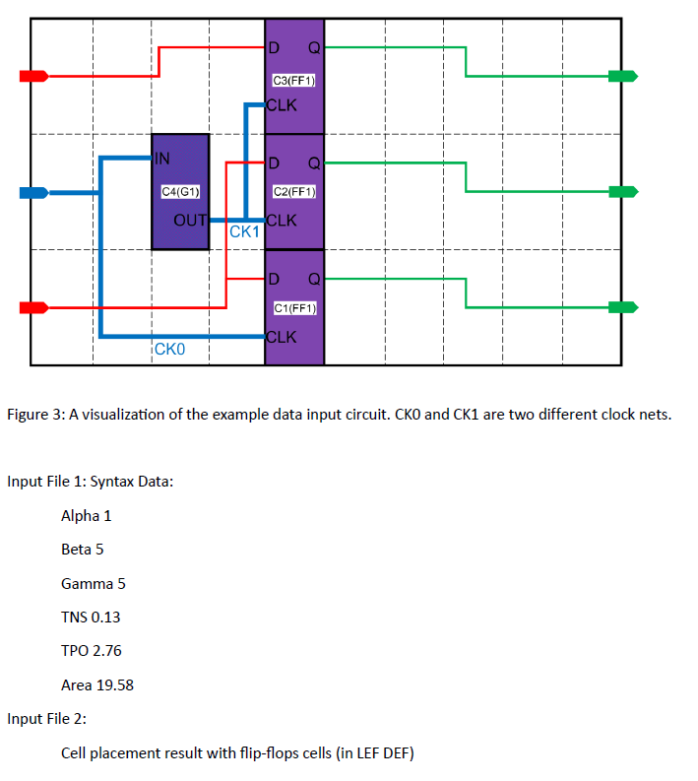
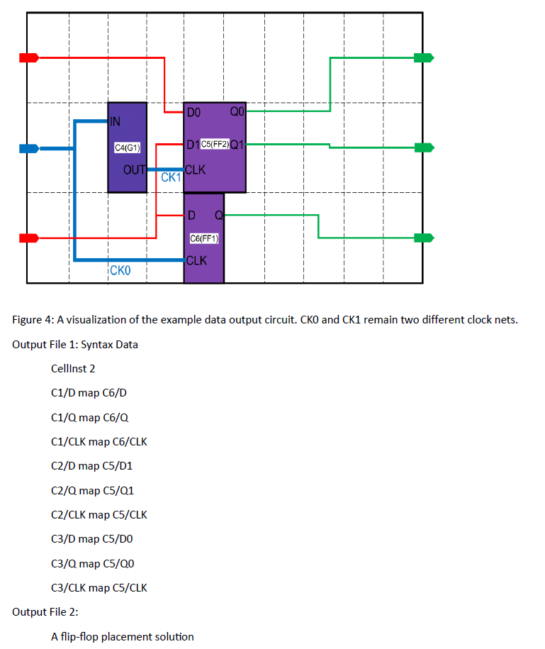
Sample input: Sample output:

Slide 8
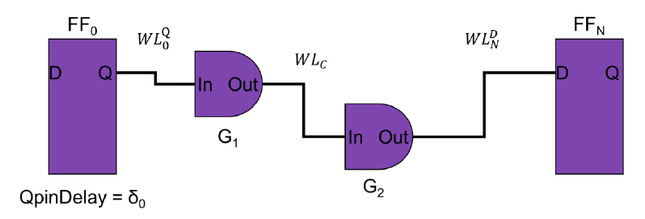
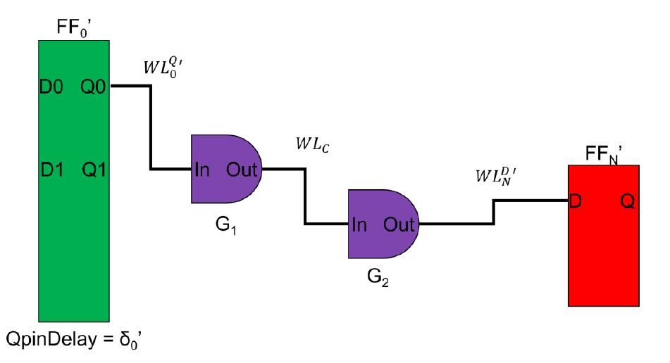
Slack

Slide 9


Score Function
TNS, Power, Area are reported using the command report_qor , report_power , report_qor from Fusion Compiler.
CPU Cores: You have 8 CPU cores available for your program.
Time Limit: The evaluation machine is limited to 60 minutes for each test case. The hidden cases will be in the same scale as public cases.

