Slide 1


TeamPulse AI
Team leader: Riya Bisht | Team member: Ishu Mehra
Theme: Future of Work & Enterprise Productivity
Problem: Lost approvals, unresolved blockers and fragile handovers
Notes:
TeamPulse AI is the working team and project name. Team leader and member were supplied by the team. No official problem ID was supplied.

Slide 2

Work waits when decisions get lost
An approval disappears in chat.
A blocker holds up dependent work.
An absence leaves critical context behind.
TeamPulse connects each concern to an owner, evidence and the next action.
Notes:
Problem framing drawn from README.md and docs/proposal.md. This replaces the template's download instructions; no external productivity statistics are claimed.

Slide 3
Brief about the idea
TeamPulse AI helps engineering managers coordinate delivery and support engineers.
Attention
A ranked inbox surfaces decisions, approvals and support requests.
Knowledge
Project records, dependencies and documents become an evidence-linked handover brief.
Execution
Managers approve coverage; the backup accepts before task ownership changes.
Notes:
Theme: Future of Work & Enterprise Productivity. The prototype supports knowledge access, collaboration, decision making and workflow execution. Sources: README.md; backend/app/services/handovers.py. Efficiency gains have not been measured with a real team.

Slide 4
Opportunities
Difference
Decisions, support requests and handovers share one tracked workflow.
Problem solved
Unresolved work stays visible after notifications are read.
Distinctive value
Backup eligibility is checked before ranking and again at approval and acceptance.
Human control
Rules determine risk and priority. Gemini explains evidence; people approve assignments.
Notes:
These distinctions describe the implemented prototype, not a claim of uniqueness against every competitor. Sources: notifications/service.py, services/handovers.py, rules/candidates.py.

Slide 5
List of features offered by the solution
Manager overview
Project health, ranked actions and linked risk evidence.
Engineer support
Blockers, approvals, progress updates and visible responses.
Continuity
Dependency impact, backup ranking and eleven-section handover briefs.
Accountability
Notifications, audit history and two human decisions before reassignment.
AI assistance
Project summaries, request interpretation, handover briefs and risk explanations.
Notes:
Implemented features inspected in frontend/src/pages and backend/app/api/routes. The current local demo uses deterministic fallback because no Gemini key was configured for this run.

Slide 6
Process flow: engineer absence to approved coverage
1 Engineer records
unavailability
2 Rules map tasks
and dependencies
3 Eligible backups
are ranked
6 Backup accepts;
ownership transfers
5 Manager selects
and approves
4 Brief cites records
and flags gaps
An AI recommendation alone never changes task ownership.
Notes:
Editable process diagram. Sources: backend/app/services/handovers.py; backend/tests/test_handover_flow.py. Verified locally: manager approval retains Rhea as task owner until Arjun accepts.

Slide 7
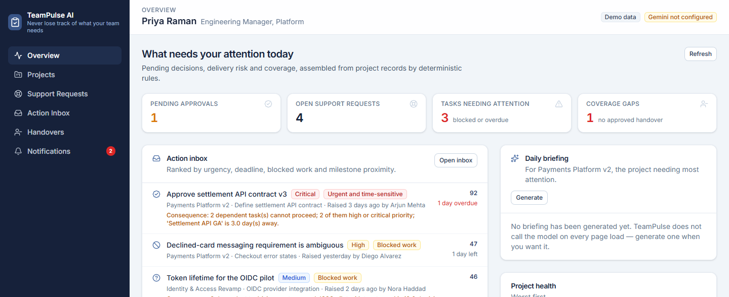
Interface: the running manager dashboard
Actual local prototype · synthetic data · AI fallback labelled in the interface
Notes:
Screenshot captured from the existing app on 18 October 2026. No mock interface was created. Source: deliverables/evidence/01-manager-overview.png.

Slide 8
Architecture diagram of the solution
React + TypeScript
Manager and engineer UI
HTTP / JSON
FastAPI application
Authorization + workflows
Deterministic rules
Risk, ranking, dependencies
AI service
Gemini + validated fallback
Repository abstraction
Memory / Firestore adapter
Firebase Authentication is implemented for production; this demo uses development personas.
Notes:
Editable architecture diagram. Sources: backend/app/main.py, repositories/database.py, ai/service.py, core/security.py, frontend/src/services/auth.ts. Firestore, live Firebase identity and Cloud Run were not tested in this local validation.

Slide 9
Technologies used in the solution
Frontend
React 19, TypeScript, Vite, Tailwind CSS and React Router.
Backend
Python 3.12, FastAPI, Pydantic and Uvicorn.
AI and data
Google Gen AI SDK, Gemini integration and Cloud Firestore adapter.
Identity and hosting
Firebase Authentication code; Docker / Cloud Run deployment configuration.
Verification
pytest, coverage, Vitest, Testing Library, Ruff and oxlint.
Notes:
Source: frontend/package.json, backend/requirements.txt, Dockerfile. Runtime used for this validation: Python 3.12.10 and Node 24.22.0. Locked Firebase packages require Node >=24.12, although README currently says Node 20+.

Slide 10
Implementation cost and operating assumptions
Local prototype
No cloud account or API key needed for the memory-backed fallback demo.
Development
Existing hardware and team time; engineering effort has not been costed.
Hosted pilot
Cloud Run, Firestore and Gemini usage depend on traffic and configuration.
Estimate status
No cloud cost estimate or paid deployment was verified in this run.
Notes:
No current vendor pricing is asserted. Local mode requires no paid service; hardware, electricity and developer time are excluded. A hosted budget requires explicit workload assumptions and current vendor calculators.

Slide 11
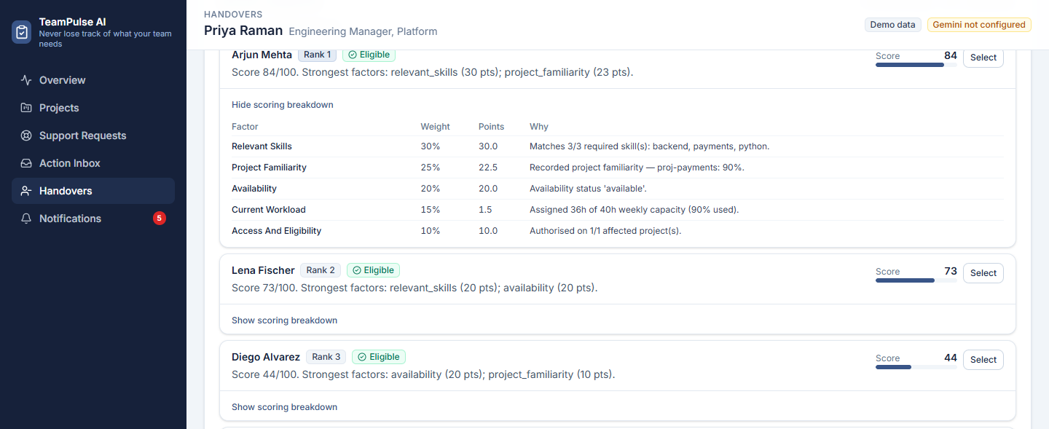
Prototype snapshot: backup recommendations
Ranked candidates show the trade-off; managers retain the assignment decision.
Notes:
Actual local screenshot: deliverables/evidence/09-candidate-ranking.png. Synthetic ranking: Arjun 84, Lena 72.5. Weights are initial design choices, not validated performance measures.

Slide 12
Prototype performance and benchmarking
Local verification | Result | Scope
Backend / frontend tests | 138 / 47 passed | Existing automated suites
Backend statement coverage | 91% | 3,244 statements
Expected delivery risks | 8 / 8 found | One synthetic payments project
Ineligible assignments | 6 / 6 refused | Synthetic backup candidates
Unauthorized reads | 60 / 60 refused | 45 cross-user + 15 project reads
Build and Python lint pass. Frontend lint: 16 warnings, 0 errors.
Synthetic results do not establish real-team productivity gains or production readiness.
Notes:
Fresh validation on 18 October 2026. Sources: deliverables/evidence/backend-tests.xml; frontend Vitest output (47 passed); scripts/run_evaluation.py output. Coverage: 3,244 statements, 307 missed (90.54%, rounded to 91%). No latency benchmark, user study or production performance claim is made.

Slide 13
Additional details and future development
Validated locally
Manager and engineer flows, requests, approvals, handovers and fallback behaviour.
Before a real pilot
Real user onboarding, persistent data setup and a complete Firebase sign-in check.
Reliability work
Atomic handover updates, scheduled reminders and broader browser / Firestore tests.
Product evaluation
Test with a real team; measure decision waiting time and handover completeness.
Notes:
Future items are a backlog, not changes made during this task. Source code remains unchanged. Known gaps: docs/evaluation.md and this repository review. Cloud deployment and live AI were not revalidated.

Slide 14
Repository, demo video and product access
GitHub public repository
github.com/demon192/pulse-ai
Three-minute demo
Team recording planned · add the public video URL before submission
Final product
Local: http://127.0.0.1:8000 · public hosting pending
Notes:
The team will record the demo themselves using the companion three-minute script. Add the public video URL before final submission. localhost is accessible only on the demo computer. Replace it with the hosted app URL when deployment is complete. No upload or cloud publication was performed.

Slide 15
Three-minute demo walkthrough
0:00–0:35
Manager overview: the approval holding up settlement delivery.
0:35–1:15
Engineer raises a blocker; manager responds; the outcome stays tracked.
1:15–2:30
Absence impact, ranked backups and a brief; approve, then accept.
2:30–3:00
Notifications, AI provenance and the limits of this local prototype.
Notes:
The companion demo script provides narration and exact persona changes. Synthetic personas are Priya, Diego, Rhea and Arjun. Demonstrate fallback openly when a Gemini key is not configured.

Slide 16


