Slide 1
CEIS150 Module 1
Software Environment Setup

Slide 2
Rubric
Activity | Requirement(s) | Points
Python Program Running Successfully | Python program | 30

Slide 3
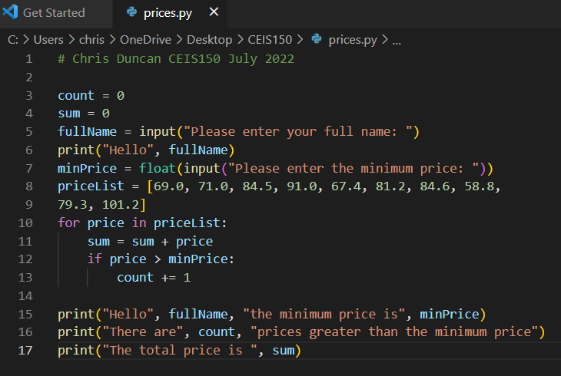
Program
Screen shot of Python program running successfully.

Slide 4
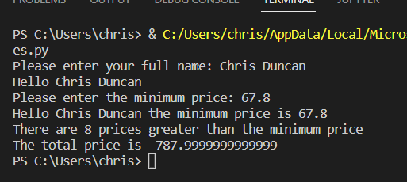
Program
Screen shot of Python program running successfully.

