Slide 1

CEIS150 Module 2 Christopher Duncan
Class Diagrams
Class Coding
Unit Testing

Slide 2
Rubric
Activity | Requirement(s) | Points
Class Diagram | Class Diagram | 10
Class Code | Screen Shot of Class Code | 15
Unit Test | Screen Shot of Unit Test | 15

Slide 3
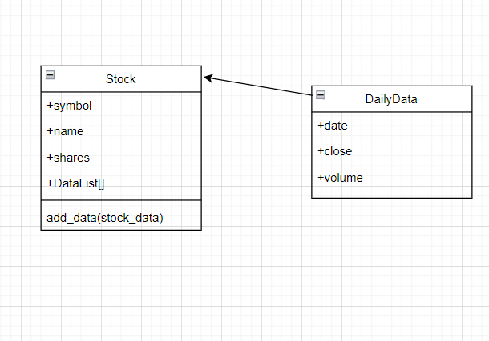
Class Diagram
Paste your Visio Class Diagram

Slide 4
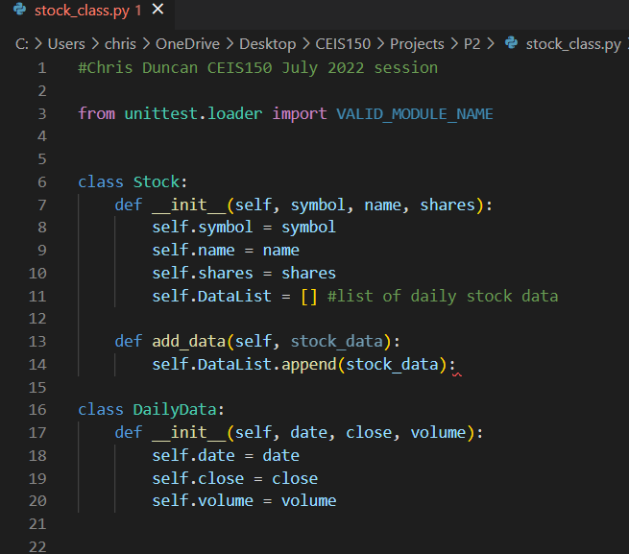
Class Code
Screen Shot of your stock_class.py file.

Slide 5

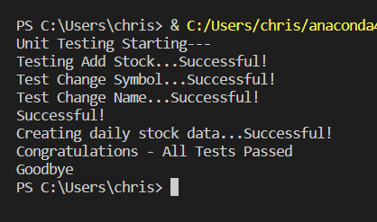



Unit Test
Screen Shot of your successful unit test.

