Slide 1
CEIS150 Module 3
Text-Based User Interface
Summary Report
By Christopher Duncan

Slide 2
Rubric
Activity | Requirement(s) | Points
Adding a Stock | Screen Shot of adding stock data | 20
Listing all Stocks | Screen Shot of listing 3 stocks | 10
Daily data | Screen Shot of adding daily data | 10

Slide 3
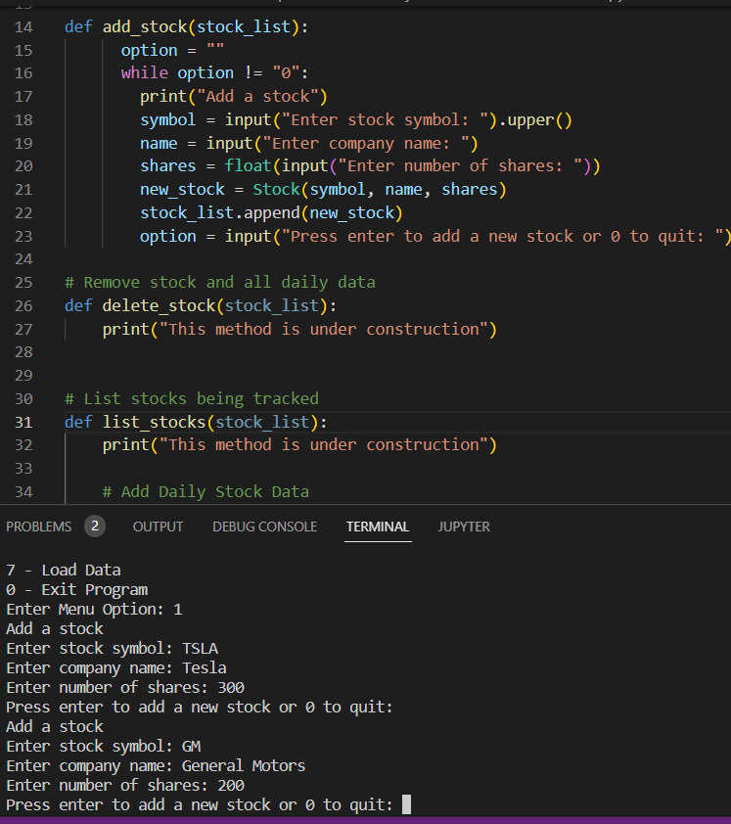
Adding a Stock

Slide 4
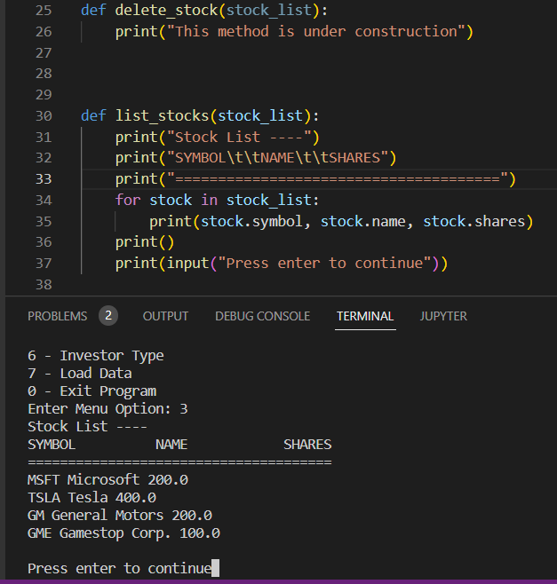
Listing 3 Stocks

Slide 5
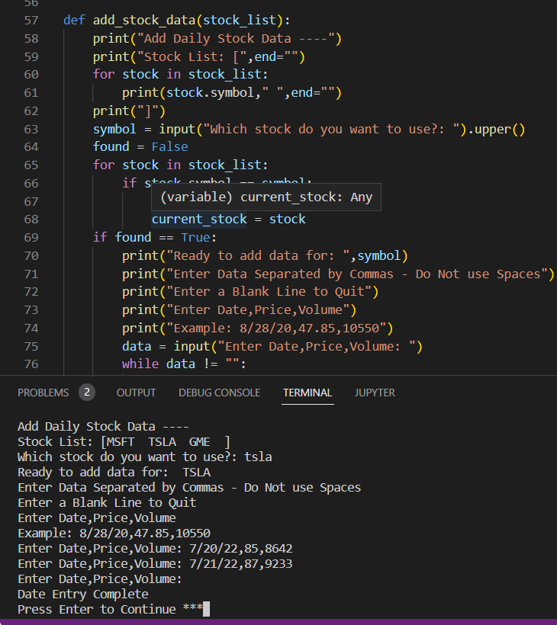
Daily Data

