Slide 1
CEIS150 Module 4
Inheritance Summary Report
Christopher Duncan

Slide 2
Rubric
Activity | Requirement(s) | Points
Inherited classes | Screen shot of classes | 15
Unit Tests | Screen Shot of unit tests working | 15
Main program | Screenshot of classes in main | 10

Slide 3
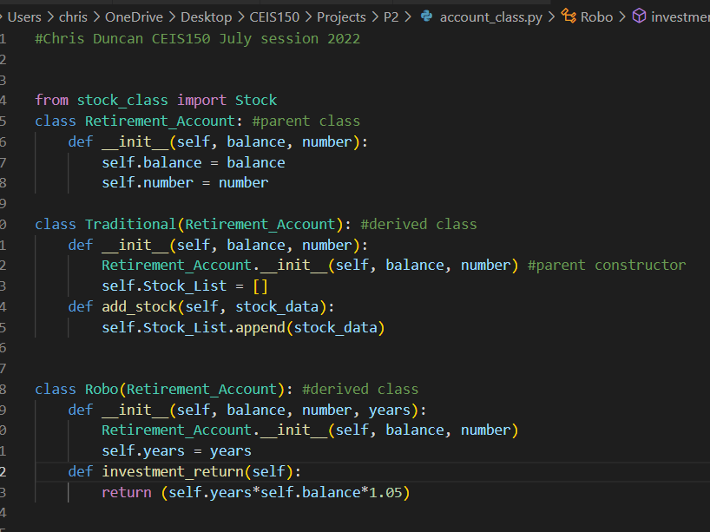
Inherited classes

Slide 4
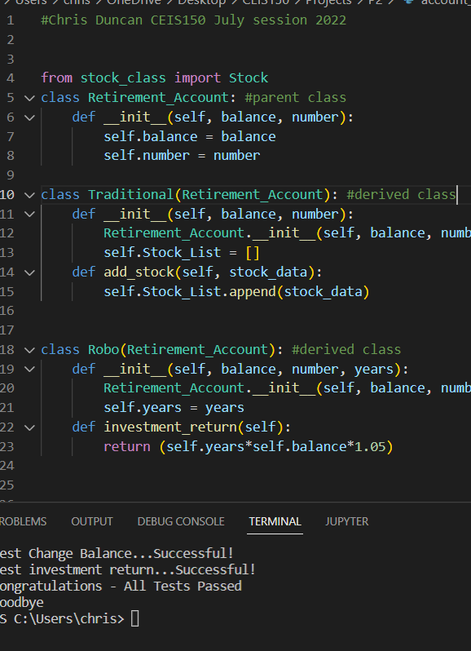
Unit Tests

Slide 5
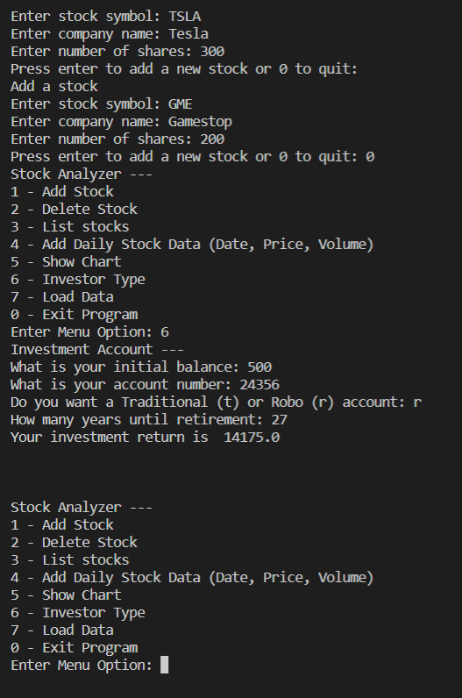
Stock menu program

