Slide 1
CEIS150 Module 5
Creating a Chart
Christopher Duncan

Slide 2
Rubric
Activity | Requirement(s) | Points
Chart | Screen shot of working Chart | 40

Slide 3

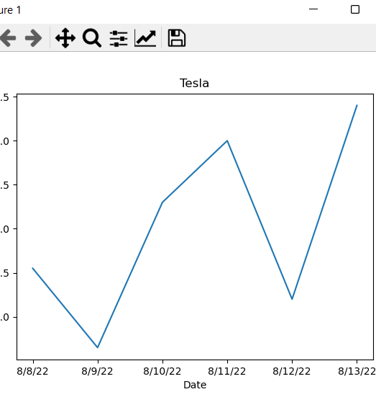
Chart

