Slide 1
CEIS150 Module 6
Loading Data
Christopher Duncan

Slide 2
Rubric
Activity | Requirement(s) | Points
File | Screen shot of file in File Explorer | 20
Importing data | Screenshot of chart from historical data import | 20

Slide 3
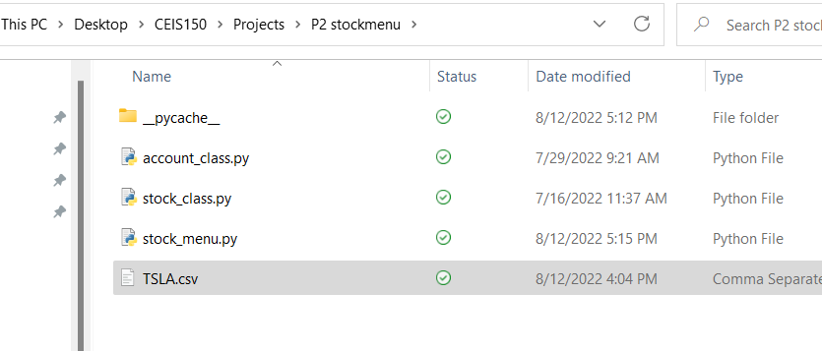
File

Slide 4
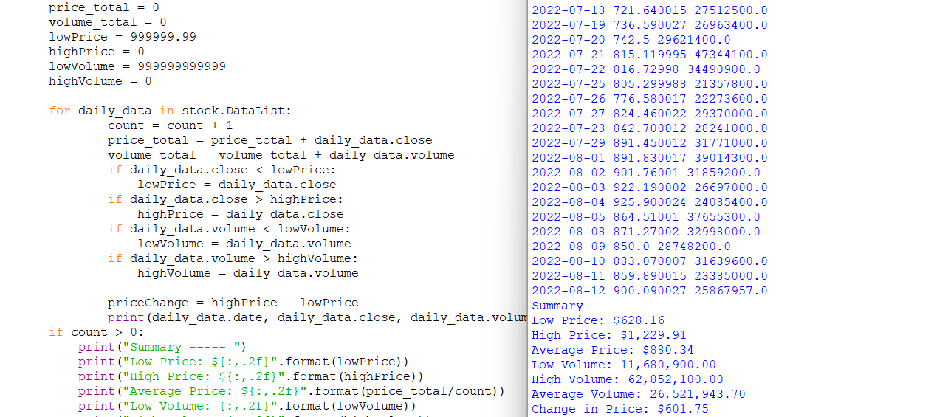
Importing data

Slide 5
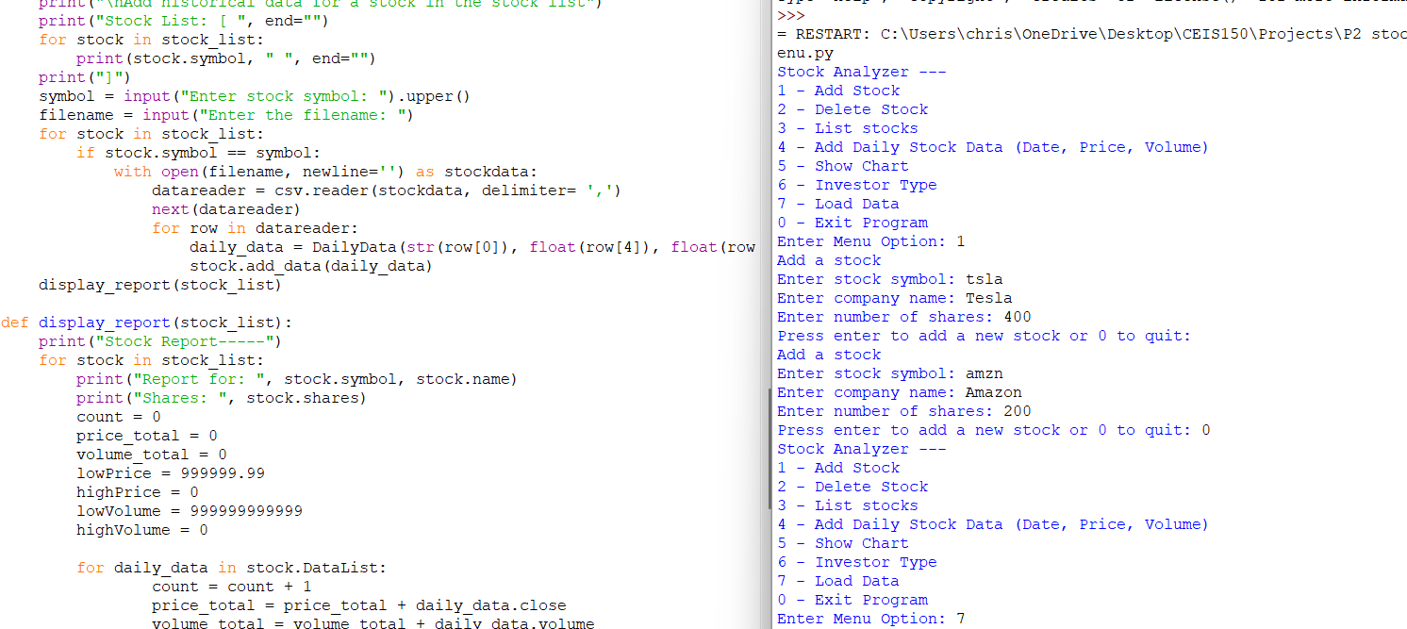
Adding Stocks

