Slide 1
CEIS150 Module 7
GUI
Christopher Duncan

Slide 2
Rubric
Activity | Requirement(s) | Points
Stocks in GUI | Screen shot of working program | 15
History complete | Screen shot of working History Tab | 15
Report Complete | Screen shot of Report Complete | 10

Slide 3

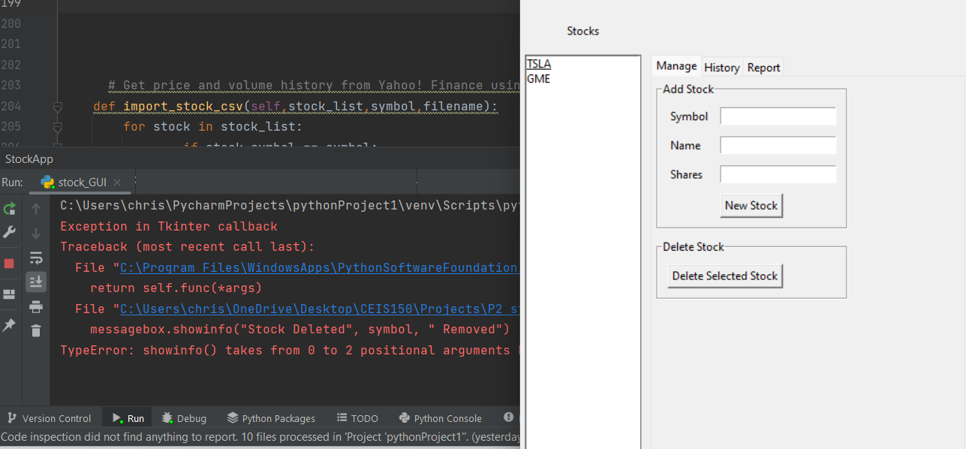
Stocks in GUI

Slide 4
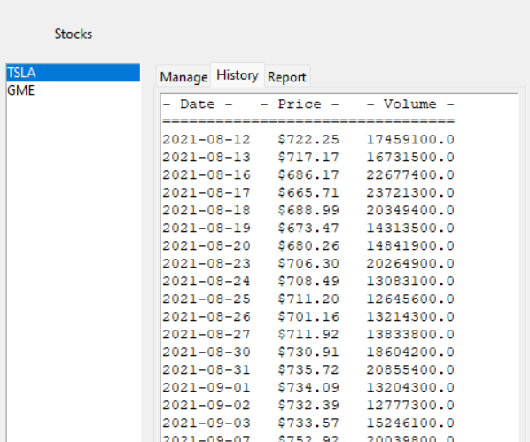
History Tab

Slide 5
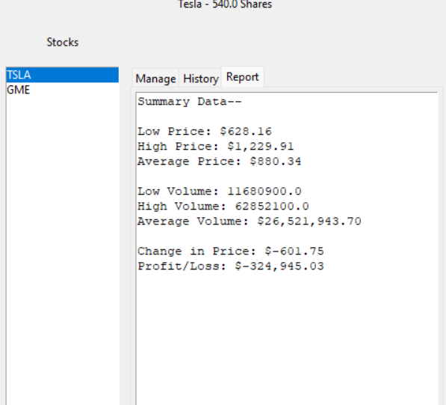
Report Complete

Slide 6
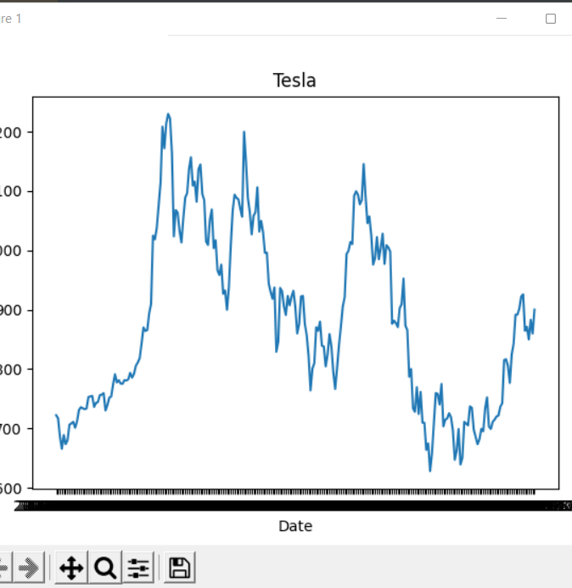
Chart

