Slide 1
Terraform Onboarding
SAAS

Slide 2
Agenda
Introduction
Why are we doing this?
Plan
Architecture
How it works
Demo
11/22/2022
Terraform Onboarding

Slide 3
Introduction
Converting UI/manual creation and maintenance of DataDog Monitors and PagerDuty resources (currently Users, Teams, Services, Escalation Policies and Schedules) into code-managed Terraform modules.
11/22/2022
Terraform Onboarding

Slide 4
Why are we doing this?
Allows squads to manage monitor and resource releases along with code releases
Automatically integrates DataDog monitors with PagerDuty services (and Slack soon) to seamlessly escalate incidents to proper engineers
Keeps monitor naming, tags and key settings uniform across the enterprise
MaC allows for easy recovery or reverting of changed or deleted resources
We can identify and remove unmanaged/abandoned monitors and resources
11/22/2022
Terraform Onboarding

Slide 5
Plan
1
2
3
4
5
Introduction & Demo(Today)
A basic demo of what it is?
Setup
Enable SAAS team members for the migration.
Migration
YAML files for Datadog/PagerDuty modules would be created with the support of SRE.
Review
PR would be created and shared for SRE review.
Apply
Post PR approval the changes would be applied via Terraform Web Console.
11/22/2022
Terraform Onboarding

Slide 6
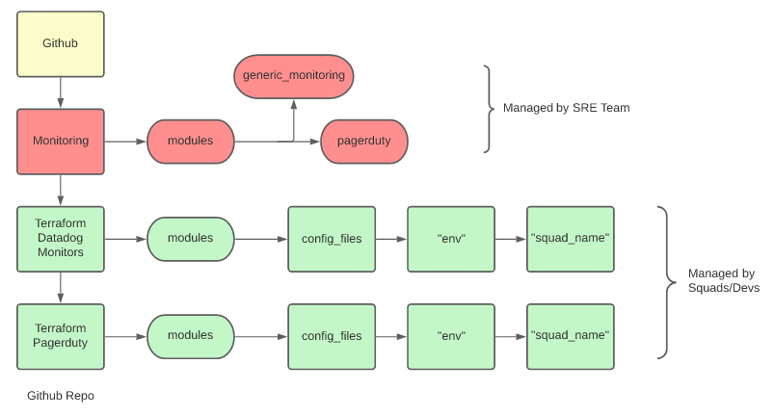
Architecture
11/22/2022
Terraform Onboarding

Slide 7
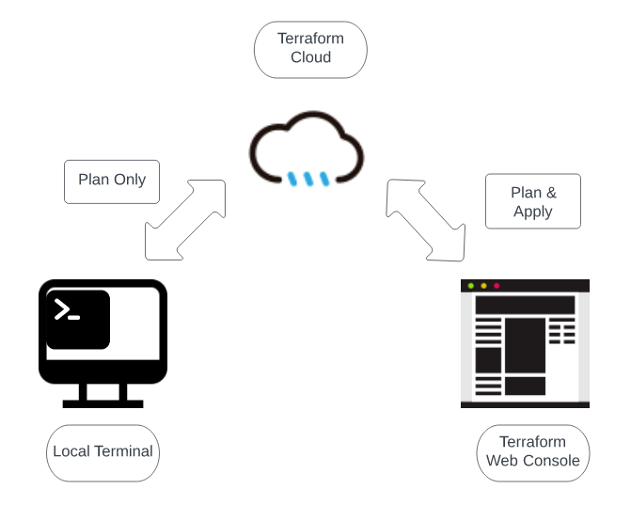
How it works
11/22/2022
Terraform Onboarding

Slide 8
Demo
11/22/2022
PRESENTATION TITLE

Slide 9
Thank you

