Slide 1
How information is organized in Google Search
Blokhin D.M. ICU7-62B

Slide 2

The robots
As the robot visits sites, it follows the links indicated on them to other pages. He pays special attention to new and changed sites, as well as broken links.

Slide 3
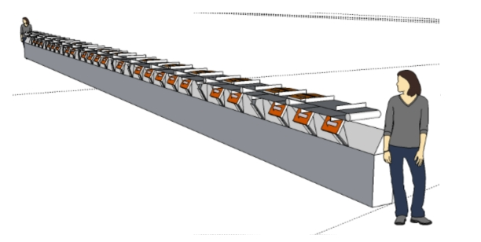
Scanning
The Internet is like a library that contains billions of titles and is constantly growing, but does not have a centralized book-keeping system.

Slide 4
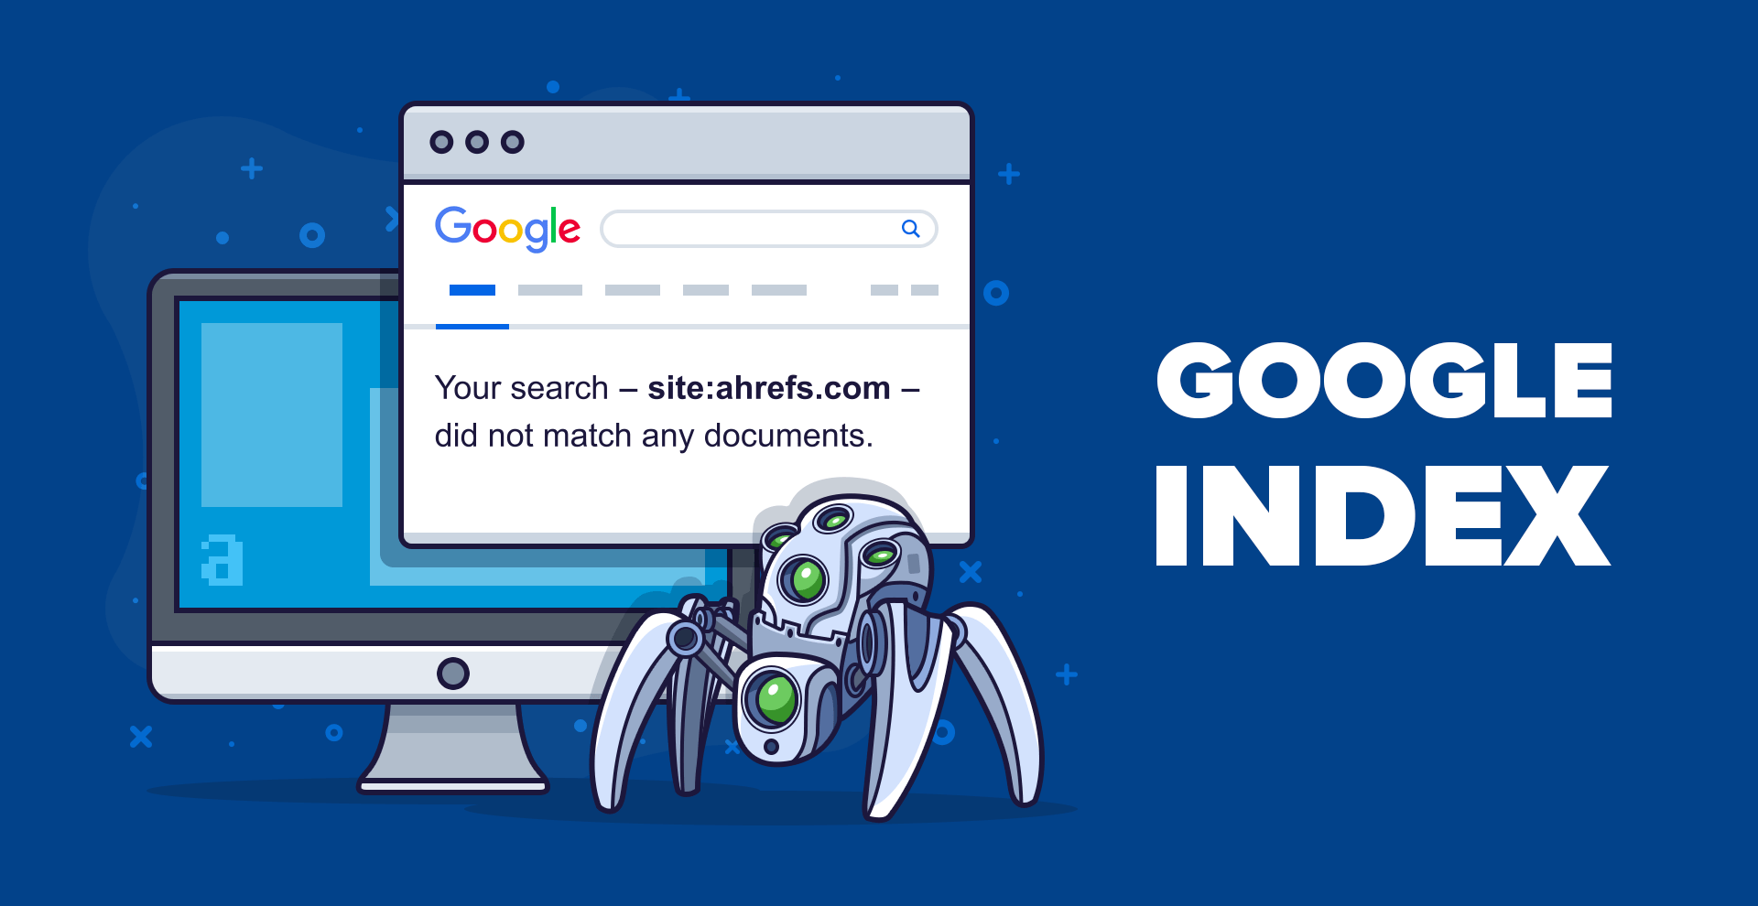
Google index
The Google Search Index contains hundreds of billions of pages!!!

Slide 5
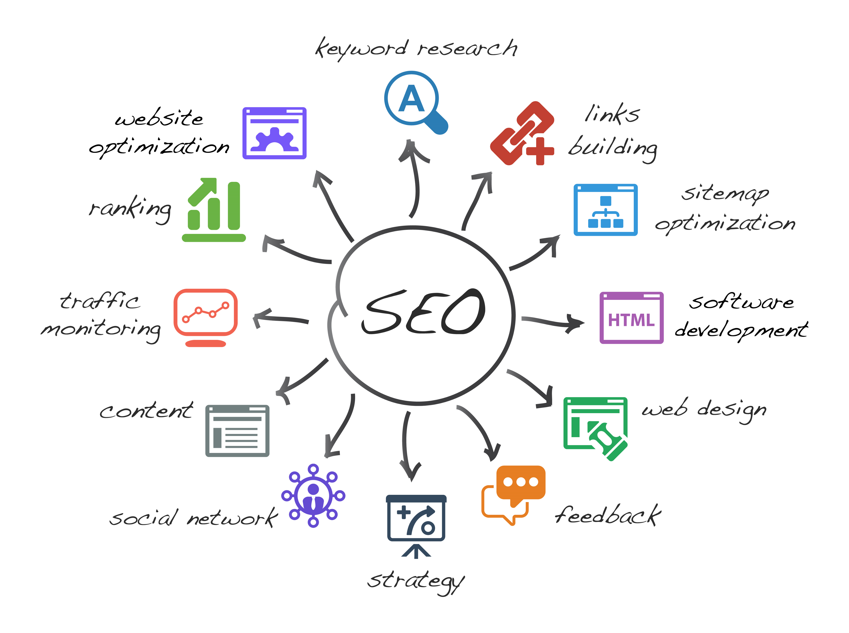
Optimisng
Thousands of engineers and scientists are involved in optimizing algorithms and developing new search tools.

Slide 6
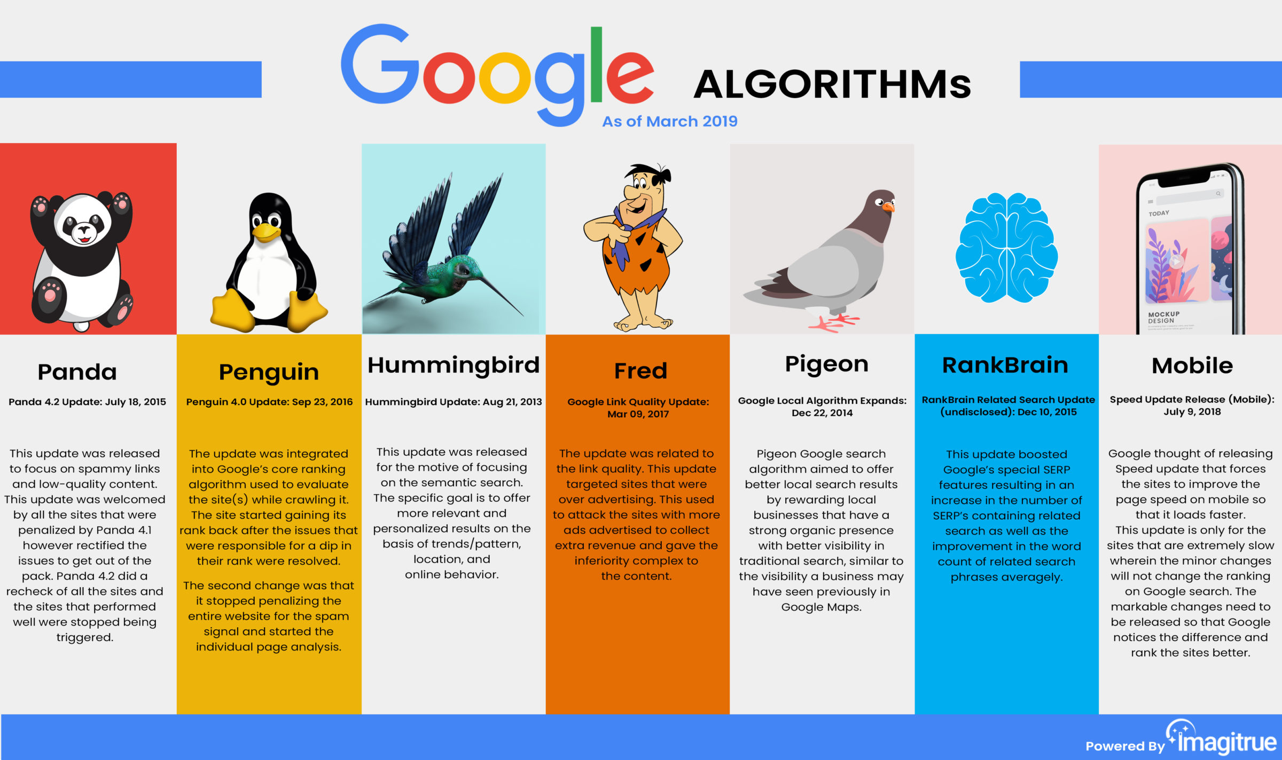
Algorithms

Slide 7

Ensurance

