Slide 1
My future profession
Blokhin IcU7-62B

Slide 2
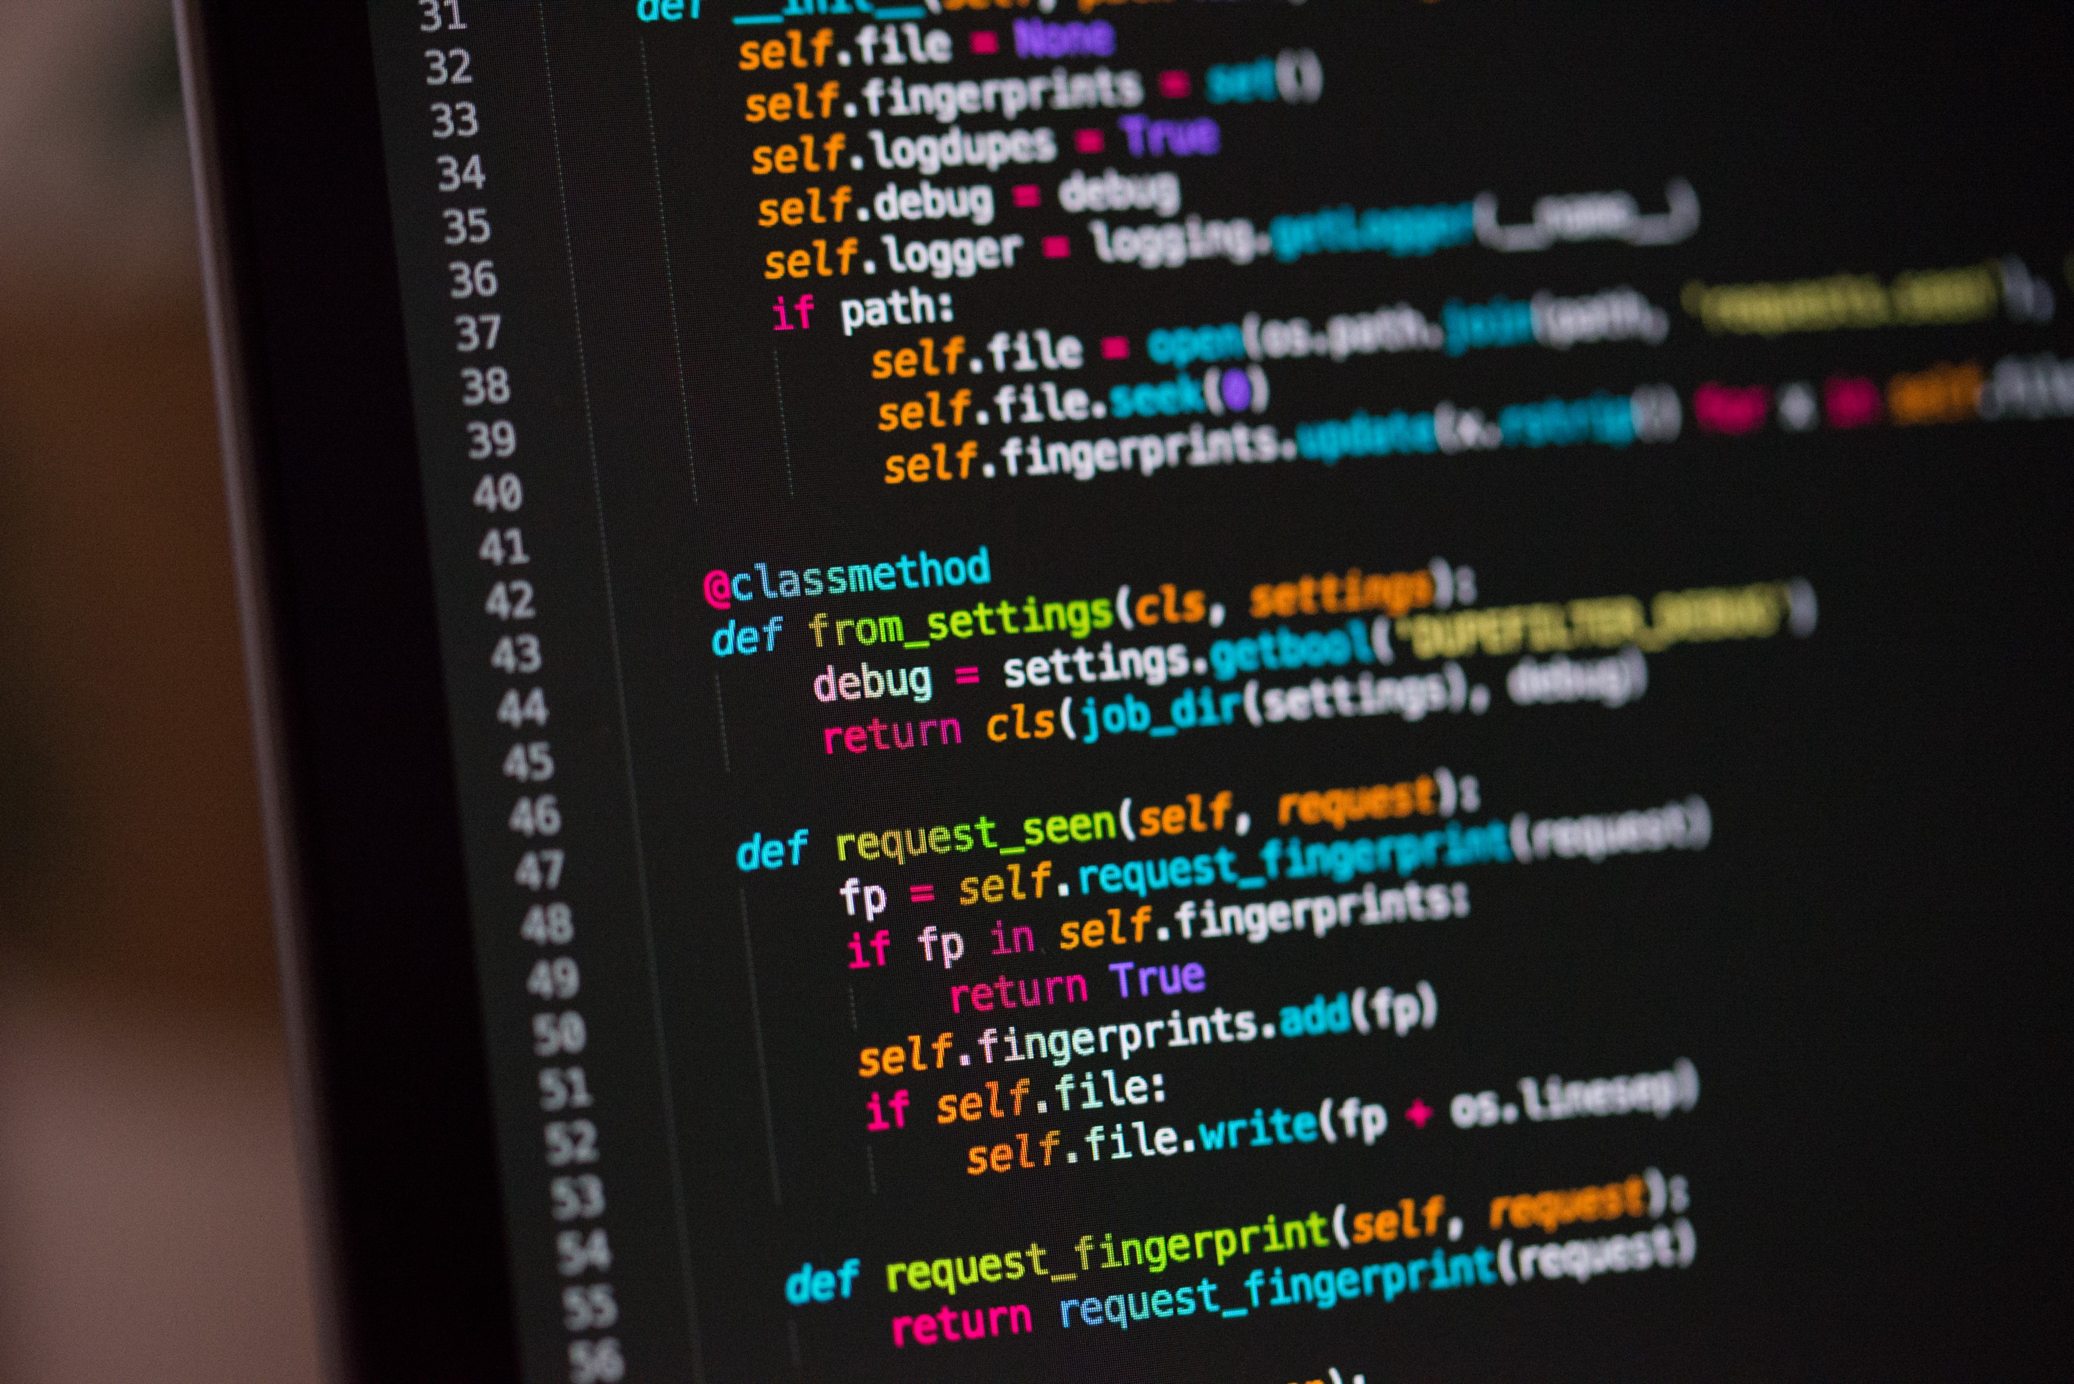
Programming

Slide 3

Languages

Slide 4

Companies

Slide 5
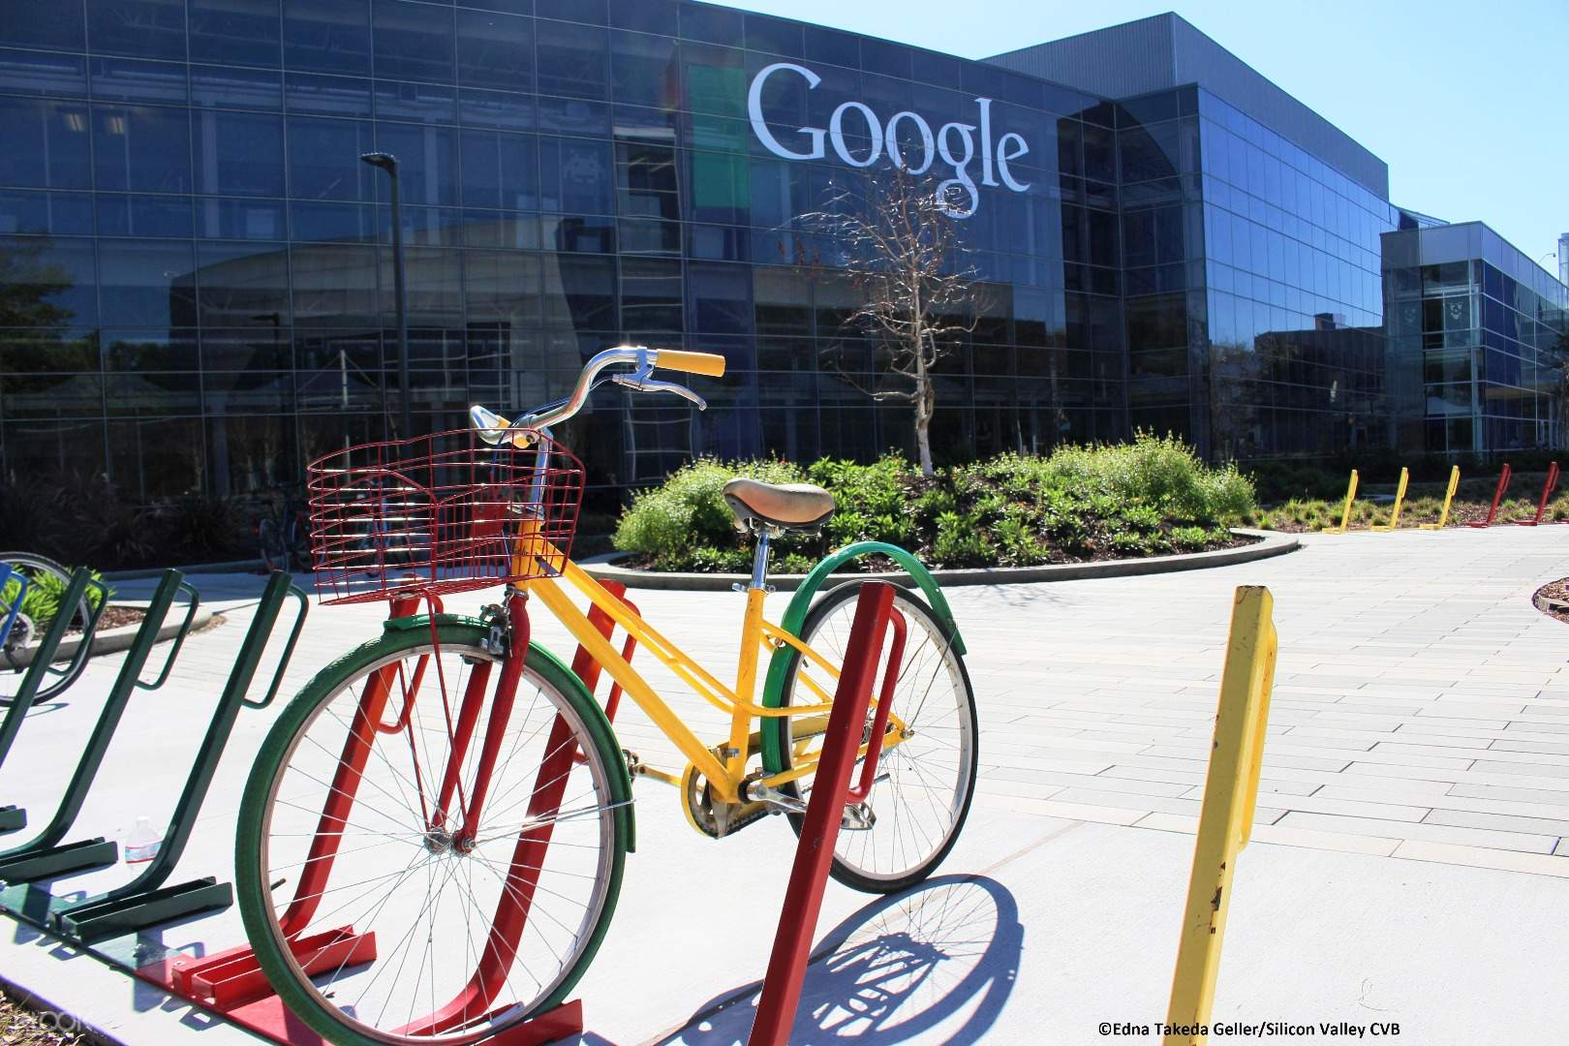
Silicon valley

Slide 6


My favorite languages

Slide 7

Thanks for attention and make your dreams come true!

