Slide 1
📈 AI Stock Market Research Assistant
Databricks AI Bootcamp · Capstone Project
Azure Databricks · Meta Llama 3.3 70B · Unity Catalog · Databricks Apps
Medallion Pipeline
Agentic AI (11 tools)
RAG + Vector Search
Databricks Apps
Jayanth Dolai · Senior Software Engineer · Optum / UnitedHealth Group
6+ years in Azure, Databricks, and Microsoft Fabric · B.Tech CSE, NIT Trichy 2019
📦 github.com/demonjd2026-afk/ai-stock-research-assistant
🔗 linkedin.com/in/jayanth-dolai-7b115213a
Certifications: Databricks DE Associate · DP-900 · DP-700 · DP-600 · Databricks Gen AI Associate
⚠️ Built on Databricks Free Edition — roadblocks encountered: (1) api.massive.com blocked by outbound domain filter → switched to api.polygon.io (same key, Massive rebranded from Polygon Oct 2025); (2) Massive free tier = end-of-day data only, not real-time — pipeline ingests previous day's OHLCV close; (3) OAuth JWT federation unavailable → Delta CDF used instead of Lakebase CDF.

Slide 2
Problem Statement
Why build an AI-native stock research platform on the Databricks Lakehouse?
⏰
Real-Time Gap
🧩
Fragmented Tooling
Analysts rely on delayed spreadsheets; no live ingest pipeline for market data into a governed lakehouse.
Price feeds, news, sentiment, and research notes live in separate silos — no unified platform.
🤖
No Agentic Layer
📰
News-Price Disconnect
Standard BI dashboards can't answer free-form queries, compare tickers, or take write actions.
Qualitative news signals are never linked to quantitative price moves in a queryable form.
✅ Solution
An end-to-end Databricks Lakehouse platform ingesting 20 S&P 500 tickers in real time, enriching them with news sentiment via semantic RAG, and exposing a Llama 3.3 70B agentic chat interface for research, comparison, and watchlist management.

Slide 3
Architecture Overview
Medallion Lakehouse · Agentic AI · RAG — fully orchestrated on Azure Databricks
Polygon
REST API
🥉 Bronze
Raw Ingest
🥈 Silver
Normalized
🥇 Gold
Aggregates
Vector
Search RAG
Llama 3.3
70B Agent
Tickers (20)
Bronze → Silver
AAPL · GOOGL · META · MSFT · NVDA (Tech) | BAC · GS · JPM · MS · V (Finance)
ABBV · JNJ · MRK · PFE · UNH (Healthcare) | AMZN · TSLA · WMT · CVX · XOM
Explicit float()/int() casting · MAX(snapshot_date) dedup · MERGE upsert on (ticker, snapshot_date)
Unity Catalog MODIFY grants (UC metastore v1.0) · News dedup by headline hash
Gold Layer
AI Agent (11 tools)
sector_rankings: SIC descriptions resolved via ticker_config view
top_movers: daily % return ranked per sector · Sentiment aggregates joined to price
Read: get_price_data · get_sentiment · compare_tickers · get_top_movers · search_news · get_sector_rankings · flag_price_moves
Write: add_to_watchlist · remove_from_watchlist · save_research_note · save_analysis_report
RAG Pipeline
Workflow Automation
90 news articles + 20 company profiles → BGE Large embeddings → Databricks AI Search
stock-assistant-vs Vector Search endpoint (ONLINE) · synced daily by Workflow task 4
stock-assistant-daily-pipeline | 4-task DAG: bronze → silver → gold → sync_vs_index
Cron: 0 0 22 ? * MON-FRI | Serverless compute — no cluster startup latency

Slide 4
Medallion Pipeline Deep Dive
Bronze → Silver → Gold: data quality, dedup, and aggregation at each layer
🥉 Bronze Layer
🥈 Silver Layer
🥇 Gold Layer
• Polygon REST API (api.polygon.io)
• MERGE upsert on (ticker, snapshot_date)
• sector_rankings: SIC → clean sector names
• 20 tickers across 5 sectors
• MAX(snapshot_date) dedup pre-Gold join
• top_movers: daily % return ranked
• Explicit float()/int() casting
• News dedup by headline hash
• Sentiment avg joined to price data
• Delta Lake partitioned by snapshot_date
• UC grants: MODIFY (metastore v1.0)
• Serves Agent tools + VS sync task
• Auto-schema detection; ACID writes
• Sentiment linked to ticker × date
• Optimized for low-latency queries

Slide 5
Agentic AI — 11 Function-Calling Tools
Llama 3.3 70B with a 5-round tool-use loop — reads, writes, and reasons over the lakehouse
📊
get_price_data
😊
get_sentiment
⚡
compare_tickers
Fetch latest price, volume, % return for a ticker from Gold
Retrieve avg news sentiment score for a ticker
Side-by-side price + sentiment comparison of 2 tickers
🏆
get_top_movers
🔍
search_news
📈
get_sector_rankings
Top 5 gainers and losers for the day from Gold
RAG over 110 embedded docs via Databricks AI Search
Sector market cap + avg return from Gold sector_rankings
🚨
flag_price_moves
➕
add_to_watchlist
➖
remove_from_watchlist
Alert if a ticker moved > N% in a day
Write: add ticker to a named watchlist in Silver
Write: remove ticker from a watchlist in Silver
📝
save_research_note
📋
save_analysis_report
Write: persist freeform research note to Delta
Write: save structured AI analysis report to Delta

Slide 6
RAG Pipeline — Semantic Search on Financial News
BGE Large embeddings + Databricks AI Search + Llama 3.3 70B grounded responses
📰 Data Sources
🧠 Embeddings
90 news articles
20 company profiles
Silver Delta table (news_for_search_index)
110 total documents embedded
BGE Large model
stock-assistant-vs endpoint
Databricks Vector Search (ONLINE)
Auto-sync via Workflow task 4
🔍 Query Flow
💬 Grounded Response
User query → search_news tool
Semantic similarity search
Top-K relevant chunks retrieved
Context injected into Llama prompt
Llama 3.3 70B reasons over retrieved context
News grounding prevents hallucination
Source attribution in response
Fallback: direct tool data if RAG scores low

Slide 7
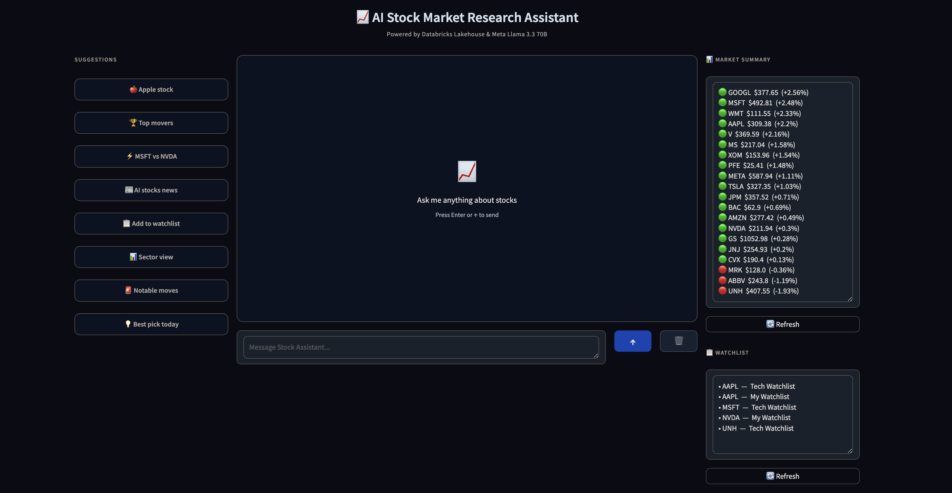
App Demo — Market Summary + Watchlist
Right panel: 20 tickers with % change + named watchlists updated via AI chat · Databricks Apps deployment
Market Summary Sidebar
20 tickers with live price + % change. Green dot = gainer, red dot = loser — sorted by daily return.
Watchlist Panel
Named watchlists (My Watchlist, Tech Watchlist) — populated via agent write tools in chat.
Suggestion Buttons
8 pre-built queries: Apple stock, Top movers, MSFT vs NVDA, AI stocks news, Sector view, and more.
📦 github.com/demonjd2026-afk/ai-stock-research-assistant

Slide 8
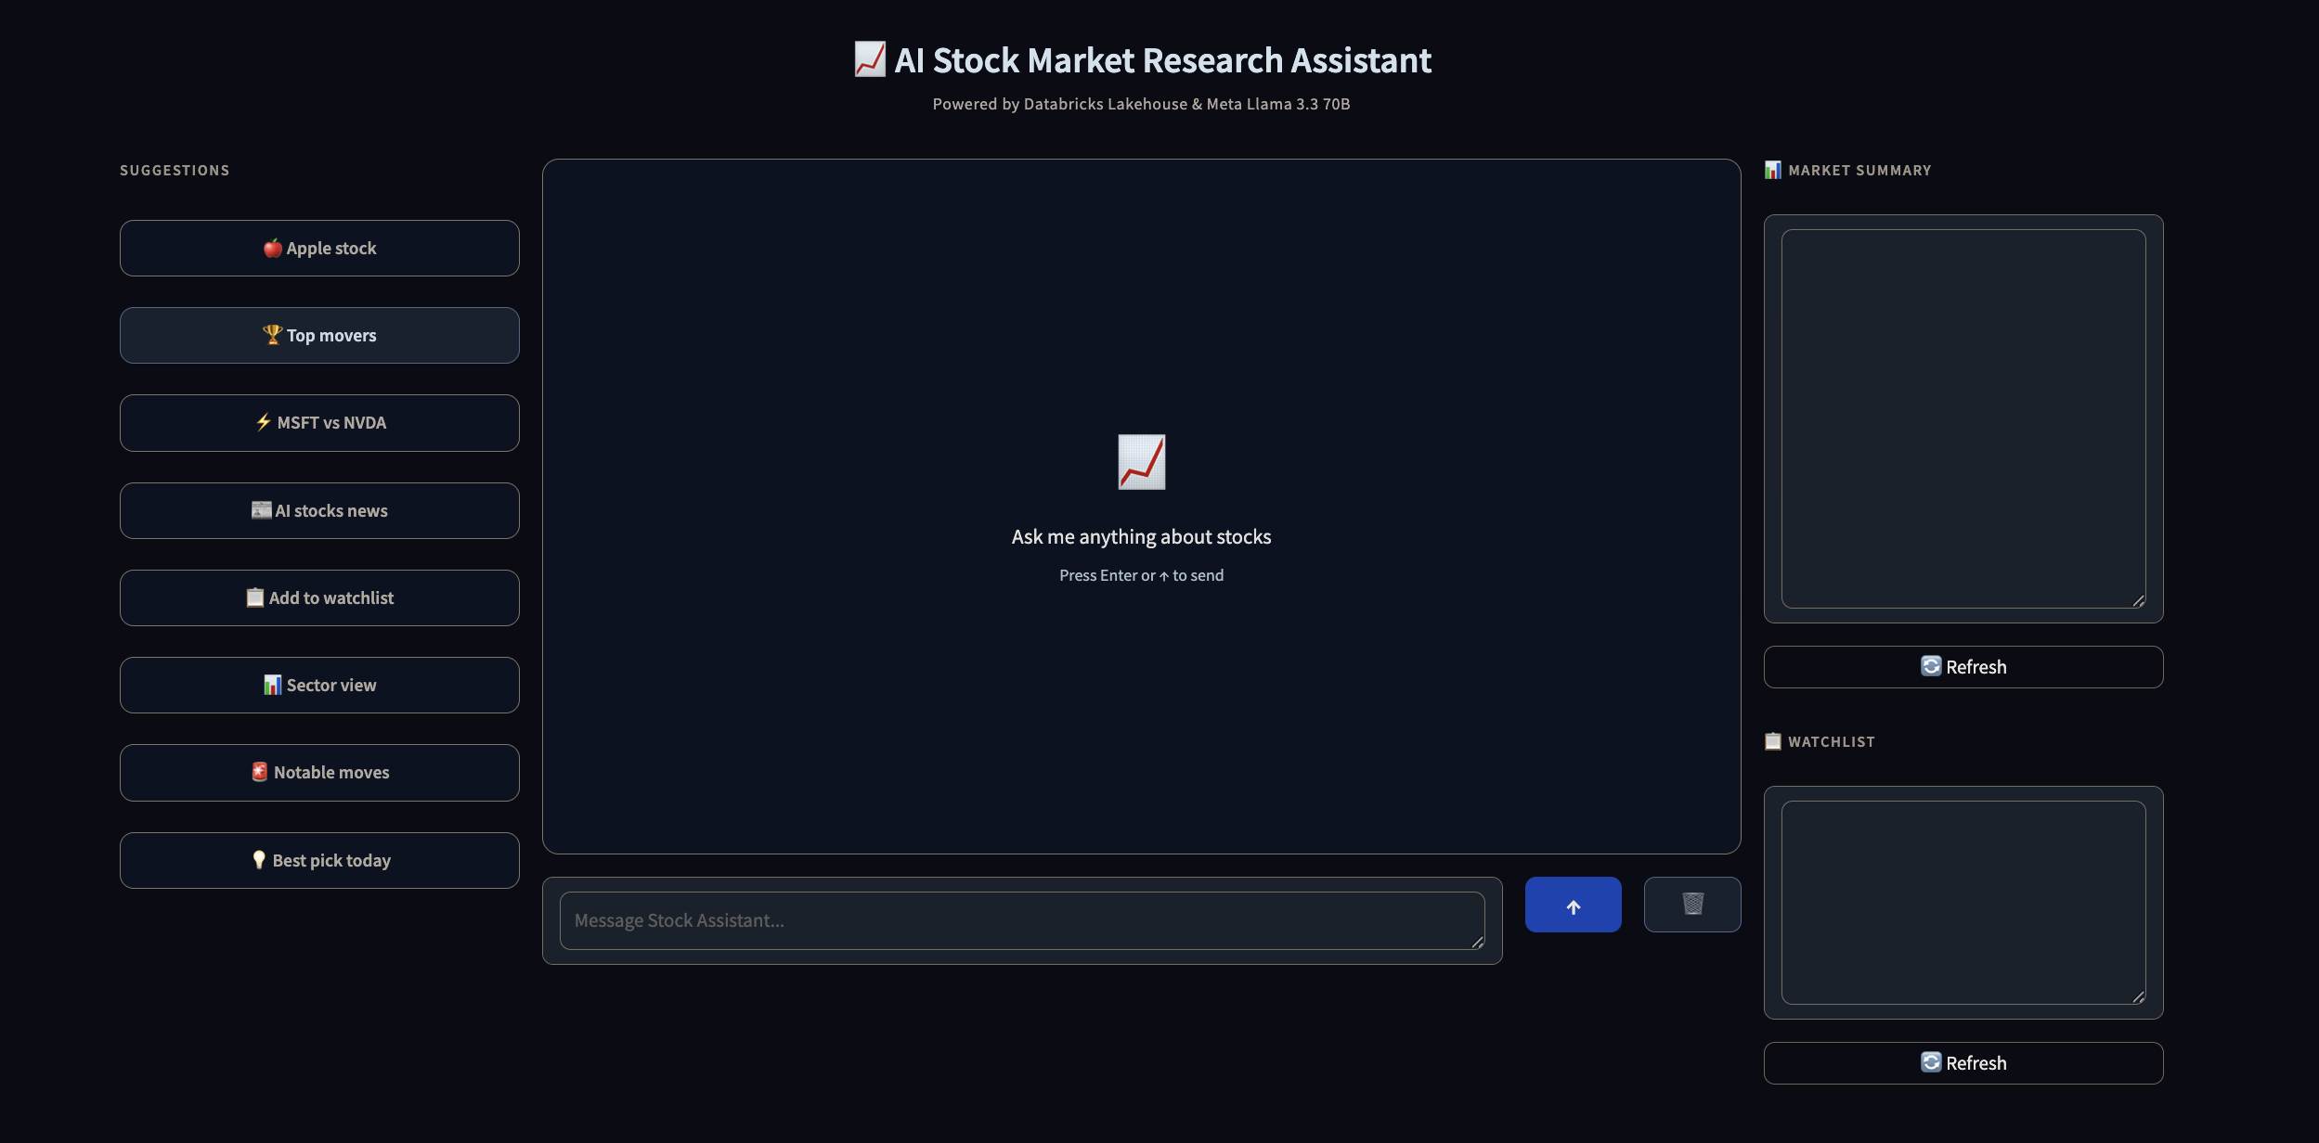
App Walkthrough — Screen 1 of 6
App Interface — Empty State
3-column layout: suggestions panel · chat area · market summary + watchlist sidebar
Key Highlights
8 pre-built suggestion shortcuts (Apple stock, Top movers, MSFT vs NVDA, etc.)
Market summary and watchlist panels ready to populate
Enter-to-send input with clear button
Powered by Databricks Lakehouse & Meta Llama 3.3 70B

Slide 9
App Walkthrough — Screen 2 of 6
Market Summary Loaded
20 S&P 500 tickers displayed with real-time price and % change indicators
Key Highlights
Green dot = gainer, red dot = loser — colour-coded at a glance
Sorted by daily return descending (GOOGL +2.56% → UNH -1.93%)
Watchlist sidebar shows named lists: Tech Watchlist, My Watchlist
Refresh button re-fetches live data from Gold Delta table

Slide 10
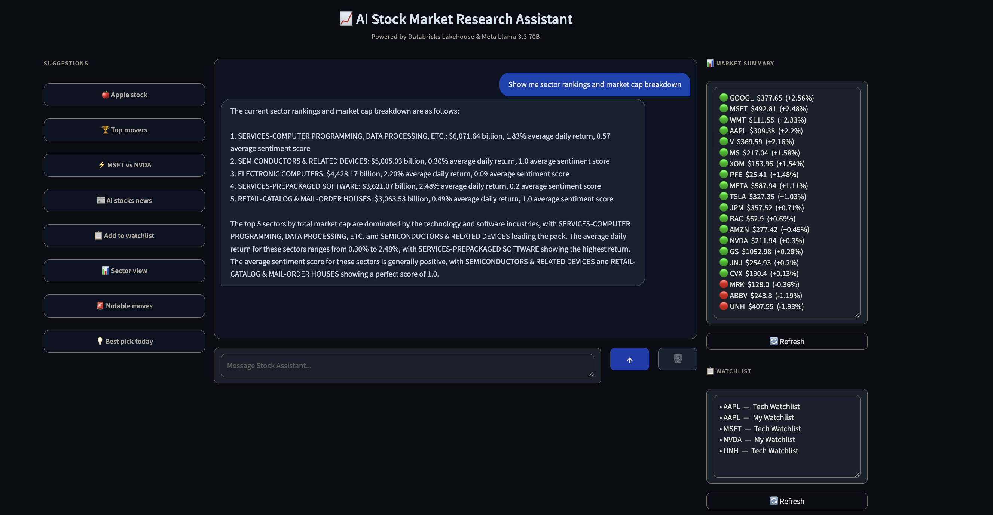
App Walkthrough — Screen 3 of 6
Sector Rankings Query
AI agent calls get_sector_rankings tool → returns market cap breakdown from Gold layer
Key Highlights
Top 5 sectors by total market cap with avg daily return + sentiment score
SERVICES-COMPUTER PROGRAMMING leads at $6,071B market cap
SEMICONDUCTORS & RELATED at $5,005B — second largest sector
AI synthesises and explains the data in natural language

Slide 11
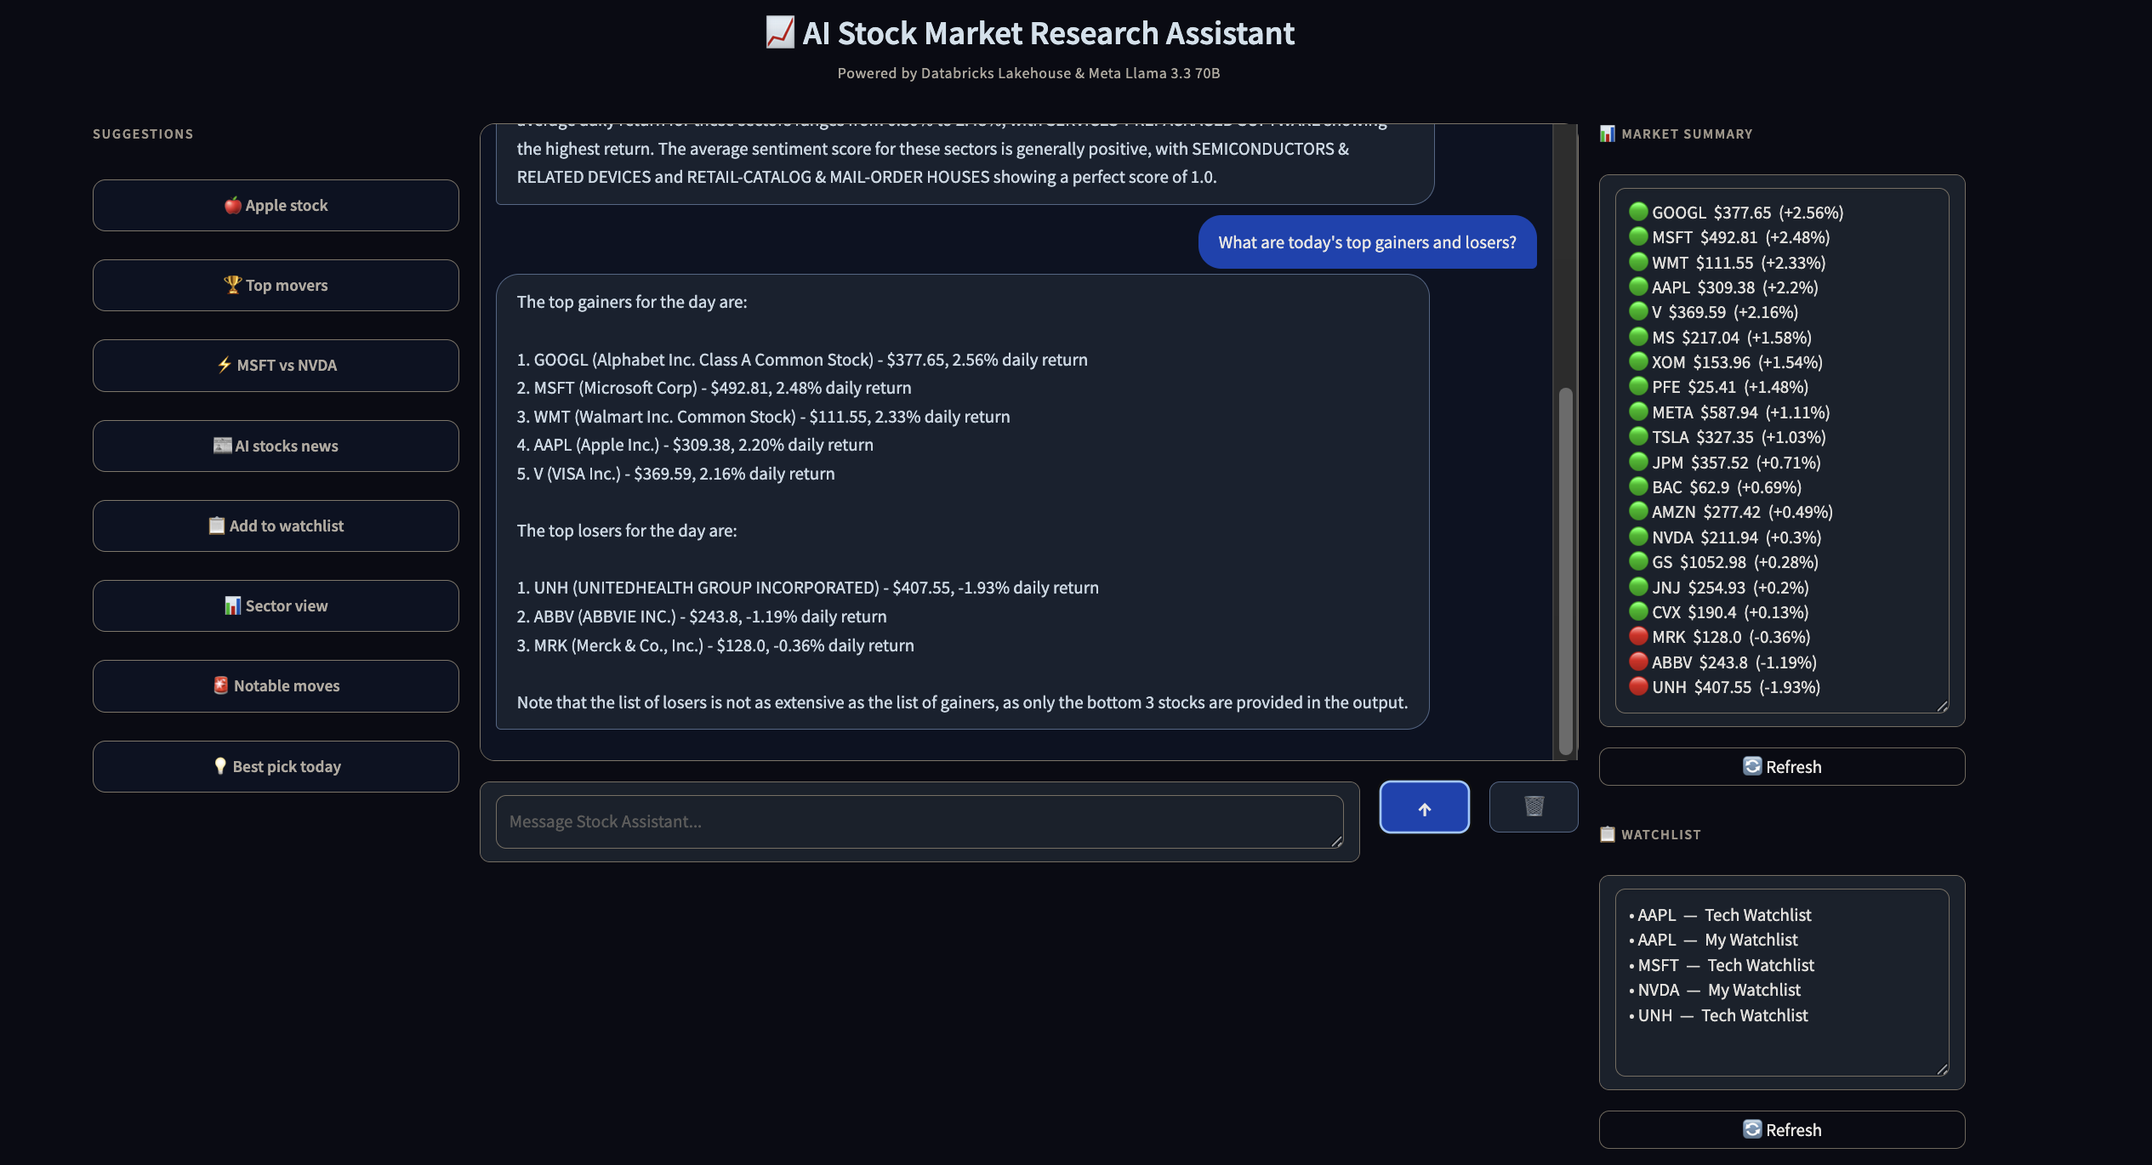
App Walkthrough — Screen 4 of 6
Top Gainers & Losers
Agent calls get_top_movers tool — daily performance ranked across all 20 tickers
Key Highlights
Top 5 gainers: GOOGL +2.56%, MSFT +2.48%, WMT +2.33%, AAPL +2.20%, V +2.16%
Top 3 losers: UNH -1.93%, ABBV -1.19%, MRK -0.36%
Full company names returned alongside ticker symbols
Agent notes caveat on data completeness

Slide 12
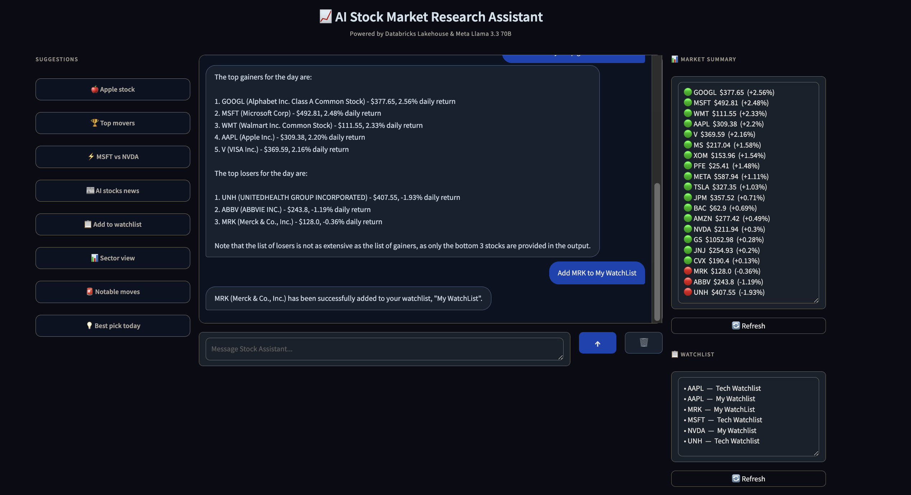
App Walkthrough — Screen 5 of 6
Add to Watchlist — Write Action
Agent calls add_to_watchlist tool — confirms write to Silver Delta table in chat
Key Highlights
User asked: 'Add MRK to My WatchList'
Agent confirms: 'MRK (Merck & Co., Inc.) has been successfully added to your watchlist, My WatchList'
Watchlist sidebar auto-updates to show MRK — My WatchList
Demonstrates agent write capability, not just read queries

Slide 13
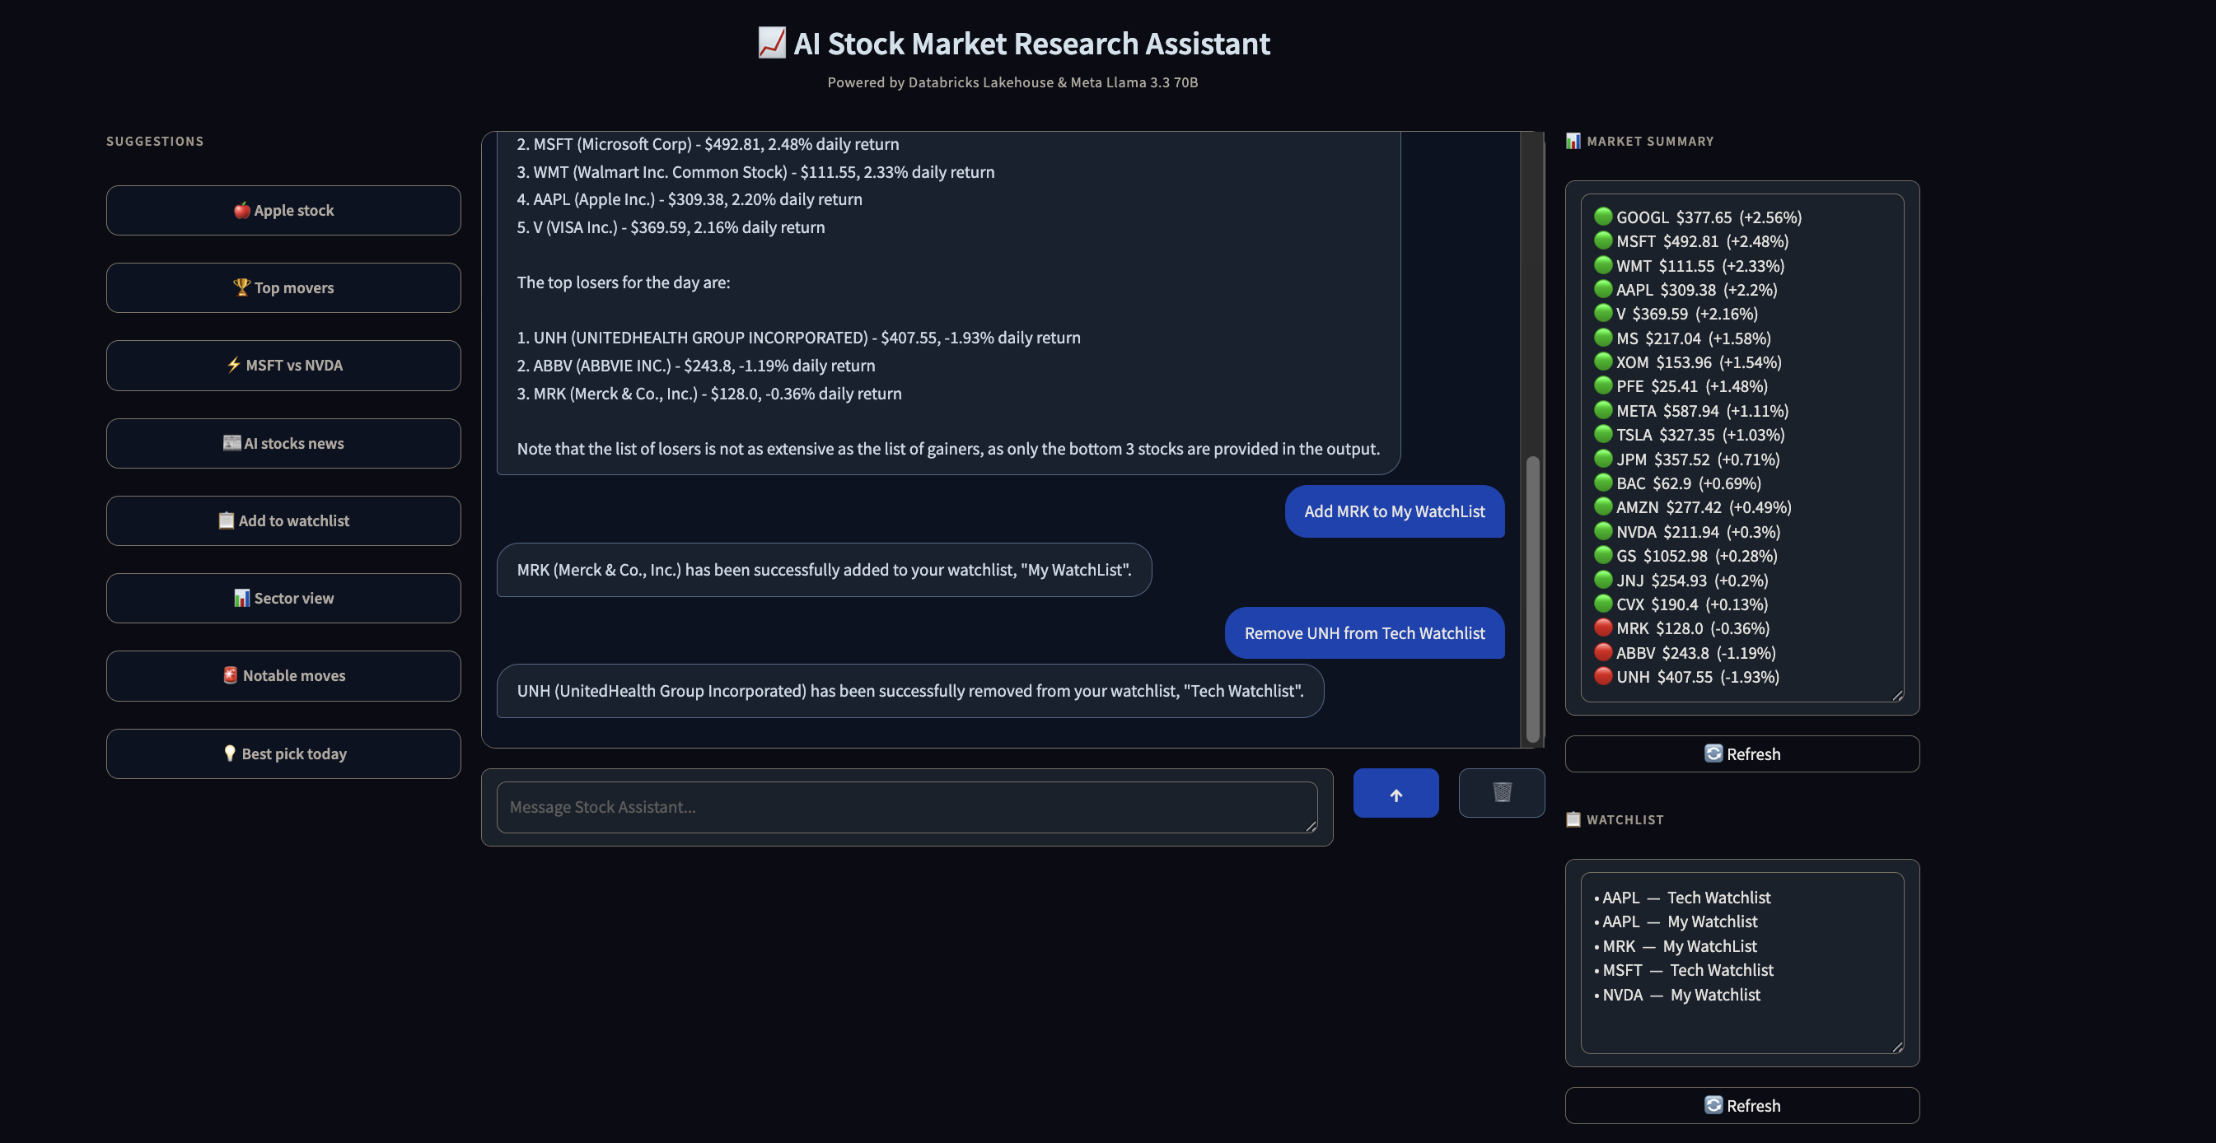
App Walkthrough — Screen 6 of 6
Remove from Watchlist — Write Action
Agent calls remove_from_watchlist tool — watchlist updated and confirmed in chat
Key Highlights
User asked: 'Remove UNH from Tech Watchlist'
Agent confirms removal: 'UNH (UnitedHealth Group) has been successfully removed from Tech Watchlist'
Sidebar updates: UNH removed, MRK retained in My WatchList
Both add and remove write tools demonstrated end-to-end

Slide 14
Lakebase + Delta CDF
OLTP write-back layer + Change Data Feed — design decisions on Free Edition
Lakebase (Design Intent)
Delta CDF (Active)
Production Design Intent
• Lakebase = Databricks-managed Postgres OLTP layer
• Delta Change Data Feed enabled on Silver tables
• Lakebase: watchlist + notes in Postgres (low-latency OLTP)
• Designed for transactional write-back (watchlists, notes)
• Captures INSERT/UPDATE/DELETE with _change_type flag
• CDF: streaming propagation Silver → Gold deltas
• OAuth JWT federation — not available on Free Edition
• Streams incremental changes without full table scan
• Free Edition constraint → Delta-only implementation
• Architecture pattern documented for production readiness
• Powers near-real-time Gold refresh on data change
• Architecture is production-extensible — swap in Lakebase
• Agent write tools target Silver Delta as substitute
• Production: CDF → streaming job → Gold
• Demonstrates awareness of Databricks storage tiers

Slide 15
Workflow Automation
stock-assistant-daily-pipeline — 4-task DAG on Databricks Workflows
Task 1
bronze_ingest
Task 2
silver_transform
Task 3
gold_aggregate
Task 4
sync_vs_index
Schedule
Task Dependencies
Cron: 0 0 22 ? * MON-FRI
Runs at 22:00 UTC every weekday
Serverless compute (no cluster startup cost)
bronze → silver → gold → sync_vs_index
Linear DAG with dependency declarations
Fail-fast on any upstream error
Compute
Monitoring
Serverless compute for all tasks
No cluster configuration or startup latency
Cost-optimised for daily batch workloads
Task-level status in Workflows UI
Failed run alerts configurable via email
Run history retained for 60 days

Slide 16
Technical Decisions & Learnings
Key engineering trade-offs and constraints solved during implementation
API Selection
Type Casting
api.polygon.io chosen — api.massive.com blocked by Free Edition outbound filter. Polygon provides identical market data with reliable REST endpoints.
Polygon returns inconsistent int/float types. Explicit float()/int() casting in Bronze prevented Silver schema conflicts and downstream Gold aggregation errors.
Databricks SDK vs OpenAI SDK
Delta CDF vs Lakebase CDF
DATABRICKS_TOKEN is empty at module import time inside Databricks Apps. Switched to get_w().api_client.do() for runtime credential resolution — no hardcoded secrets.
Lakebase OAuth JWT federation unavailable on Free Edition. Delta CDF with _change_type flag replicates the CDC pattern with native Delta capabilities.
Gradio HTML vs Chatbot
Unity Catalog Grants
gr.Chatbot causes JavaScript errors inside Databricks Apps runtime. Replaced with gr.HTML + gr.State for a custom chat bubble renderer — full control, no JS conflicts.
UC metastore v1.0 does not support INSERT as a table privilege. MODIFY used instead — documented in setup guide for future team members.

Slide 17
Skills Demonstrated
What this capstone proves as a Senior Software Engineer portfolio piece
Medallion Architecture
Unity Catalog Governance
Bronze→Silver→Gold pipeline with dedup, MERGE upsert, and partitioned Delta tables — production patterns.
Schemas, secret scopes, MODIFY grants, ticker registry — data governance on Free Edition UC.
Semantic RAG
Agentic AI (11 tools)
BGE Large embeddings + Databricks AI Search — cutting-edge NLP applied to financial documents.
Llama 3.3 70B + function-calling + 5-round tool loop — multi-step AI reasoning over the lakehouse.
Workflow Orchestration
Full-stack Deployment
Multi-task DAG, cron scheduling, serverless compute — production automation from day one.
Live Databricks App, Gradio 3-column UI, chat interface, real market data — demo-ready.
📦 github.com/demonjd2026-afk/ai-stock-research-assistant
Jayanth Dolai — Senior Software Engineer
🔗 linkedin.com/in/jayanth-dolai-7b115213a

