Slide 1

Java web application created using Spring MVC or Spring Boot
Java Full Stack Developer - Case of Study

Slide 2
intro
Name of the application: Salango
Type: Restaurant website
Main features: Order food online, create clients accounts, admin users, check menu, booking tables online, write reviews about the menu, service, etc.

Slide 3
Technical Requirements
Java, Javascript
Jakarta/Java Server Pages (JSP)
Spring MVC
Tomcat as the web server
MariaDB
HTML, CSS

Slide 4
Software development methodology
Requirement
Design
Maintanance
Implementation
Verfication

Slide 5
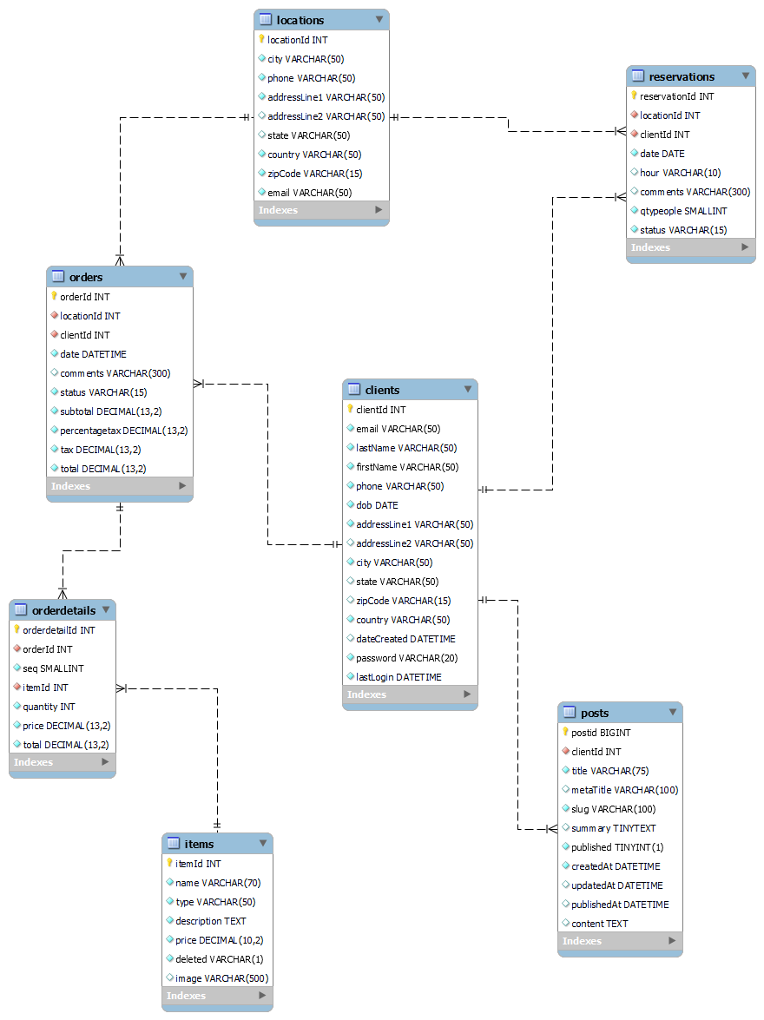

Slide 6
arquitecture
Presentation Layer
API Layer
Business Logic Layer
Persistence Layer
Client
(Browser)
Controller
Service
Model
Requests
Repository Class Extending CRUD Services
Dependency Injection
Database

Slide 7
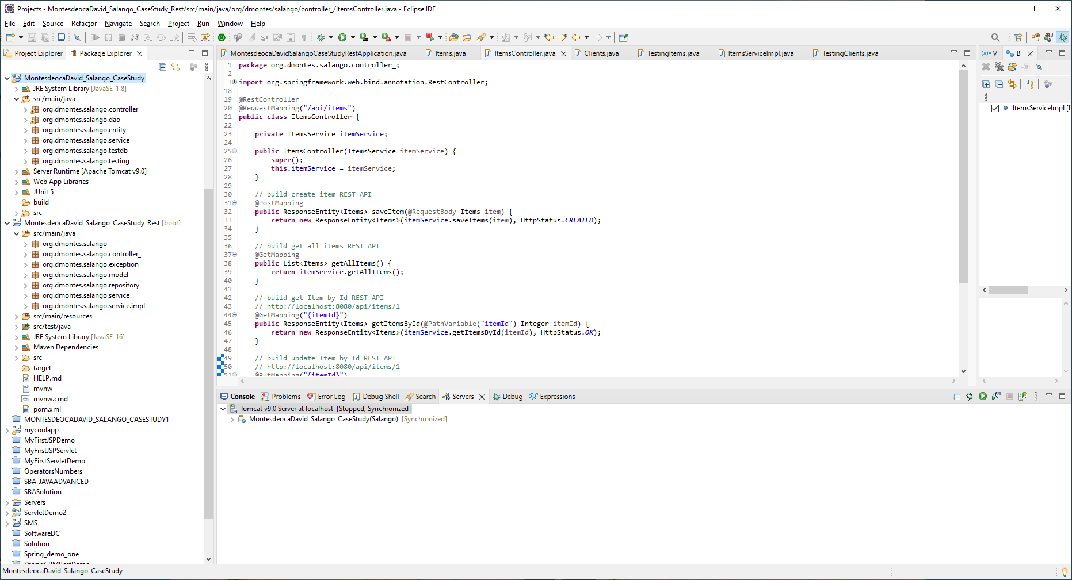

Slide 8
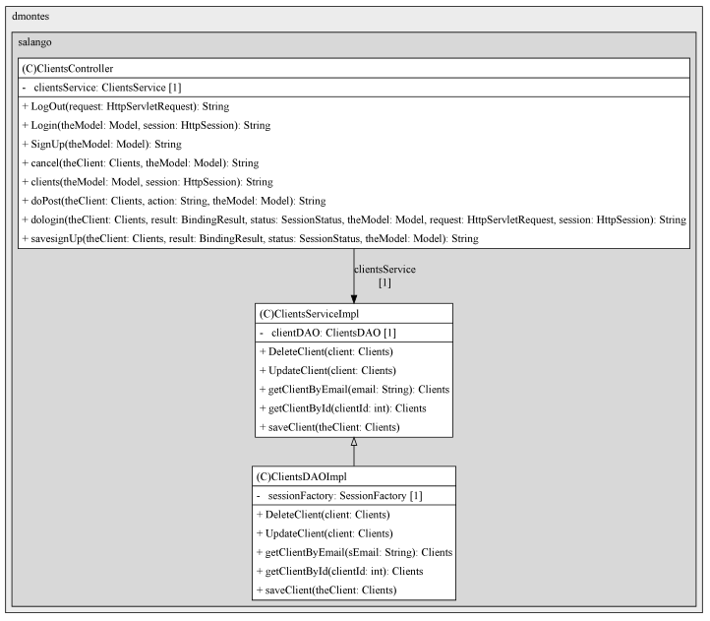

Slide 9
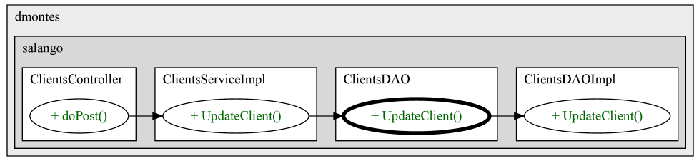

Slide 10
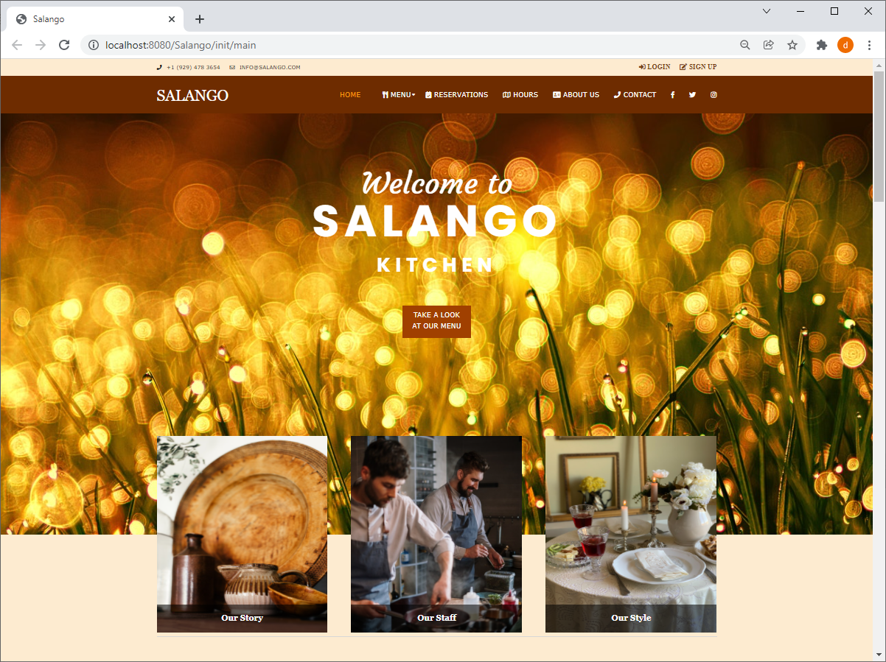

Slide 11
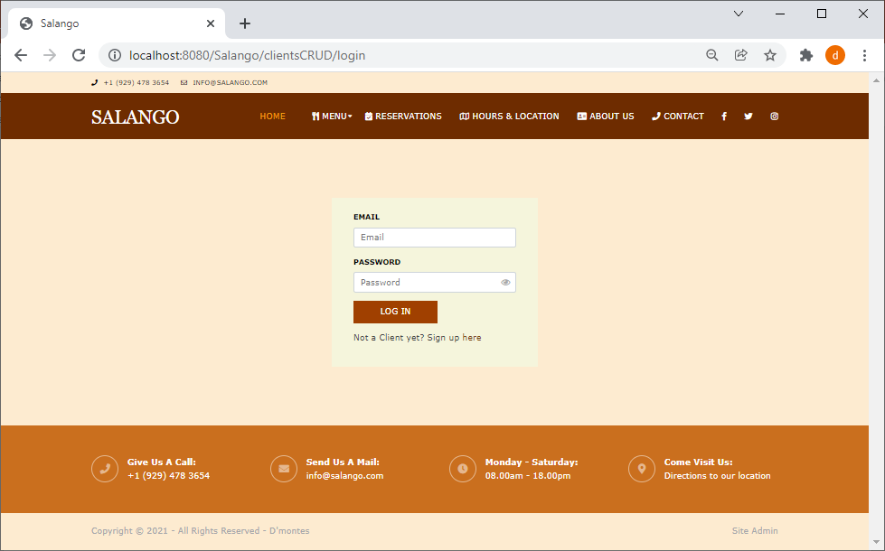

Slide 12
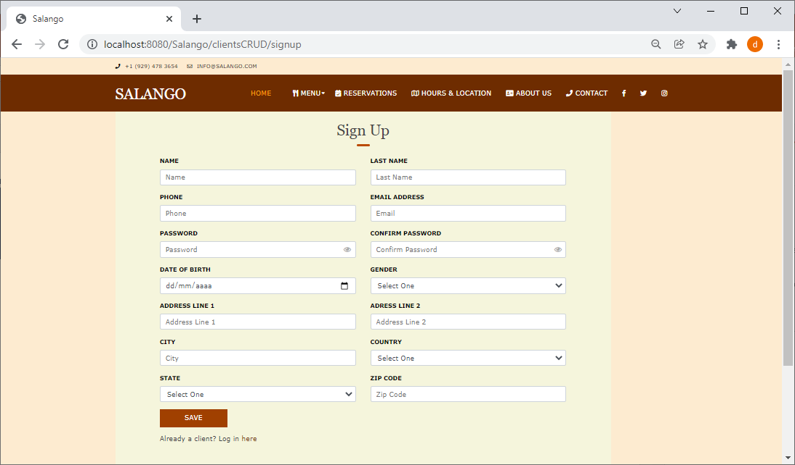

Slide 13
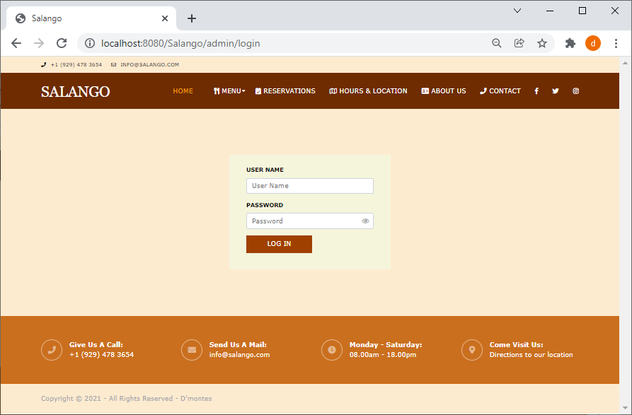

Slide 14
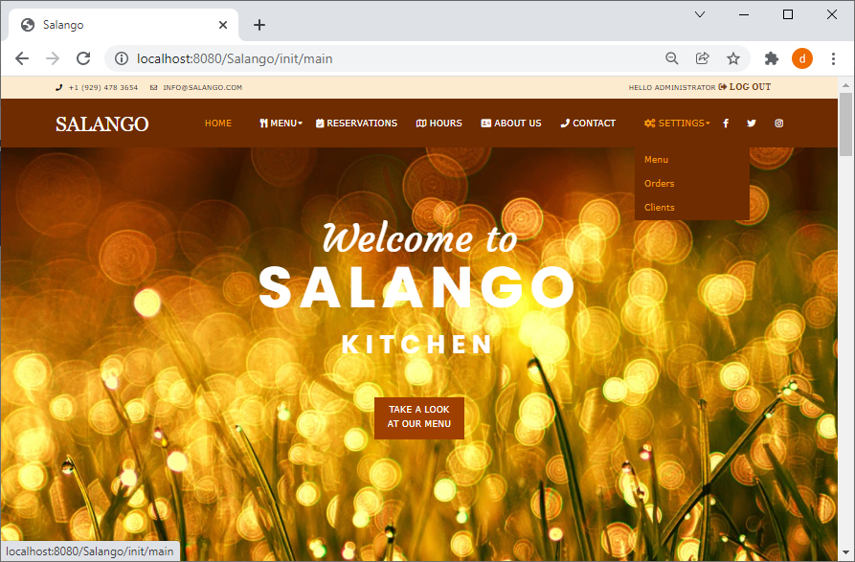

Slide 15
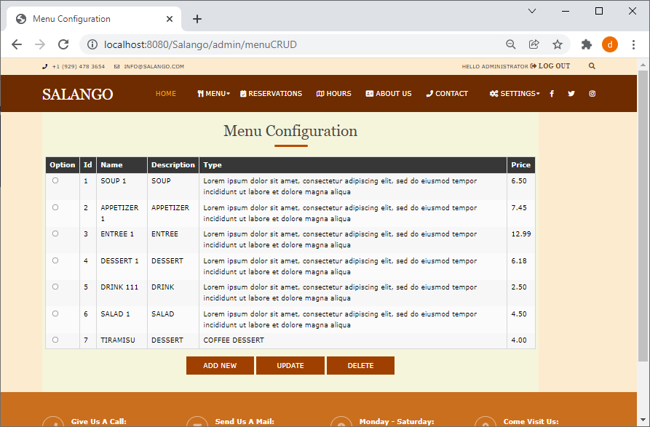

Slide 16
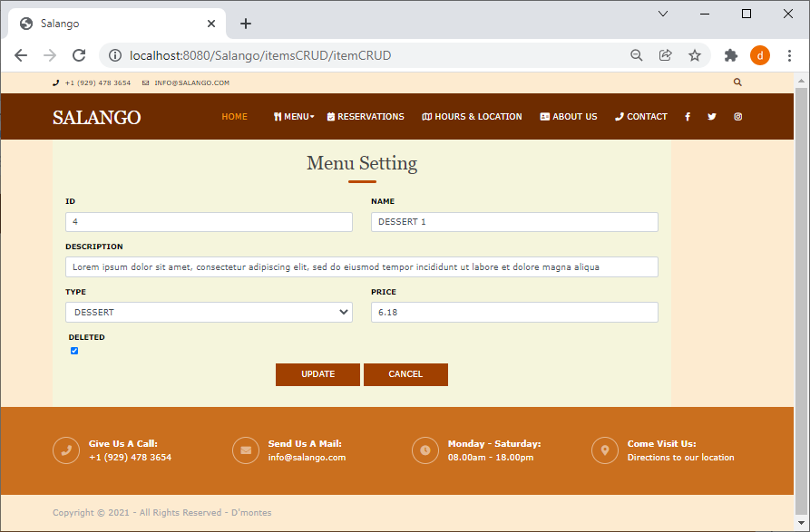

Slide 17
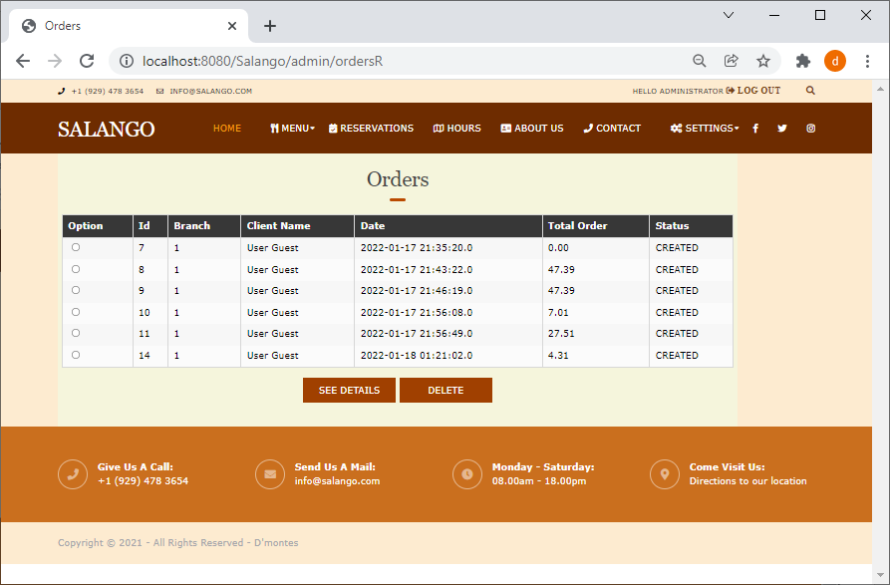

Slide 18
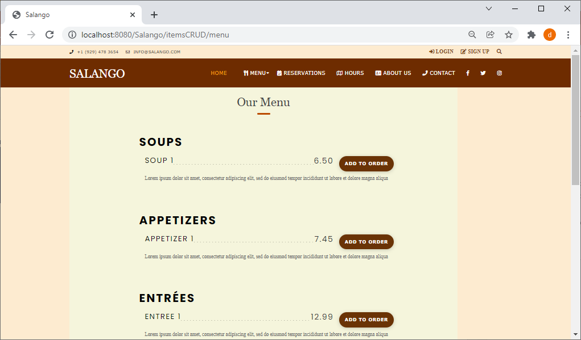

Slide 19
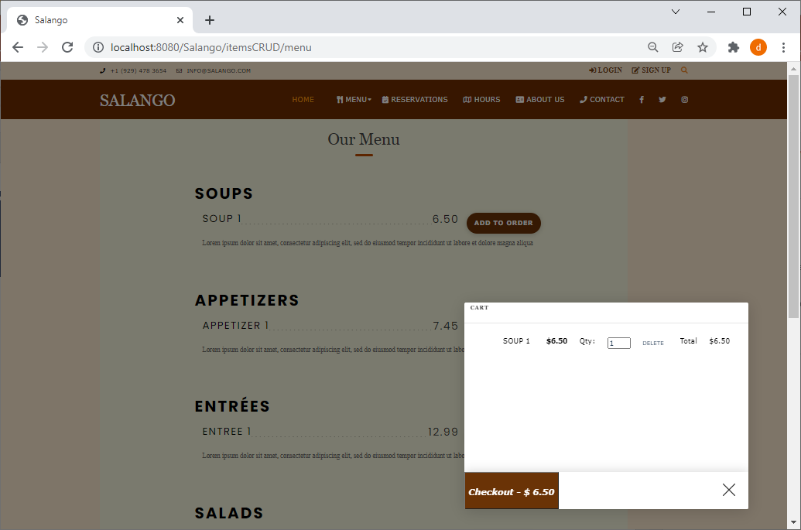

Slide 20
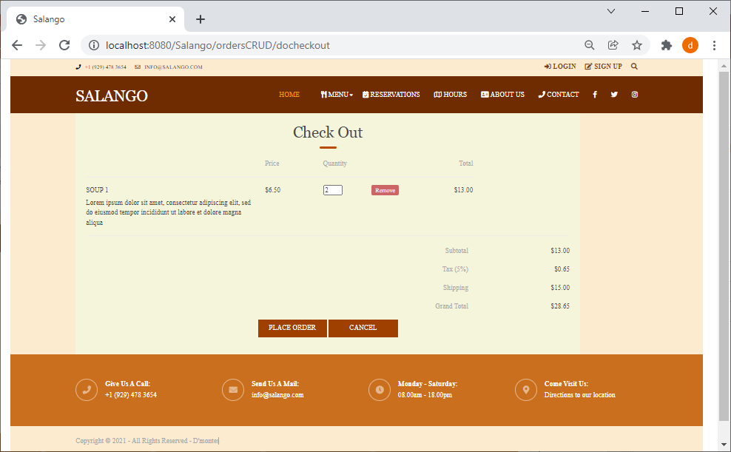

Slide 21

Thank you
de_montesdeoca@Hotmail.com

