Slide 1
Εργασία VLSI 2
Ομάδα 10
Δημοσθένης Καραμπάρπας 1089862
Γρηγόριος Ρισβάς 1092774

Slide 2
Περιεχόμενα
Τμήμα 1: Θεωρία
Τμήμα 2: Κώδικες

Slide 3
Απλός Υπολογισμός Υπολοίπου
Διαίρεση X
Αφαίρεση και Πρόσθεση ✔
Σύγκριση ✔
Για 12
12 - 5 = 7, 7 - 5 = 2
Για -12
-12 + 5 = -7, -7 + 5 = -2, -2 + 5 = 3

Slide 4
Θεωρία Τμηματοποίησης
Α = 11110000 = 1111 * 2^4 + 0000
AmodX = (1111 * 2^4 modX + 0000modX)modX
Για 2^4 modX = 1 τότε κάθε κομμάτι ξεχωριστά.
Αν γίνεται με μοτίβο ανά 4 bits τότε ένας 32 bit αριθμός
1111|0000|1111|0000|1111|0000|1111|0000
Αν αρνητικός, μόνο το πρώτο τμήμα θεωρείται αρνητικός

Slide 5
Mod5
n | 2^n mod 5
0 | 1
1 | 2
2 | 4
3 | 3
4 | 1
5 | 2
6 | 4

Slide 6
Mod5
Ανά 4 bits επανάληψη
Eίσοδο 32 Bits σε 8 κομμάτια των 4 Bit
0100|0100|0100|0100|0100|0100|0100|0100
=1145324612 με mod5 = 2
Μέγιστο υπόλοιπο ανά κομμάτι είναι 5-1=4.
4 * 8 κομμάτια = 32.
Υπόλοιπο του 32 με mod5 = 2

Slide 7
Mod9
n | 2^n mod 9
0 | 1
1 | 2
2 | 4
3 | 8
4 | 7
5 | 5
6 | 1

Slide 8
Mod9
Ανά 6 bits επανάληψη
Eίσοδο 32 Bits πρέπει να μετατραπεί σε 36 Bits, 6 κομμάτια
111111|001000|001000|001000|001000|001000
=-937393656 με mod9 = 3
Μέγιστο υπόλοιπο ανά κομμάτι είναι 9-1=8 με το πρώτο -1+9=8.
6 * 8 κομμάτια = 48.
Υπόλοιπο του 48 με mod9 = 3

Slide 9
Κινέζικο Θεώρημα Υπολοίπων, παράδειγμα
14 έχει παράγοντες το 2 και 7 πρώτοι αριθμοί
Χ = 14k + υπόλοιπο
Αν γνωρίζουμε Χ όπου Xmod2 = 1 και Χmod7 = 5.
mod2 από 1,3,5,7,9,11,13 και mod7 ικανοποιείται από 5,12
Xmod14=5

Slide 10
Mod14
Xmod14 | Xmod2 | Xmod7
0 | 0 | 0
1 | 1 | 1
2 | 0 | 2
3 | 1 | 3
4 | 0 | 4
5 | 1 | 5
6 | 0 | 6

Slide 11
Mod14
Xmod14 | Xmod2 | Xmod7
7 | 1 | 0
8 | 0 | 1
9 | 1 | 2
10 | 0 | 3
11 | 1 | 4
12 | 0 | 5
13 | 1 | 6

Slide 12
Mod7
n | 2^n mod 7
0 | 1
1 | 2
2 | 4
3 | 1
4 | 2
5 | 4

Slide 13
Mod7
Ανά 3 bits επανάληψη
Eίσοδο 32 Bits πρέπει να μετατραπεί σε 33 Bits, 11 κομμάτια
111|110|110|110|110|110|110|110|110|110|110
=−153391690 με mod7 = 3
Μέγιστο υπόλοιπο ανά κομμάτι είναι 7-1=6 με το πρώτο -1+7=6.
6 * 11 κομμάτια = 66.
Υπόλοιπο του 66 με mod7 = 3

Slide 14
Mod2
To Mod2 μπορεί να υπολογιστεί απλά κοιτώντας το τελευταίο bit ενός αριθμού
πχ
001101mod2 = 1
101100mod2 = 0

Slide 15
Mod15
n | 2^n mod 15
0 | 1
1 | 2
2 | 4
3 | 8
4 | 1
5 | 2
6 | 4

Slide 16
Mod15
Ανά 4 bits επανάληψη
Eίσοδο 32 Bits, 8 κομμάτια
1111|1110|1110|1110|1110|1110|1110|1110
=−17895698 με mod15 = 7
Μέγιστο υπόλοιπο ανά κομμάτι είναι 15-1=14 με το πρώτο -1+15=14.
14 * 8 κομμάτια = 112.
Υπόλοιπο του 112 με mod15 = 7

Slide 17
Κώδικας Mod5 και Σχεδιάγραμμα

Slide 18
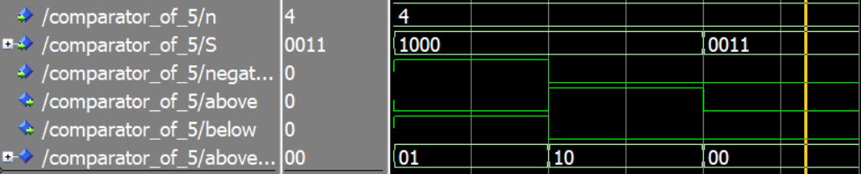
Testbench Comparator 5

Slide 19
library ieee; use ieee.std_logic_1164.all;use ieee.numeric_std.all; entity comparator_of_5 is generic (n:integer:=4); port( S: in std_logic_vector(n-1 downto 0); negative: in std_logic; above: out std_logic; below: out std_logic ); end comparator_of_5; architecture dataflow of comparator_of_5 is signal above_below : std_logic_vector(1 downto 0); begin above_below <= "10" when (S(n-1 downto 3) /= std_logic_vector(to_unsigned(0, n-3)) and negative = '0') or (negative = '0' and S(2) = '1' and (S(1) = '1' or S(0) = '1')) else "01" when (S(n-1) = '1' and negative = '1') else "00"; above <= above_below(1); below <= above_below(0); end dataflow;
Notes:
Να πω πως επιλέγει το μεγαλύτερο

Slide 20
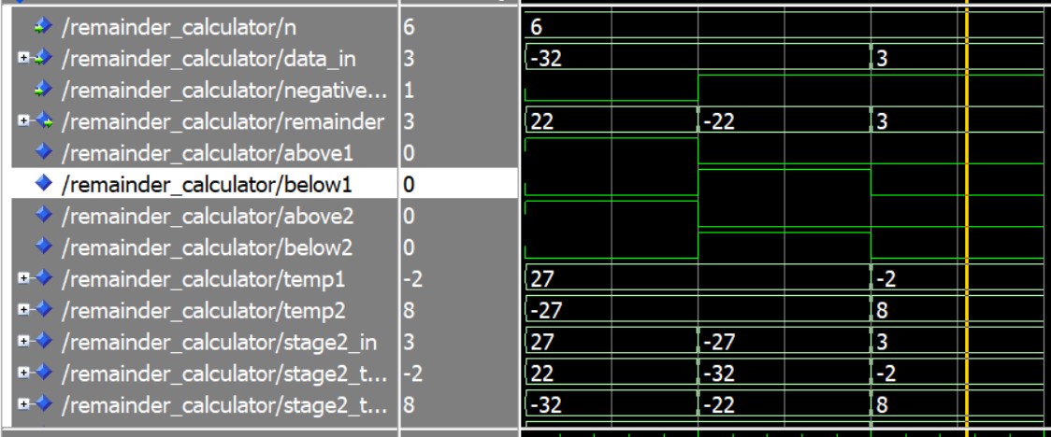
Testbench υπολογισμού κρατουμένου

Slide 21
data <= (others => '0') when (data_in = all_ones and negative_first = '0') else
data_in;
-- First comparison stage
comp1: comparator_of_5
generic map(n)
port map(data, negative_first, above1, below1);
-- First arithmetic stage
add_above: adder_n
generic map(n)
port map(data, mod5_comp, '0', temp1, open);
add_below: adder_n
generic map(n)
port map(data, mod5, '0', temp2, open);
-- Intermediate mux
stage2_in <= temp1 when above1 = '1' else
temp2 when below1 = '1' else
data;
-- Second comparison stage
comp2: comparator_of_5
generic map(n)
port map(stage2_in, negative_first, above2, below2);
-- Second arithmetic stage
add_above2: adder_n
generic map(n)
port map(stage2_in, mod5_comp, '0', stage2_temp1, open);
add_below2: adder_n
generic map(n)
port map(stage2_in, mod5, '0', stage2_temp2, open);
-- Final output selection
remainder <= stage2_temp1 when above2 = '1' else
stage2_temp2 when below2 = '1' else
(others => '0') when (data_in = all_ones and negative_first = '0') else--for 15
stage2_in;
end architecture;
Notes:
Να πω τα προβλήματα ότι 15->5, έπρεπε να υπολογίζω πόσους αθροιστές χρειάζεται, επίσης να τρέχει παράλληλα

Slide 22
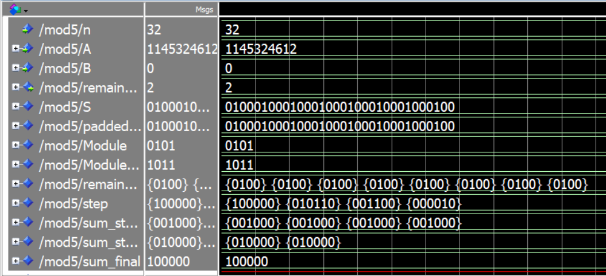
Mod 5 TestBench

Slide 23
component adder_n is
generic (n: integer := 4);
port(
a, b: in std_logic_vector(n-1 downto 0);
cin: in std_logic;
sum: out std_logic_vector(n-1 downto 0);
cout: out std_logic
);
end component;
component comparator_of_5 is
generic (n: integer := 4);
port(
S: in std_logic_vector(n-1 downto 0);
negative: in std_logic;
above: out std_logic;
below: out std_logic
);
end component;
component remainder_calculator is generic(n: integer := 32);
port (
data_in : in std_logic_vector(n-1 downto 0);
negative_first: in std_logic;
remainder : out std_logic_vector(n-1 downto 0)
);
end component;
begin
Module <= std_logic_vector(to_signed(5, 4));
Module_Complement <= std_logic_vector(to_signed(-5, 4));
adder : adder_n
generic map(n)
port map (A, B, '0', S, open);
padded_32 <= (31 downto n => S(n-1)) & S;
negative <= padded_32(31);
s_first <= padded_32(31 downto 28);
remainder_c : remainder_calculator
generic map(4)
port map(s_first,negative,
remainders(7));
generate_label:
for i in 0 to 6 generate
signal s_in: std_logic_vector(3 downto 0);
begin
s_in <= padded_32(3+i*4 downto i*4);
remainder_c : remainder_calculator
generic map(n=>4)
port map(s_in,'0',
remainders(i));
end generate;

Slide 24
gen_stage1: for i in 0 to 3 generate
signal a_padded, b_padded : std_logic_vector(5 downto 0);
begin
a_padded <= "00" & remainders(i*2);
b_padded <= "00" & remainders(i*2+1);
adder_st1: adder_n
generic map(n => 6)
port map(
a => a_padded,
b => b_padded,
cin => '0',
sum => sum_stage1(i),
cout => open
);
end generate gen_stage1;
-- Stage 2: Add results from stage 1
gen_stage2: for i in 0 to 1 generate
adder_st2: adder_n
generic map(6)
port map(
a => sum_stage1(i*2),
b => sum_stage1(i*2+1),
cin => '0',
sum => sum_stage2(i),
cout => open
);
end generate gen_stage2;
-- Final adder
adder_final: adder_n
generic map(6)
port map(
a => sum_stage2(0),
b => sum_stage2(1),
cin => '0',
sum => sum_final,
cout => open
);
step(0)<=sum_final;
generate_remainder_out_of_sum:
for i in 0 to 2 generate
remainder_c : remainder_calculator
generic map(n=>6)
port map(step(i),'0',
step(i+1));
end generate;
remainder <= step(3)(3 downto 0);
end dataflow;

Slide 25
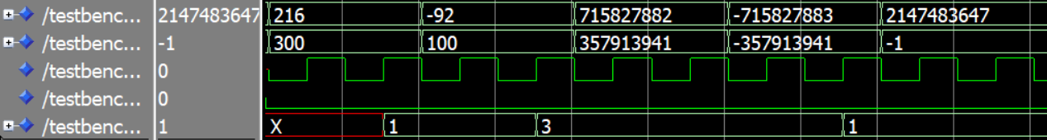
Τελικό Testbench

Slide 26
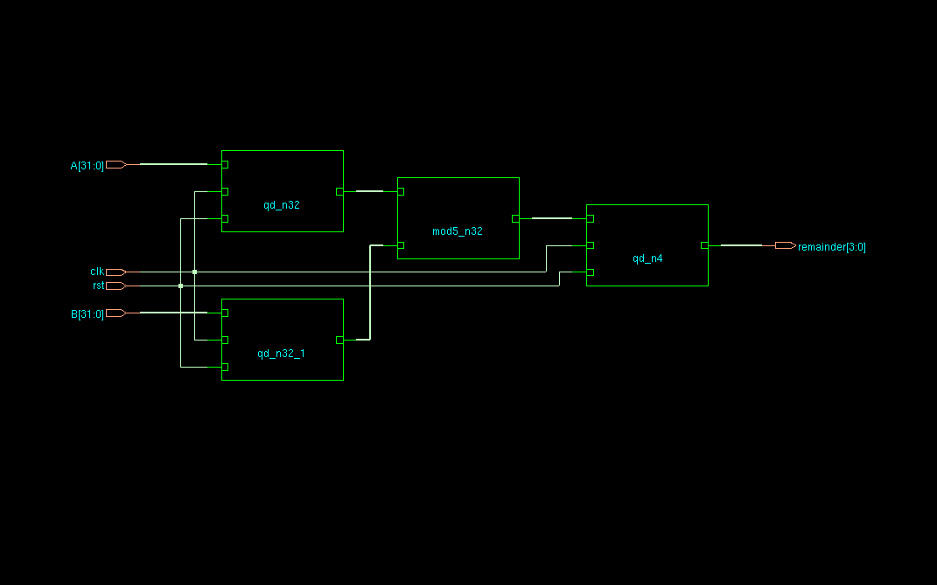
Genus Modulo 5 Adder με Flip Flops

Slide 27
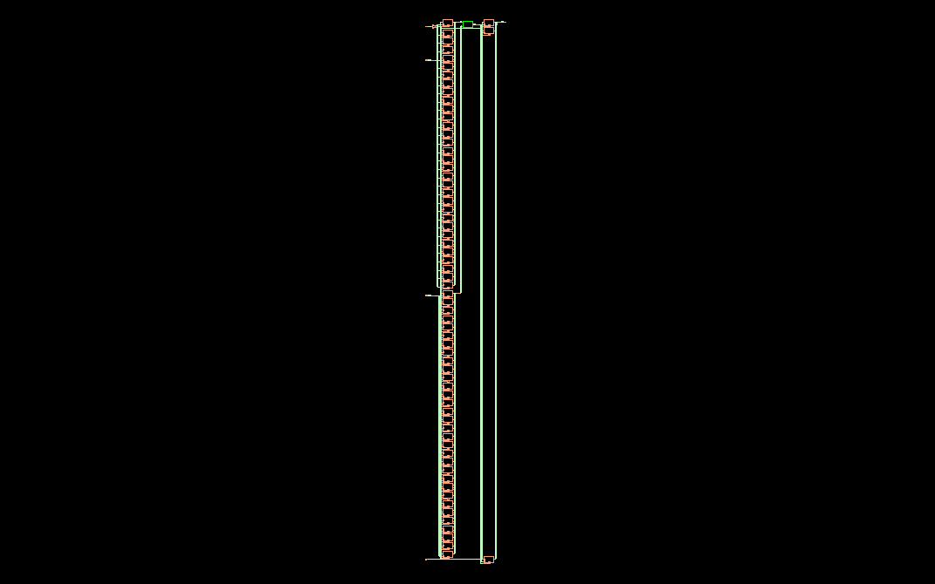
Genus Modulo 5 Adder με Flip Flops

Slide 28
Κώδικας Mod9 και Σχεδιάγραμμα

Slide 29
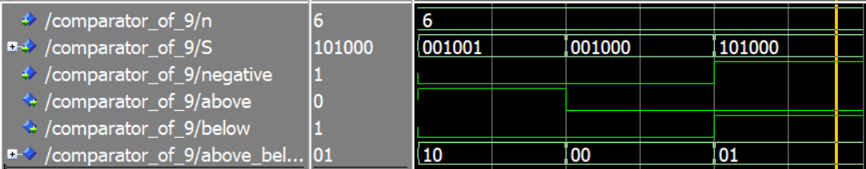
Testbench Συγκριτή Mod9

Slide 30
Συγκριτής Mod9
library ieee; use ieee.std_logic_1164.all;
entity comparator_of_9 is generic (n:integer:=6); port(
S: in std_logic_vector(n-1 downto 0);
negative: in std_logic;
above: out std_logic;
below: out std_logic
);
end comparator_of_9;
architecture dataflow of comparator_of_9 is
signal above_below : std_logic_vector(1 downto 0);
begin
above_below<="10" when ((S(5)='1'or S(4)='1') and negative='0') or (negative='0' and S(3) = '1' and (S(2)='1' or S(1) = '1' or S(0) = '1')) else
"01" when (S(n-1) = '1' and negative='1') else
"00";
above <= above_below(1);
below <= above_below(0);
end dataflow;

Slide 31
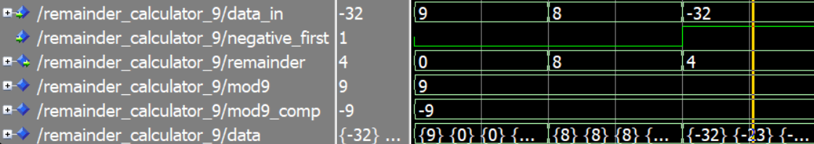
Testbench Κρατούμενου Mod9

Slide 32
Κώδικας Κρατουμένου mod9
begin
mod9 <= std_logic_vector(to_signed(9, 6));
mod9_comp <= std_logic_vector(to_signed(-9, 6));
data(0) <= "000000" when (data_in ="111111" and negative_first ='0') else --check for last one
data_in;
generate_label:
for i in 0 to 5 generate
signal above_i, below_i: std_logic;
signal temp1_i, temp2_i:std_logic_vector(5 downto 0);
begin
-- First comparison stage
comp_i: comparator_of_9
port map(data(i), negative_first, above_i, below_i);
-- First arithmetic stage
add_above_i: adder_n
generic map(6)
port map(data(i), mod9_comp, '0', temp1_i, open);
add_below_i: adder_n
generic map(6)
port map(data(i), mod9, '0', temp2_i, open);
-- Intermediate mux
data(i+1) <= temp1_i when above_i = '1' else
temp2_i when below_i = '1' else
data(i);
end generate;
-- Final output selection
remainder <= data(6);
end architecture;

Slide 33
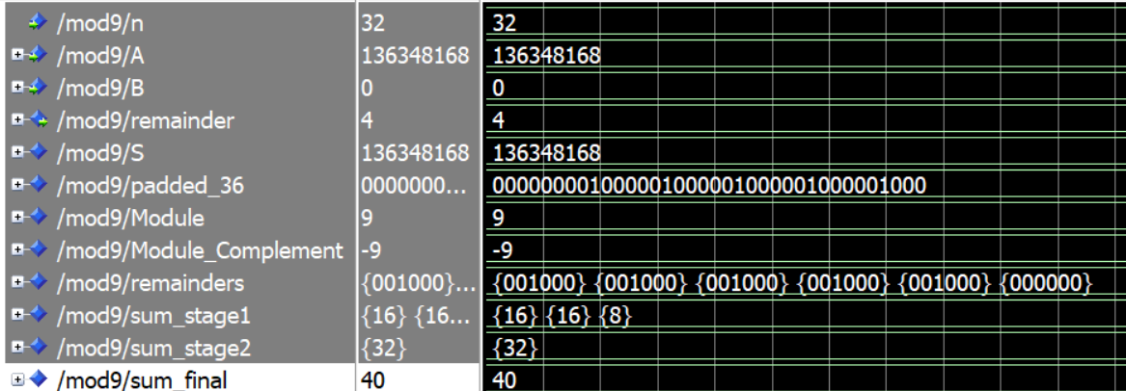
Testbench Mod9

Slide 34
Κώδικας mod9
begin
Module <= std_logic_vector(to_signed(9, 6));
Module_Complement <= std_logic_vector(to_signed(-9, 6));
adder : adder_n
generic map(n)
port map (A, B, '0', S, open);
padded_36 <= (35 downto n => S(n-1)) & S;
negative <= padded_36(35);
s_first <= padded_36(35 downto 30);
remainder_c : remainder_calculator_9
generic map(6)
port map(s_first,negative,
remainders(5));
generate_label:
for i in 0 to 4 generate
signal s_in: std_logic_vector(5 downto 0);
begin
s_in <= padded_36(5+i*6 downto i*6);
remainder_c : remainder_calculator_9
generic map(6)
port map(s_in,'0',
remainders(i));
end generate;
-- Adder tree to sum all remainders
-- Stage 1: Add pairs of remainders
gen_stage1: for i in 0 to 2 generate
adder_st1: adder_n
generic map(6)
port map(
a => remainders(i*2),
b => remainders(i*2+1),
cin => '0',
sum => sum_stage1(i),
cout => open
);
end generate gen_stage1;
-- Stage 2: Add results from stage 1
adder_st2: adder_n
generic map(6)
port map(
a => sum_stage1(0),
b => sum_stage1(1),
cin => '0',
sum => sum_stage2(0),
cout => open
);
-- Final adder
adder_final: adder_n
generic map(6)
port map(
a => sum_stage1(2),
b => sum_stage2(0),
cin => '0',
sum => sum_final,
cout => open
);
remainder_sum : remainder_calculator_9
generic map(6)
port map(sum_final,'0',
remainder);
end dataflow;

Slide 35
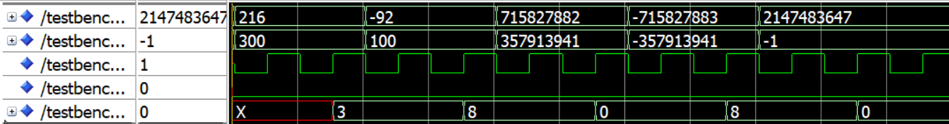
Τελικό Testbench

Slide 36

Genus Modulo 9 Adder με Flip Flops

Slide 37
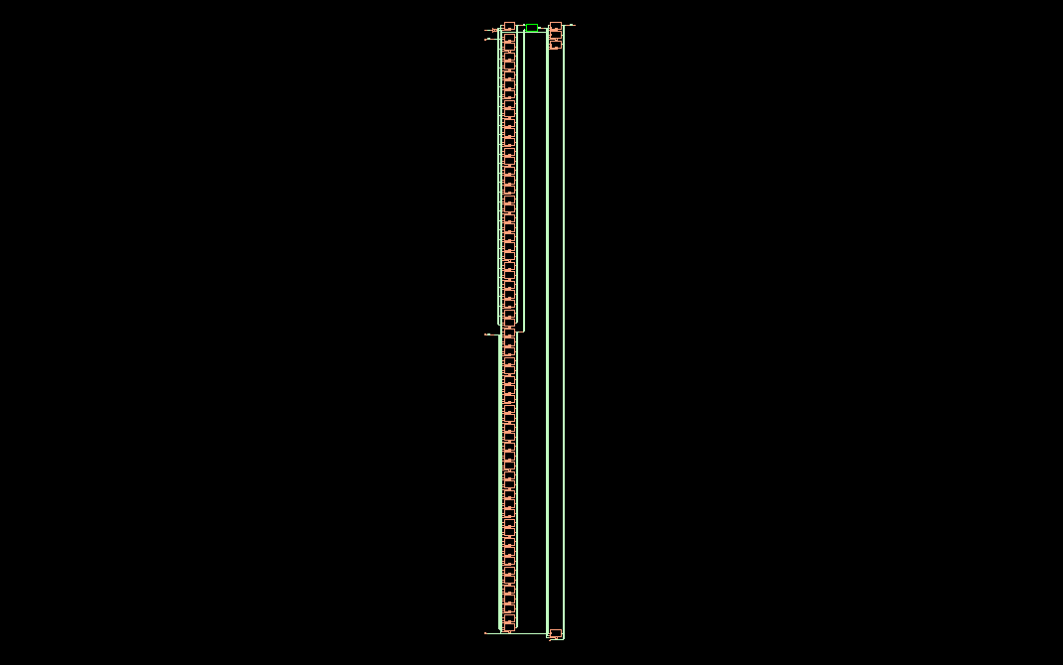
Genus Modulo 9 Adder με Flip Flops

Slide 38
Κώδικας Mod14 (Mod7) και Σχεδιάγραμμα

Slide 39
Συγκριτής Mod7
library ieee;
use ieee.std_logic_1164.all;
use ieee.numeric_std.all;
entity comparator_of_7 is
generic (n: integer := 3);
port (
S: in std_logic_vector(n-1 downto 0);
negative: in std_logic;
above: out std_logic;
below: out std_logic
);
end comparator_of_7;
architecture dataflow of comparator_of_7 is
signal above_below: std_logic_vector(1 downto 0);
signal S_padded : std_logic_vector(6 downto 0); -- always 7 bits
begin
S_padded <= (6 downto n => '0') & S;
above_below <= "10" when (
(S_padded(6 downto 3) /= "0000" and negative = '0') or
(negative = '0' and S(2) = '1' and S(1) = '1' and S(0) = '1')
) else
"01" when (S(n-1) = '1' and negative = '1') else
"00";
above <= above_below(1);
below <= above_below(0);
end dataflow;

Slide 40
Κώδικας Κρατουμένου mod7
begin
mod7 <= std_logic_vector(to_signed(7, 7));
mod7_comp <= std_logic_vector(to_signed(-7, 7));
data(0) <= (others => '0') when (data_in = all_ones and negative_first = '0') else
(6 downto n => data_in(n-1)) & data_in when negative_first ='1' else
(6 downto n => '0') & data_in;
generate_label:
for i in 0 to 9 generate
signal above_i, below_i: std_logic;
signal temp1_i, temp2_i:std_logic_vector(6 downto 0);
begin
-- First comparison stage
comp_i: comparator_of_7
generic map(7)
port map(data(i), negative_first, above_i, below_i);
-- First arithmetic stage
add_above_i: adder_n
generic map(7)
port map(data(i), mod7_comp, '0', temp1_i, open);
add_below_i: adder_n
generic map(7)
port map(data(i), mod7, '0', temp2_i, open);
-- Intermediate mux
data(i+1) <= temp1_i when above_i = '1' else
temp2_i when below_i = '1' else
data(i);
end generate;
-- Final output selection
remainder<=data(10)(n-1 downto 0);
end architecture;

Slide 41
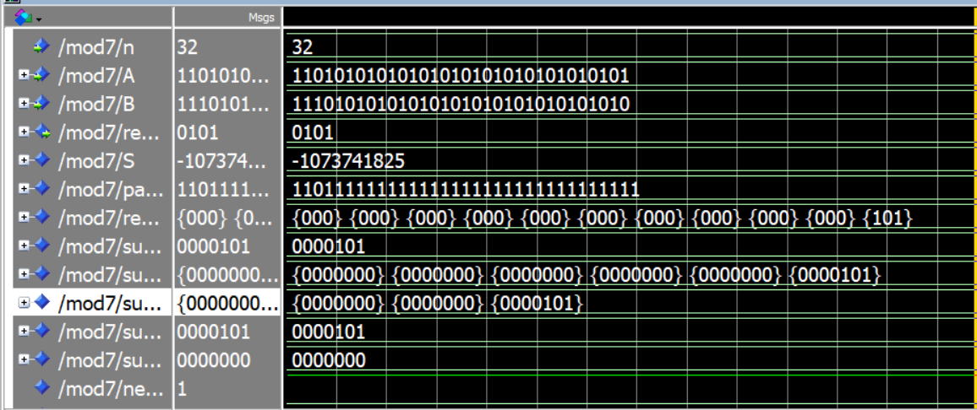
Testbench Mod7

Slide 42
Κώδικας mod7
begin
adder : adder_n
generic map(n)
port map (A, B, '0', S, open);
padded_33 <= (32 downto n => S(n-1)) & S;
negative <= padded_33(32);
s_first <= padded_33(32 downto 30);
remainder_c : remainder_calculator_7
generic map(3)
port map(s_first,negative,
remainders(10));
generate_label:
for i in 0 to 9 generate
signal s_in: std_logic_vector(2 downto 0);
begin
s_in <= padded_33(2+i*3 downto i*3);
remainder_c : remainder_calculator_7
generic map(3)
port map(s_in,'0',
remainders(i));
end generate;
gen_stage1: for i in 0 to 4 generate
signal a_padded, b_padded : std_logic_vector(6 downto 0);
begin
a_padded <= "0000" & remainders(i*2);
b_padded <= "0000" & remainders(i*2+1);
adder_st1: adder_n
generic map(7)
port map(
a => a_padded,
b => b_padded,
cin => '0',
sum => sum_stage1(i),
cout => open
);
end generate gen_stage1;
sum_stage1(5)<="0000"&remainders(10);
-- Stage 2: Add results from stage 1
gen_stage2: for i in 0 to 2 generate
adder_st2: adder_n
generic map(7)
port map(
a => sum_stage1(i*2),
b => sum_stage1(i*2+1),
cin => '0',
sum => sum_stage2(i),
cout => open
);
end generate gen_stage2;
-- Pre Final adder
adder_prefinal: adder_n
generic map(7)
port map(
a => sum_stage2(0),
b => sum_stage2(1),
cin => '0',
sum => sum_final_temp,
cout => open
);
-- Final adder
adder_final: adder_n
generic map(7)
port map(
a => sum_stage2(2),
b => sum_final_temp,
cin => '0',
sum => sum_final,
cout => open
);
remainder_sum : remainder_calculator_7
generic map(7)
port map(sum_final,'0',
sum_remain);
remainder <= sum_remain(3 downto 0);
end dataflow;

Slide 43
Κώδικας mod14
begin
adder : adder_n
generic map(n)
port map (A, B, '0', S, open);
mod7_module: mod7
generic map(n)
port map (A, B, mod7_remainder);
remainder <= "0000" when (S(0) = '0' and unsigned(mod7_remainder) = 0) else -- 0
"1000" when (S(0) = '0' and unsigned(mod7_remainder) = 1) else -- 8
"0010" when (S(0) = '0' and unsigned(mod7_remainder) = 2) else -- 2
"1010" when (S(0) = '0' and unsigned(mod7_remainder) = 3) else -- 10
"0100" when (S(0) = '0' and unsigned(mod7_remainder) = 4) else -- 4
"1100" when (S(0) = '0' and unsigned(mod7_remainder) = 5) else -- 12
"0110" when (S(0) = '0' and unsigned(mod7_remainder) = 6) else -- 6
"0111" when (S(0) = '1' and unsigned(mod7_remainder) = 0) else -- 7
"0001" when (S(0) = '1' and unsigned(mod7_remainder) = 1) else -- 1
"1001" when (S(0) = '1' and unsigned(mod7_remainder) = 2) else -- 9
"0011" when (S(0) = '1' and unsigned(mod7_remainder) = 3) else -- 3
"1011" when (S(0) = '1' and unsigned(mod7_remainder) = 4) else -- 11
"0101" when (S(0) = '1' and unsigned(mod7_remainder) = 5) else -- 5
"1101" when (S(0) = '1' and unsigned(mod7_remainder) = 6) else -- 13
"1111"; -- default fallback (error or undefined)
end dataflow;

Slide 44
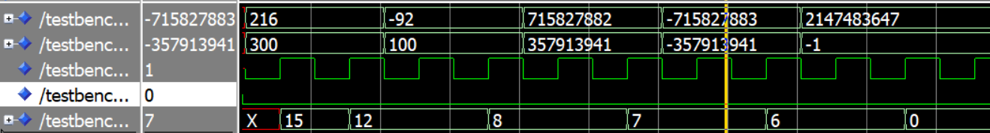
Τελικό Testbench

Slide 45

Genus Modulo 14 Adder με Flip Flops

Slide 46
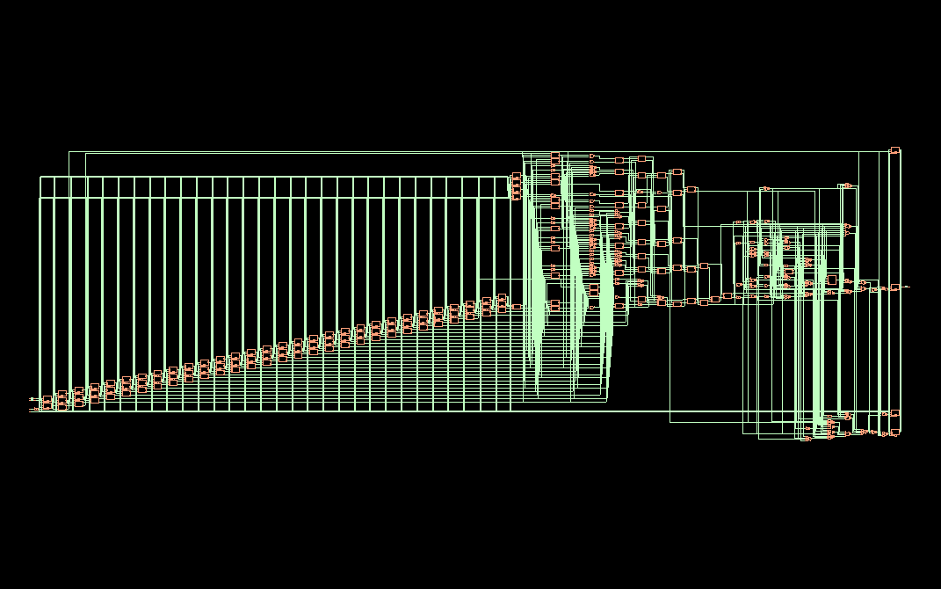
Genus Modulo 14 Adder με Flip Flops

Slide 47
Κώδικας Mod15 και Σχεδιάγραμμα

Slide 48
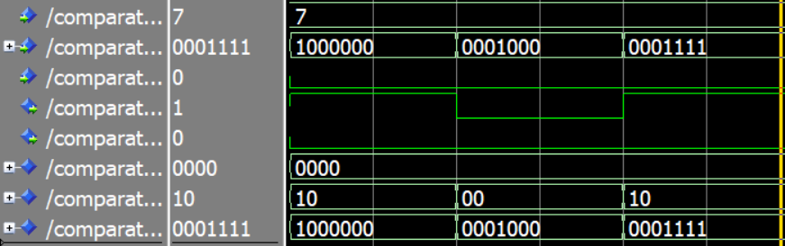
Testbench Comparator 15

Slide 49
Συγκριτής Mod15
library ieee;
use ieee.std_logic_1164.all;
use ieee.numeric_std.all;
entity comparator_of_15 is
generic (n: integer := 7);
port (
S: in std_logic_vector(n-1 downto 0);
negative: in std_logic;
above: out std_logic;
below: out std_logic
);
end comparator_of_15;
architecture dataflow of comparator_of_15 is
signal test: std_logic_vector(3 downto 0); -- 4 bits (but we only compare 3)
signal above_below: std_logic_vector(1 downto 0);
signal S_padded : std_logic_vector(6 downto 0); -- always 7 bits
begin
S_padded <= (6 downto n => '0') & S;
test <= std_logic_vector(to_unsigned(0, 4)); -- "0000"
above_below <= "10" when (
(S_padded(6 downto 4) /= "000" and negative = '0') or
(negative = '0' and S(3) = '1' and S(2) = '1' and S(1) = '1' and S(0) = '1')
) else
"01" when (S(n-1) = '1' and negative = '1') else
"00";
above <= above_below(1);
below <= above_below(0);
end dataflow;

Slide 50
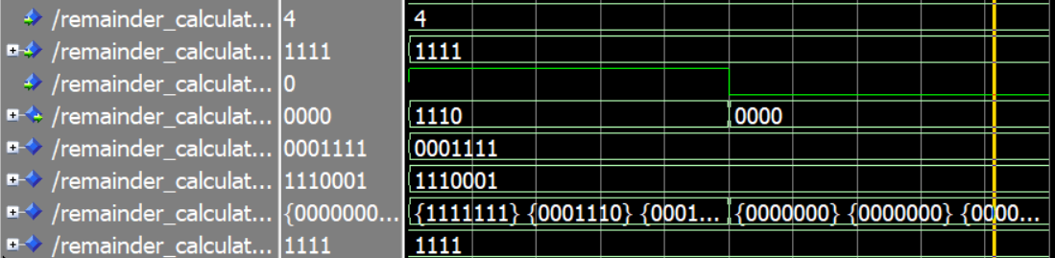
Testbench Κρατούμενο

Slide 51
Κώδικας Κρατουμένου mod15
begin
mod15 <= std_logic_vector(to_signed(15, 7));
mod15_comp <= std_logic_vector(to_signed(-15, 7));
data(0) <= (others => '0') when (data_in = all_ones and negative_first = '0') else
(6 downto n => data_in(n-1)) & data_in when negative_first ='1' else
(6 downto n => '0') & data_in;
-- so that for 15 when mod15_comp can't be actually used for 4 bits so i bypass it
-- for 7 bits 1111111 in the adding remainders stage, its impossible as max 14*8=112=1110000
generate_label:
for i in 0 to 7 generate
signal above_i, below_i: std_logic;
signal temp1_i, temp2_i:std_logic_vector(6 downto 0);
begin
-- First comparison stage
comp_i: comparator_of_15
generic map(7)
port map(data(i), negative_first, above_i, below_i);
-- First arithmetic stage
add_above_i: adder_n
generic map(7)
port map(data(i), mod15_comp, '0', temp1_i, open);
add_below_i: adder_n
generic map(7)
port map(data(i), mod15, '0', temp2_i, open);
-- Intermediate mux
data(i+1) <= temp1_i when above_i = '1' else
temp2_i when below_i = '1' else
data(i);
end generate;
-- Final output selection
remainder<=data(8)(n-1 downto 0);
end architecture;

Slide 52
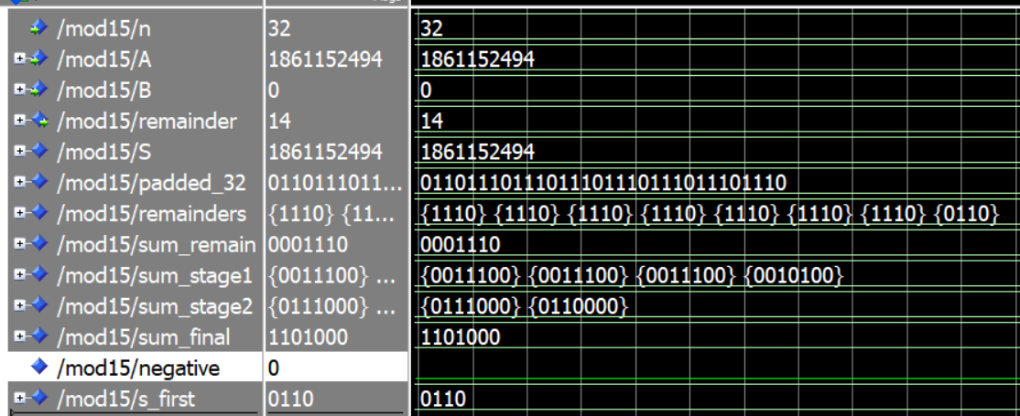
Testbench Mod15

Slide 53
Κώδικας mod15
begin
adder : adder_n
generic map(n)
port map (A, B, '0', S, open);
padded_32 <= (31 downto n => S(n-1)) & S;
negative <= padded_32(31);
s_first <= padded_32(31 downto 28);
remainder_c : remainder_calculator_15
generic map(4)
port map(s_first,negative,
remainders(7));
generate_label:
for i in 0 to 6 generate
signal s_in: std_logic_vector(3 downto 0);
begin
s_in <= padded_32(3+i*4 downto i*4);
remainder_c : remainder_calculator_15
generic map(4)
port map(s_in,'0',
remainders(i));
end generate;
-- Adder tree to sum all remainders
-- Stage 1: Add pairs of remainders
gen_stage1: for i in 0 to 3 generate
signal a_padded, b_padded : std_logic_vector(6 downto 0);
begin
a_padded <= "000" & remainders(i*2);
b_padded <= "000" & remainders(i*2+1);
adder_st1: adder_n
generic map(7)
port map(
a => a_padded,
b => b_padded,
cin => '0',
sum => sum_stage1(i),
cout => open
);
end generate gen_stage1;
-- Stage 2: Add results from stage 1
gen_stage2: for i in 0 to 1 generate
adder_st2: adder_n
generic map(7)
port map(
a => sum_stage1(i*2),
b => sum_stage1(i*2+1),
cin => '0',
sum => sum_stage2(i),
cout => open
);
end generate gen_stage2;
-- Final adder
adder_final: adder_n
generic map(7)
port map(
a => sum_stage2(0),
b => sum_stage2(1),
cin => '0',
sum => sum_final,
cout => open
);
remainder_sum : remainder_calculator_15
generic map(7)
port map(sum_final,'0',
sum_remain);
remainder <= sum_remain(3 downto 0);
end dataflow;

Slide 54
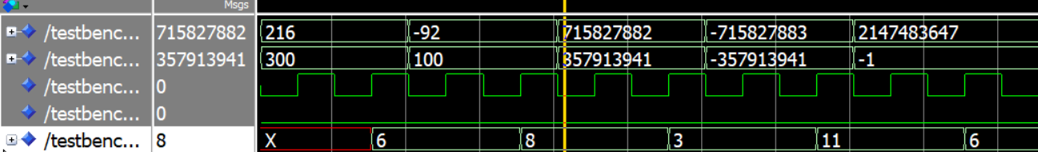
Τελικό Testbench

Slide 55
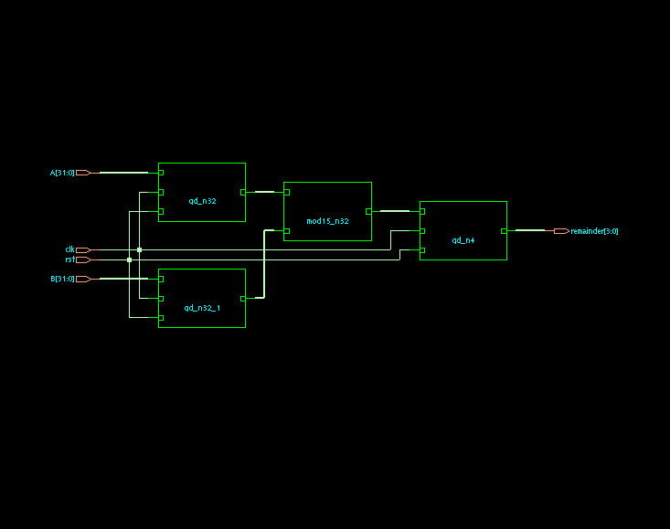
Genus Modulo 15 Adder με Flip Flops

Slide 56
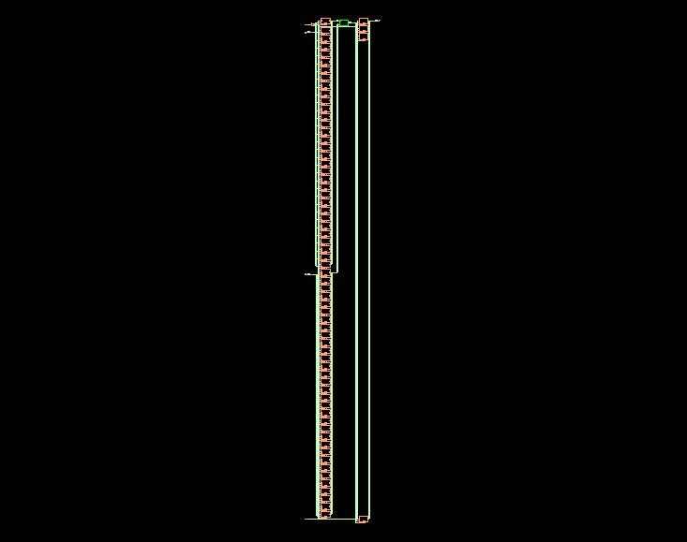
Genus Modulo 15 Adder με Flip Flops

