Slide 1
Designing Applications for Everyone
Presented By Dempsey Thompson
Making sure our applications work for all people.

Slide 2
The goal today is to deepen our understanding of Inclusive Design Principles, the Importance of Accessibility and how we can Achieve these in Practice.

Slide 3
01
Inclusive Design
Focuses on considering everyone’s different abilities, preferences, and needs. Ensuring that as many people as possible can enjoy our designs.

Slide 4
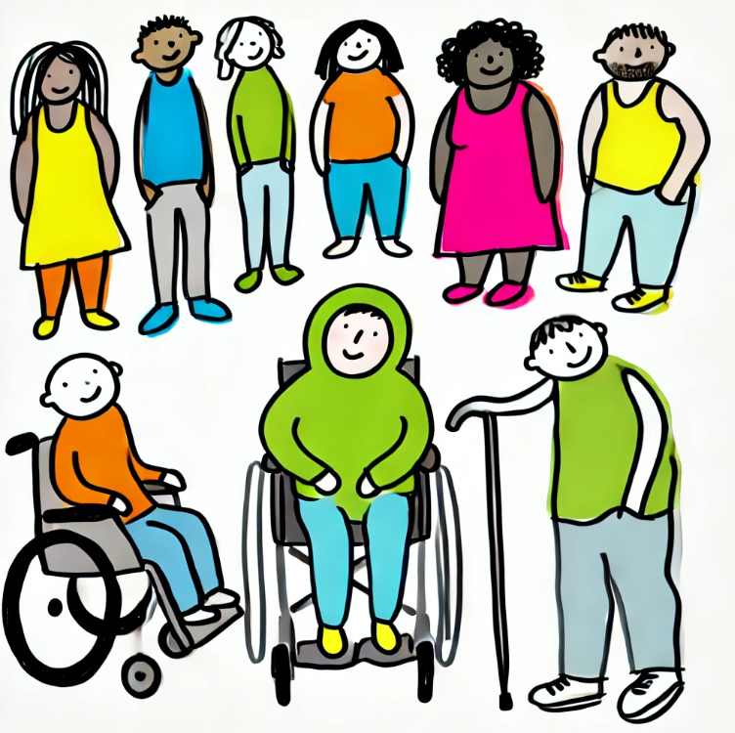
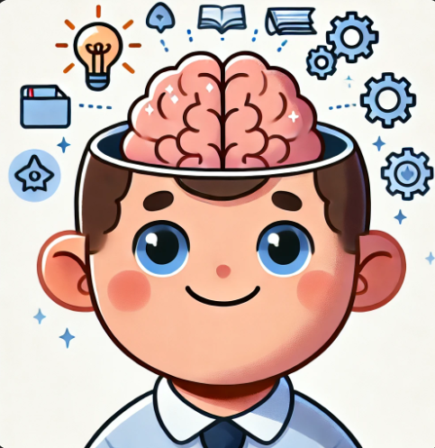
Why Bother?
Diversity:
- We want everyone to be able to enjoy our apps.
- It’s important to recognize exclusion.
Learning:
- It’s a design process that puts people first.
- Ensuring everyone can use our apps can mean new and different problems to solve, to make us even better developers.

Slide 5
Impairments
Language barrier
Mental Disabilities
Inclusive Design is a mindset when creating an application. You have to be diligent and consider a broad range of use cases.
Color Blind
Physical Disabilities

Slide 6
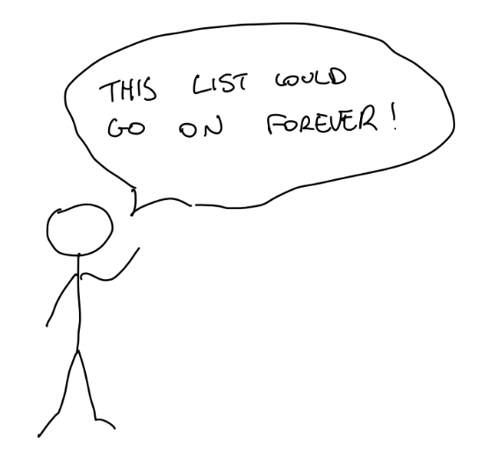

Slide 7
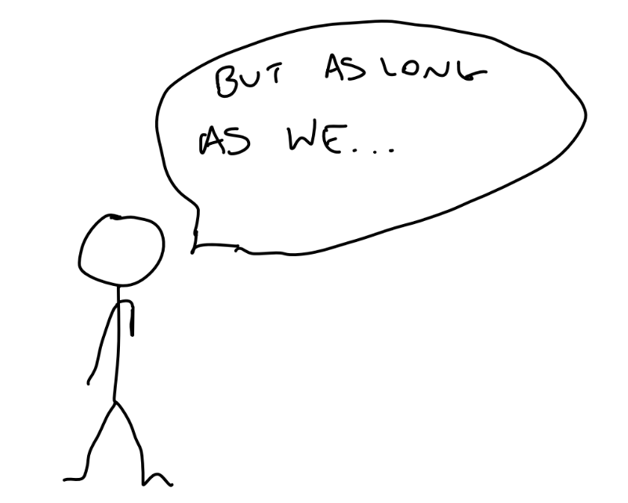

Slide 8
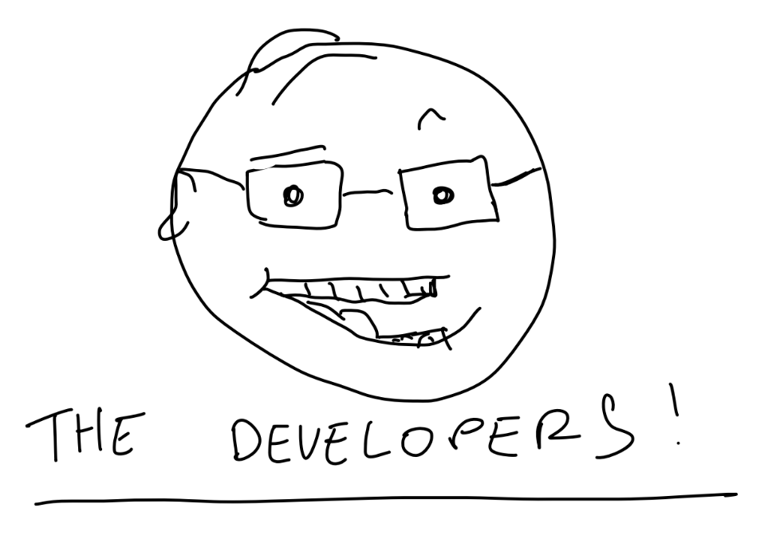

Slide 9
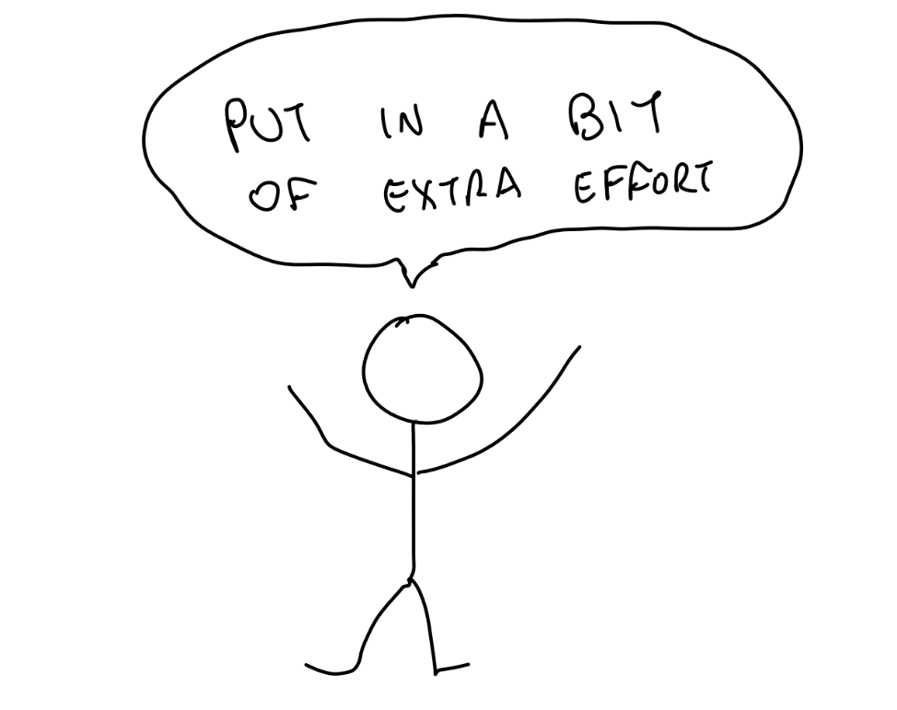

Slide 10
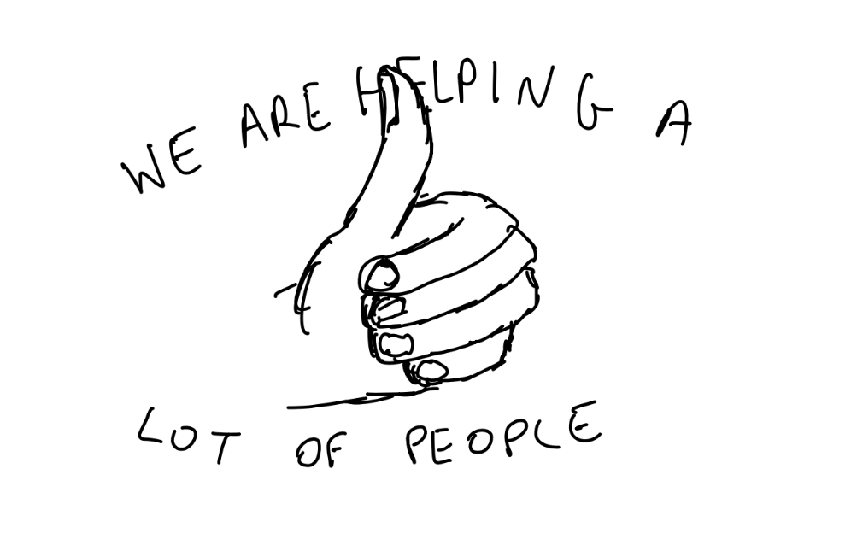

Slide 11
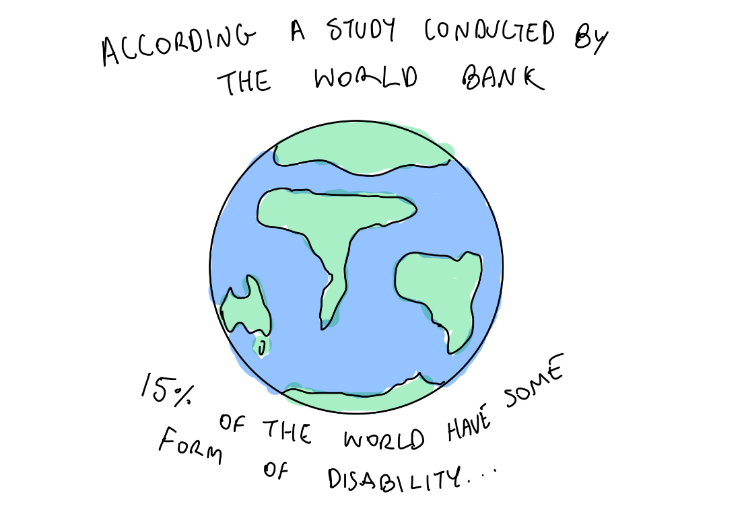
2

Slide 12
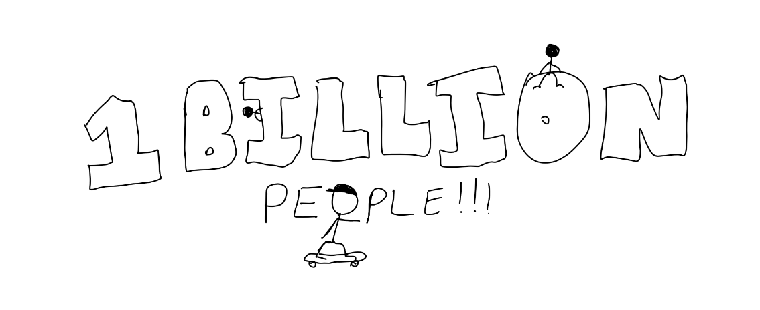

Slide 13
02
Importance of Accessibility
In a sense falls under Inclusive Design but also is its own thing. Accessibility is based on the Web Content Accessibility Guidelines (WCAG). It is specifically centered around people with disabilities or impairments.

Slide 14
Perceivable
Operable
Understandable
Robust
Information and UI elements must be presented in ways users can perceive (e.g. text alternatives for images).
Users must be able to interact with the interface (e.g. keyboard navigation, enough time to read and use content)
Content and operation must be easy to understand (e.g. readable text, predictable behavior)
Content must be compatible with a wide range of assistive technologies and remain accessible as technology evolves.

Slide 15


Companies Like Microsoft and IBM actively promote accessibility and provide their own tools to encourage developers to design apps following these 4 principles.

Slide 16
03
Nuts + Bolts
How to actually implement some of the things we have spoken about in React.

Slide 17
Keyboard Accessibility
Most modern frameworks (like React) handle a lot of keyboard accessibility for you.
Standard HTML elements like buttons and links are automatically focus-able and can be tabbed to.
However, sometimes we have custom components or complex UI interactions (very often) and we might need to enhance keyboard accessibility.
A common example of having to manage focus may be when opening a modal or something of that nature.

Slide 18
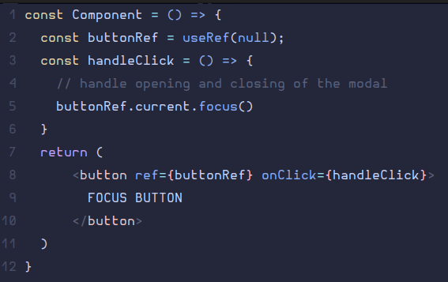
Modal Example
Say for example we want to open a modal.
When we close this modal it’d make sense that the button we used to open it would be focused.
Here is how we can do this in react.

Slide 19
Audio Accessibility
Here we want to ensure that our content can be delivered through audio well.
This involves using semantic HTML, labeling and a logical structure.
Logical structure can refer to things like Header hierarchy.
Labels (“label” tag or “aria-label”) are necessary especially for forms to associate the input to the field.
We can capture dynamic changes in an element (like a notification) by adding an “aria-live” attribute.
Finally common sense, like having useful names for links and headers makes a big difference.

Slide 20


Examples

Slide 21
Zoom Feature
We can implement a zoom feature pretty simply.
All we need to consider is how we want to modify the content
within the component.
We have the “transform: scale()” method, or adjusting the
font-size, width or height of elements.

Slide 22
Design Tips
Use semantic HTML elements to convey structure and meaning.
Provide text alternatives for images, audio, and video content.
Ensure all interactive elements are keyboard accessible.
Maintain high color contrast for better readability.
Use clear, descriptive labels and ARIA roles where necessary.
Design with responsive layouts to ensure accessibility across devices
(wasn’t really covered in this talk).
Prioritize simplicity and clarity in your design to accommodate diverse
user needs.
Ensure content is understandable by users with varying levels of technical
proficiency.
Consider cultural diversity by avoiding assumptions about language, symbols,
and imagery.

Slide 23
Thanks for Watching

