Slide 1
Missouri Bark Field Guide
An in-depth guide for enjoying Missouri bark

Slide 2
Bark Safety ⚠️
Important Safety Principles
Know your purpose: Bark removal may be done for identification, specimen collection, art, or insect inspection. NEVER STRIP BARK –it is the tree’s lifeline.
Target deadwood: Collect from fallen branches or dead trees whenever possible to mitigate harm to healthy trees.
Limit live removal and never girdle the trunk
Protect yourself: Wearing gloves and eye protection is advised to protect against splinters and insect bites.

Slide 3

Missouri Hardwood Trees
White Oak (Quercus alba) – Missouri’s state tree; valued for its strong, durable wood.
Northern Red Oak (Quercus rubra) – A common oak with reddish bark and acorns.
Shagbark Hickory (Carya ovata) – Recognizable by its peeling bark; produces edible nuts.
Black walnut (Juglans nigra) – Known for its dark wood and edible walnuts.

Slide 4
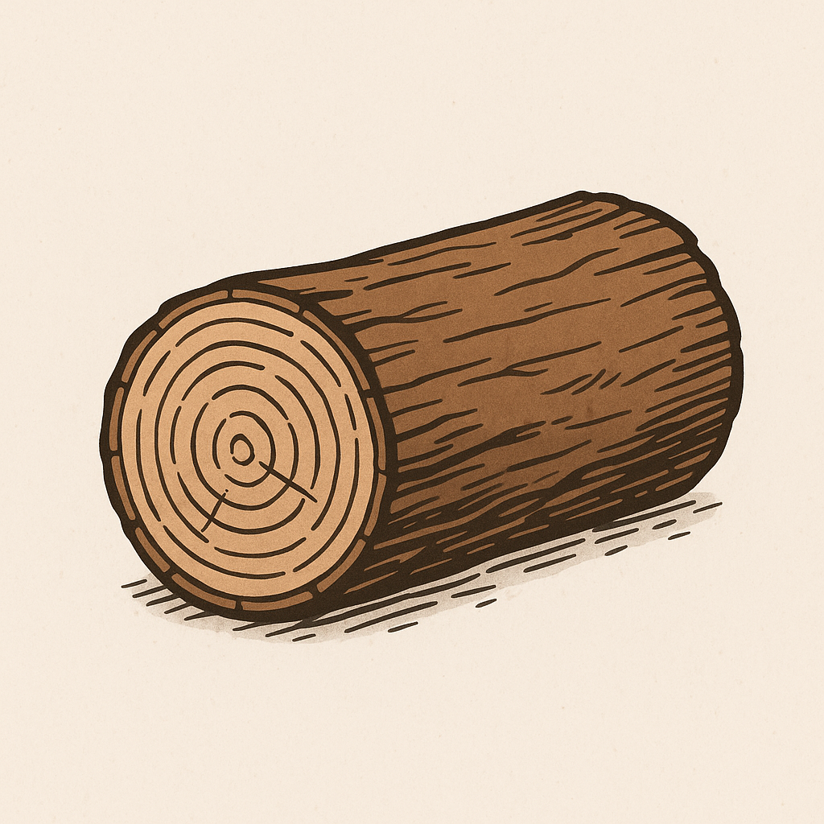
Missouri Hardwood Trees continued..
Sugar Maple (Acer saccharum) – Famous for its brilliant fall color and sap for maple syrup.
American Elm (Ulmus americana) – Once widespread, though many have been lost to Dutch elm disease.

Slide 5

Missouri Softwoods
Eastern Red Cedar (Juniperus virginiana) – Actually a juniper; very common in fields and along fences.
Shortleaf Pine (Pinus echinata) – Missouri’s only native pine; found mostly in the Ozarks.

Slide 6

Missouri Floodplain & Bottomland Trees
Sycamore (Platanus occidentalis) – Huge tree with mottled bark, common along rivers.
Cottonwood (Populus deltoids) – Fast-growing tree found near streams.
Silver Maple (Acer saccharinum) – Tolerant of flooding, with deeply cut leaves.
Black Willow (Salix nigra) – Found along water, used for erosion control.

Slide 7
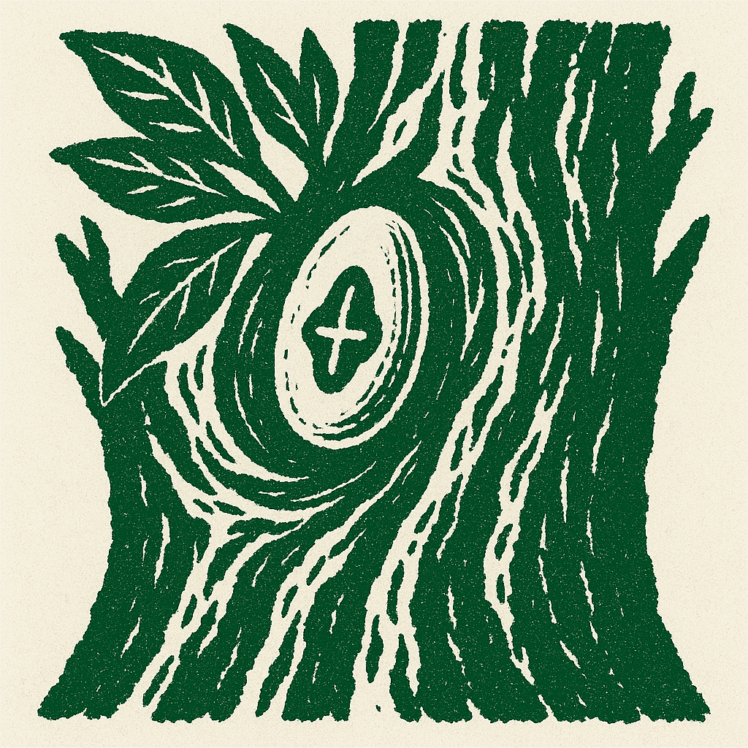
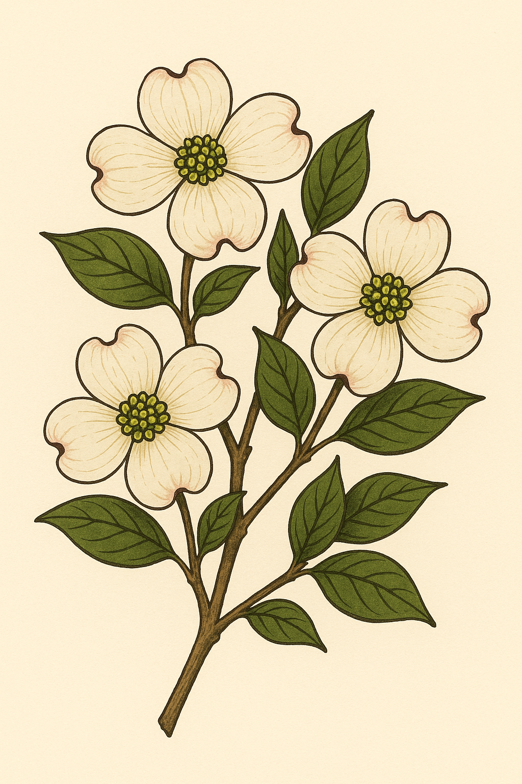
Ornamental & Wildlife-Friendly
Redbud (Cercis canadensis) – Small tree with pink spring blossoms.
Flowering Dogwood (Cornus florida) – Missouri’s state tree flower, known for white petals.
Persimmon (Diospyros virginiana) – Produces edible orange fruit.
Pawpaw (Asimina triloba) – Missouri’s “tropical” tree; produces custard-like fruit.

Slide 8
Nutritional Value of Missouri Bark
Inner bark (cambium layer), not the rough outer bark, is the edible portion.
Provides Carbohydrates, fiber, vitamins, and secondary compounds (tannins, resins, salicylates).
Historically used by Native American tribes in Missouri as both food and medicine.
Bark is rarely eaten raw — usually dried, ground, or boiled into teas

Slide 9
Further Nutritional Information..
White Oak & Northern Red Oak can be dried and ground into make-shift flower.
White Oak bark teas can be used for astringent medicinal purposes.
Shagbark Hickory bark can be chewed for quick energy.
Hickory bark can be boiled into flavor syrups
American Elm can be used to make mucilage starch.
Eastern Red Cedar can be used for kindling
Cottonwood bark can be used to create Salicin (aspirin-like compound)
Flowering Dogwood Bark can be used as a quinine substitute.

Slide 10
