Slide 1
EEG acquisition
30 minutes of resting-state EEG.
Clinical setup:
Natus software, device?,
21 EEG electrodes (10-20 cap),
3 EOG electrodes,
1 ECG electrode.
Test group: 18 M, 12 F, age 0-19.
Control group: 31 M, 35 F, age 0-19.

Slide 2
Preprocessing tools
Preprocessing in Python with the following packages:
Numpy,
Pandas,
MNE,
MNE BIDS,
MNE Connectivity,
Autoreject.

Slide 3
EEG preprocessing protocol
Converted acquired data into the BIDS format.
Extended alpha-band, 7-14 Hz (Kavčič et al. 2023, 2023, 2024).
Average re-referencing.
Automated cleanup: MNE ICA on EEG, ECG and EOG + autoreject.
Kept mid 20 minutes of data, 100 x 12 second epoch (Miljevic et al. 2020).

Slide 4
Connectomes
Constructed a connectome for each participant:
100 x 12 s epochs (Miljevic et al. 2020).
Similarity metric: debiased weighted phase lag (db-WPLI, Vinck et al. 2011).

Slide 5
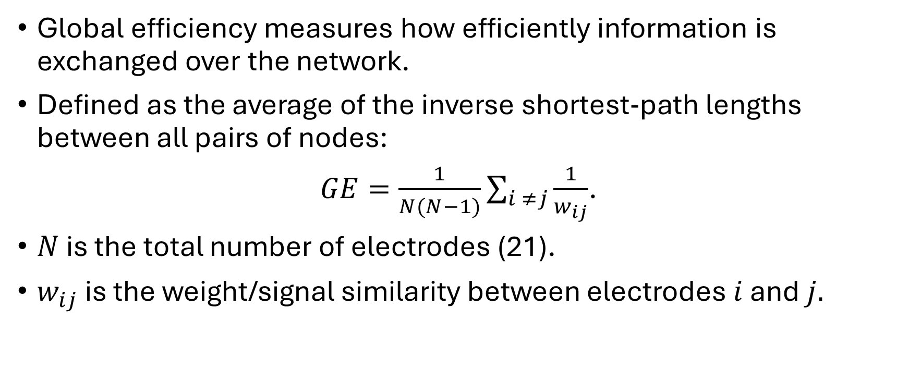
The global efficiency metric (GE)
Global efficiency measures how efficiently information is exchanged over the network.
Defined as the average of the inverse shortest‐path lengths between all pairs of nodes:
$GE=\frac{1}{N(N−1)}\sum_{i ≠j}{\frac{1}{w_{ij}}}$.
$N$ is the total number of electrodes (21).
$w_{ij}$ is the weight/signal similarity between electrodes $i$ and $j.$

Slide 6
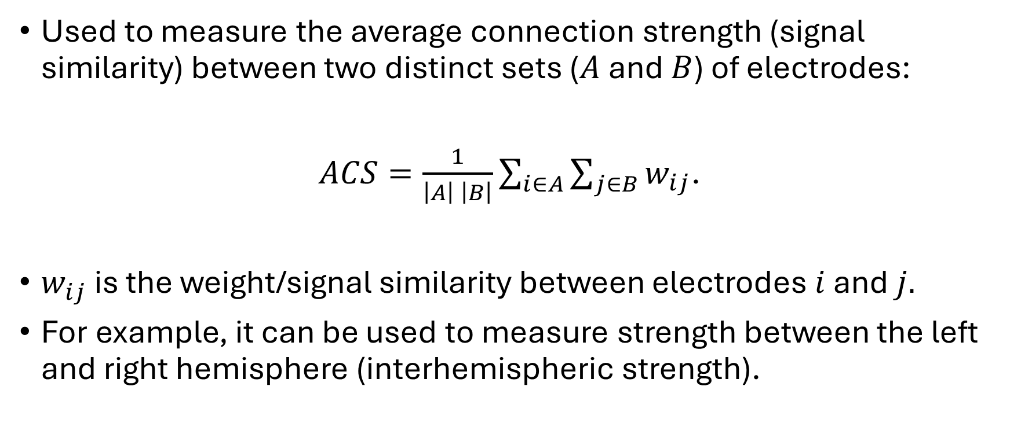
Average connection strength metric (ACS)
Used to measure the average connection strength (signal similarity) between two distinct sets ($A$ and $B$) of electrodes:
$ACS=\frac{1}{\left|A\right| \left|B\right|}\sum_{i∈A}{\sum_{j∈B}{w_{ij}}}$.
$w_{ij}$ is the weight/signal similarity between electrodes $i$ and $j.$
For example, it can be used to measure strength between the left and right hemisphere (interhemispheric strength).

Slide 7
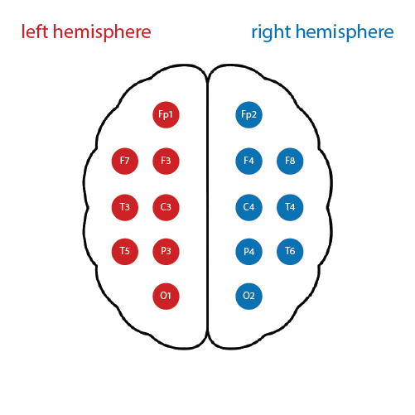
Interhemispheric strength (IHS)
ACS between the electrodes of the right and the left hemisphere.

Slide 8
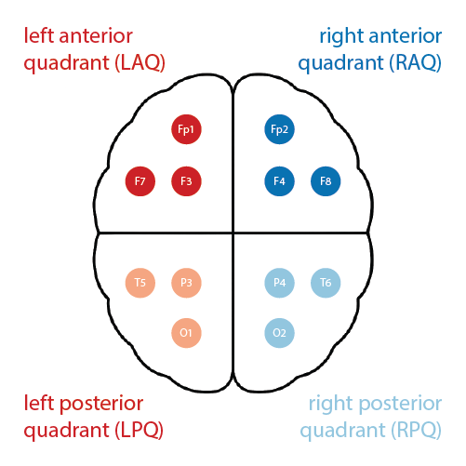
ACS between "quadrants"
LAQ vs RAQ,
LPQ vs RPQ,
LAQ vs RPQ,
RAQ vs LPQ.

Slide 9
Bayesian analysis
Bayesian t-test for comparison between the control and test group.
Bayesian linear regression to investigate how metrics change with age.
Executed in R and Stan.
Terminology:
moderate evidence if probability larger than 90%,
strong evidence if probability larger than 95%,
probability too low to make conclusions in other cases.

Slide 10
Paired tests
Per Kavcic et al. 2024, each participant from the test group was matched with all participants from the control group that:
were of the same sex,
differed at most by 1 year in age.
For each metric we calculated the difference between the pair.
Statistical tests then verify if these differences are negative (higher value of the metric in the control group) or positive (higher value of the metric in the test group).

Slide 11
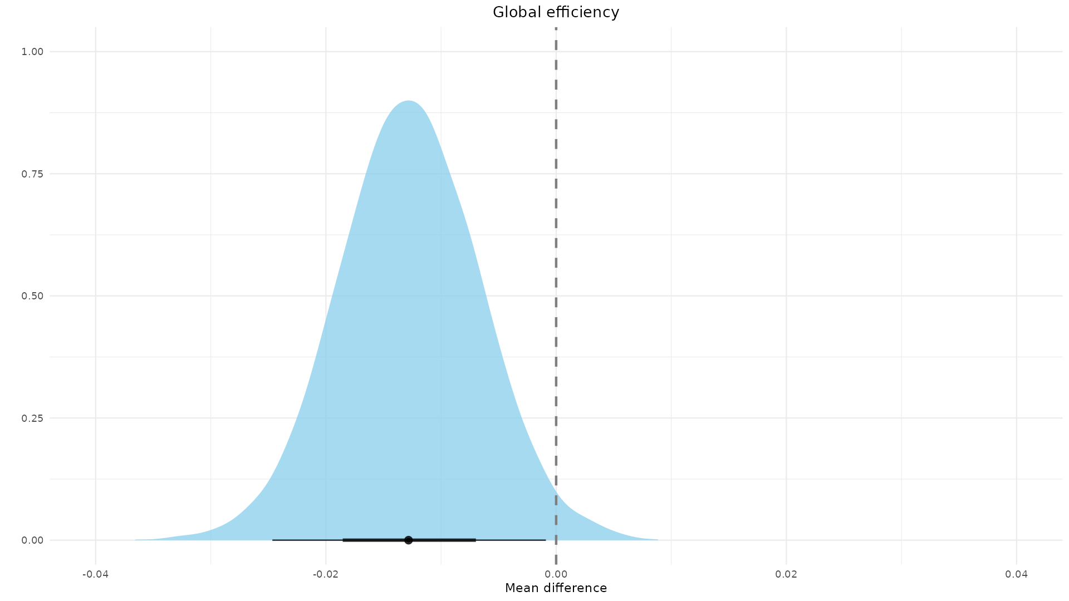
Global efficiency
Strong evidence that global efficiency is lower in the test group (P = 98.12 ± 0.27%).

Slide 12
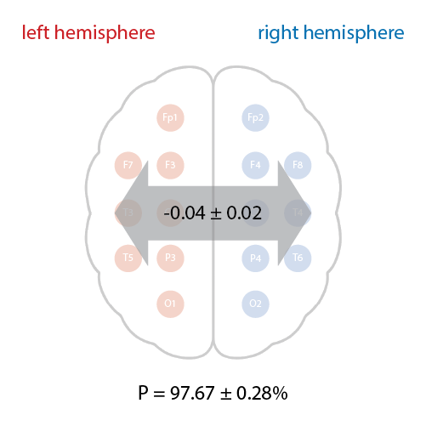
IHS
Strong evidence that IHS is lower in the test group.
On average IHS in the test group was 0.04 lower than in the control group.

Slide 13
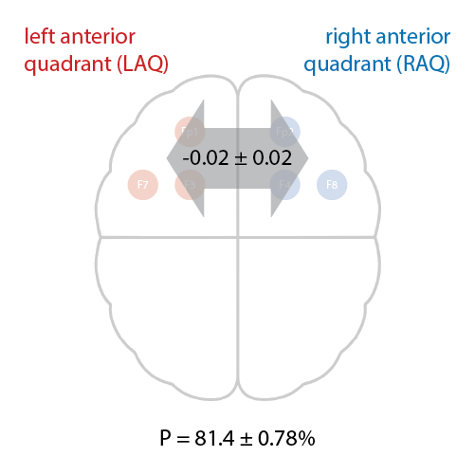
LAQ vs RAQ
No significant evidence.

Slide 14
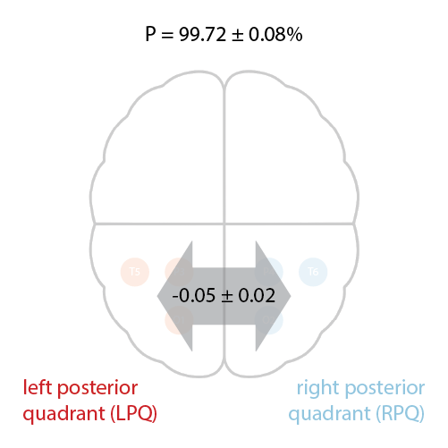
LPQ vs RPQ
Strong evidence that ACS is lower in the test group.

Slide 15
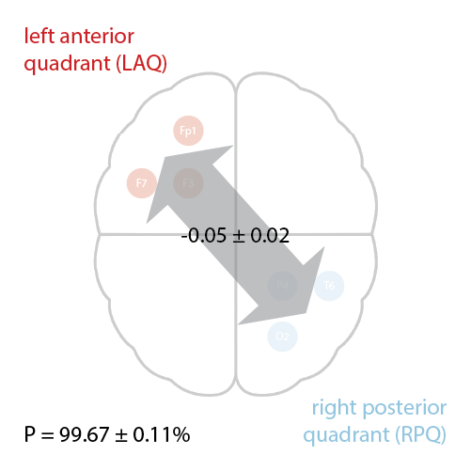
LAQ vs RPQ
Strong evidence that ACS is lower in the test group.

Slide 16
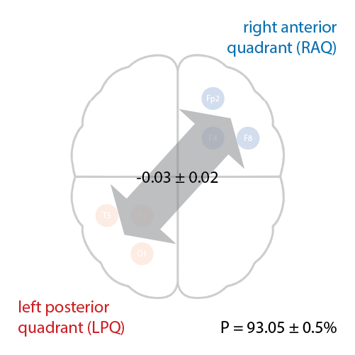
RAQ vs LPQ
Moderate evidence that ACS is lower in the test group.

Slide 17
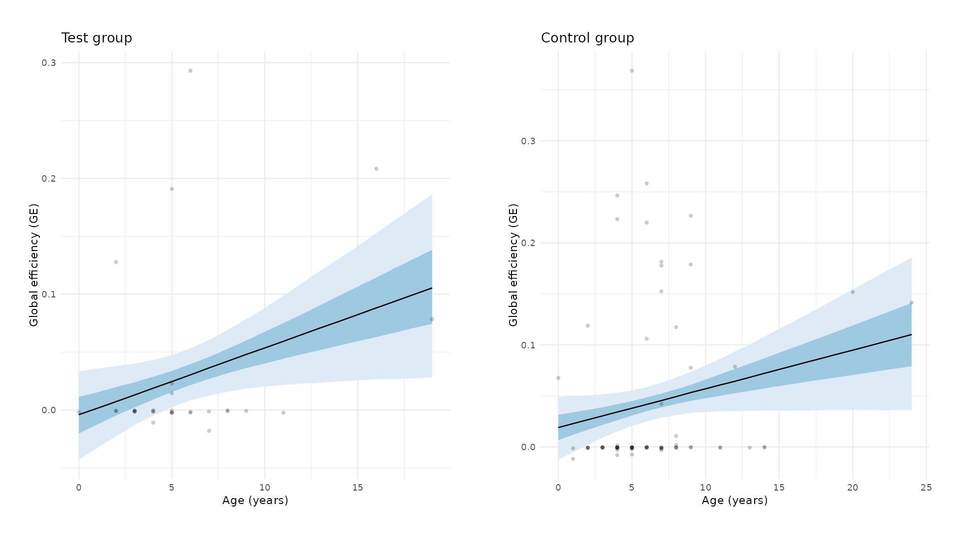
GE development
"Normal" development in terms of GE, it increases with age.

Slide 18
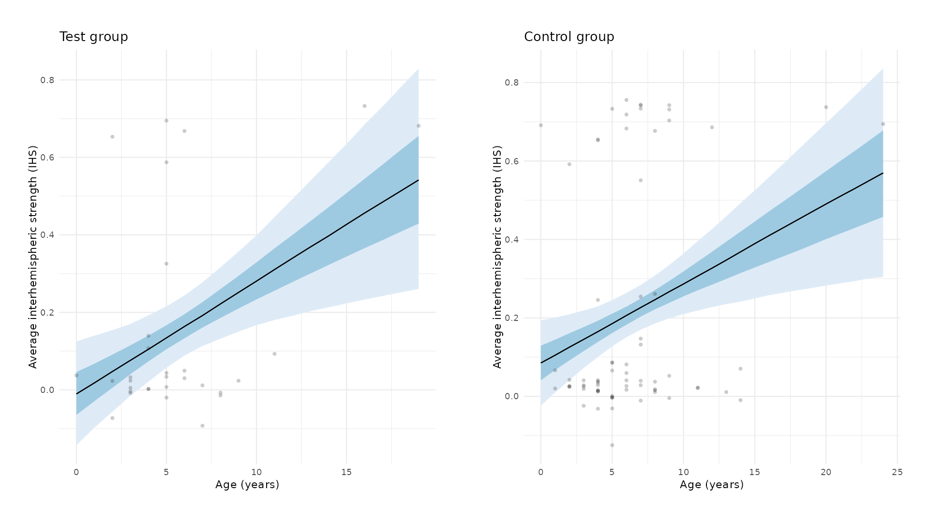
IHS development
"Normal" development in terms of IHS, it increases with age.

Slide 19
Open science
Data (connectomes and demographics) along with all code is available at: https://github.com/demsarjure/ped_neuro_eeg.

Slide 20
References
Kavčič, Alja, et al. "EEG alpha band functional brain network correlates of cognitive performance in children after perinatal stroke." NeuroImage 297 (2024): 120743.
Kavčič, Alja, et al. "EEG functional connectivity after perinatal stroke." Cerebral Cortex 33.17 (2023): 9927-9935.
Kavčič, Alja, et al. "Age related changes and sex related differences of functional brain networks in childhood: A high-density EEG study." Clinical Neurophysiology 150 (2023): 216-226.
Miljevic, Aleksandra, et al. "Electroencephalographic connectivity: a fundamental guide and checklist for optimal study design and evaluation." Biological Psychiatry: Cognitive Neuroscience and Neuroimaging 7.6 (2022): 546-554.
Vinck M, Oostenveld R, Van Wingerden M, Battaglia F, Pennartz CM. An improved index of phase-synchronization for electrophysiological data in the presence of volume-conduction, noise and sample-size bias. NeuroImage. 2011:55(4):1548–1565. ISSN 10538119.
Gorgolewski, Krzysztof J., et al. “The Brain Imaging Data Structure, a Format for Organizing and Describing Outputs of Neuroimaging Experiments.” Scientific Data, vol. 3, 2016, article no. 160044, doi:10.1038/sdata.2016.44.
Python Software Foundation. “Python Language Reference, Version 3.x.” Python Software Foundation, 2023. https://docs.python.org/3/reference/.
Carpenter, Bob, et al. “Stan: A Probabilistic Programming Language.” Journal of Statistical Software, vol. 76, no. 1, 2017, pp. 1–32, doi:10.18637/jss.v076.i01.
Gramfort, Alexandre, et al. “MEG and EEG Data Analysis with MNE-Python.” Frontiers in Neuroscience, vol. 7, 2013, p. 267, doi:10.3389/fnins.2013.00267.
MNE-Python Developers. MNE-Python. Zenodo, 2021, doi:10.5281/zenodo.592483.
Appelhoff, Stefan, et al. “MNE-BIDS: Organizing Electrophysiological Data into the BIDS Format and Facilitating Their Analysis.” Journal of Open Source Software, vol. 4, no. 44, 2019, p. 1896, doi:10.21105/joss.01896.
Li, Adam, et al. mne-connectivity. Version 0.6.0, 6 Dec. 2024, GitHub, https://github.com/mne-tools/mne-connectivity.
Jas, Mainak, et al. “Automated Rejection and Repair of Bad Trials in MEG/EEG.” 6th International Workshop on Pattern Recognition in Neuroimaging (PRNI), 2016.
Jas, Mainak, et al. “Autoreject: Automated Artifact Rejection for MEG and EEG Data.” NeuroImage, vol. 159, 2017, pp. 417–429, doi:10.1016/j.neuroimage.2017.06.030.

