Slide 1
Epigenomic model of cardiac enhancers with application to GWAS
Avinash Das Sahu,
Radhouane Aniba ,
Yen-Pei Christy Chang,
Sridhar Hannenhalli

Slide 2
Introduction
GWAS reveal associations between genomic loci and phenotypic traits.
Inferring causality from associations is a major challenge.
Majority of GWAS SNPs lie in non-coding regions and regions distal from any gene, making functional inference hard.
Distal regulatory elements like enhancers are crucial in understanding causality and mechanism of interaction.

Slide 3
Enhancers identification
Sequence based features¹
Absence of discriminative sequence properties
Enhacers are cell-type specific
Epigenomic features²⁻⁴
Discriminative
P300 bound regions

Slide 4
SVM model for cardiac enhancers
Positive training set:
83 experimentally heart enhancers validated in transgenic mice.
Split into 1kb regions (step size 500 bps)
Notes:
Make sure you can defend the choice of splitting.
Also make sure you know the length distribution- they are not that long.

Slide 5
SVM model for cardiac enhancers
Negative training set:
Random samples of 1 Kb genomic regions.
Randomly selected promoters.

Slide 6
SVM model for cardiac enhancers
Features: Epigenetic signal in 1Kb regions.
H3K4me1
H3K4me3
P300
DNase hypersensitivity (DNase-I)
Notes:
Provide references and make sure you know about these references

Slide 7
SVM model for cardiac enhancers
Training set
positive
Epigenetic features
SVM
Model
negative
Parameter
5 fold CV
Grid search

Slide 8
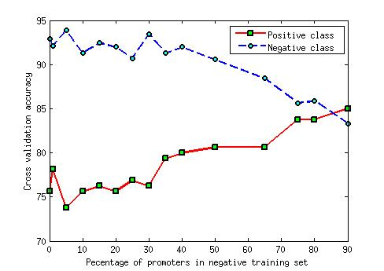
SVM model for cardiac enhancers
Promoters act as support vectors for SVM hyperplane.
Notes:
Have 1 sentence conclusion from this slide

Slide 9
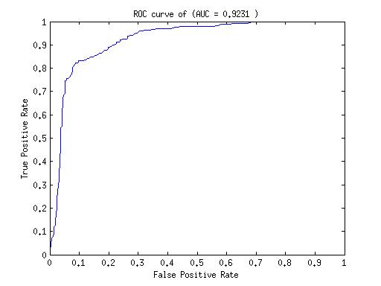
SVM model for cardiac enhancers
Testing
84% positive accuracy
92% negative accuracy
AUC 0.9231

Slide 10
Comparative Accuracy

Slide 11
SVM model for cardiac enhancers
Most of enhancer models predict P300 bound regions as enhancers.
Many of P300 bound regions don’t act as enhancers.
Our SVM correctly predicted 10 out of 13 P300 peaks validated non-enhancers.
Notes:
You already siad this 2 slides ago.
But I thing this needs to be said separately and emphasized.

Slide 12
Linking enhancers to cardiac phenotypes SNPs
Hypothesis: Causal variants underlying cardiac GWAS signals lie in cardiac enhancers.
229 NHGRI's cardiac GWAS SNPs.
Identify enhancers in linkage disequlibrium for each GWAS SNP.

Slide 13
Cardiac regulatory motifs
LD
SVM enhancer
GWAS
TRANSFAC PWM scan
TRANSFAC PWM scan
Motif enrichment

Slide 14
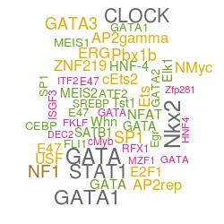
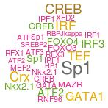
Cardiac regulatory motifs
SVM VS GWAS
SVM VS P300
SVM enhancers are enriched in heart specific motifs.
Notes:
Show a schematic for motif enrichment analysis.
Make sure you know the source of motifs and PM_SCAN/Thresoldetc 95%.

Slide 15
Cardiac GWAS enhancers regulate closest genes
LD
Closest gene
SVM enhancer
GWAS
DHS
Gene expression
DHS
Relatively correlated
SVM enhancers regulate closest genes compared to GWAS SNP

Slide 16
Cardiac GWAS enhancers regulate closest genes
LD
Closest gene
SVM enhancer
P300
DHS
Gene expression
DHS
Relatively correlated
SVM enhancers regulate closest genes compared to P300 bound SNP.

Slide 17
Genes near cardiac enhancers are enriched in cardiac functions
Closest gene
Closest gene
SVM enhancer
GWAS
LD

Slide 18
Genes near cardiac enhancers are enriched in cardiac functions
Enriched in cardiac specific function
Closest gene
Closest gene
SVM enhancer
GWAS
LD

Slide 19
Conclusion
We presented a supervised model for enhancers with
Positive training set as validated enhancers in transgenic mice.
Epigenomic marks as features.
Better negative set.
We used our model to find context specific enhancers to interpret GWAS signals.
The enhancers were enriched in known core cardiac transcription factor.
The enhancers are regulators of closest genes.
Closest genes are involved in cardiac functions and heart diseases.

Slide 20
Thank you

