Slide 1
Gene Classification via Tissue Tree Biclustering
Avinash Das

Slide 2
Gene categories
Tissue specific
genes

Slide 3
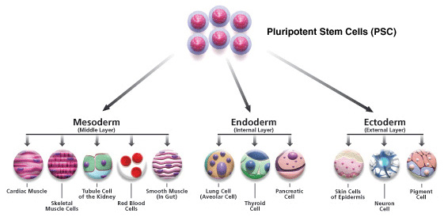
Tissue tree

Slide 4
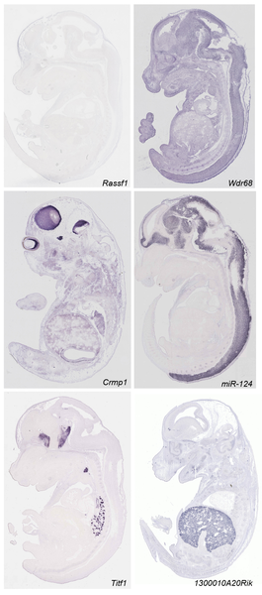
In-situ hybridization data
Diez-Roux G, Banfi S, Sultan M, Geffers L, et al. (2011) A High-Resolution Anatomical Atlas of the Transcriptome in the Mouse Embryo. PLoS Biol 9(1): e1000582. doi:10.1371/journal.pbio.1000582
http://www.plosbiology.org/article/info:doi/10.1371/journal.pbio.1000582
Notes:
Mouse transciptomic data. They have analyzed around 18000 transcript by RNA ISH. They performed saggital section on 14th day wild type mice.

Slide 5
ISH data
360,000 images were viewed and annotated!
5510 genes x 811 anatomies matrix
11000 genes x 811 tissue matrix with missing data.
Discrete data with annotation strong, medium, weak or no expression
Notes:
Discretized data matrix have information whether a particular gene have high low medium or no expression in this 811 anatomies

Slide 6
Problem
Infer tissue tree
At each internal nodes of tissue tree find which genes are
homogenously active in subtree
inactive in subtree
inhomogenous

Slide 7
Latent state
Infer tissue tree
At each internal nodes of tissue tree find which genes are
homogenously active in subtree: z_{g,n} = 1
inactive in subtree: z_{g,n} = -1
inhomogenous: z_{g,n} = 0

Slide 8
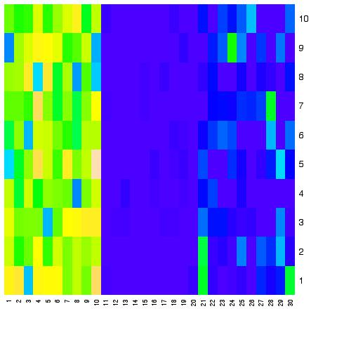
Latent gene state variable
z_{g,heart} = -1 homogenously inactive
in subtree
Embryo
brain
Forebrain
Hidbrain
limb
Forelimb
Hidlimb
heart
z_{g,brain} = 0 inhomogenous
z_{g,limb} = 1 homogenously active
in subtree

Slide 9
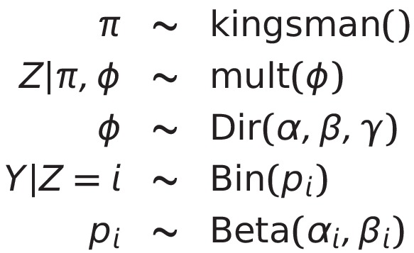
Generative process

Slide 10
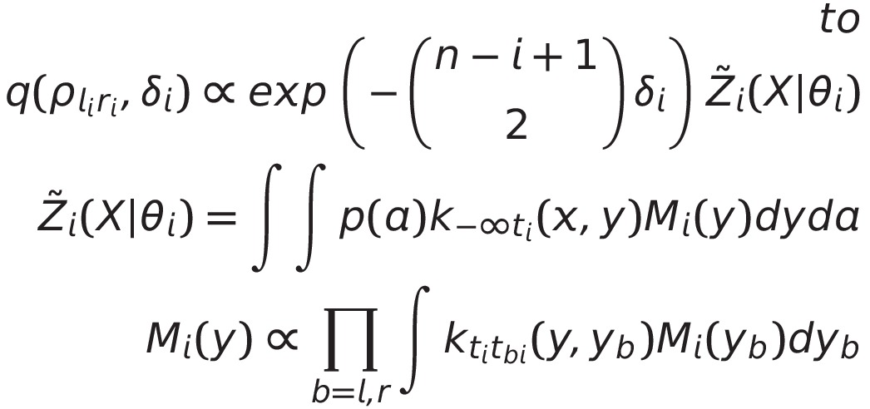
Kingsman coalscent

Slide 11
Kingsman coalscent

Slide 12
Solution
From Y at leafs infer:
Tree
Y at internal nodes of tree
Define new generative process:

Slide 13
Resultant model

Slide 14
Resultant model
A=2
B=2
C=2
A=0
B=1
C=2
A=0
B=1
C=0
A=0
B=1
C=2

Slide 15
Resultant model
A=2
B=2
C=2
A=0
B=1
C=2
A=0
B=1
C=0
A=0
B=1
C=2
Like HMM

Slide 16
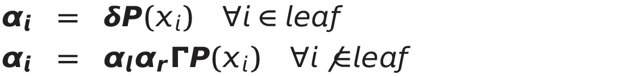
EM inference
Outer product
3 Dimensional

Slide 17
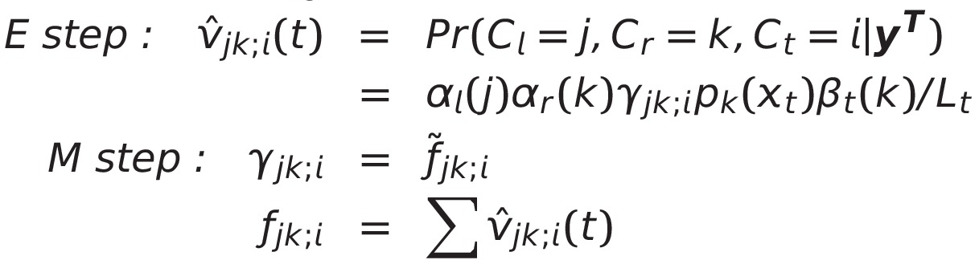
EM inference

Slide 18
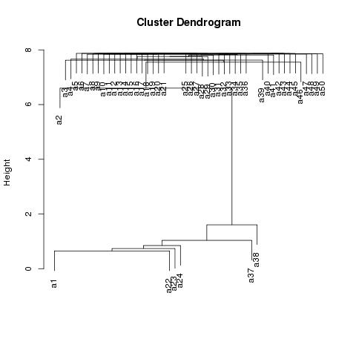
Result
Cardio vascular tissue

Slide 19
Advantage
Missing data handling
Tissue tree specific biclustering
Active and inactive biclusters
Error resistant
Assign edge length to tissue tree

Slide 20
Conclusion
Framework to infer a tissue tree
Leverage tissue tree to find meaningful gene classification
Gene dynamic on subtree

Slide 21
Thanks

