Slide 1
Gene dynamics on tissue tree
Avinash Das

Slide 2
Gene classification by tissue tree biclustering
Avinash Das

Slide 3
Gene categories
Tissue specific
genes

Slide 4
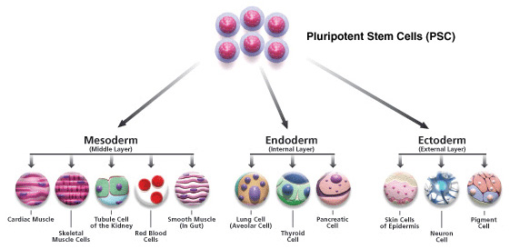
Tissue tree

Slide 5
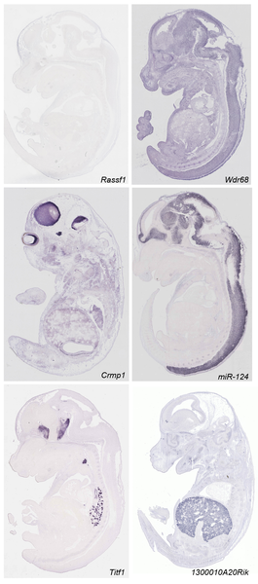
In-situ hybridization data
Diez-Roux G, Banfi S, Sultan M, Geffers L, et al. (2011) A High-Resolution Anatomical Atlas of the Transcriptome in the Mouse Embryo. PLoS Biol 9(1): e1000582. doi:10.1371/journal.pbio.1000582
http://www.plosbiology.org/article/info:doi/10.1371/journal.pbio.1000582
Notes:
Mouse transciptomic data. They have analyzed around 18000 transcript by RNA ISH. They performed saggital section on 14th day wild type mice.

Slide 6
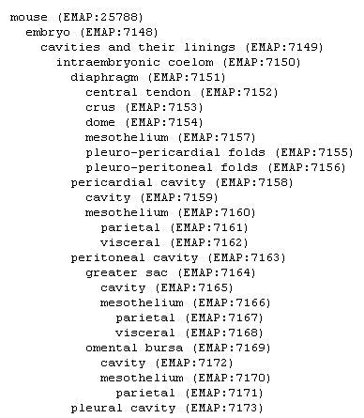
ISH data
RNA ISH for each 18000 transcripts
Automatic microscopes collect image data
Sent out in a digital format for Manual annotation across the tissue tree
Notes:
Discretized data matrix have information whether a particular gene have high low medium or no expression in this 811 anatomies

Slide 7
ISH data
360,000 images were viewed and annotated!
5510 genes x 811 anatomies matrix
11000 genes x 811 tissue matrix with missing data.
Discrete data with annotation strong, medium, weak or no expression
Notes:
Discretized data matrix have information whether a particular gene have high low medium or no expression in this 811 anatomies

Slide 8
Problem
Infer tissue tree
At each internal nodes of tissue tree find which genes are
homogenously active in subtree
inactive in subtree
inhomogenous

Slide 9
Latent state
Infer tissue tree
At each internal nodes of tissue tree find which genes are
homogenously active in subtree: z_{g,n} = 1
inactive in subtree: z_{g,n} = -1
inhomogenous: z_{g,n} = 0

Slide 10
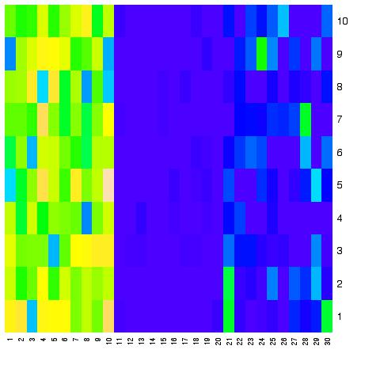
Latent gene state variable
z_{g,heart} = -1 homogenously inactive
in subtree
Embryo
brain
Forebrain
Hidbrain
limb
Forelimb
Hidlimb
heart
z_{g,brain} = 0 inhomogenous
z_{g,limb} = 1 homogenously active
in subtree

Slide 11
Bayesian hierarchical clustering

Slide 12
Bayesian hierarchical clustering
Use tree structured model as data generating process.
Bayesian: Compute posterior probability by defining prior (over trees).
Uncertainty over trees
Meaningful branch length
Deal with missing data
Noise resistant

Slide 13
Bayesian hierarchical clustering
Likelihood P(Data/tree) is simple Markov process defined on the tree that evolves forward on time.
Prior over trees by Kingman’s coalscent.

Slide 14
Kingsman’s coalescent

Slide 15
Kingsman’s coalescent

Slide 16
Kingsman’s coalescent

Slide 17
Kingsman’s coalescent

Slide 18
Kingsman’s coalescent

Slide 19
Data generation: Forward sampling

Slide 20
Inference: Upward propogation

Slide 21
Inference: Integrating out

Slide 22
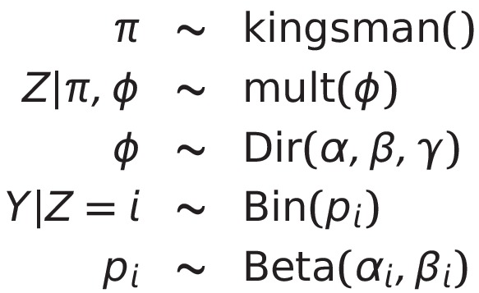
Generative process

Slide 23
Example
- Compute belief at node 1.
3
m_{3→2}
Fig. 12 (Yedidia et al.)
1
m_{2→1}
2
m_{4→2}
4

Slide 24
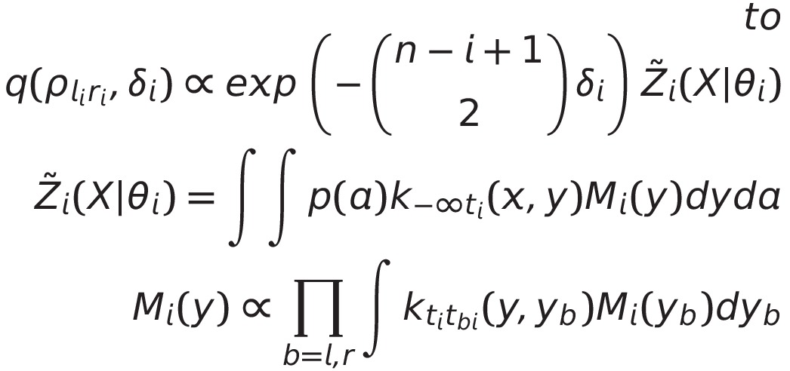
Kingsman’s coalescent messages

Slide 25
Kingsman’s coalescent

Slide 26
Solution
From Y at leafs infer:
Tree
Y at internal nodes of tree
Define new generative process:

Slide 27
Resultant model

Slide 28
Resultant model
A=2
B=2
C=2
A=0
B=1
C=2
A=0
B=1
C=0
A=0
B=1
C=2

Slide 29
Resultant model
A=2
B=2
C=2
A=0
B=1
C=2
A=0
B=1
C=0
A=0
B=1
C=2
Like HMM

Slide 30
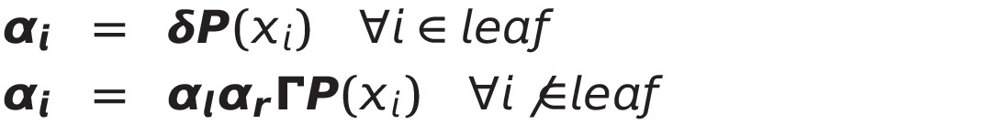
EM inference: Upward messages
Outer product
3 Dimensional

Slide 31
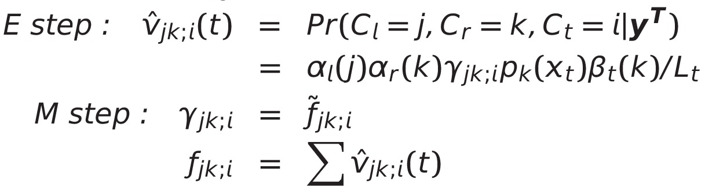
EM inference

Slide 32
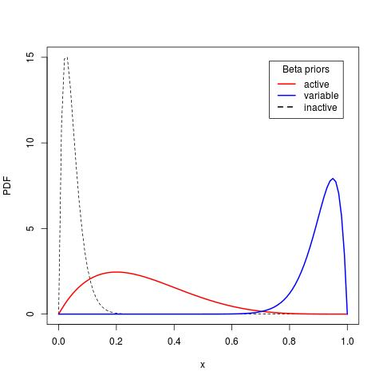
Inferred process

Slide 33
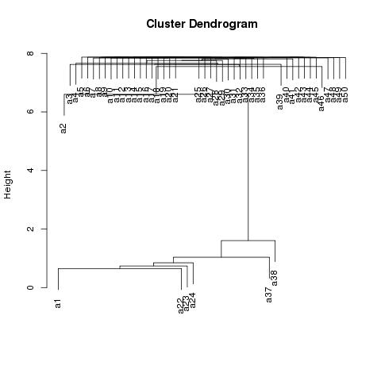
Result
Cardio vascular tissue

Slide 34
Advantage
Missing data handling
Tissue tree specific biclustering
Active and inactive biclusters
Error resistant
Assign edge length to tissue tree

Slide 35
Thanks

