Slide 1
Spatial epigenetics
Avinash Das

Slide 2
Outline
Data
Biclustering
Enrichment analysis
Tree biclustering generative process

Slide 3
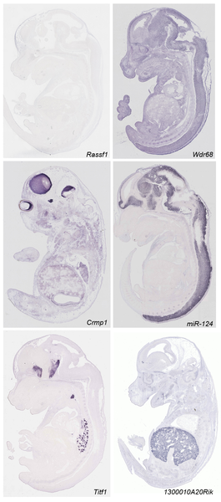
ISH data
Diez-Roux G, Banfi S, Sultan M, Geffers L, et al. (2011) A High-Resolution Anatomical Atlas of the Transcriptome in the Mouse Embryo. PLoS Biol 9(1): e1000582. doi:10.1371/journal.pbio.1000582
http://www.plosbiology.org/article/info:doi/10.1371/journal.pbio.1000582
Notes:
Mouse transciptomic data. They have analyzed around 18000 transcript by RNA ISH. They performed saggital section on 14th day wild type mice.

Slide 4
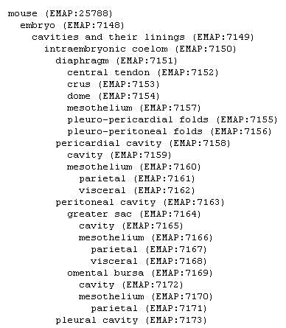
ISH data
RNA ISH for each 18000 transcripts
Automatic microscopes collect image data
Sent out in a digital format for Manual annotation across the tissue tree
Notes:
Discretized data matrix have information whether a particular gene have high low medium or no expression in this 811 anatomies

Slide 5
ISH data
360,000 images were viewed and annotated!
5510 genes x 811 anatomies matrix
11000 genes x 811 tissue matrix
Discrete data with annotation strong, medium, weak or no expression
Notes:
Discretized data matrix have information whether a particular gene have high low medium or no expression in this 811 anatomies

Slide 6
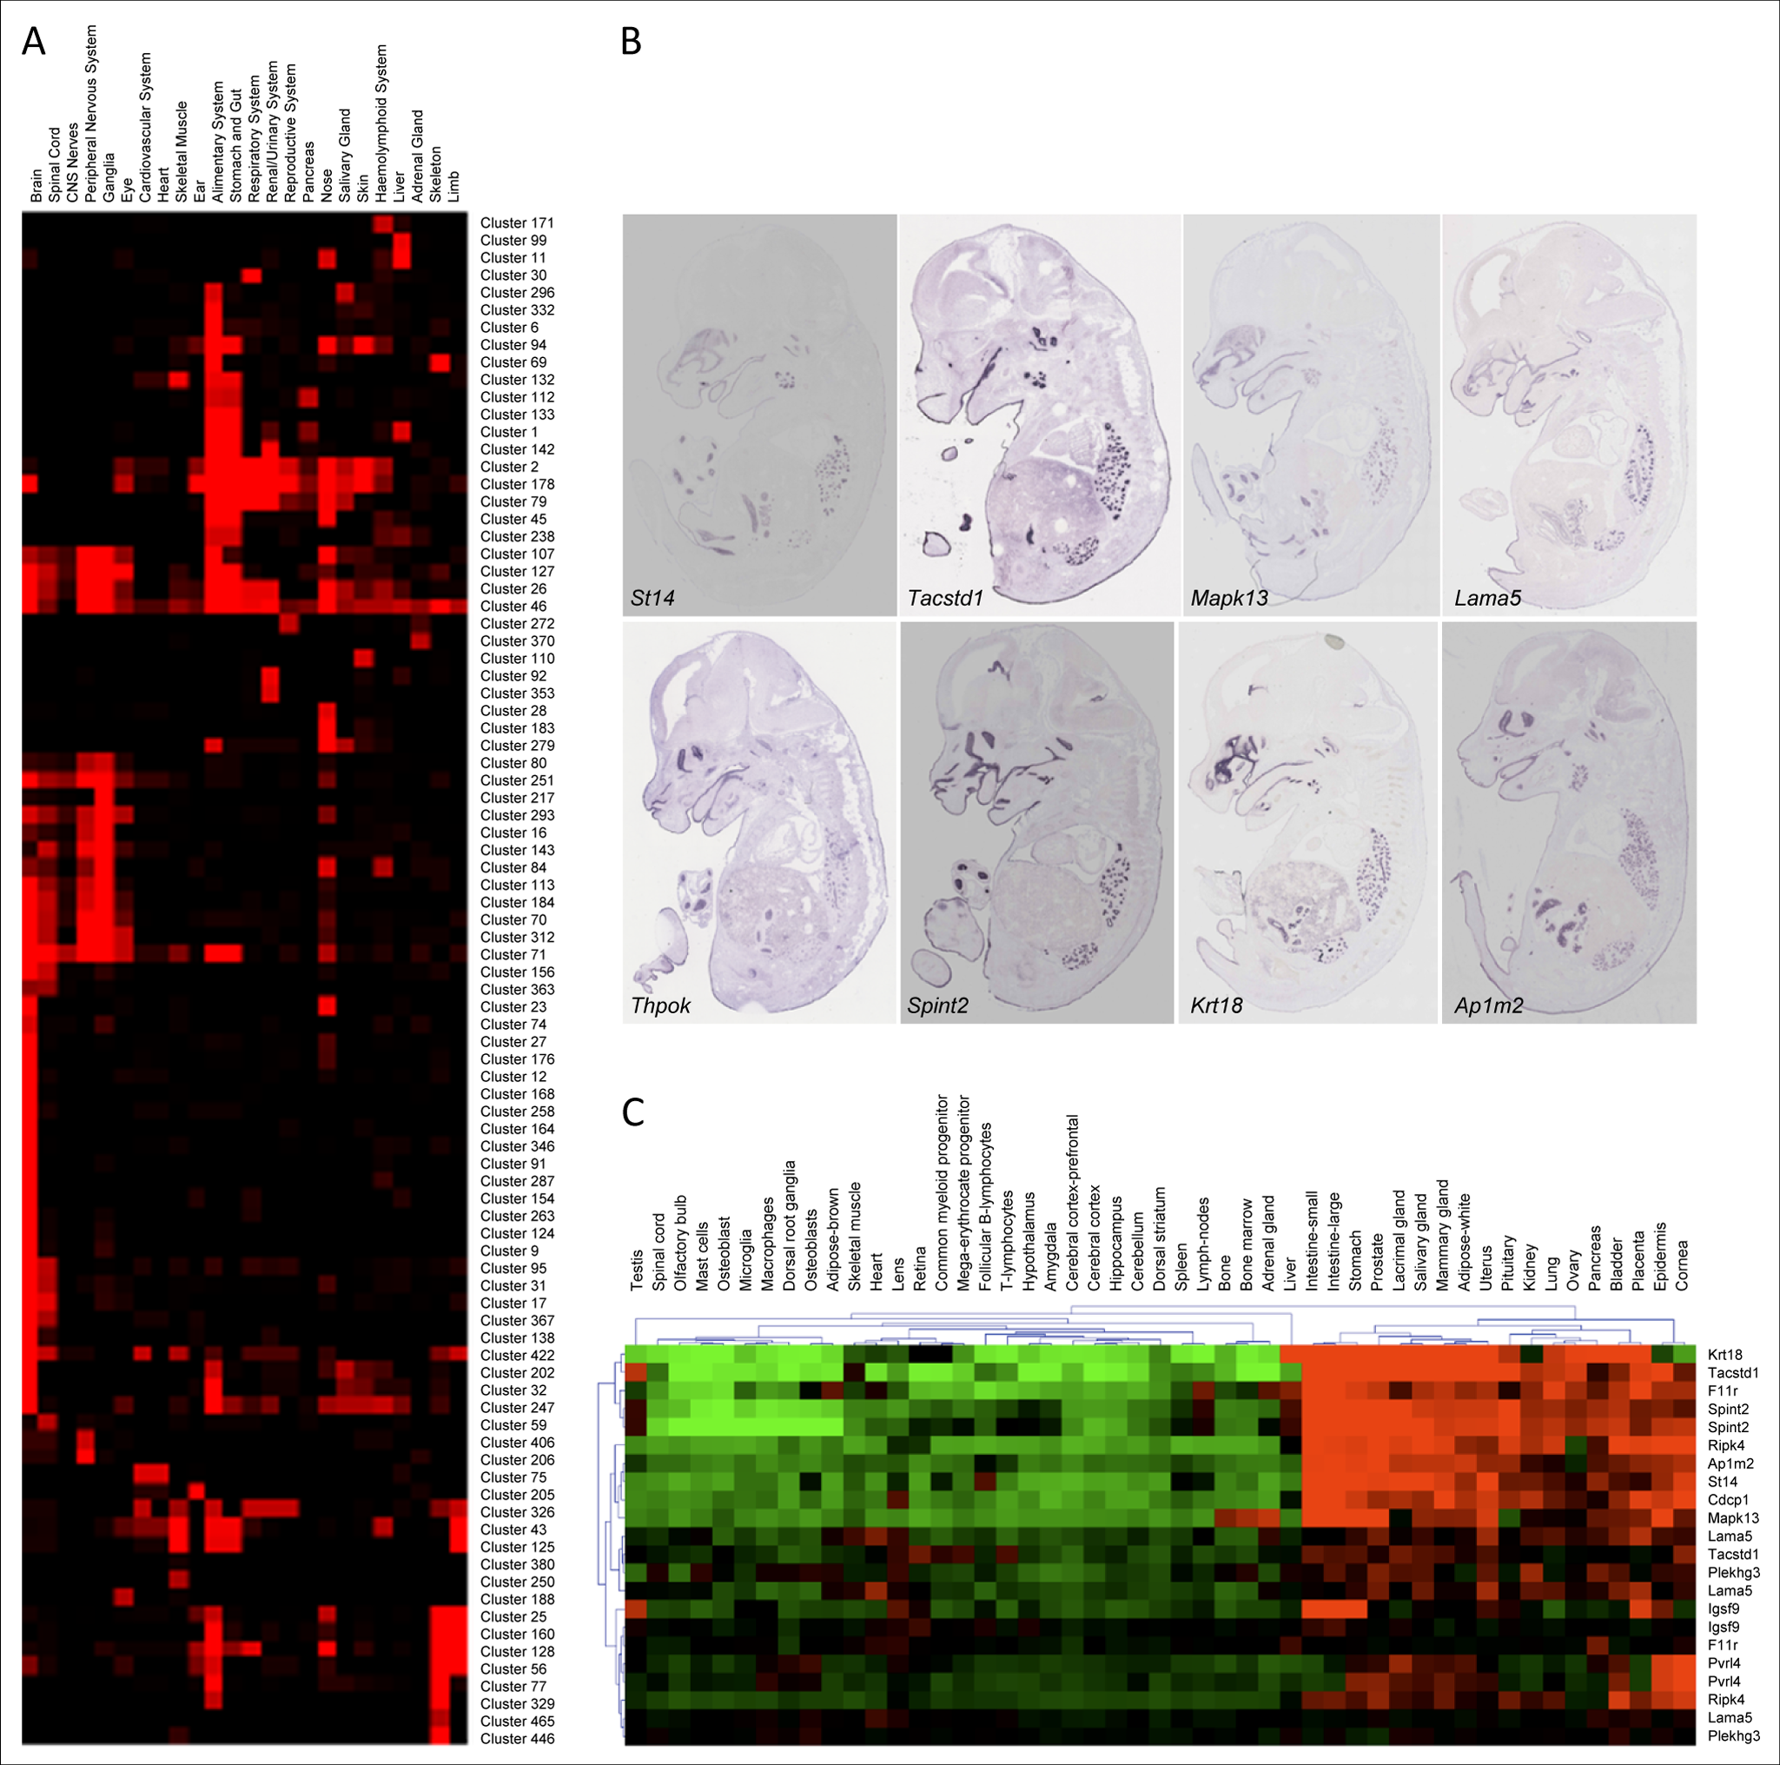
Spatial gene-expression
Gene expression matrix

Slide 7
Spatial gene-expression

Slide 8
Spatial gene-expression
3D space ⬄ Tissue tree⬄ Gene expression

Slide 9
Spatial epigenetic
Build a map of epigenetic data along the tissue
Colormetric ISH?
Chip-Seq experiment for each tissue types?

Slide 10
Spatial epigenetics
3D space ⬄ Tissue type ⬄ Gene expression ⬄ Epigenetics data
Motif enrichment
….

Slide 11
Tissue type ⬄ Gene expression
Clustering
Group of rows having similar expression across all tissues
Gene multifunctional
➔ Group of gene display similar expression across some tissue

Slide 12
Tissue type ⬄ Gene expression
Gene expression matrix

Slide 13
Tissue type ⬄ Gene expression
Biclustering:
Statistically significant correlated sub-martices
Direct map of tissue to gene
Overlapping biclusters ➔ multifunctional gene
Not cover all matrix ➔ remove uninteresting genes

Slide 14
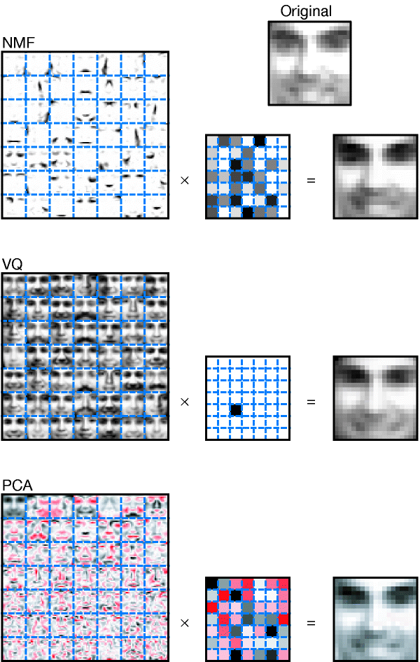
Intuition to NMF

Slide 15
Problem with VQ
Only one semantic variable to represent the element.

Slide 16
Problem with PCA
Negative values allowed
All elements are used to represent each documents
No interpretation exists.

Slide 17
NMF
Make sense that a image be related to subset of topic with different weight. This subset should be SPARSE.
The essence of NMF is that the algorithm must choose a small number of features to act as building blocks that can be scaled and added together in various combinations to best reconstruct the original data.

Slide 18
NMF

Slide 19
Bi-Clustering
Cheng-Church Algorithm
Bicluster are constant up to row and column effect
Residue is deviation from this
Greedy search
SAMBA
Bipartite graph
Biclusters are dense subgraph
Null hypothesis: random graph
Alternative hypothesis: edges in bicluster appear with high probability
Notes:
CC: expression levels in a bicluster are constant up to row and column (additive) effects, deviation from this is defined as residue. Greedily search submatrix.
SAMBA: Statistical-Algorithmic Method for Biclustering Analysis. Bipartite graph.

Slide 20
Bi-Clustering
Bimax
Concentrate ones in the upper right
Divide in 2 submatrices
Notes:
CC: expression levels in a bicluster are constant up to row and column (additive) effects, deviation from this is defined as residue. Greedily search submatrix.
SAMBA: Statistical-Algorithmic Method for Biclustering Analysis. Bipartite graph.

Slide 21
Grid search
Best biclustering methods
Bi-clustering algorithm?
Number of biclusters?
Parameter of biclusters?

Slide 22
Grid search
Grid search with GO enrichment score
Percentage of significant biclusters
Percentage of GO annotation enriched

Slide 23
Enrichment analysis
Enrichment analysis with:
Chromatin (Different cell types)
DNase
CPG
Enhancer
Methylation
TFBS
….

Slide 24
Enrichment analysis
Biclusters
with specific cell type activity
siginificant enrichment of transcription factors and chromatin signatures

Slide 25
Motif enrichment
GC bias compensated foreground and background
Score TRANFAC vertebrate motifs
Fisher exact test

Slide 26
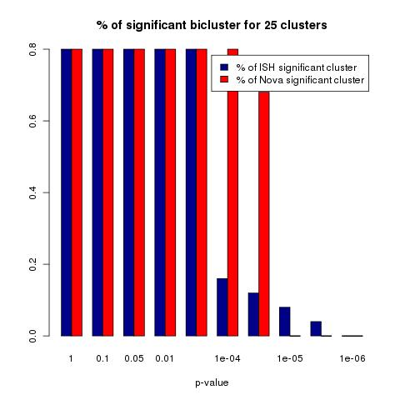
Comparison with novartis dataset
21000 genes x 122 tissue types

Slide 27
Problem with traditional biclustering
Deeply overlapping biclusters
Prior information about the gene or tissue structure cannot be used
We have a tissue tree
No distinction between active or inactive gene in biclusters

Slide 28
Generative biclustering
Hierarchical generative process
Sample tree structure of tissue (CRP)
Positions the genes at nodes
Sample expression at leaf

Slide 29
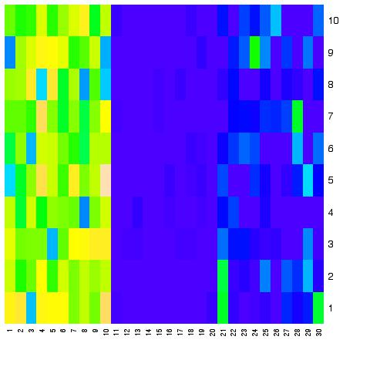
Embryo
brain
Forebrain
Hidbrain
limb
Forelimb
Hidlimb
heart

Slide 31
Tissue tree biclustering
We already have tissue tree
Discrete data
Want to differentiate active and inactive biclusters
Handle missing data and noisy data

Slide 32
Latent gene state variable
Latent gene state variable of subtree z_{g,n} =
0 ➔ Gene exp is homogenously inactive in subtree
1 ➔ Gene exp is homogenously active in subtree
2 ➔ Gene exp is inhomogenous in subtree

Slide 33
Latent gene state variable
A=2
B=2
C=2
A=0
B=1
C=2
A=0
B=1
C=0
A=0
B=1
C=2

Slide 34
Latent gene state variable
A=2
B=2
C=2
A=0
B=1
C=2
A=0
B=1
C=0
A=0
B=1
C=2

Slide 35
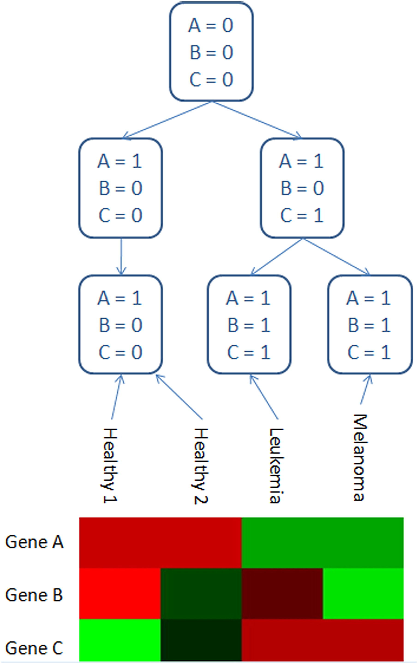
Generative biclustering
forelimb
Hindlimb
Hindbrain
Forebrain

Slide 36

Generative process
z ~ mult(ф)
Ф ~ Dir(α)
$(Y\left|Z=i) \sim Bin\left(pi\right)\right)$
$Bin\left(pi\right)\sim Beta(α\text{i}\text{,}βi)$

Slide 37
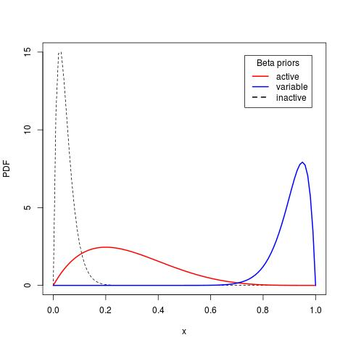
Generative process

Slide 38
Outcome
Tissue tree specific biclustering
Active and inactive biclusters
Error resistant & missing data handling
Assign edge length to tissue tree
Joint learning of tissue tree

Slide 39
Tree learning

Slide 40
Conclusion
Biclustering of ISH data
Enrichment analysis of biclusters
Created spatial-epigenetic map
Tissue tree specific biclustering

Slide 41
Questions

