Slide 1
Using Machine Learning and Non-Game Factors to Predict NFL Games
By Jacob DeMuth

Slide 2
Background
This project was about using machine learning to predict the outcome of NFL games.
Machine learning and AI have become very popular as of late but as I will discuss later using machine learning to predict NFL matches isn’t anything new
The goal of this project was to explore features that had previously not been implemented by other researchers

Slide 3
Objectives
The first objective was to determine if including stadium and weather features will improve the overall accuracy of a machine learning model in predicting the outcome of an NFL game
The second objective was to determine what impact stadium and weather features have on the results of NFL games
By exploring these objectives researchers will be able to determine if it’s worth further exploring the use of external factors in the prediction of sports games

Slide 4
Past Works (1996 – 2003)
The first paper published involving the use of machine learning in NFL game prediction was in 1996 by M. C. Purucker
He used what are called Neural Networks to predict the outcome of 28 NFL games in which the network correctly predicted 21 of the 28 games
In 2003 a researcher named Kahn would later improve upon Purucker’s Neural Network by including three-week historical averages and season averages of team related stats
Kahn would train his model on weeks 1 through 13 of the 2003 NFL regular season and test the accuracy of his model on weeks 14 and 15 of the NFL regular season
He achieved an accuracy of 75% over 208 matches taking place during weeks 14 and 15 of the NFL regular season

Slide 5
Past Works (2011)
In 2011 Jim Warner would apply a Gaussian Model in his predictions rather than the previously used Neural Networks
Jim would also train his model on data from the entire 2000 to 2009 NFL season and test the model based on the 2011 season
This differed from previous works as other researchers would train and test their models using the same single season
While Jim Warner’s model achieved an accuracy of 64.36% the use of non-Neural Network based models as well as the inclusion of multiple NFL seasons in testing and training would become the standard for future research
Within that same year a researcher known as Albert Shau would implement a Support Vector Machine model and achieve an accuracy of 68.4% for the 2011 NFL season
Albert would follow in Jim’s lead by training his model on data from 1970 up to the 2011 NFL season

Slide 6
Past Works (2018-2020)
In 2018 Pablo Bosch would be the first researcher to test multiple machine learning models rather than only testing with one model
He implemented a Support Vector Machine model, Logistic Regression model, Random Forest Model, a Neural Network, and a LSTM Neural Network
Pablo’s models achieved an average accuracy of 63% utilizing data from the 2009 to 2016 NFL seasons
His most accurate model would be the Logistic Regression model with an accuracy of 63.33%
Pablo’s idea of testing multiple models rather than sticking to one model would be utilized by Ryan Beal, Timothy Norman, and Sarvapali Ramchurn in their 2020 paper
They implemented a mix of previously used models but included a few different models as well
These new models included Nearest Neighbor, Decision Tree, AdaBoost, and Quadratic Discriminant Analysis
They tested their models on data from the 2015 through 2019 NFL seasons and found that Naïve Bayes was their most accurate model achieving a score of 67.53%.

Slide 7

Methodology – Features used
The main features were as follows:
Stadium Elevation (in meters)
Stadium Capacity
Wind Speed (in mph)
Temperature (in Fahrenheit)
Other features used:
ELO Rating & Probability
ELO is a mathematical rating given to a team (same ELO as is used in chess)
Average Passing, Rushing, & Total Yards
Average Rushing Attempts
Average Fumbles, Interceptions, & Turnovers
Average Drives
Spread Amount & Over/Under Line
Average Points Scored & Point Difference
Stadium Neutrality & if the home or away team is the favorite
Basic Version of Calculating ELO Rating

Slide 8
Methodology – Models Tested
The models tested:
Random Forest
Extra Trees
LGBM Classifier
XGBoost Classifier
Baggin Classifier
Logistic Regression
Kneighbors
Gaussian Naïve Bayes
Decision Tree
Quadratic Discriminant Analysis
SVC
Ridge Classifier
SGD Classifier

Slide 9
Methodology – Training/Testing Setup
Training Data consisted of regular season data from 2005 through 2015
Testing Data consisted of regular season data from 2016 through 2022 with a few weeks from 2023
The models make their picks based on a 50/50 probability as to if they believe the home team will win or not
Breakdown
IF the model predicts the home team has a >50 percent chance of winning the game and the home team does win, this is considered a correct pick
IF the model predicts the home team has a >50 percent change of winning the game and they lose, this is considered an incorrect pick

Slide 10

Methodology– Score Calculation
The two main metrics that were used were accuracy score and correlation coefficient
Accuracy is the percentage of games the model correctly predicted
Correlation coefficient is the strength of the relationship between the features that were observed and the result of NFL games
Correlation coefficient is done a scale ranging from -1 to 1 with the closer to -1 or 1 indicating a stronger relationship
The accuracy of the model was calculated as follows:
Accuracy = Number of Correct Predictions/Total Number of Predictions Made
The correlation coefficient was calculated as follows:
R = relationship between correlation coefficient matrix
C = covariance matrix

Slide 11
Data Collection Process
Data was collected using data webscraping
Web scraping is using code to extract information from a website and possibly download it to some format such as CSV or JSON
Data was stored in multiple CSV sheets before being combined into one final CSV sheet with data cleaning occurring during each step of the combination
This cleaning included filling in blank spots and verifying there were no duplicate games
The AVG feature (average yards, average fumbles, etc.) were created in code by importing in those stats and using code to create new CSV sheets that contained the calculated averages

Slide 12
Results
The average accuracy was 64.55% with ~1280 of the 1983 games being correctly picked
The most accurate models were LGBMClassifier, Gaussian Naïve Bayes, Decision Tree Classifier, and SVC with accuracy scores of 64.65%
The correlation coefficient of the observed features were as follows:
Stadium elevation: 0.02
Stadium Capacity: 0.01
Wind Speed: 0.02
Temperature: -0.04

Slide 13
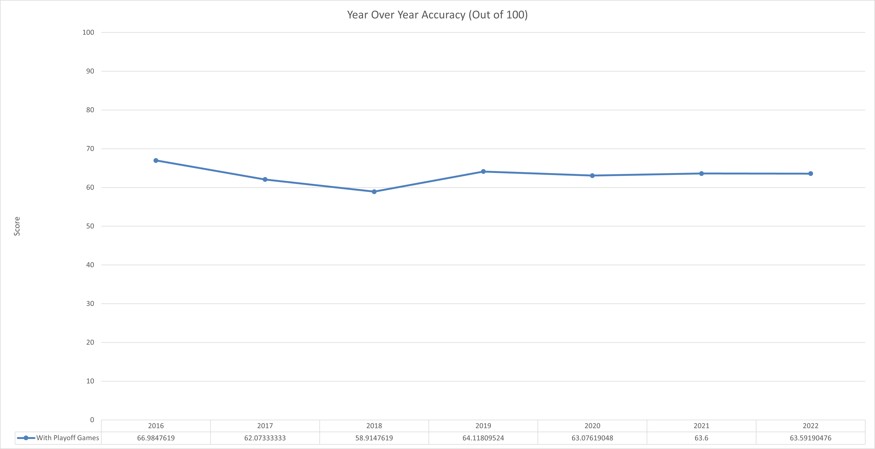

Slide 14
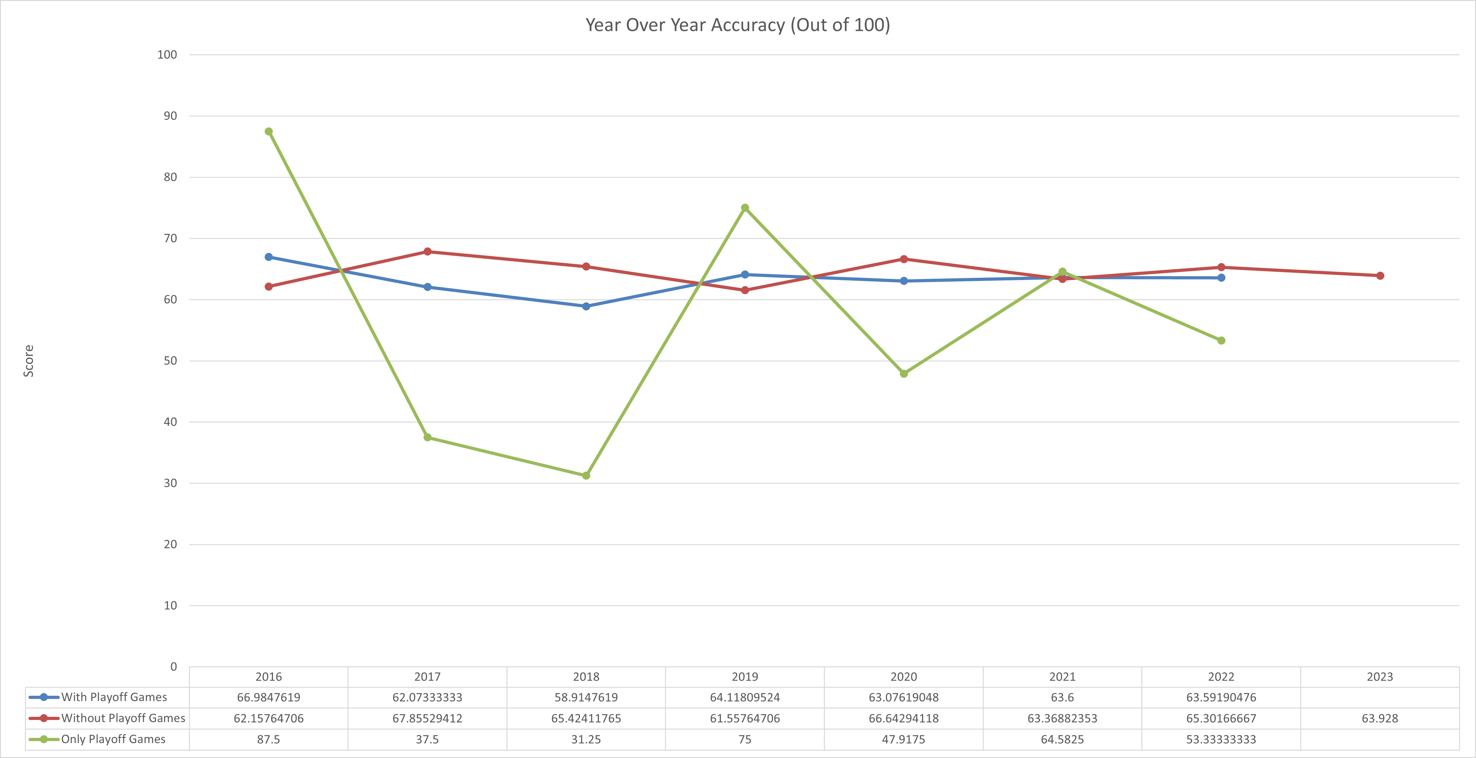

Slide 15
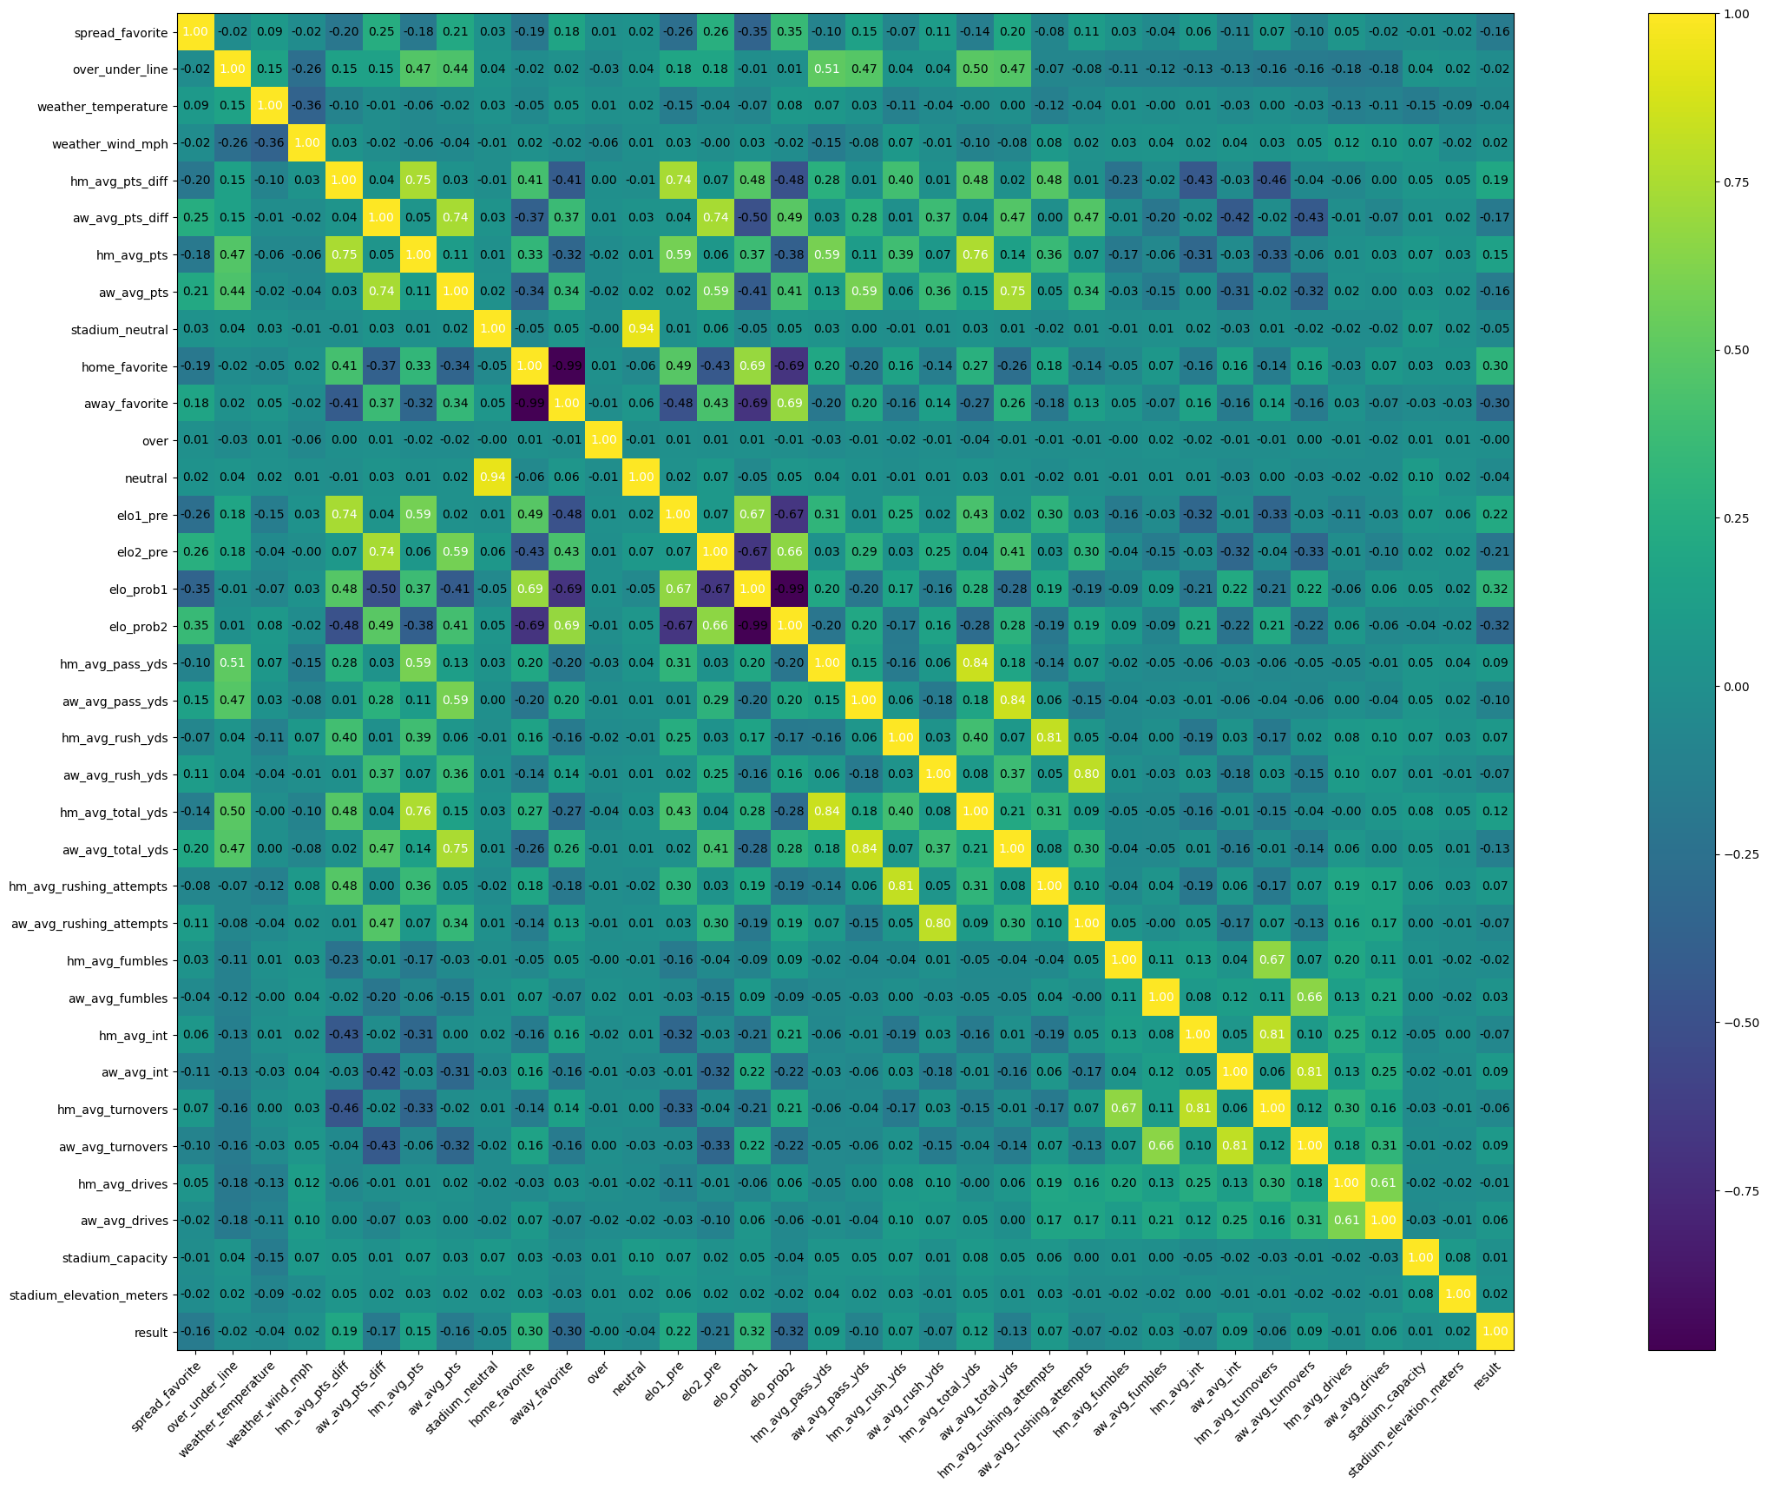
Top 5 Features
ELO Probability
Home ELO Prob: 0.32
Away ELO Prob: 0.32
Team ELO (Pre-Game)
Home ELO Rating: 0.22
Away ELO Rating: -0.21
Team Favorite
Home Favorite: 0.30
Away Favorite: -0.30
Avg Points Per Game
Home Average: 0.15
Away Average: -0.16
Avg Point Differential Per Game
Home Average: 0.19
Away Average: -0.17
Honorable Mention
Spread: -0.16

Slide 16
Analysis of Results
Based on these results one can conclude that weather and stadium features have minimal impact on the outcome of NFL games
This could be due to players being used to different kinds of weather as well as being used to stadium elevations since the elevation of a stadium doesn’t change
The NFL also has rules in place for extreme weather conditions so they're not a lot of extreme weather games
NFL players might also be used to large stadiums since a lot of big college stadiums can host as many people as an NFL stadium

Slide 17
Conclusion
While the accuracy of the model was below previous works and the observed features had minimal impact on the prediction of games this research will now be able to be used by future researchers when deciding what features to include in their models
Future work might include training/testing on more data as well as the inclusion of other features such as humidity, wind chill, surface of the playing field, and the Vegas money line.
This is a project I had a lot of fun working on and I do plan to continue working on this after this semester is concluded

Slide 18
The End
Thank you all for you time!

