Slide 1
Using CI / CD technology for delivery web application development
Student: Demyanenko Pavel

Slide 2
Agenda
1
Used tools
2
Infrastructure
3
Terraform
4
Jenkins
5
Result

Slide 3


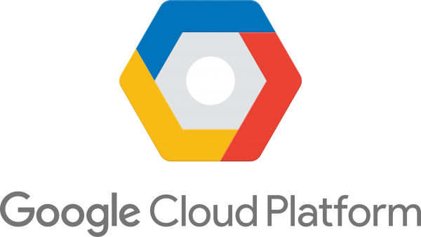




Used tools

Slide 4
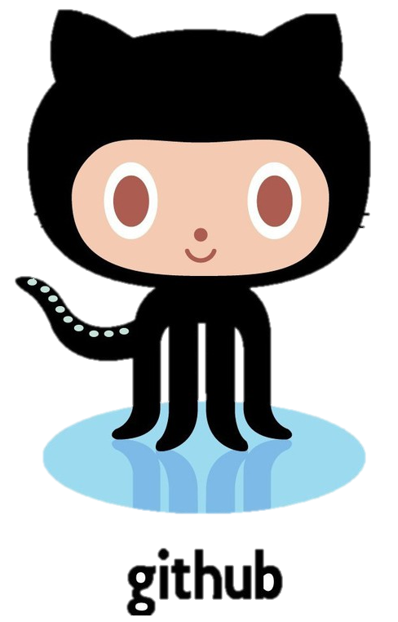

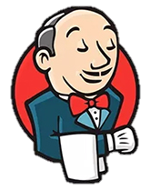

Infrastructure
Push
Global Internet
Local Vm
git
Terraform
one a minute
gcp-instance
Jenkins Master
gcp-instance
Jenkins Slaves
with Docker

Slide 5
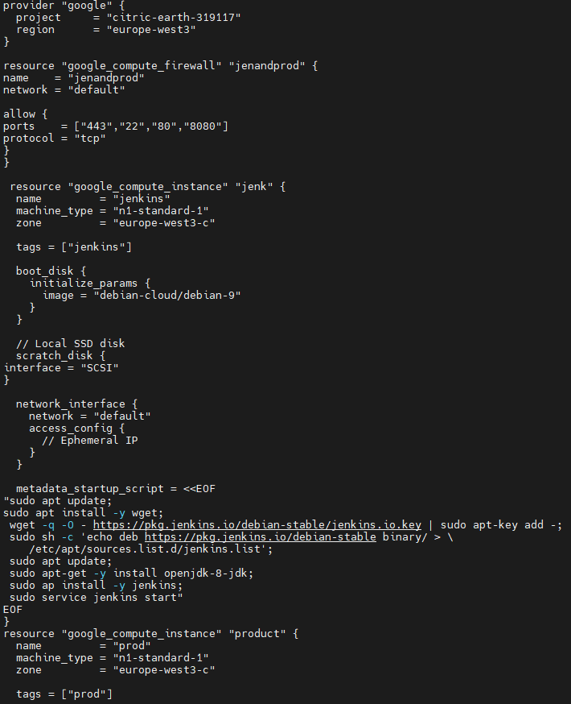
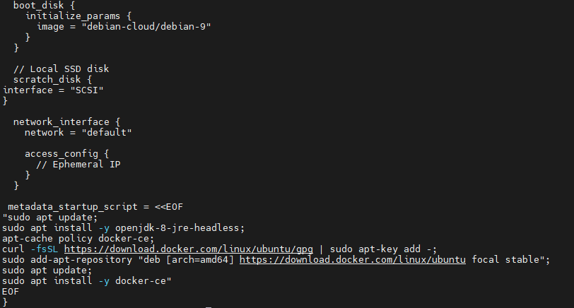
Terraform
https://github.com/demyanenkopaul/simple/blob/main/main.tf

Slide 6
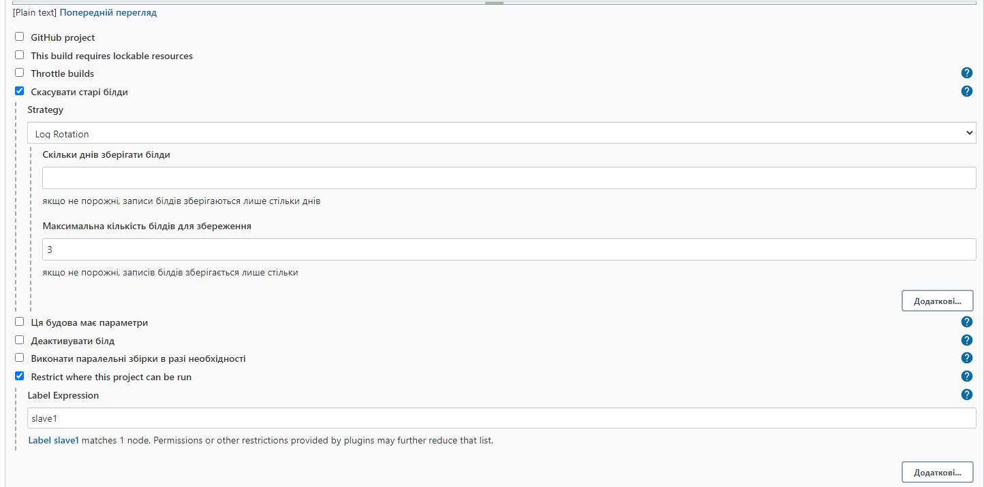
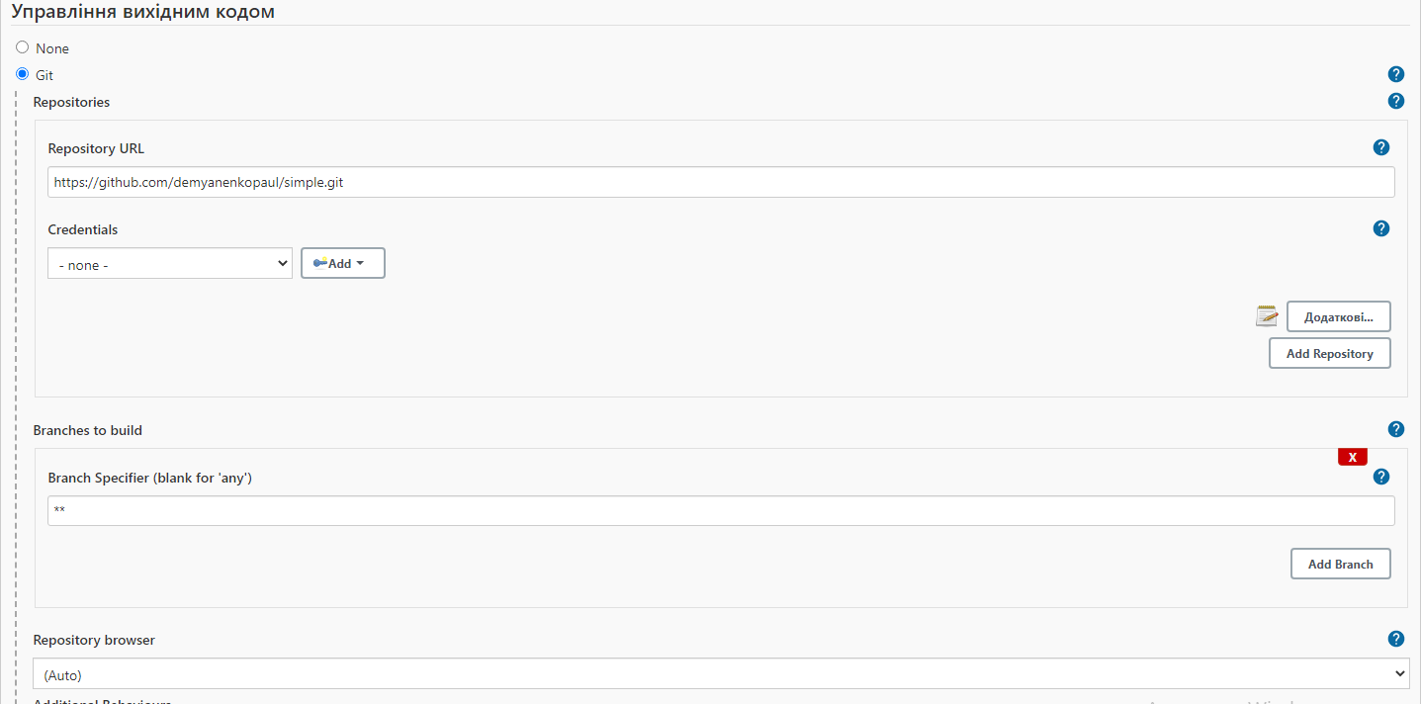
Jenkins

Slide 7
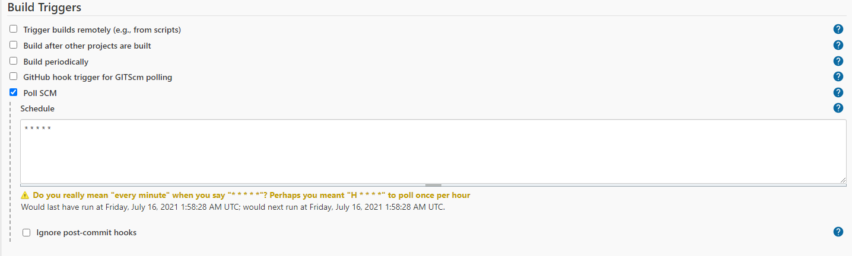
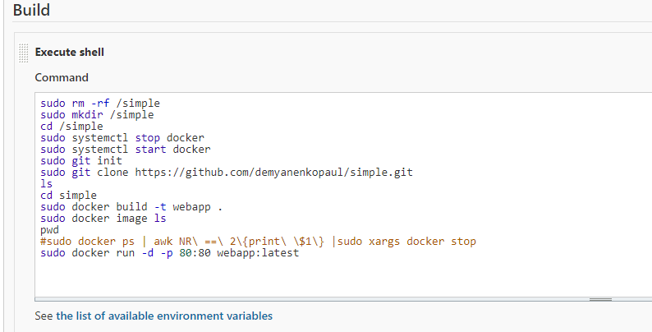
Jenkins

Slide 8
You have any questions?
Student: Demyanenko Pavel
Email: pavel.demyanenko.98@gmail.com

