Slide 1
Probability & Distributions for Developers
Developed by Demyd Dzyuban @July 2019 (draft)

Slide 2
Law of Large Numbers (LLN)
Law of Large Numbers (LLN) is a keystone for practical application of distributions of random values and their prediction.
The General Theorem:
Large quantity of random values follow a certain pattern/conditions -> so it is possible to predict some stable outcome with no material influence of random values.
In fact, LLN is the set of different theorems stipulating the rationale and application of LLN. The Chebyshev’s Theorem is the most general LLN and Bernoulli Theorem is the simplest one.
https://en.wikipedia.org/wiki/Law_of_large_numbers
https://www.youtube.com/watch?v=63XCjjJQ0-o

Slide 3
Chebyshev's inequality
Chebyshev’s inequality guarantees that, for a wide class of probability distributions, no more than a certain fraction of values can be more than a certain distance from the mean.
So it stipulates that random value is within the specific range from the mean.
The inequality is used to prove Chebyshev’s Theorem.
https://en.wikipedia.org/wiki/Chebyshev%27s_inequality

Slide 4
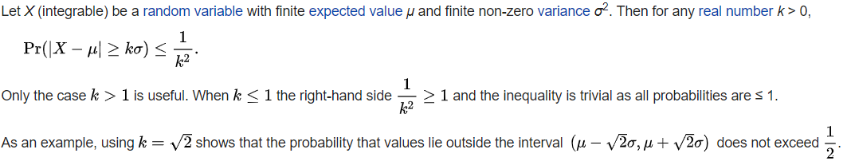
Chebyshev's inequality – Part 2
https://en.wikipedia.org/wiki/Chebyshev%27s_inequality

Slide 5
Chebyshev's Theorem
↑ of the quantity of random variables -> Arithmetic Mean loses the random property ->
Arithmetic Mean ~ Expected Value
On-job application:
The descriptive statistics of the sample is assumed to give sufficient description of the general population.
http://www.statistics4u.com/fundstat_eng/cc_chebyshev.html

Slide 6

Bernoulli’s Theorem
↑ of the quantity of observations -> Frequency ~ Probability
where P of random variable is within the range (0, 1]
Pn(k) – probability of the event to occur k times in n independent trials;
p – probability of the event
q = 1 - p

Slide 7
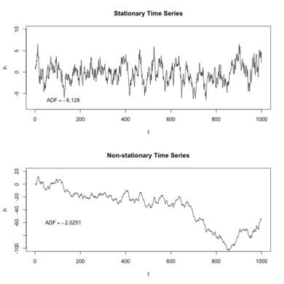
Distribution properties
Stationarity
Stability
Distribution is stable if a linear combination of two independent random variables with this distribution has the same distribution, up to location and scale parameters.
A random variable is stable if its distribution is stable
https://en.wikipedia.org/wiki/Stable_distribution
Finite Variance
https://stats.stackexchange.com/questions/94402/what-is-the-difference-between-finite-and-infinite-variance
https://towardsdatascience.com/stationarity-in-time-series-analysis-90c94f27322

Slide 8
Cases to apply the specific distributions (inferential statistics)
Hypothesis testing | Distribution
Sample mean: population mean is known population mean is unknown | normal distribution t-distribution
Sample share | normal distribution
Comparison of two variances | F-distribution
Comparison of means of two samples: population variances are known population variances are unknown | normal distribution t-distribution
Comparison of shares of two samples | normal distribution

Slide 9
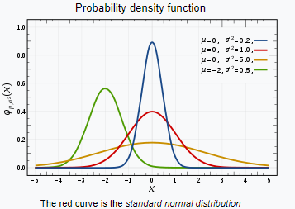

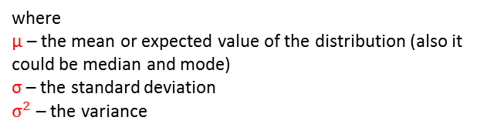
Normal Distribution
where
µ – the mean or expected value of the distribution (also it could be median and mode)
σ – the standard deviation
$σ^{2}$ – the variance
Area under the curve = 1 (probability)
https://en.wikipedia.org/wiki/Normal_distribution
https://courses.lumenlearning.com/introstats1/chapter/the-standard-normal-distribution/

Slide 10
Central Limit Theorem (CLT)
The sampling distribution of the sample means approaches a normal distribution as the sample size gets larger — no matter what the shape of the population distribution.
An essential component of the Central Limit Theorem is that the average of your sample means will be the population mean.
Similarly, if you find the average of all of the standard deviations in your samples, you’ll find the actual standard deviation for your population.
https://www.statisticshowto.datasciencecentral.com/probability-and-statistics/normal-distributions/central-limit-theorem-definition-examples/

Slide 11
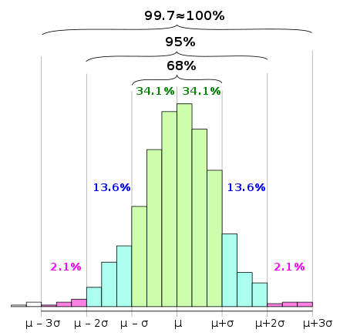
Three Sigma Rule
An empirical rule stating that, for many reasonably symmetric unimodal distributions, almost all of the population lies within three standard deviations of the mean.
In statistics, the empirical rule stipulates that the specific fraction of the population lies within a band around the mean in a normal distribution with a width of two, four and six standard deviations.
https://www.oxfordreference.com/view/10.1093/oi/authority.20110803104447825
https://en.wikipedia.org/wiki/68%E2%80%9395%E2%80%9399.7_rule
https://www.mathsisfun.com/data/standard-normal-distribution.html

Slide 12
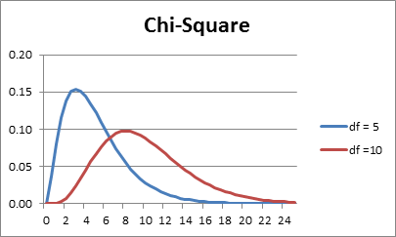
Skewness and Kurtosis
http://www.real-statistics.com/descriptive-statistics/symmetry-skewness-kurtosis/
https://www.spcforexcel.com/knowledge/basic-statistics/are-skewness-and-kurtosis-useful-statistics

Slide 13
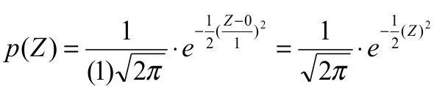

Standard Normal Deviate
The standard normal distribution is a normal distribution of standardized values called z-scores.
A z-score is measured in units of the standard deviation.
https://www.google.com/search?q=standardized+normal+distribution+function&tbm=isch&source=iu&ictx=1&fir=KnzOYQYCWGe7eM%253A%252CcNmGppNGE7l3gM%252C_&vet=1&usg=AI4_-kSUsKWlMfyq3ne8kzSjdv_RmJl-kA&sa=X&ved=2ahUKEwiZ25_RycbjAhWPa1AKHeBmCLkQ9QEwBHoECAYQBg#imgrc=3TG6TWgAvYWz-M:&vet=1
The z-score tells you how many standard deviations (σ) the value x is above (to the right of) or below (to the left of) the mean, μ.
How to apply Z-tables:
https://www.mathsisfun.com/data/standard-normal-distribution-table.html
https://courses.lumenlearning.com/introstats1/chapter/the-standard-normal-distribution/

Slide 14

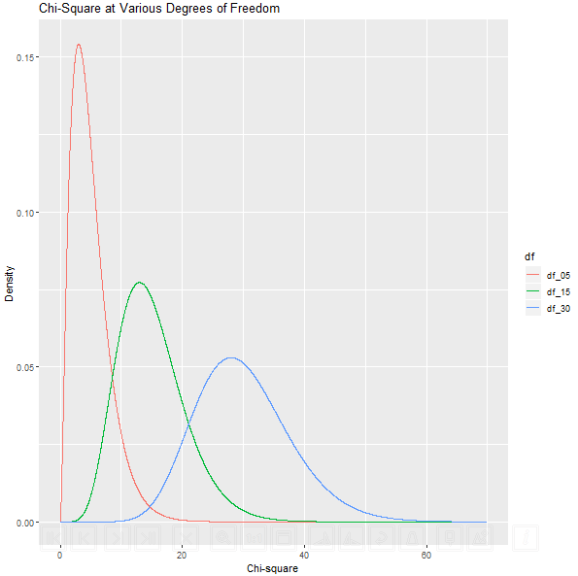
χ(Chi) Distribution
Probability Density Function
- Gamma function https://en.wikipedia.org/wiki/Gamma_function), k – degree of freedom, x – standard random normal variable.
Application of Chi distribution:
testing for a population variance
test for statistical independence
test for goodness of fit
test for homogeneity
https://stepupanalytics.com/application-of-chi-square-distribution/
https://www.khanacademy.org/math/statistics-probability/inference-categorical-data-chi-square-tests/chi-square-goodness-of-fit-tests/v/chi-square-distribution-introduction

Slide 15
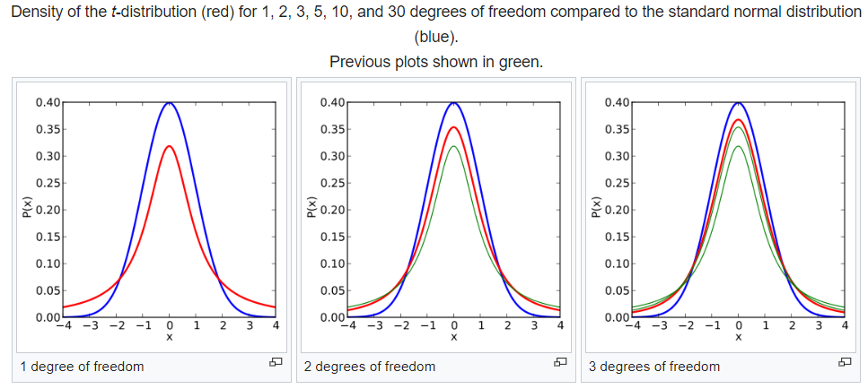
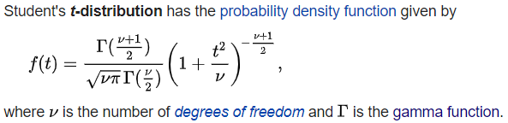
Student’s Distribution (t-distribution)
Application of t-distribution:
Test of Hypothesis of the Population Mean
Test of Hypothesis of the Difference Between Two Means
Test of Hypothesis of the Difference Between Two Means With Dependent Samples
Test of Hypothesis about the Coefficient of Correlation
https://businessjargons.com/applications-of-t-distribution.html
https://en.wikipedia.org/wiki/Student%27s_t-distribution

Slide 16
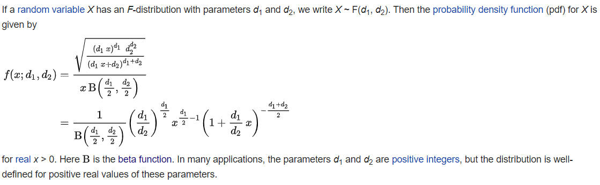
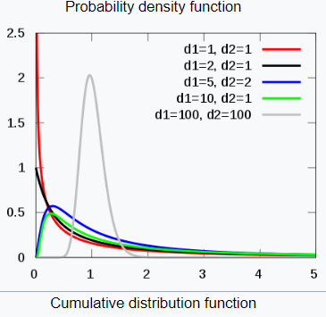
Fisher–Snedecor Distribution (F-distribution)
Application of F-distribution:
test for the equality of the two population variances
test for the null hypothesis and alternative hypothesis in regression models
testing of significance of an observed R² (observed multiple correlation coefficient) of a variate with k other variates in a random sample of size n from (k+1) variate population
https://stepupanalytics.com/application-of-f-distribution/
https://en.wikipedia.org/wiki/F-distribution

Slide 17
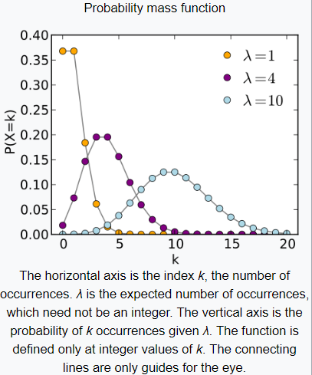
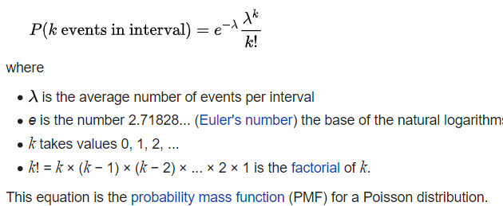
Poisson Distribution (descrete)
https://corporatefinanceinstitute.com/resources/knowledge/other/poisson-distribution/
https://en.wikipedia.org/wiki/Poisson_distribution

Slide 18
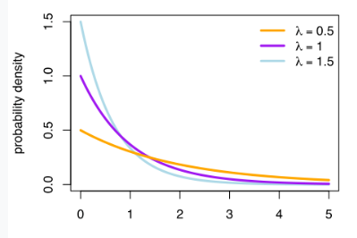

Exponential Distribution
where λ – parameter rate, x – random variable
The exponential distribution occurs naturally when describing the waiting time in a homogeneous Poisson process.
It can be used in a range of disciplines including queuing theory, physics, reliability theory, and hydrology.
Examples of events that may be modeled by exponential distribution include:
time until a radioactive particle decays
time between clicks of a Geiger counter
time until default on payment to company debt holders
distance between mutations on a DNA strand
time it takes for a bank teller to serve a customer
http://wiki.stat.ucla.edu/socr/index.php/AP_Statistics_Curriculum_2007_Exponential

Slide 19


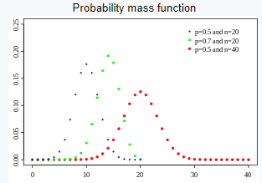
Binomial Distribution (descrete)
Binomial distribution can be applied whenever you're talking about the number of successes in a fixed number of independent trials, with the same fixed probability of success on each trial. "fixed" means not random.

Slide 20
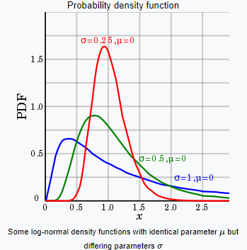
Log-Normal Distribution
https://en.wikipedia.org/wiki/Log-normal_distribution

