Slide 1
Exploratory Analysis for Rookies
Developed by Demyd Dzyuban @June 2019 (draft)

Slide 2
General Course Overview
Exploratory Analysis Basics
Probability and Distributions
Inferential statistics
Machine Learning Algorithms (the content is in progress)
Detailed Syllabus is in ‘Course Content’.
R script to generate numeric values for slides is in ‘draft.Rmd’

Slide 3
Population vs. Sample
Population is the finite data set comprising 100% of the info required to make the best analytical solution.
Sample is a part of the population. It has the identical structure, mean and variance are close to population ones -> it is likely to make the approximate solution to population one.
In real life it is unlikely to encompass 100% of all info required -> samples are used to work with.
Thus, any sample is a population for subsamples and vice verse.

Slide 4
Types of data
Discrete – 1, 2 , 3, 5466, 0, 76832675, …
Continuous – 1.22, 1.223, 1.2234, 56.567, …
Categorical – c(“Yes”, “No”, “Unknown”), c(“12/12/2019”, “31/12/2017”), …
Categorical variables could be treated in different ways – mainly it is converting to numbers and processing as numbers.

Slide 5
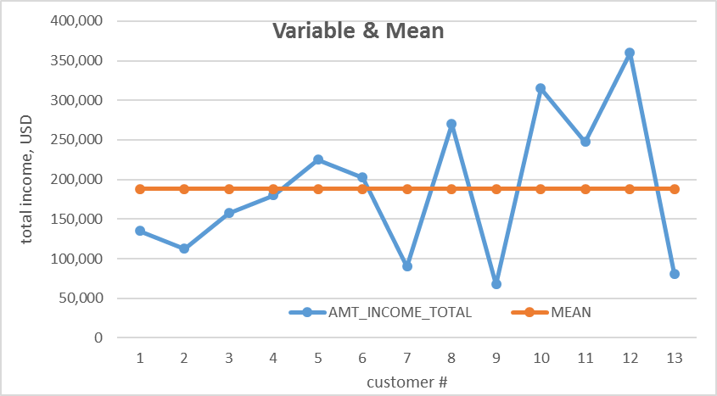
MEAN
The ultimate idea of the mean is to extract the central tendency (value grouping) of the specific data set.
The mean can be describe in different way depending of the applied domain – statistics, theory of probability, etc. - https://en.wikipedia.org/wiki/Mean)
The types of mean:
arithmetic mean (AM)
geometric mean (GM)
harmonic mean (HM)

Slide 6




Types of Mean
Arithmetic Mean (AM):
The best way to use the mean:
to measure the average values of the data set – AM
to measure the average pace of dynamics (movement) - GM
to deal with datasets of rates or ratios (i.e. fractions) over different lengths or periods – HM.
where Xi is values, n – quantity of values.
Geometric Mean (GM):
Harmonic Mean (HM):
Relationship of Means (AM):

Slide 7
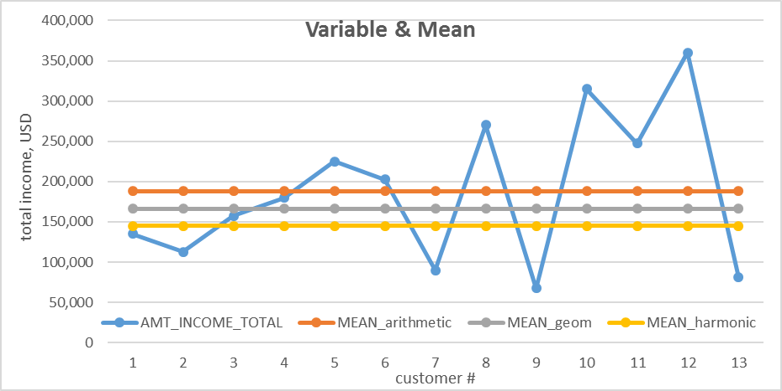
Mean Visualization

Slide 8
Mean Derivatives
Mode is the value with the highest frequency rate.
Median is the value splitting the ordered data set in two equal subsamples.
This indicator are used to evaluate initial homogeneity of the data set -> AMT_ANNUITY and AMT_GOODS_PRICE are the most homogenous.
The less data set is homogenous -> more preprocessing steps have to be taken to compile the homogeneous data set.
Relationship of AM, Mode and Median:
The best data set means AM ~ Mode ~ Median.

Slide 9
Outliers
Outliers are extreme values which are limited in quantity but have a material effect to calculated values.
From practical point of view outliers can be defined in different ways but main approaches are expert and analytical.
In a small example we have excluded TOP 12 (expert approach) of 48,745 records -> AM is impacted immaterially.
Analytical approach means application of any reasonable calculated indicators. For instance, AM/mode ratio.
Outliers themselves could make a separate sample to look into.

Slide 10
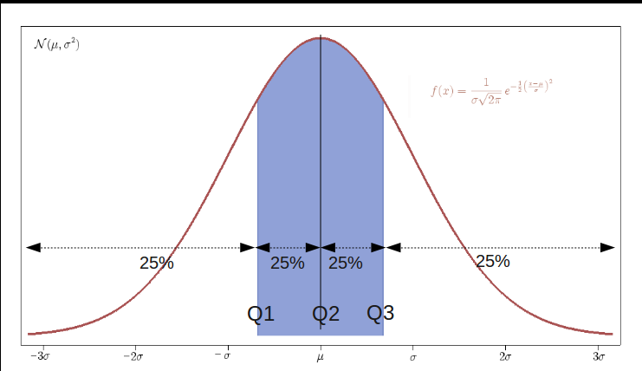
Quantiles
Statistics
Probability Distribution

Slide 11
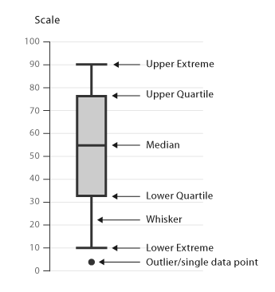
Box-and-whisky plot
https://datavizcatalogue.com/methods/box_plot.html

Slide 12
Impact of Grouping Towards Mean and Variance
It is strongly recommended to investigate subgrouping in the entire data set.
The example above proves the variable “AMT_CREDIT_USD” could comprise two different sub samples because of material difference of Mean.
The same approach is recommended to use about Variance analysis for subgroups.

Slide 13


Variance (Measures of deviation)
Range (R)
Range (R) = Maximum value – Minimum value
https://www.toppr.com/guides/maths/statistics/range-and-mean-deviation/
Average absolute deviation (d)
d =
https://en.wikipedia.org/wiki/Average_absolute_deviation
Standard deviation (σ)
https://en.wikipedia.org/wiki/Standard_deviation

Slide 14
Variance (Measures of deviation) – Part 2

Slide 15

Covariance
https://en.wikipedia.org/wiki/Covariance
where n – quantity of observations,
x and y are random variables
E(x), E(y) – expected value / mean
The major disadvantage of covariance is no limit to estimate the covariance value.
The correlation is use to remove the drawback of covariance.

Slide 16

Correlation
https://en.wikipedia.org/wiki/Correlation_and_dependence
where cov(X, Y) – covariance of two variables,
X and X are random variables
µ(x), µ(y) – mean
Range of ρX,Y: -1 … 1
ρX,Y -> 1 : both variable are moving in the same direction (strong relationship)
ρX,Y -> 1 : both variable are moving in the opposite direction (strong relationship)
ρX,Y -> 0 : no explicit relationship between variables is found
Correlation coefficient (ρX,Y) demonstrate the presence of linear relationship between two variable.
Based upon ρX,Y the correlation matrix is created.

Slide 17
Covariance & Correlation
Covariance
Correlation

Slide 18
Applied example

Slide 19
Brief Summary of Applied Example
all variables contain extreme values which could be investigated
from the point of view of variance the best variable is HOUR_APPR_PROCESS_START (27%) -> it could be used in further draft calculations even despite high oscillator ratio
other variables with high oscillator ratio and variance ratio are subject to be investigated for potential subsampling or aggregation
the existence of more then 1 mode could be the reason to reconsider the data set of the variable.

