Slide 1
Dennis Adrians
<TCH> 05/2019

Slide 2
AGENDA
Requirements Check
Ziele & Motivation
Azure Cognitive Services
Hands On: Prerequisites
Hands On: Dependencies
Text Analytics
Hands On: Text Analytics
Computer Vision
Hands On: Computer Vision
Summary

Slide 3
Requirements Check
Visual Studio Code (or any other code editor) https://code.visualstudio.com/Download
.NET Core SDK https://dotnet.microsoft.com/download
NodeJS https://nodejs.org/en/download/
Demo Project https://github.com/denadr/CognitiveServicesDemo

Slide 4
Ziele & Motivation
Why Cognitive Services?
Easy quick start

Slide 5





Azure Cognitive Services
Decision
Speech
Search
Language
Vision
Notes:
Decision
Anomaly Detector (Preview)
Content Moderator
Personalizer (Preview)
Speech
Speech Services
Speech-to-text (speech-recognition/SR)/text-to-speech (TTS)
Custom wake-word (keyword-spotter/KWS)
Conversation-transcription (CTS)
Intent
Translation
Phrase list personlization/custom speech adaptation
Voice-first virtual assistant
Call-center transcription
Speaker Recognition (Preview)
Search
- Bing News Search
- Bing Video Search
- Bing Web Search
- Bing Autosuggest
- Bing Custom Search
- Bing Entity Search
- Bing Image Search
- Bing Visual Search
Bing Spell Check
- Bing Local Business Search (Preview)
Language
Language Understanding (LUIS)
QnA Maker
Text Analytics
Translator Text
Vision
Computer Vision
Custom Vision Service
Face API
Form Recognizer (Preview)
Ink Recognizer (Preview)
Video Indexer

Slide 6
DEMO: PREREQUISITES
Task 2: Create Cognitive Services Resource

Slide 7
HANDS ON: PREREQUISITES
Task 1: Create Azure Account
Task 2: Create Cognitive Services Resource

Slide 8
DEMO: DEPENDENCIES
Task 3
Task 4

Slide 9
HANDS ON: DEPENDENCIES
Task 3
Task 4

Slide 10
Language API: Text Analytics
Language Detection
Sentiment Analysis
Entity Recognition
Key Phrase Extraction
https://azure.microsoft.com/en-us/services/cognitive-services/text-analytics/

Slide 11
HANDS ON: Text Analytics
Task 5

Slide 12
Vision API: Computer Vision
Image Analysis
Text Extraction
Smart Thumbnail Generation
...
https://azure.microsoft.com/en-us/services/cognitive-services/computer-vision/

Slide 13
HANDS ON: Computer Vision
Task 6

Slide 14
Summary
Accessible
Easy to use
Very quick start
extremely powerful

Slide 15
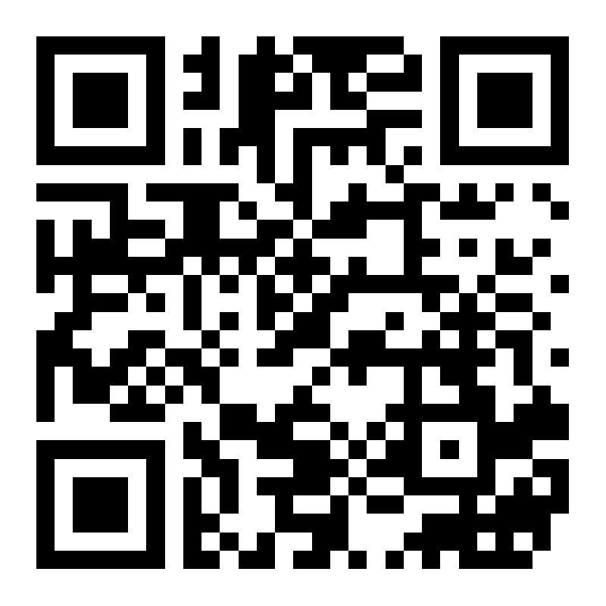
Feedback
https://www.tc-hamburg.com/Feedback?SessionID=624682

Slide 16
Dennis Adrians
Cloud Developer
822 16 75 30
dadrians@bright-skies.de

