Slide 1
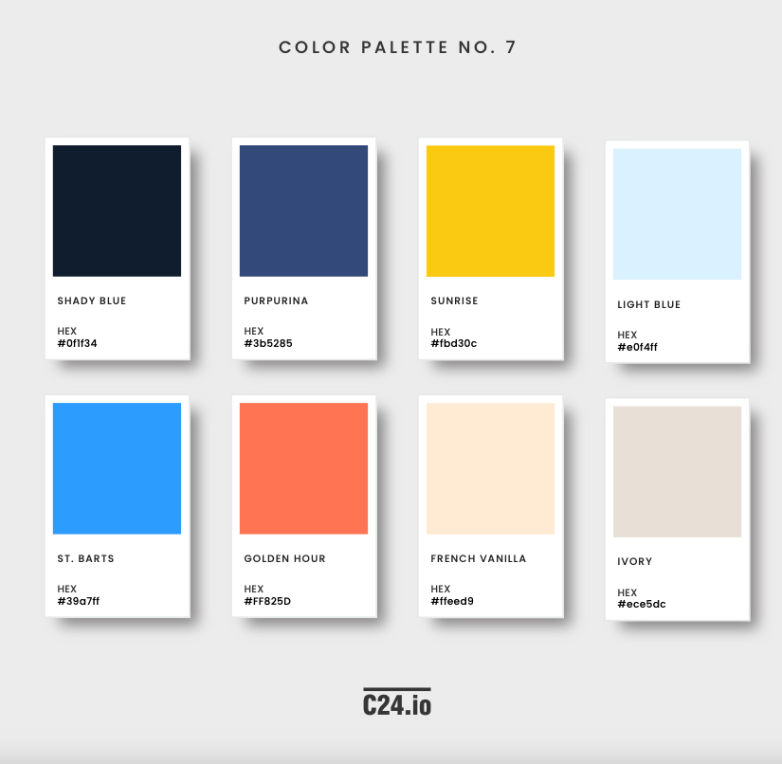



Color palette
Main colors
#385286
#fbd30c
#0F1F34
#e0f4ff
Secondary colors
#ece5dc
#faf8f7
#39a7ff
#5CA7A0
#C7D4DA
#FF825D
#ffeed9

Slide 2
Resources / links
Link to the manufacturer
https://store.flokk.com/norway/en-gb/products/hag-capisco?model=8126-STD&code=0EJF9J

Slide 3

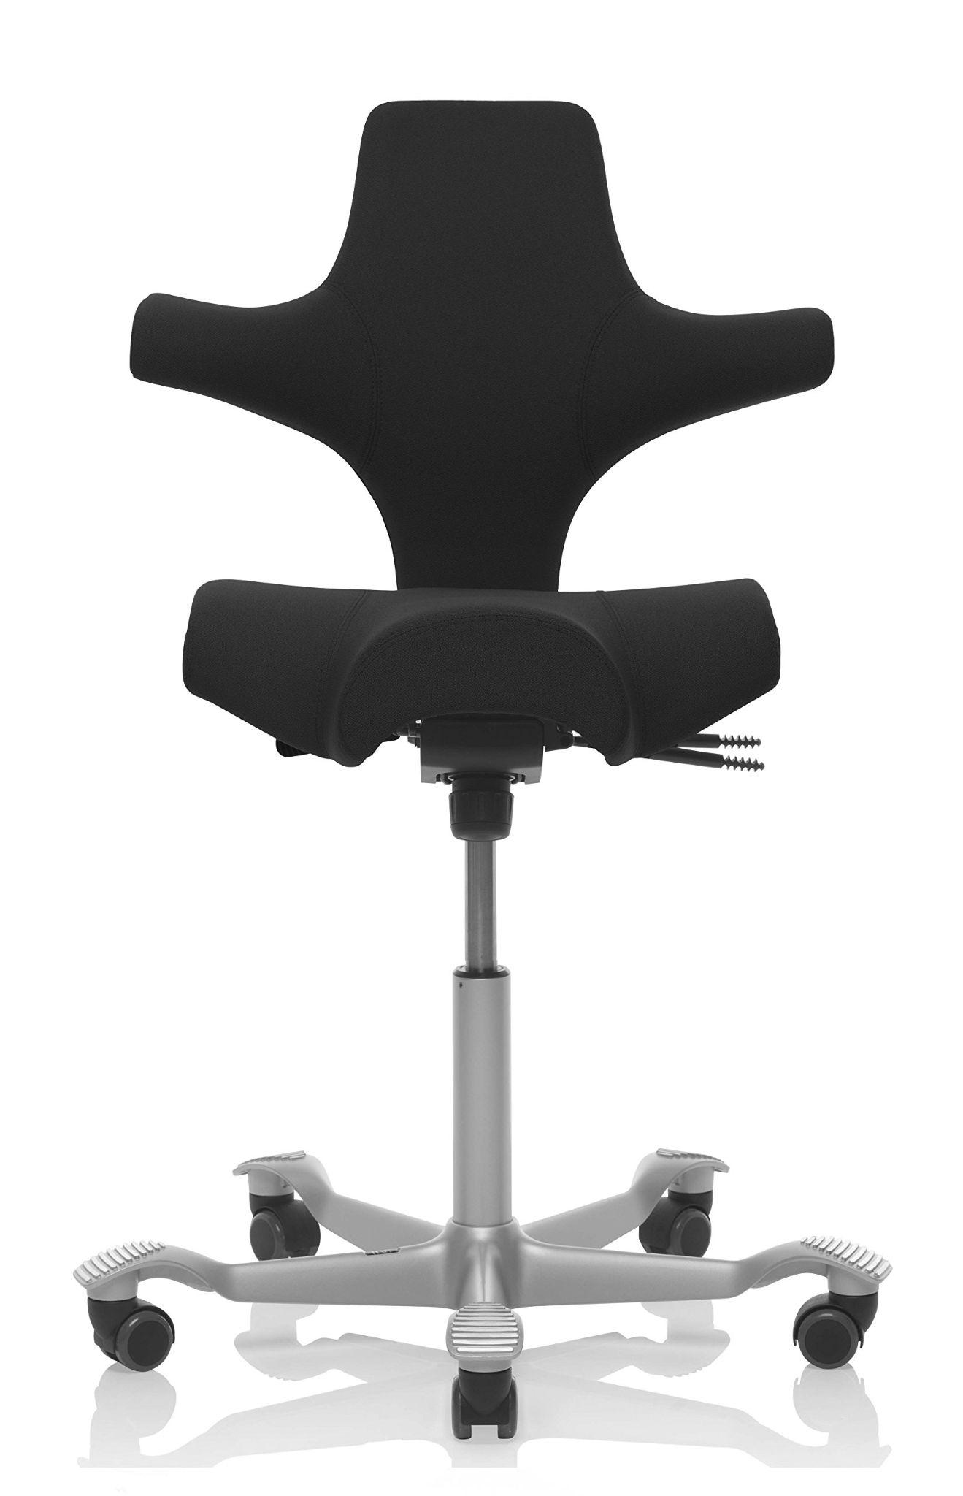
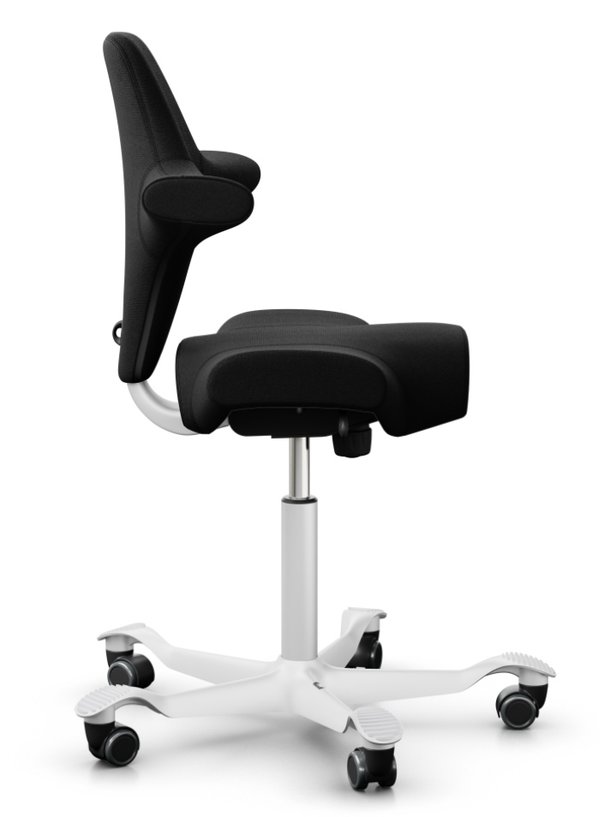
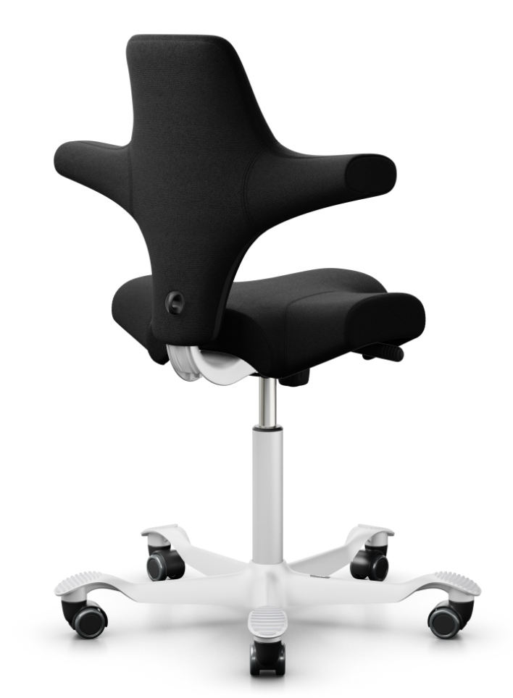
Håg Capisco: Not without reason Norway's most popular office chair.
Find your perfect, used Capisco chair: Advice, tips and help from C24
.
Save time and find your perfect Capisco chair at C24!
Realistic video viewings of gently used and newly cleaned chairs
Low prices, including shipping
Pay after you have seen and tried the chair
About the Chair:
Excellent lumbar support: Ideal for people with back or hip problems. Promotes ergonomic sitting and supports a variety of postures.
Timeless design icon: A classic piece that will never go out of style. Used Capisco chairs in black are in high demand and sell quickly on the second-hand market.
Fully Customizable Comfort: Easily adjust the chair to your ideal sitting position for maximum comfort, no tools required.
Norwegian design inspired by the rider's saddle: Offers a unique and comfortable sitting experience.

Slide 4


Do's and Don'ts for Buying a Used Håg Capisco Chair:
Do: | Don't:
Inspect the condition carefully: Check the seat, backrest, and base. | Buy without seeing: Be wary of low-quality pictures.
Popular Choice: Black is the most in-demand color for Capisco chairs. | Choose unpopular colors: Black is the easiest to resell.
See the chair in daylight: Avoid misleading pictures. Request a video in daylight: See the chair's real condition and avoid a bad purchase. Buy a newly cleaned chair or choose a chair with a new seat cover. | Trust pictures blindly: Many pictures of used chairs are manipulated, and stains can be hard to see. Be critical and inspect the chair in daylight before buying. Stains on a used Capisco chair can be a major problem. They are difficult to remove, and can make the chair feel dirty and worn out. The solution is simple: Buy a newly cleaned chair or choose a chair with a new seat cover.

Slide 5
C24 vs. Competitors: Buying a Used Håg Capisco Chair
Feature | C24 | Competitors
Video Viewing | Yes, saves time and provides better assessment of chair condition | No
Payment | After test sitting | Before delivery
Shipping | Free in Oslo/Bærum | Varies
Price | Competitive | Varies
Selection | Large, priority to newsletter subscribers | Limited
Advice | Yes, avoid mistakes, usage, models | Varies

Slide 6
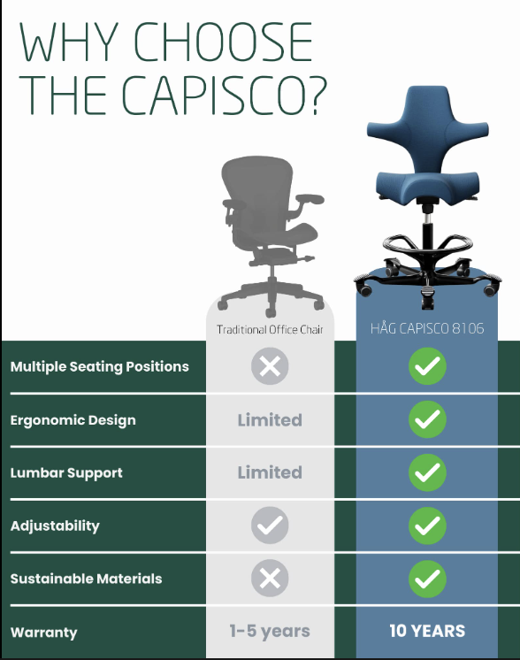
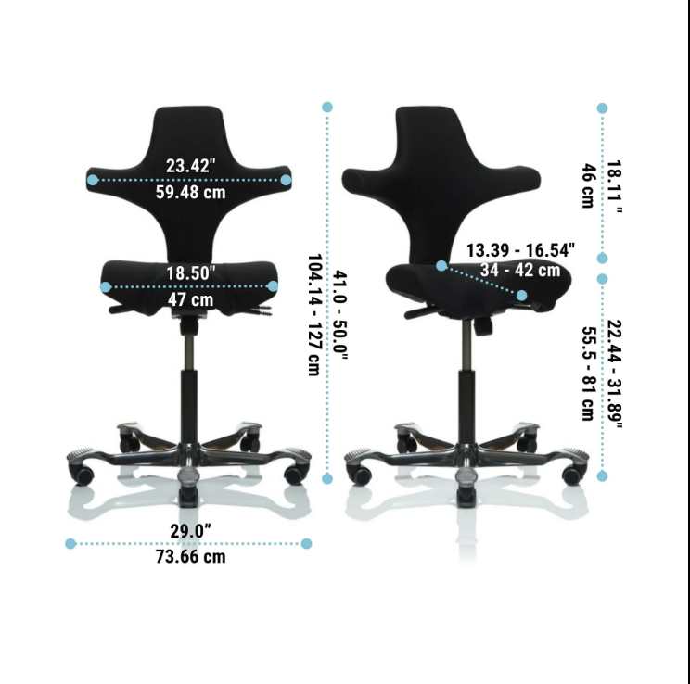
Remove this
( In Norway we only use “cm” )
Vanskelig å reselge brukt vs enkelt på grunn av høy etterspørsel

Slide 7
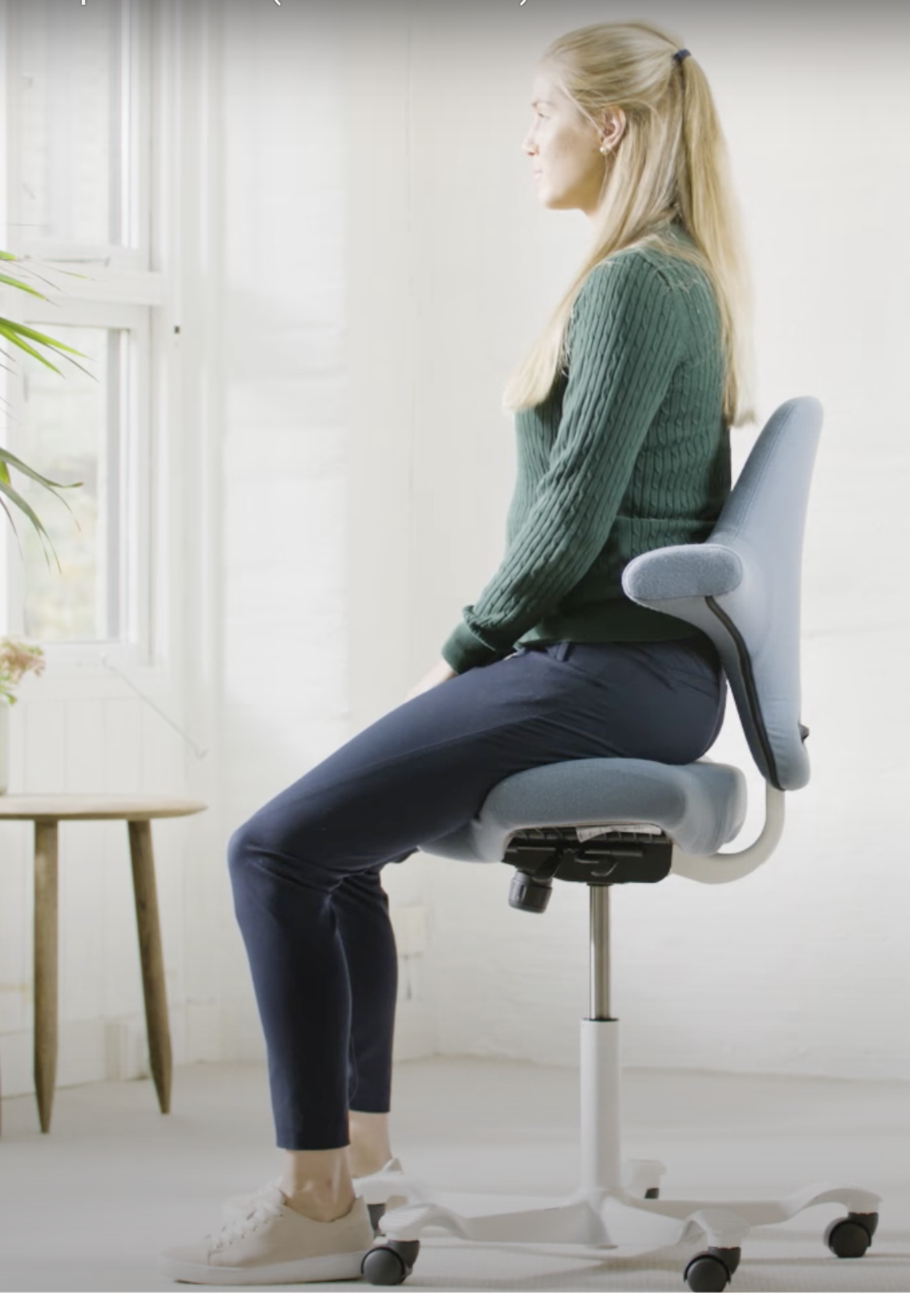
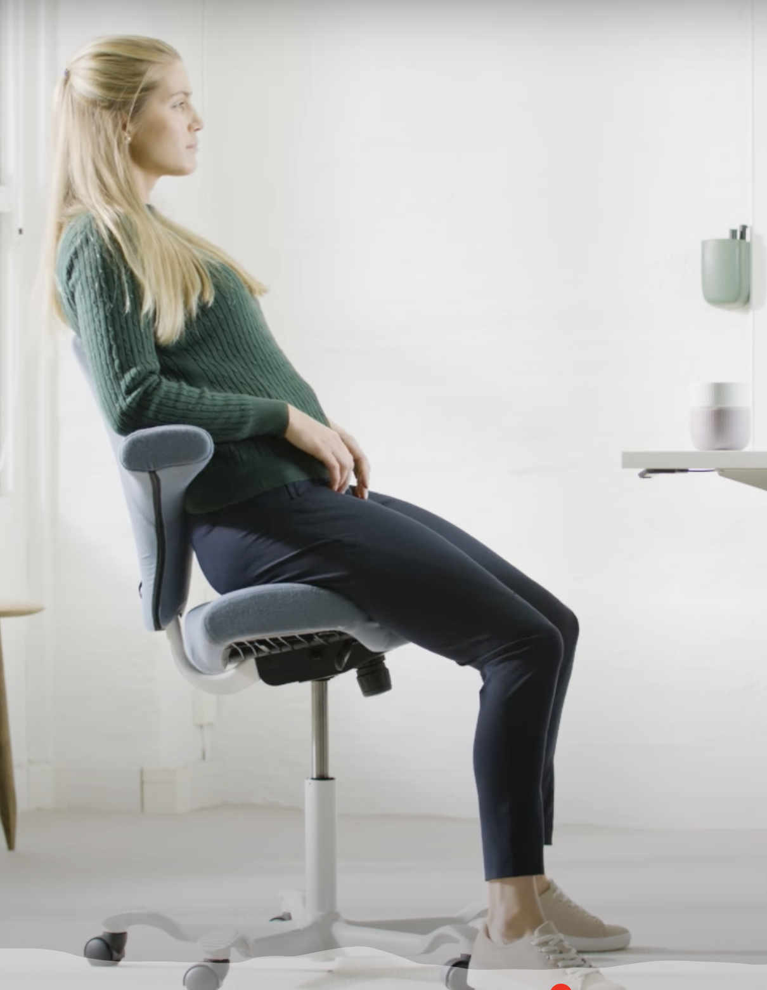
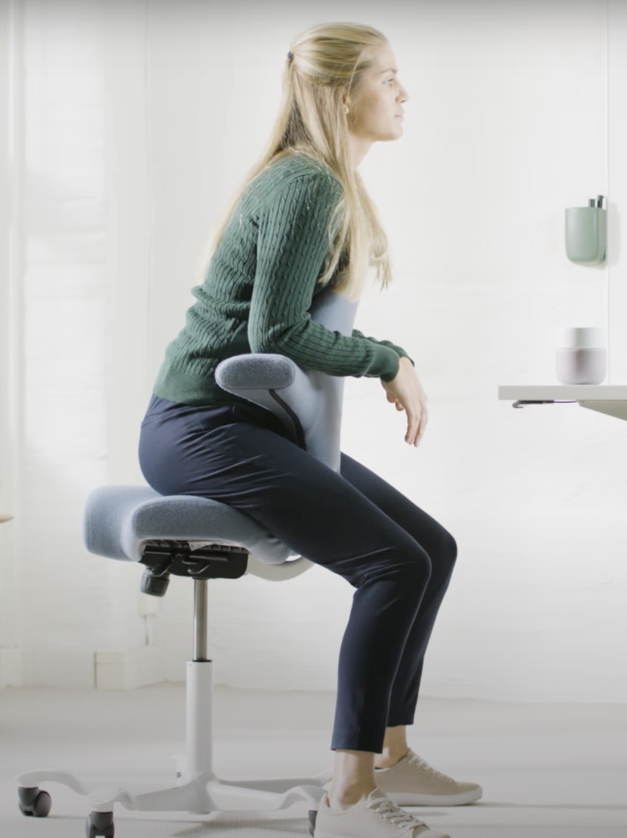
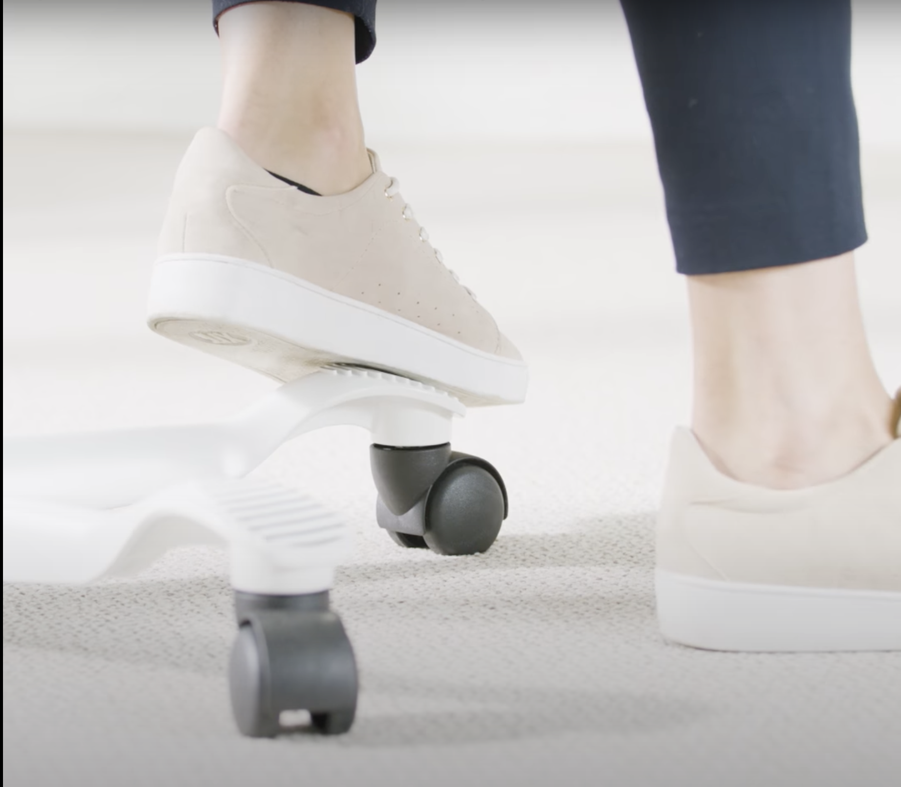
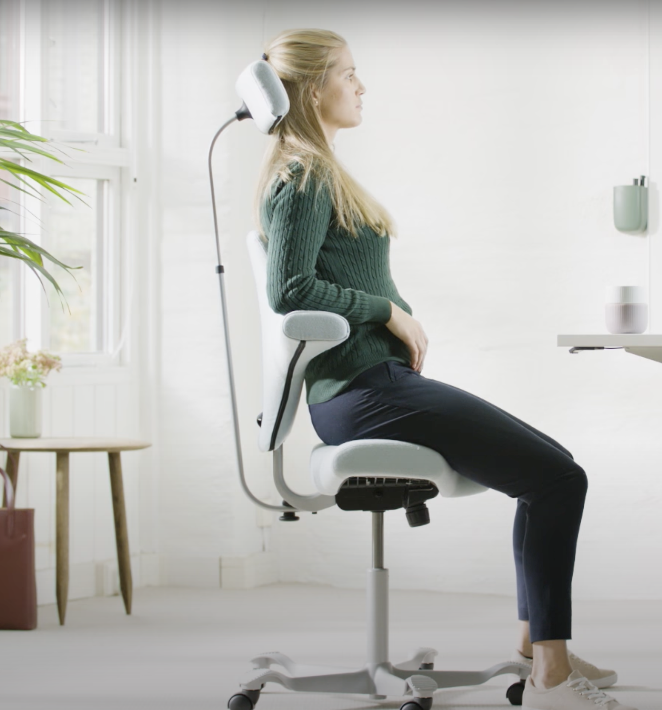
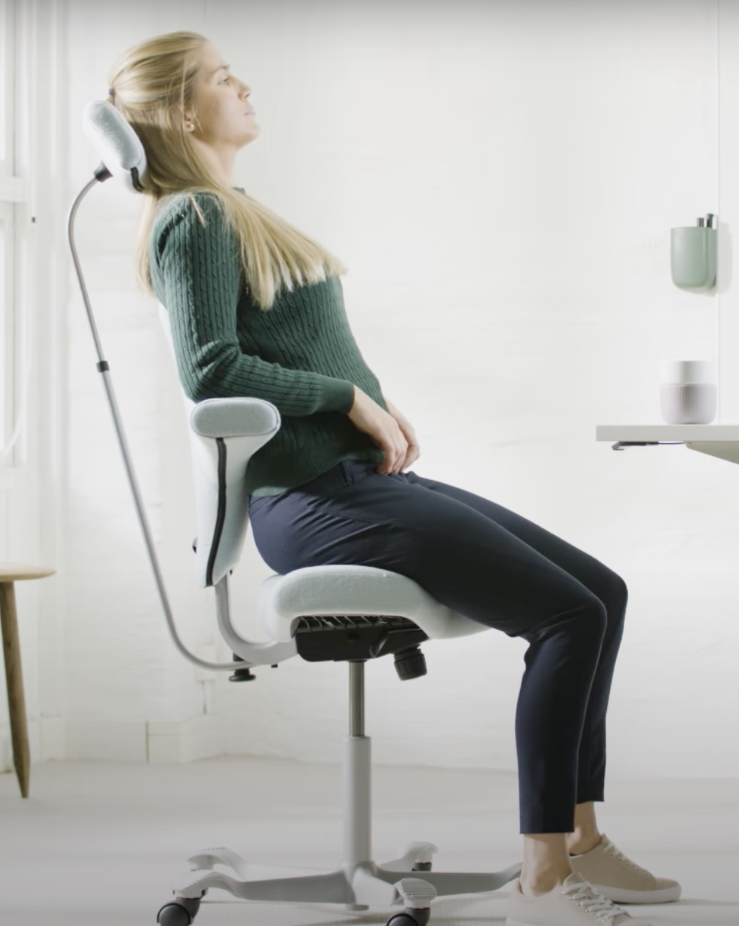
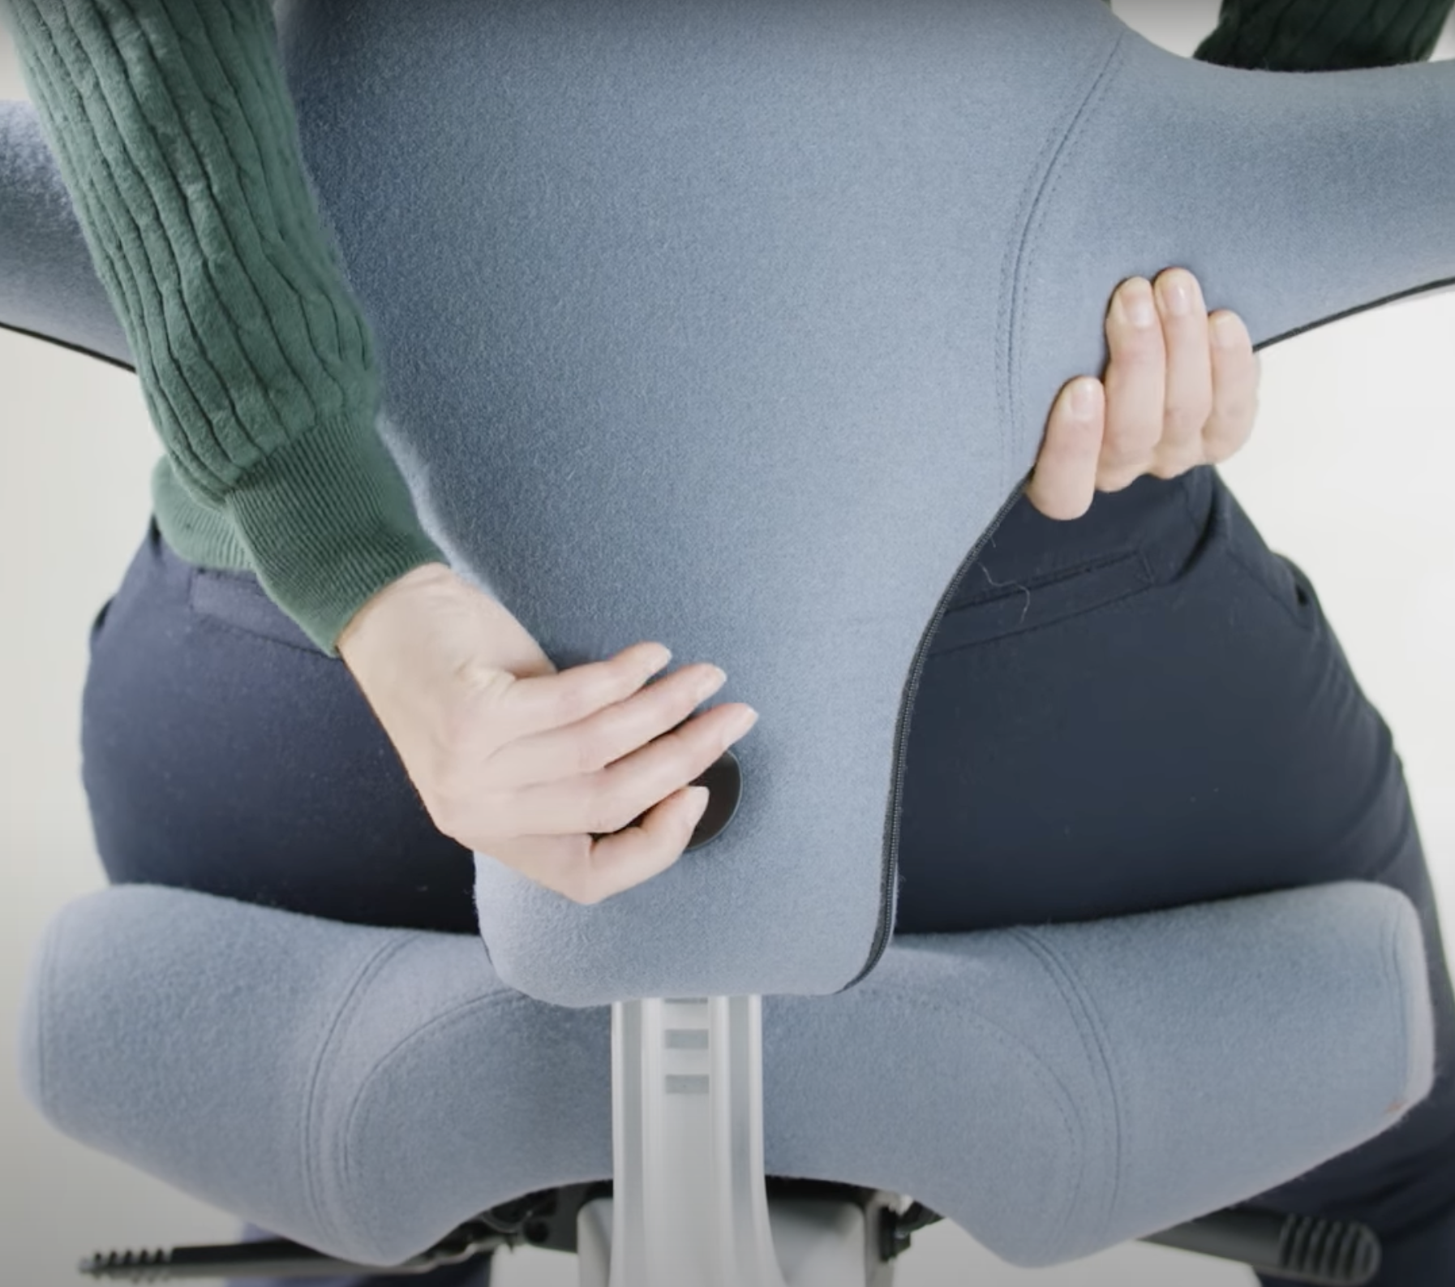

Slide 8
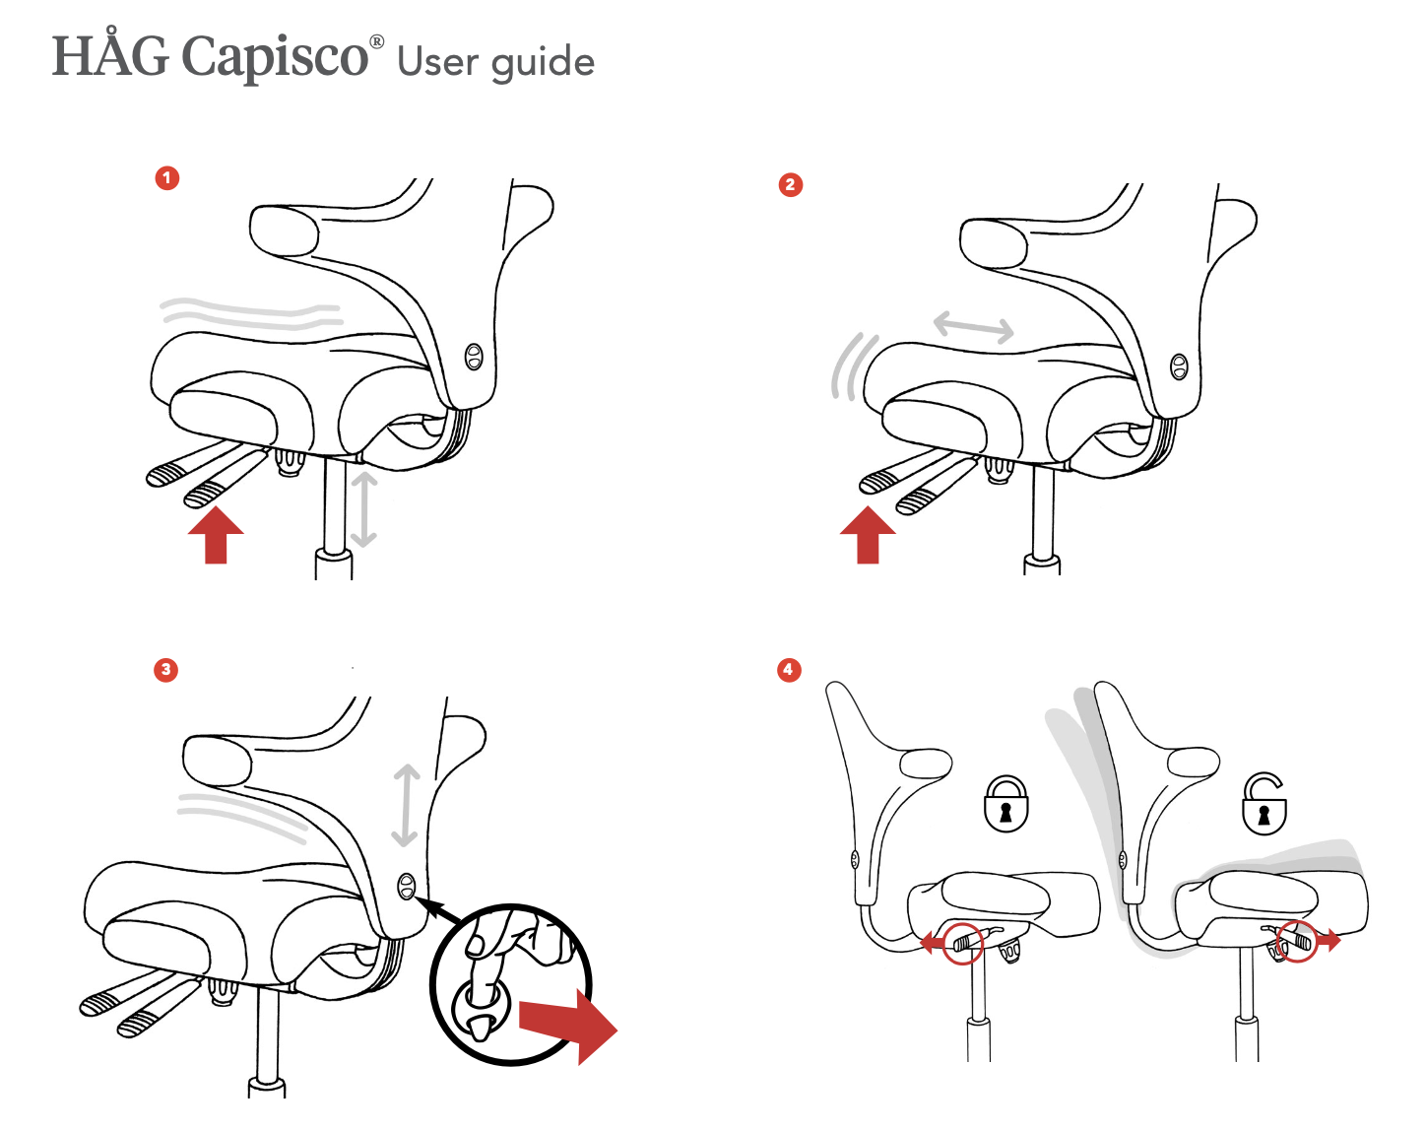

Slide 9
Concerned about buying a used chair online?
C24 offers:
Quality-controlled used Capisco chairs
Detailed video presentations in daylight
Transparent condition with any minor signs of wear
Safe and reliable buying experience
All our chairs are newly cleaned or have new seat covers.
Skip the misleading pictures. Get a realistic view of your perfect Capisco.
Upgrade your workday: Håg Capisco
Fill out our simple form and receive:
Video presentations of selected chairs
Updated offers on used Capisco chairs
Free delivery and try-out in Oslo and Bærum
Unsubscribe at any time.
Do you have any questions? Contact us here: [link to contact us page]

