Slide 1
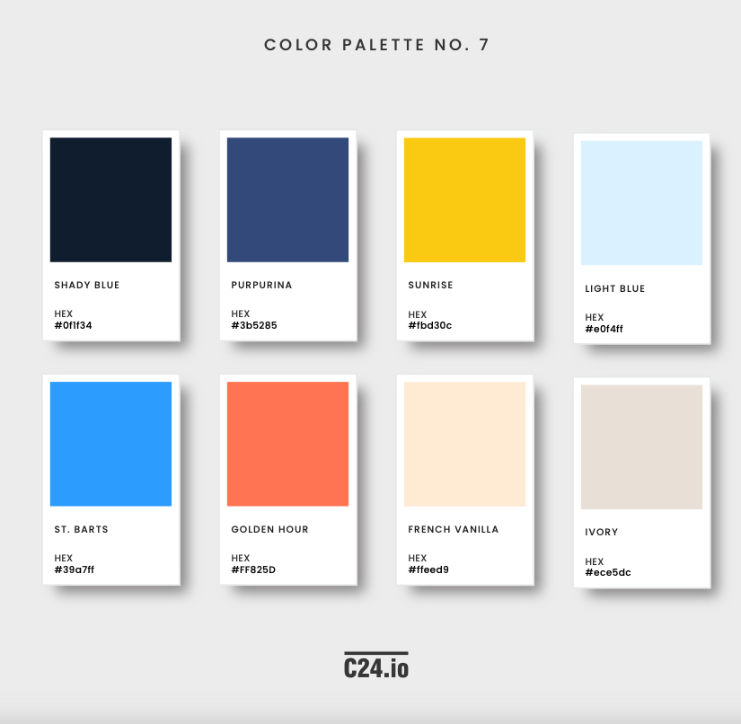



Color palette
Main colors
#385286
#fbd30c
#0F1F34
#e0f4ff
Secondary colors
#ece5dc
#faf8f7
#39a7ff
#5CA7A0
#C7D4DA
#FF825D
#ffeed9

Slide 2
Resources / links
Link to the manufacturer
https://store.flokk.com/norway/en-gb/products/hag-capisco?model=8126-STD&code=0EJF9J

Slide 3
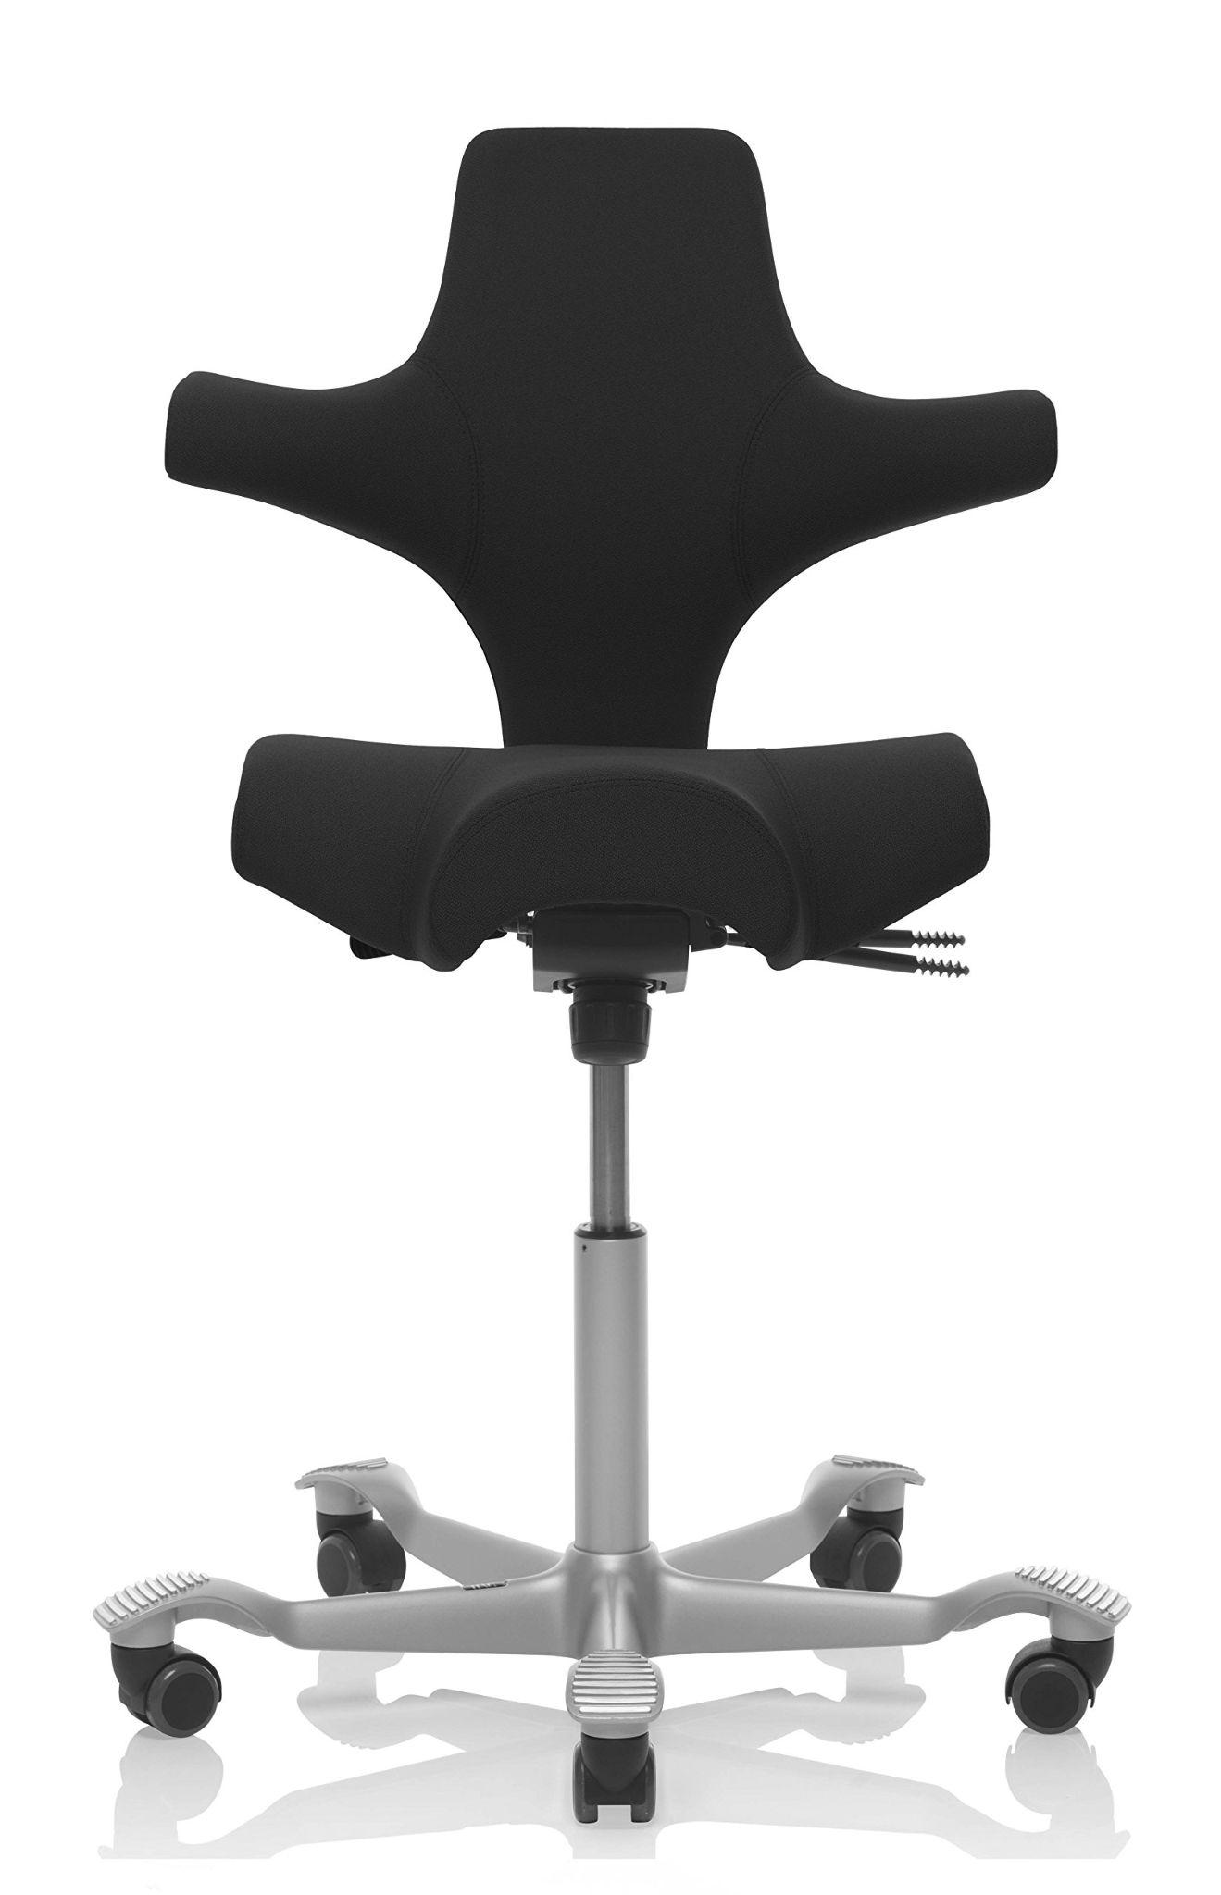
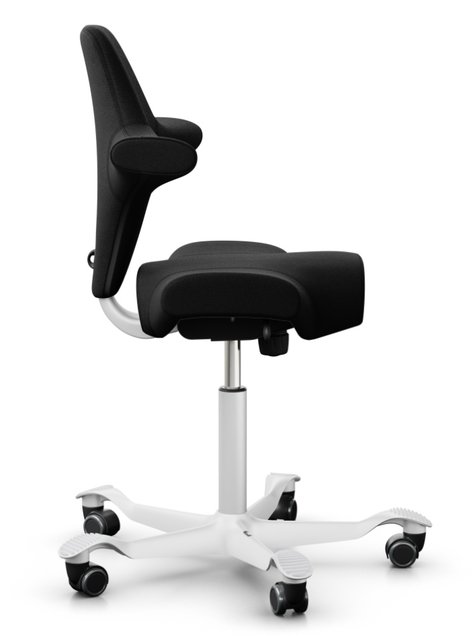
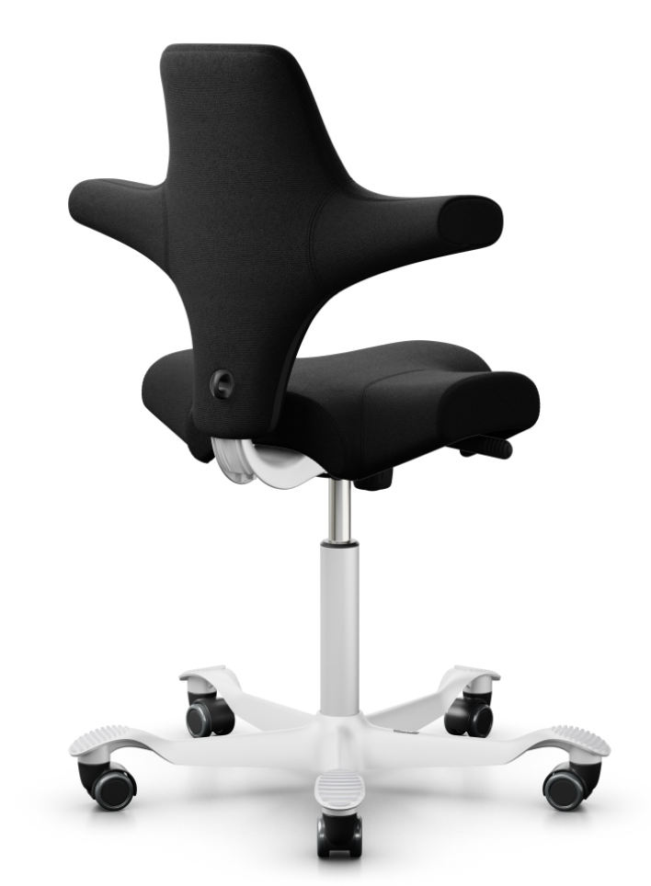
Håg Capisco: The Most Popular Ergonomic Office Chair in Norway – For Good Reason
Find Your Perfect, Used Capisco Chair: Advice, Tips, and Help from C24
Timeless Design Icon with a Focus on Comfort:
The Håg Capisco offers excellent lumbar support and a unique sitting experience inspired by the rider's saddle. It's a smart choice for ergonomics and comfort in the office.
Buy Smart, Sit Comfortably:
Find a gently used Capisco chair at a low price from C24. Enjoy ergonomic support for years to come, and you can easily resell it for a similar price.
Why Choose C24?
See realistic video viewings of gently used and newly cleaned chairs
Get low prices, including shipping
Pay after you have seen and tried the chair

Slide 4



Do's and Don'ts for Buying a Used Håg Capisco Chair:
Do: | Don't:
Inspect the condition carefully: Check the seat, backrest, and base. | Buy without seeing: Be wary of low-quality pictures.
Popular Choice: Black is the most in-demand color for Capisco chairs. | Choose unpopular colors: Black is the easiest to resell.
See the chair in daylight: Avoid misleading pictures. Request a video in daylight: See the chair's real condition and avoid a bad purchase. Buy a newly cleaned chair or choose a chair with a new seat cover. | Trust pictures blindly: Many pictures of used chairs are manipulated, and stains can be hard to see. Be critical and inspect the chair in daylight before buying. Stains on a used Capisco chair can be a major problem. They are difficult to remove, and can make the chair feel dirty and worn out. The solution is simple: Buy a newly cleaned chair or choose a chair with a new seat cover.

Slide 5
C24 vs. Competitors: Buying a Used Håg Capisco Chair
Feature | C24 | Competitors
Video Viewing | Yes, saves time and provides better assessment of chair condition | No
Payment | After test sitting | Before delivery
Shipping | Free in Oslo/Bærum | Varies
Price | Competitive | Varies
Selection | Large, priority to newsletter subscribers | Limited
Advice | Yes, avoid mistakes, usage, models | Varies

Slide 6
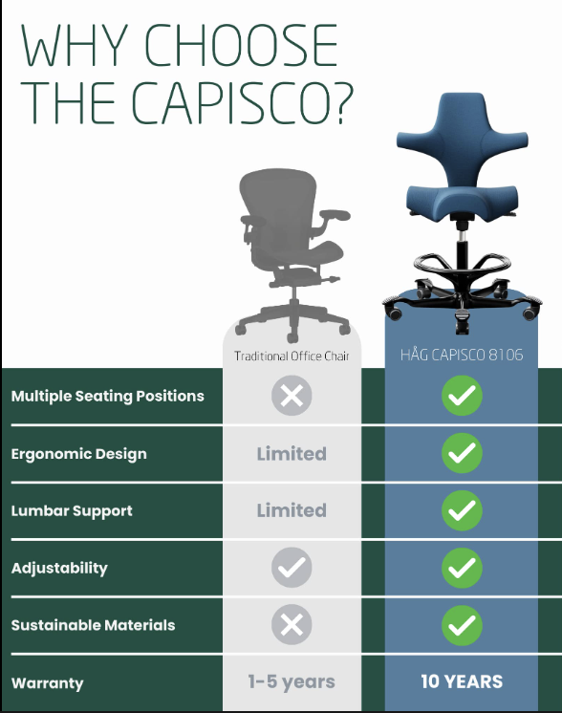
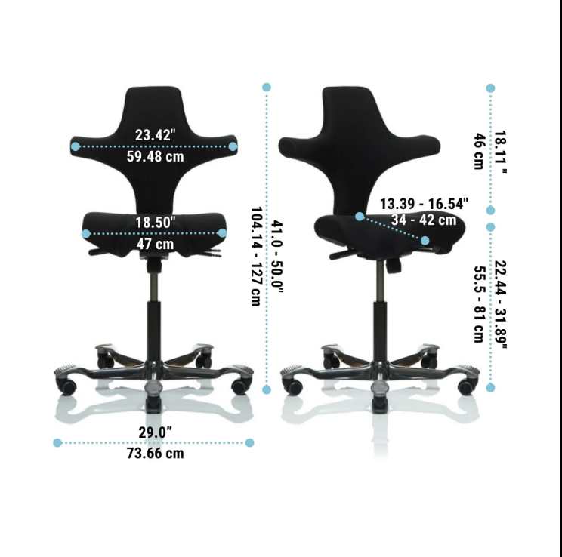
Remove this
( In Norway we only use “cm” )
Difficult to resell
Easy to resell

Slide 7

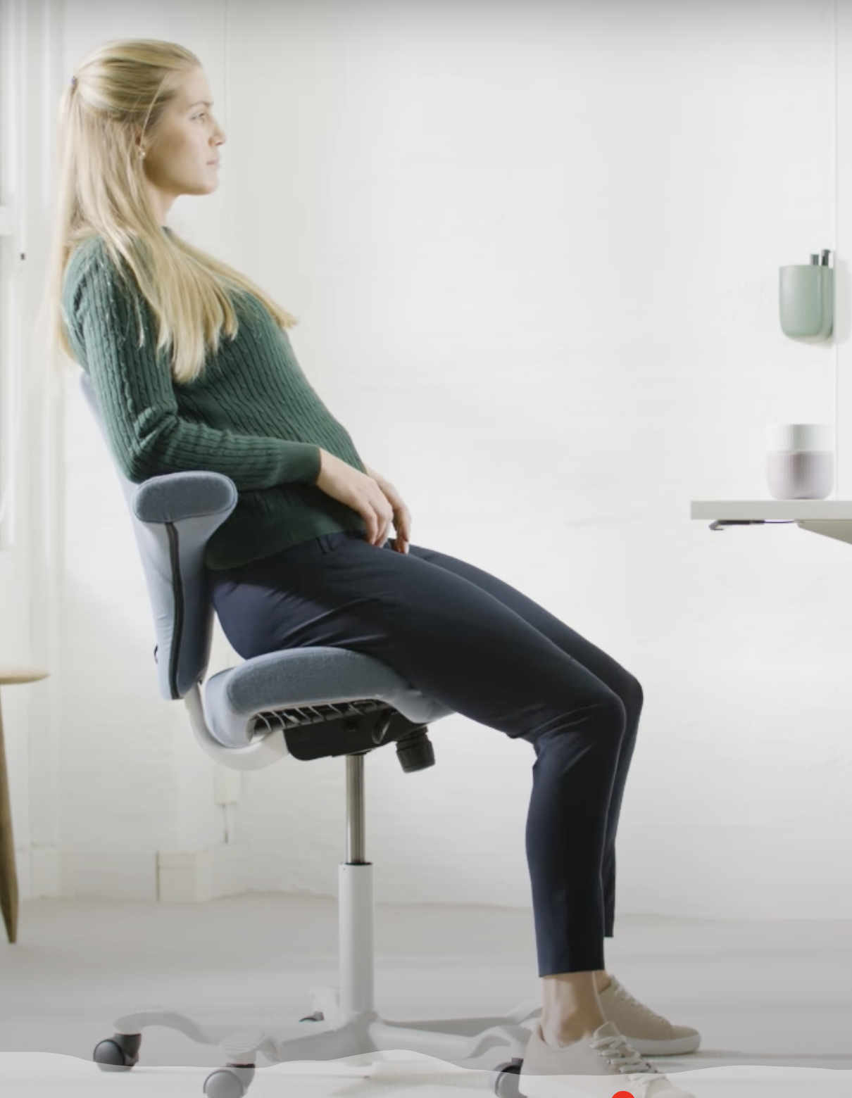
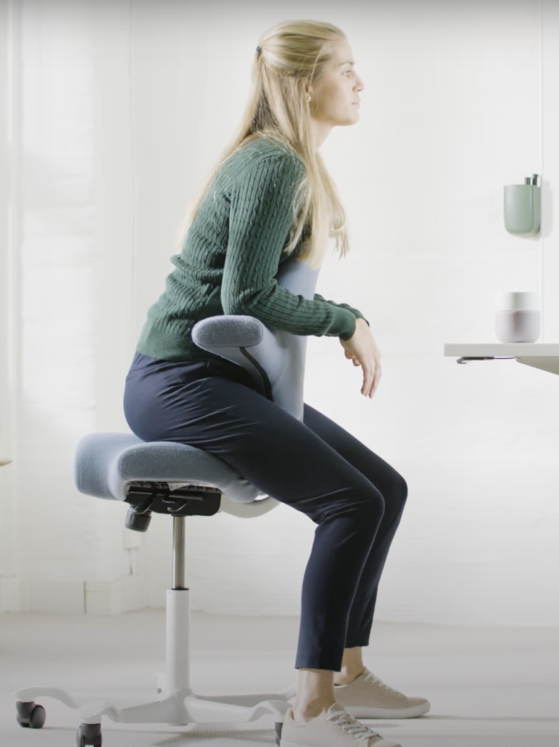
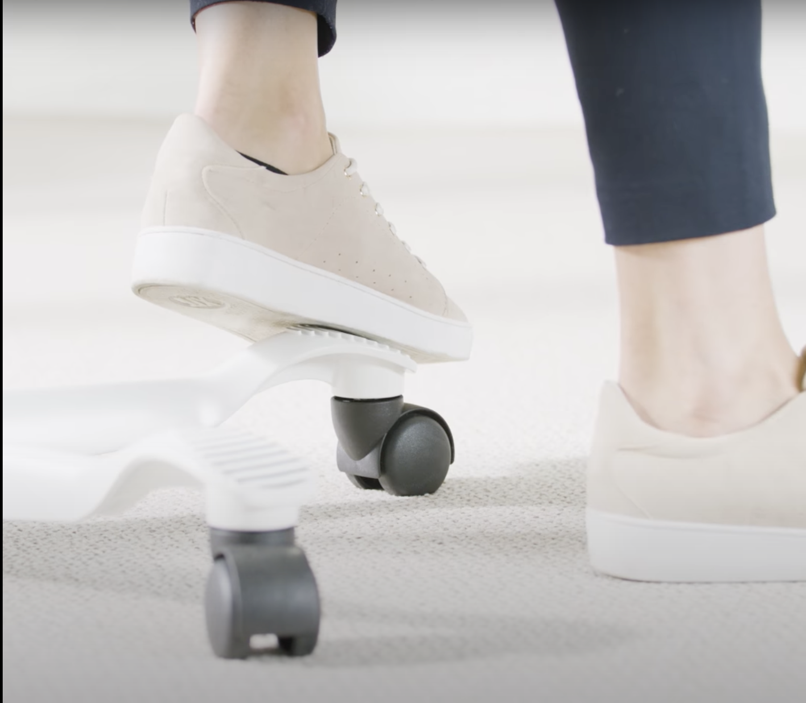
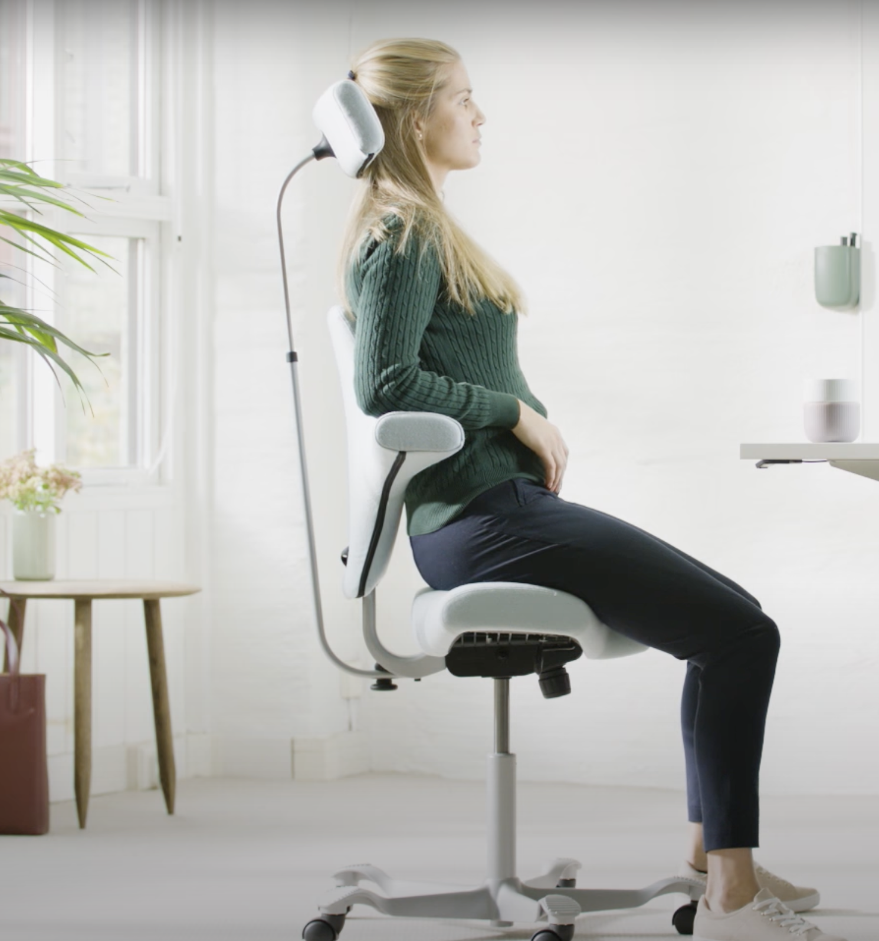
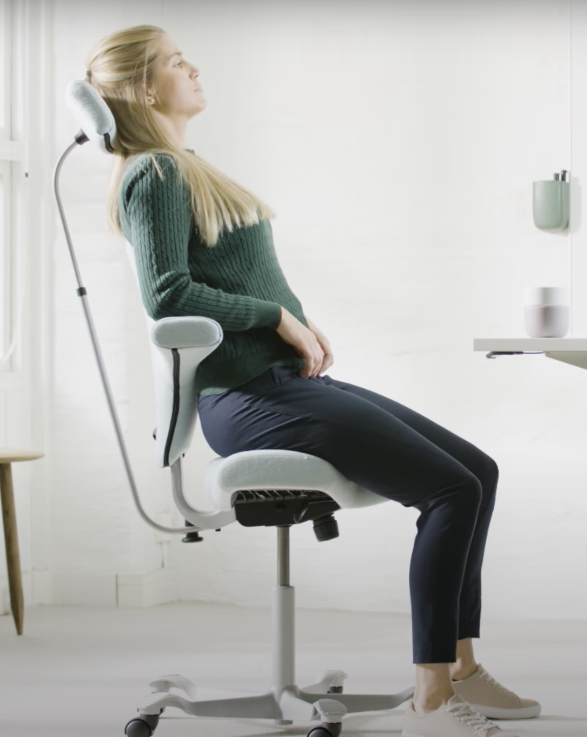
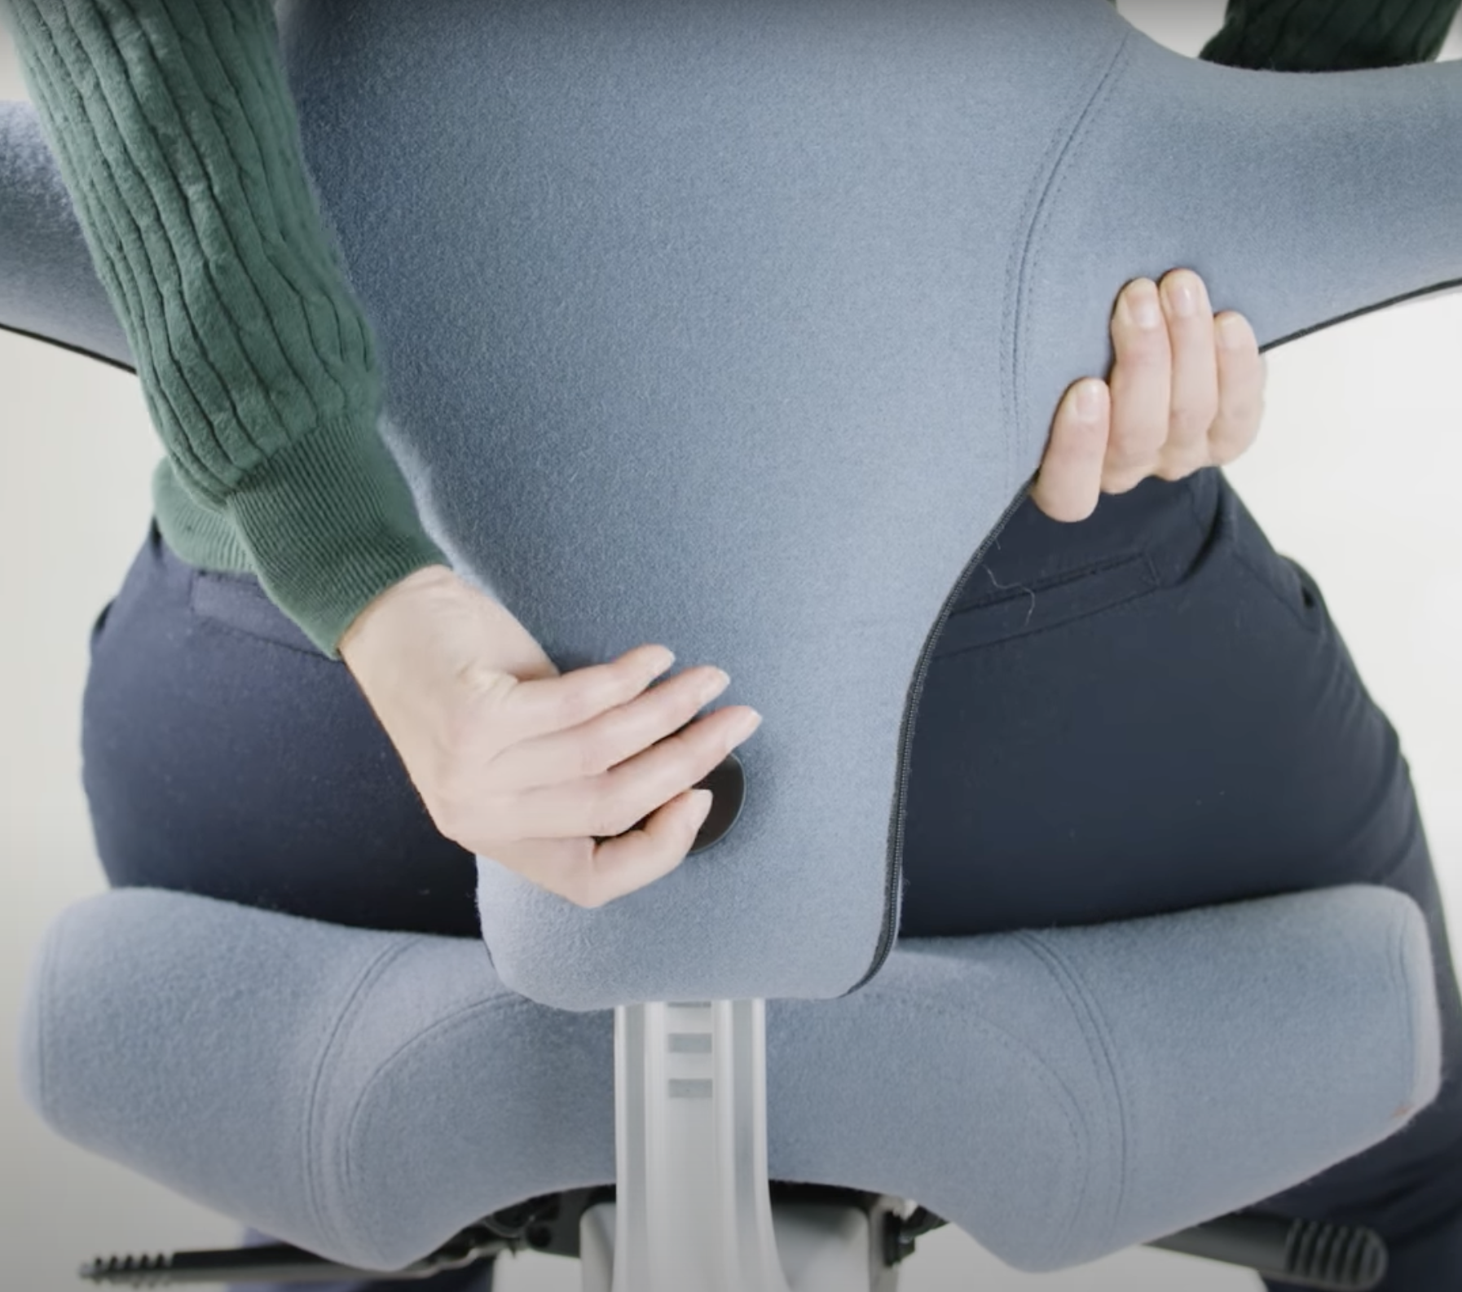

Slide 8
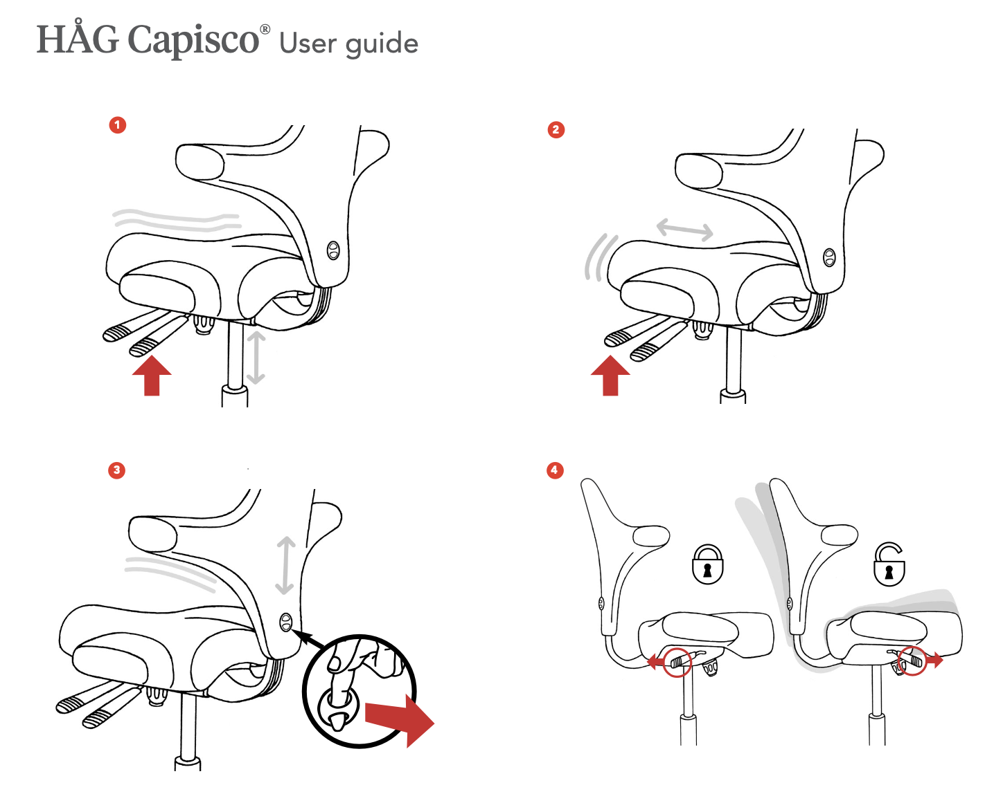

Slide 9
Buy Smart, Sit Comfortably:
Enjoy ergonomic support for years to come, and you can easily resell it for a similar price
Here's how C24 helps you find your perfect, gently used Capisco chair at a low price:
Enjoy lasting comfort and value: Ergonomic support and easy resale.
Make an informed decision: See realistic video viewings in daylight.
Get a chair in top condition: Choose from newly cleaned chairs or chairs with new seat covers, especially in the popular black color.
Buy with confidence: Low prices, secure payment after seeing and trying the chair.
Do you have any questions? Contact us here: [link to contact us page]

